Slide 1

Design Pattern
Search
Factory
Truong Dang Minh Khue

Slide 2
Definition
encapsulates object creation by letting subclasses decide what object to create
Factory Pattern

Slide 3
Definition
Dependency
Inversion Priciple
Depend upon abstractions. Do not depend upon concrete class.

Slide 4

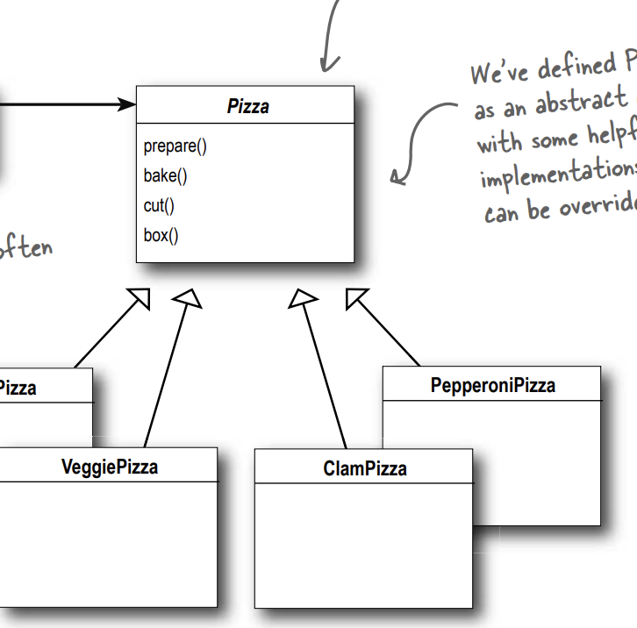
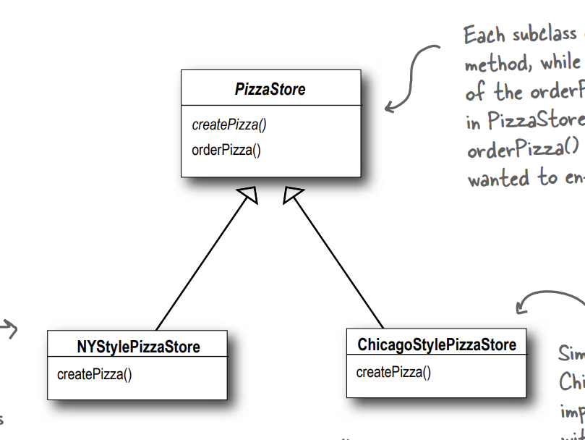


Slide 5
Thank you!
Until our next design pattern!

