Slide 1

Design Pattern
Search
Strategy
Truong Dang Minh Khue

Slide 2


 | Design Principles
 | Let's get to know some principles first
1
2
3
Identify the aspects of your application that vary and separate (encapsulate) them from what stays the same. | Program to an interface, not an implementation. | Favor composition over inheritance

Slide 3

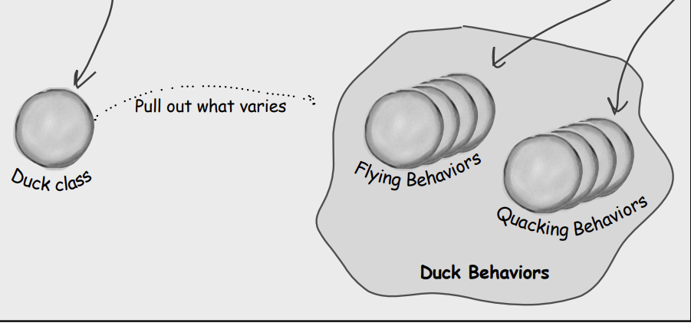
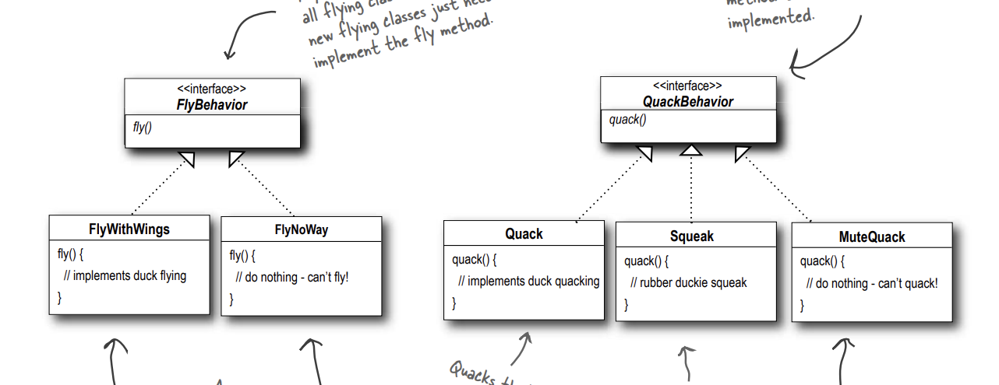


Slide 4
Definition
defines a family of algorithms, encapsulates each one, and makes them interchangeable.
Strategy Pattern

Slide 5
Thank you!
Until our next design pattern!

