Slide 1

Design Pattern
Search
Template
Truong Dang Minh Khue

Slide 2
Definition
defines the skeleton of an algorithm in a method, deferring some steps to subclasses.
Template Pattern

Slide 3

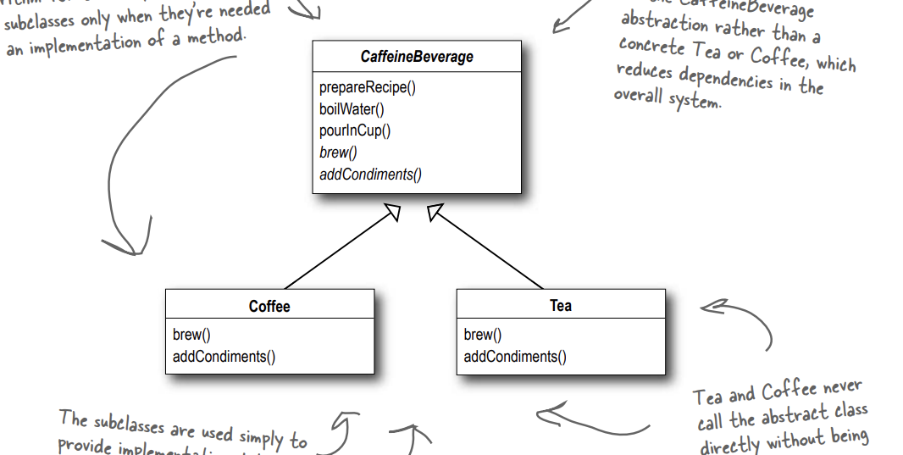


Slide 4
Thank you!
Until our next design pattern!

