Slide 1
DeadZone
Academic Productivity Loss Dectector
TEAM MEMBERS:
Aiswarya PS
Dilsha PP
Amitha c Agnel
Anjana C

Slide 2
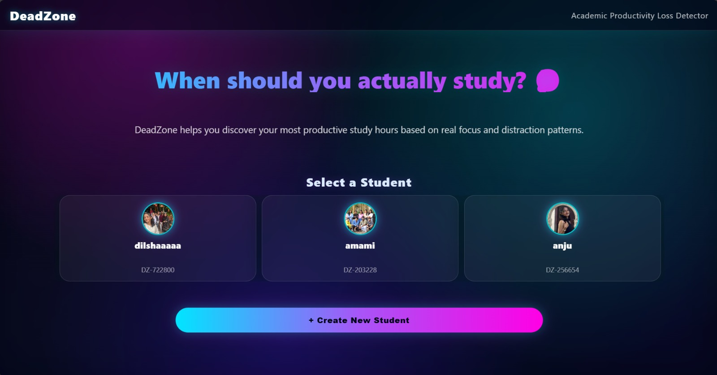
INTRODUCTION
DeadZone is a web-based productivity analysis system that helps students identify their most productive study hours and dead zones by analyzing focus level, distractions, and study session data.

Slide 3
Problem Statement
Problem Identified:
Students struggle to identify when they study best
Productivity loss due to distractions and poor time planning
No simple tool to analyze personal study patterns
Generic study advice doesn’t work for everyone
Why It Matters:
Leads to wasted study hours
Increased stress and poor academic performance

Slide 4
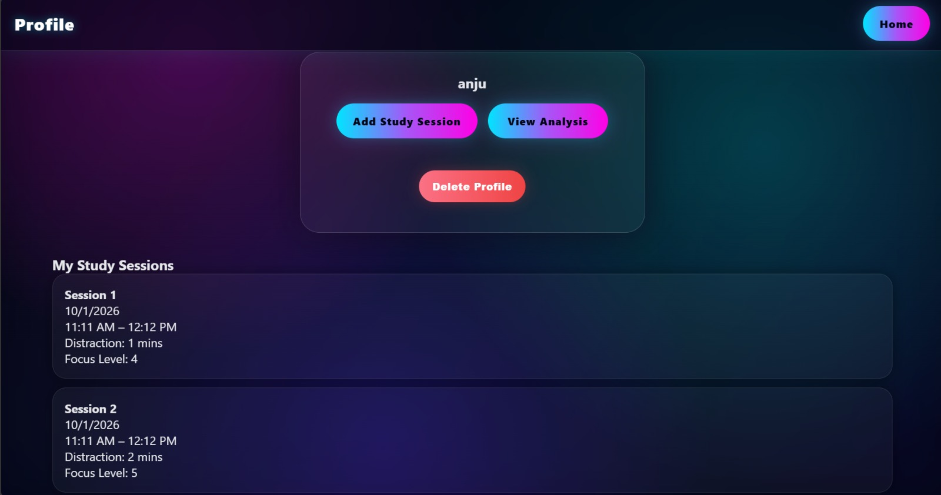
OUR COMPANY
Venus has a beautiful name and is the second planet from the Sun. It’s hotter than Mercury

Slide 5
Solution:DeadZone
Our Solution:
DeadZone provides personalized productivity insights by tracking study sessions and analyzing time-based performance.
What DeadZone Does:
Records study sessions
Tracks distractions & focus level
Calculates productivity score
Identifies Best Study Window
Detects Dead Zone (least productive time)
Outcome:
Students can study smarter, not longer.

Slide 6
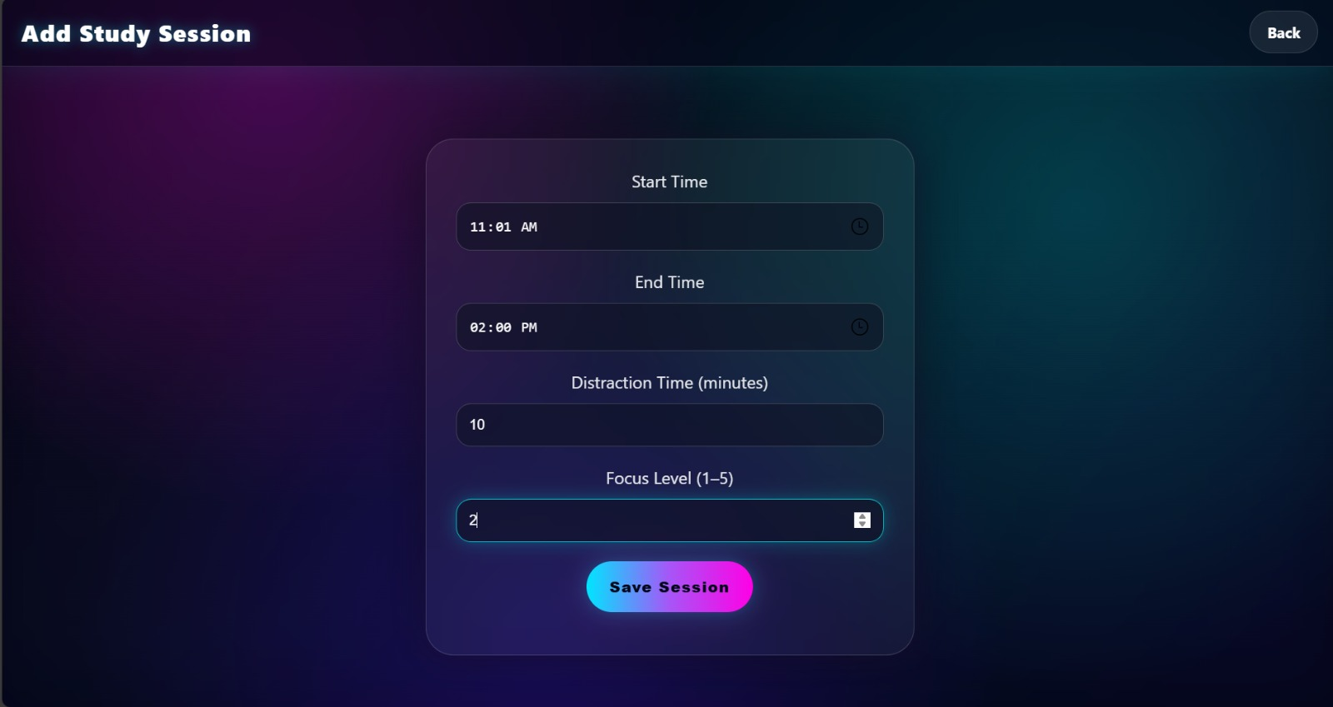
SOLUTION
Mercury is the closest planet to the Sun and the smallest one in the Solar System—it’s only a bit larger than the Moon

Slide 7
SYSTEM FEATURES
Core Features:
👤 Multiple student profiles
🕒 Study session logging
📉 Distraction & focus tracking
📊 Productivity analysis graph
🧠 Best time & dead zone detection
💾 Local storage (no login required)
🎨 Neon, user-friendly UI
Unique Point:
Each student gets personalized insights, not generic advice.

Slide 8
WORKING METHODOLOGY
How DeadZone Works:
Student creates a profile
Adds study session details
(start time, end time, distraction, focus)
Sessions stored in browser
Productivity score calculated
Time slots grouped:
  Early Morning
  Morning
  Afternoon
  Evening
  Night
Best & worst slots identified

Slide 9
ANALYSIS & OUTPUT
Productivity Calculation:
Effective Study Time = Total Time − Distraction
Productivity Score based on focus level
Average score per time slot
Final Output:
📊 Bar graph of productivity
🏆 Best Study Window
⚠️ Dead Zone detected
Benefit:
Helps students schedule important study tasks at the right time.

Slide 10
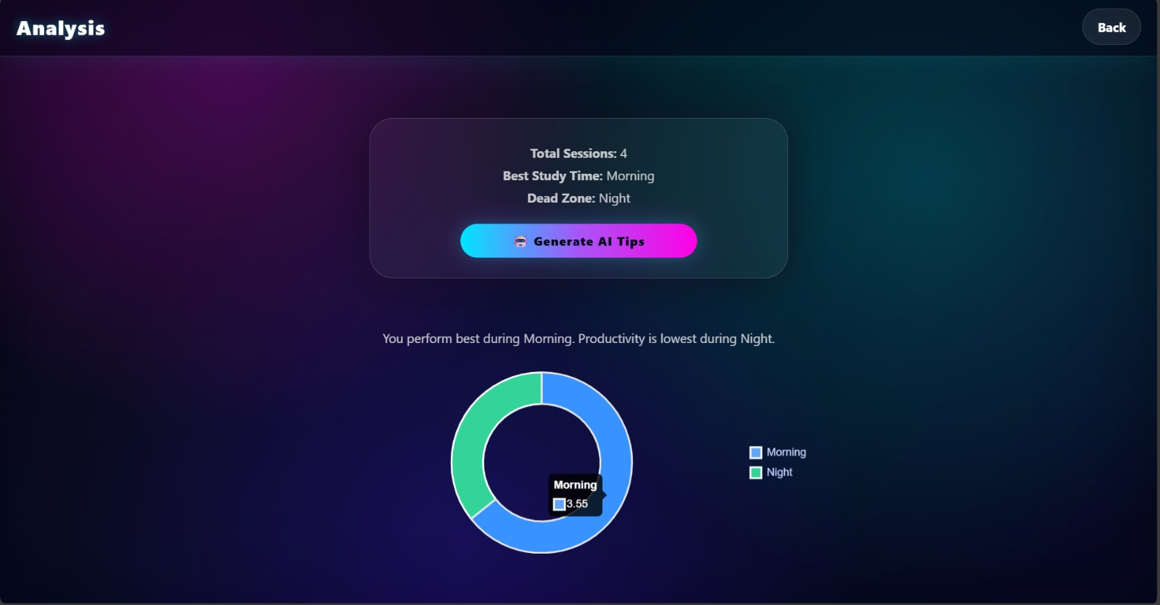
THEM
US
Mercury is the closest planet to the Sun and it’s also the smallest one in the Solar System
Venus has a beautiful name and is the second planet from the Sun. It’s hotter than Mercury

Slide 11
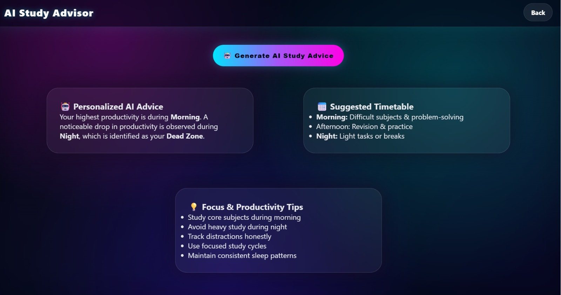
THEM
US
Mercury is the closest planet to the Sun and it’s also the smallest one in the Solar System
Venus has a beautiful name and is the second planet from the Sun. It’s hotter than Mercury

Slide 12
TECHNOLOGIES USED
Frontend:
HTML5
CSS3 (Neon UI Theme)
JavaScript
Libraries & Tools:
Chart.js (Data Visualization)
LocalStorage (Data persistence)
VS Code
Why This Stack?
Lightweight
Fast
Beginner-friendly
Hackathon efficient

Slide 13
CONCLUSION & FUTURE SCOPE
Conclusion:
DeadZone successfully helps students identify their productive study hours and avoid time-wasting dead zones through simple analysis and visualization.
Future Enhancements:
AI-based study suggestions
Weekly & monthly reports
Cloud sync & login
Notifications & reminders
Mobile app version
Final Message:
✨ Study at the right time, not all the time.

Slide 14
THANKS!

