Slide 1
Next Word Prediction using LSTM
A Streamlit-Based Autocomplete Application
Presented by: Aiswarya P S

Slide 2
Objective
- Build an intelligent autocomplete system using LSTM.
- Predict the next word in a sentence as the user types.
- Provide top-3 suggestions based on trained corpus data.

Slide 3
Tools and Technologies
- Python
- TensorFlow / Keras
- Streamlit
- Tokenizer
- LSTM (Long Short-Term Memory) Model

Slide 4
How the Model Works
- The text corpus is tokenized into sequences.
- Sequences are padded and passed to an LSTM model.
- The model learns word patterns and context.
- After training, the model predicts the next likely words.

Slide 5
App Interface Demo
Functionality:
- Type any partial sentence in the textbox.
- Click ‘ Press Enter to apply ’ to see predictions.
- Click on a suggested word to append it to the sentence.
(Screenshot will be shown here)

Slide 6
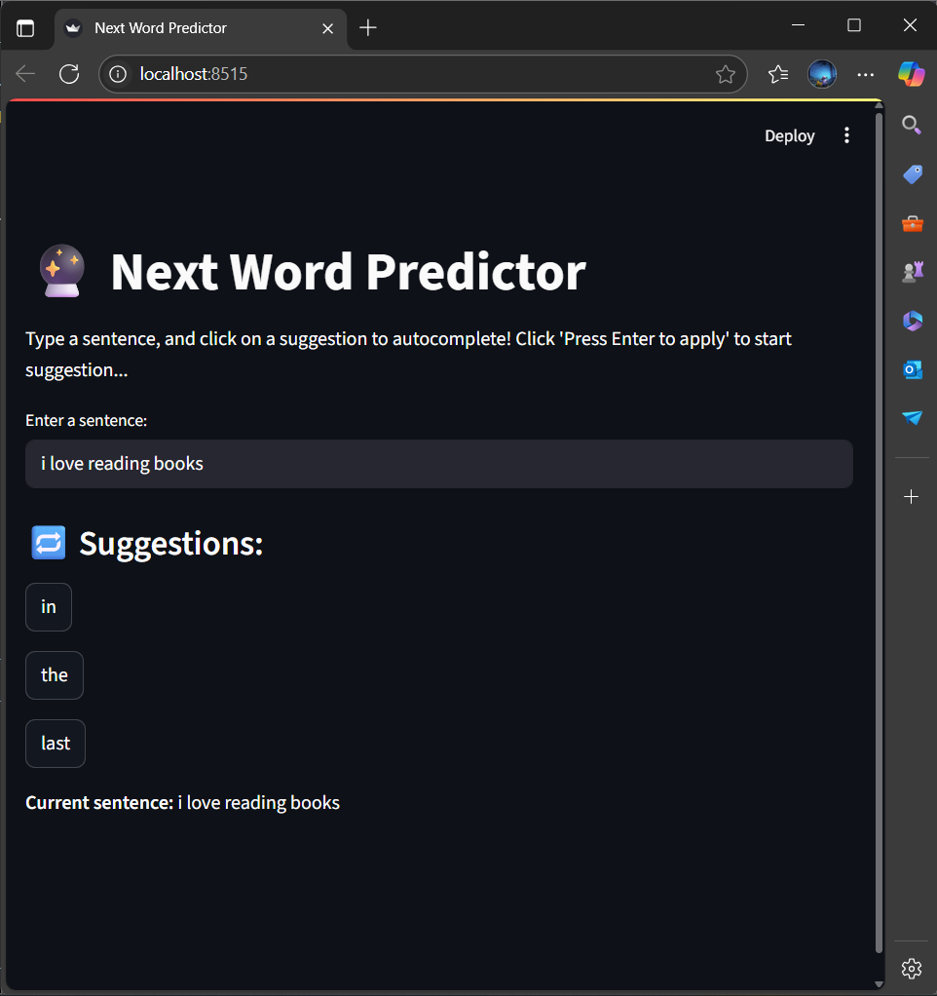

Slide 7
Key Features
- Real-time suggestion based on text input.
- Top 3 word suggestions using probability ranking.
- Simple and clean UI built using Streamlit.
- Easy model retraining with custom dataset.

Slide 8
Development Highlights
- Prepared a custom text corpus for better predictions.
- Trained and saved model + tokenizer for reuse.
- Managed Streamlit session state for dynamic UI.
- Handled streamlit rerun logic and input updates.

Slide 9
Thank you!

