Slide 1
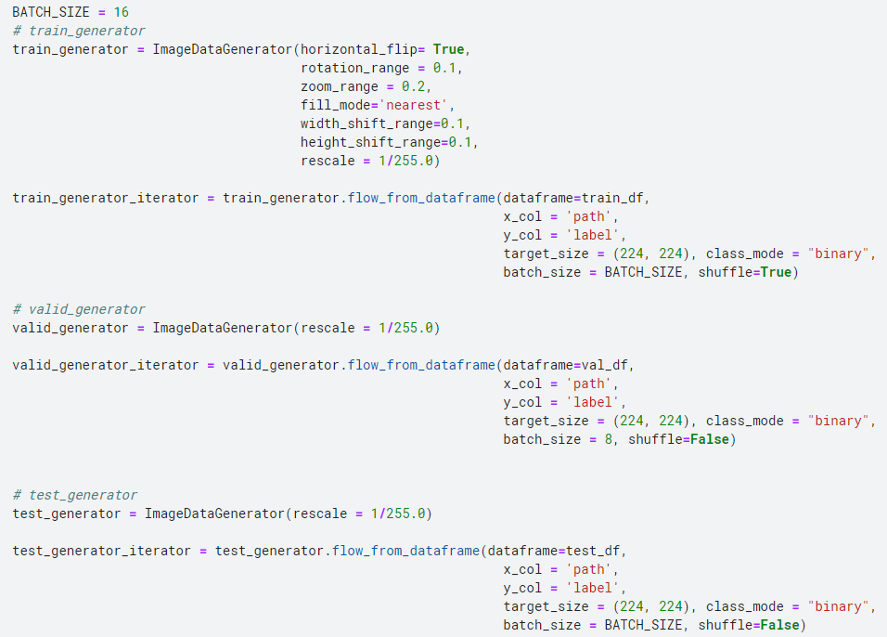

Slide 2
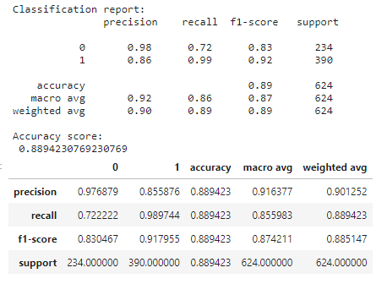
Resnet50
Optimizer = SGD(0.01, momentum=0.9)
Train : valid = 85% : 15%
pneumonia(폐렴) 예측 확률: 92%
normal(정상) 예측 확률: 83%
Test Accuracy: 88%

Slide 3
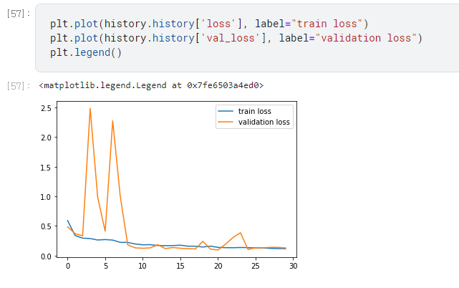
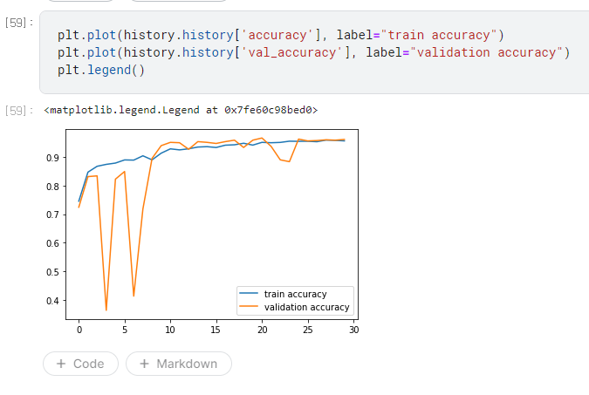

Slide 4
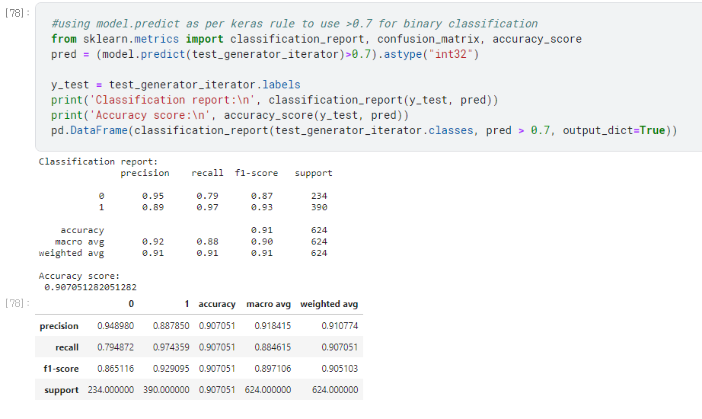

Slide 5
