Slide 1
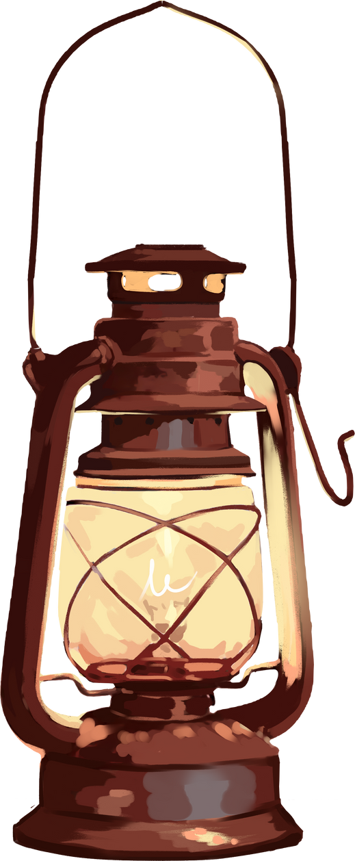

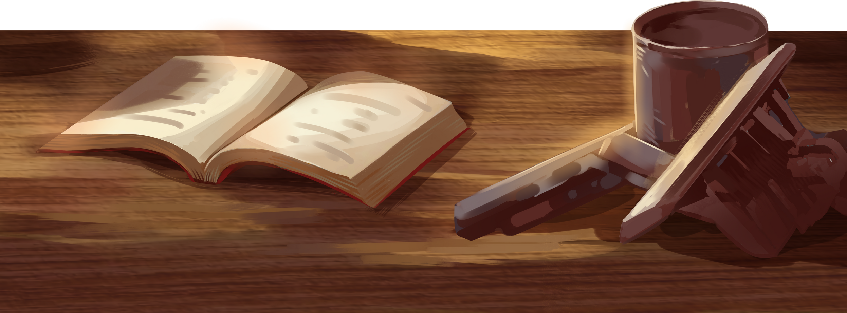
Presentation
Sahil Tushir
GitHub : sahilgittushir

Slide 2


1. Introduction
Hello, my name is Sahil Tushir, and this is my final project for the GPU Specialization Capstone.
The focus of this project is GPU-accelerated image edge detection using TensorFlow in Google Colab.
In simple terms, I built a small system that takes an image and highlights the edges or outlines in that image — not using the CPU, but by offloading the work to the GPU. Why? Because GPUs are designed to handle repetitive, matrix-heavy operations like image filtering much faster than CPUs.
This project not only demonstrates a practical use of GPU programming but also ties back to real-world applications in computer vision, image processing, and AI.

Slide 3
2. Problem Statement – Why This Problem Matters
Edge detection is a foundational task in computer vision. It’s what enables systems to recognize objects, distinguish boundaries, and extract important structural features from raw pixel data.
However, edge detection can be computationally expensive — especially when applied to large datasets, high-resolution images, or real-time video.
My goal was to implement an edge detection algorithm that runs on the GPU using a high-level framework like TensorFlow, and to visualize how the GPU makes the computation faster and more efficient.

Slide 4
3. Challenges I Faced – What Didn’t Work
Originally, I planned to use CuPy, a library similar to NumPy that runs operations on the GPU. But I quickly ran into compatibility issues — Google Colab had CUDA version mismatches, and CuPy failed with errors like:
After troubleshooting for hours, I realized that installation complexity was stealing focus from the actual problem I wanted to solve.
So I switched to TensorFlow, which is:
Pre-installed in Colab
GPU-ready by default
Capable of performing image operations like convolution
This switch allowed me to focus on the solution instead of fighting with tools.

Slide 5

My Technical Approach – How I Solved the Problem
Let me walk you through the technical steps I followed in the code:
📌 Step 1: Uploading the Image
I used a cartoon image of Ben 10 — because cartoons have strong, clear edges which make edge detection results easier to interpret visually. The image is converted to grayscale and resized to 256x256 to keep the computation light.
📌 Step 2: Defining the Sobel Filter
I used a horizontal Sobel kernel, which is a 3×3 matrix that looks like this:
[ [1, 0, -1],
[2, 0, -2],
[1, 0, -1] ]
This kernel highlights changes in pixel intensity along the horizontal direction — in other words, it brings out the edges.

Slide 6
My Technical Approach – How I Solved the Problem
📌 Step 3: Performing Convolution on the GPU
Here’s the most important part. I used TensorFlow’s tf.nn.conv2d() function, wrapped inside:
with tf.device('/GPU:0'):
This tells TensorFlow to run the convolution explicitly on the GPU, which takes advantage of the T4 GPU that Colab provides.

Slide 7
My Technical Approach – How I Solved the Problem
📌 Step 4: Showing and Saving Results
After the operation, I display two images:
The original grayscale image
The edge-detected image from the GPU
I also saved the result as gpu_output_tf.png, and confirmed GPU usage in a log.txt file using:
This returns [PhysicalDevice(name='/physical_device:GPU:0')], confirming that the GPU was used correctly.

Slide 8
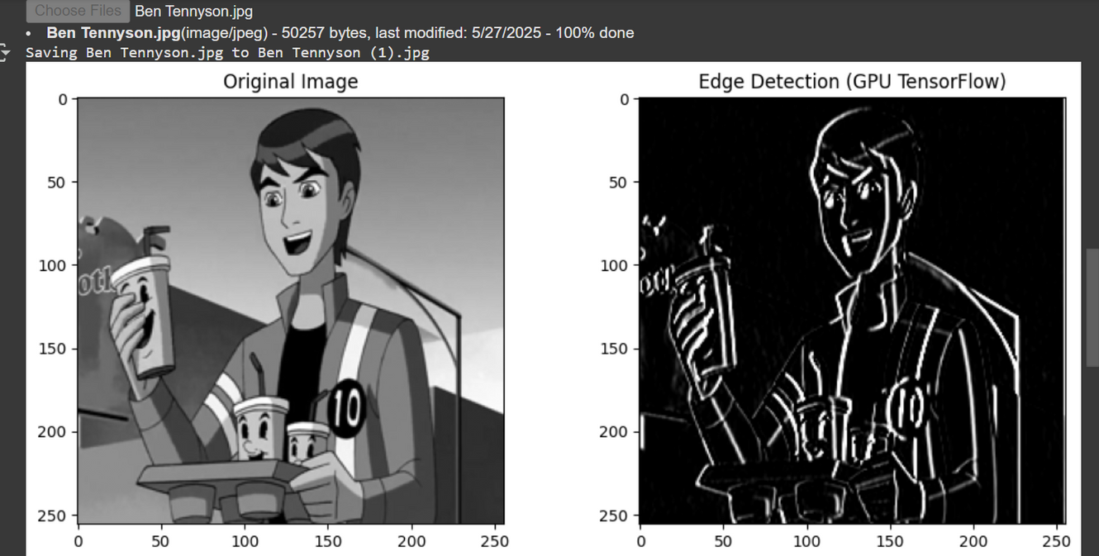
Results – What the Output Tells Us
The result speaks for itself.
On the left: the smooth grayscale image.
On the right: the output from the Sobel filter, processed entirely on the GPU.

Slide 9
Results – What the Output Tells Us
You can clearly see outlines — around the face, hands, drink cups, and hair. These are the edges in the image.
This confirms that the convolution operation worked exactly as intended. And since TensorFlow runs this on the GPU, the operation was fast, seamless, and optimized for large-scale image processing.
Even though I didn’t benchmark exact CPU vs GPU timings, visually and practically — the GPU performs the task instantly on image sizes that would otherwise take longer on CPU.

Slide 10
Lessons Learned
This project taught me a lot — not just about image processing, but also about toolchains and GPU frameworks.
I learned how to structure data for GPU processing
How to offload tensor-based operations using TensorFlow
And most importantly — how critical it is to choose the right library for the right platform
I also learned that GPU programming is not just about speed — it’s about scalability. This simple technique can be scaled to handle entire batches of images, or real-time video.

Slide 11
Conclusion – Wrapping Up
To summarize:
I built a complete GPU-accelerated edge detection system using TensorFlow in Colab
The system uses a Sobel filter to extract image features
It runs efficiently on the GPU, with results saved and visualized
I documented everything in my GitHub repo — including code, results, logs, and this video
This project fulfills the Capstone requirements by being practical, GPU-based, and well-documented.

Slide 12
Thank You

