Slide 1
SchoolMIPS CPU Core
Young Russian Chip Architects

Slide 2
Project download link:
https://github.com/MIPSfpga/schoolMIPS
Project documents:
https://github.com/MIPSfpga/schoolMIPS/tree/master/doc

Slide 3
Thanks to
David Harris and Sarah Harris, the authors of the great book “Digital Design and Computer Architecture”. SchoolMIPS is based on the CPU that is described in this book
the team of the “Digital Design and Computer Architecture” book translators
“Young Russian Chip Architects” Conference Members
Yuri Panchul, Senior Hardware Design Engineer at Imagination Technologies and MIPS. The author of the SchoolMIPS Idea.
Stanislav Zhelnio, CPU architecture, code and docs
Alexander Romanov, MIEM HSE, CPU architecture, test and port

Slide 4
What is SchoolMIPS?
the simplest CPU core
designed for using in the basic course of digital design and computer architecture
written on pure Verilog
consider subset of MIPS instructions

Slide 5
Introduction
Microarchitecture: how to implement an architecture in hardware
Processor:
Datapath: functional blocks
(ALU, Register File, etc)
Control: control signals

Slide 6
Microarchitecture
Multiple implementations for a single architecture :
Single-cycle: Each instruction executes in a single cycle
Multicycle: Each instruction is broken into series of shorter steps
Pipelined: Each instruction broken up into series of steps & multiple instructions execute at once

Slide 7
The SchoolMIPS CPU
Single-cycle
no Data Memory
The word by word addressing of Instruction Memory
Subset of MIPS Instructions:
R-type instructions (both operands are from RF): addu, or, srl, sltu, subu
I-type instructions (one of operand is a constant): addiu, lui
I-type instructions (branch): beq, bne

Slide 8
Architectural State
Determines everything about a processor :
Program Counter (PC)
Register File (RF)
with 32 General Purpose Registers (GPR)
memory (instructions, data)

Slide 9
MIPS State Elements

Slide 10
SchoolMIPS: addiu instruction
Step 1: Fetch instruction
I-type. Integer Add Immediate, rt = rs + Immediate
31 op 26 | 25 rs 21 | 20 rt 16 | 15 Immediate 0

Slide 11
SchoolMIPS: addiu instruction
Step 2: Read source operands from RF
I-type. Integer Add Immediate, rt = rs + Immediate
31 op 26 | 25 rs 21 | 20 rt 16 | 15 Immediate 0

Slide 12
SchoolMIPS: addiu instruction
Step 3: Sign-extend the immediate operand
I-type. Integer Add Immediate, rt = rs + Immediate
31 op 26 | 25 rs 21 | 20 rt 16 | 15 Immediate 0

Slide 13
SchoolMIPS: addiu instruction
Step 4: compute the arithmetic operation result
I-type. Integer Add Immediate, rt = rs + Immediate
31 op 26 | 25 rs 21 | 20 rt 16 | 15 Immediate 0

Slide 14
SchoolMIPS: addiu instruction
Step 5: write the result to the Register File
I-type. Integer Add Immediate, rt = rs + Immediate
31 op 26 | 25 rs 21 | 20 rt 16 | 15 Immediate 0

Slide 15
SchoolMIPS: addiu instruction
Step 6: Determine address of next instruction
I-type. Integer Add Immediate, rt = rs + Immediate
31 op 26 | 25 rs 21 | 20 rt 16 | 15 Immediate 0

Slide 16
SchoolMIPS: addu instruction
Read the second operand from Register File
R-type. Integer Add Unsigned, rd = rs + rt
31 op 26 | 25 rs 21 | 20 rt 16 | 15 rd 11 | 10 sa 6 | 5 funct 0

Slide 17
SchoolMIPS: addu instruction
use the register value operand (rt) instead of sign extended value
R-type. Integer Add Unsigned, rd = rs + rt
31 op 26 | 25 rs 21 | 20 rt 16 | 15 rd 11 | 10 sa 6 | 5 funct 0

Slide 18
SchoolMIPS: addu instruction
Write the result to rd (instead of rt)
R-type. Integer Add Unsigned, rd = rs + rt
31 op 26 | 25 rs 21 | 20 rt 16 | 15 rd 11 | 10 sa 6 | 5 funct 0

Slide 19
SchoolMIPS: srl instruction
read the shift amount from instruction
R-type. Shift Right Logical, rd = (uns)rt >> sa
31 op 26 | 25 rs 21 | 20 rt 16 | 15 rd 11 | 10 sa 6 | 5 funct 0

Slide 20
SchoolMIPS: beq instruction
determine address of next instruction
I-type. Branch On Equal, if (Rs == Rt) PC += (int)offset
31 op 26 | 25 rs 21 | 20 rt 16 | 15 Immediate 0

Slide 21
SchoolMIPS: beq instruction
decision to branch or not depending on aluZero

Slide 22
SchoolMIPS CPU

Slide 23
SchoolMIPS Modules
Datapath
Program Counter (PC)
Instruction Memory
Register File
Arithmetic Logic Unit(ALU)
Sign Extending module (Sign Extend)
Adders for calculation the next instruction address (pcNext и pcBranch)
Multiplexors (pcSrc, regDst и aluSrc)
Control

Slide 24
SchoolMIPS Program Counter
// sm_cpu.v (line 33)
sm_register r_pc(clk ,rst_n, pc_new, pc);
…
// sm_register.v (line 3-15)
module sm_register
(
input clk,
input rst,
input [ 31 : 0 ] d,
output reg [ 31 : 0 ] q
);
always @ (posedge clk or negedge rst)
if(~rst)
q <= 32'b0;
else
q <= d;
endmodule

Slide 25
SchoolMIPS Instruction Memory
// sm_cpu.v (line 35-37)
sm_rom reset_rom(pc, instr);
…
// sm_rom.v (line 2-17)
module sm_rom
#(
parameter SIZE = 64
)
(
input [31:0] a,
output [31:0] rd
);
reg [31:0] rom [SIZE - 1:0];
assign rd = rom [a];
initial begin
$readmemh ("program.hex", rom);
end
endmodule

Slide 26
SchoolMIPS Register File
// sm_cpu.v (line 161-182)
module sm_register_file
(
input clk,
input [ 4:0] a0,
input [ 4:0] a1,
input [ 4:0] a2,
input [ 4:0] a3,
output [31:0] rd0,
output [31:0] rd1,
output [31:0] rd2,
input [31:0] wd3,
input we3
);
reg [31:0] rf [31:0]; assign rd0 = (a0 != 0) ? rf [a0] : 32'b0; //for debug
assign rd1 = (a1 != 0) ? rf [a1] : 32'b0;
assign rd2 = (a2 != 0) ? rf [a2] : 32'b0;
always @ (posedge clk)
if(we3) rf [a3] <= wd3;
endmodule

Slide 27
SchoolMIPS ALU
oper_{2:0} | Функция | Описание
000 | ADD | A + B
001 | OR | A | B
010 | LUI | B << 16
011 | SRL | B >> shift
100 | SLTU | (A < B) ? 1 : 0
101 | SUBU | A - B
110 | Не исп.
111 | Не исп.
// sm_cpu.vh (line 11-17)
`define ALU_ADD 3'b000
`define ALU_OR 3'b001
`define ALU_LUI 3'b010
`define ALU_SRL 3'b011
`define ALU_SLTU 3'b100
`define ALU_SUBU 3'b101

Slide 28
SchoolMIPS ALU
// sm_cpu.v (line 137-159)
module sm_alu (
input [31:0] srcA,
input [31:0] srcB,
input [ 2:0] oper,
input [ 4:0] shift,
output zero,
output reg [31:0] result
);
always @ (*) begin
case (oper)
default : result = srcA + srcB;
`ALU_ADD : result = srcA + srcB;
`ALU_OR : result = srcA | srcB;
`ALU_LUI : result = (srcB << 16);
`ALU_SRL : result = srcB >> shift;
`ALU_SLTU : result = (srcA < srcB) ? 1 : 0;
`ALU_SUBU : result = srcA - srcB;
endcase
end
assign zero = (result == 0);
endmodule

Slide 29
SchoolMIPS Adders and Sign Extend
//program counter sm_cpu.v (line 28-31)
wire [31:0] pc;
wire [31:0] pcBranch;
wire [31:0] pcNext = pc + 1;
//sign extension sm_cpu.v (line 64)
wire [31:0] signImm
= { {16 { instr[15] }}, instr[15:0] };
//branch address calculation sm_cpu.v (line 65)
assign pcBranch = pcNext + signImm;

Slide 30
SchoolMIPS Multiplexors
// next PC mux: branch or +1 (line 32)
wire [31:0] pc_new = ~pcSrc ? pcNext : pcBranch;
// register file address A3 (line 44)
wire [ 4:0] a3
= regDst ? instr[15:11] : instr[20:16];
// alu source B (line 68)
wire [31:0] srcB = aluSrc ? signImm : rd2;

Slide 31
SchoolMIPS I-type Instructions
//instruction operation code sm_cpu.vh (line 21-27)
`define C_ADDIU 6'b001001 // I-type, Integer Add Immediate Unsigned
// Rd = Rs + Immed
`define C_BEQ 6'b000100 // I-type, Branch On Equal
// if (Rs == Rt) PC += (int)offset
`define C_LUI 6'b001111 // I-type, Load Upper Immediate
// Rt = Immed << 16
`define C_BNE 6'b000101 // I-type, Branch on Not Equal
// if (Rs != Rt) PC += (int)offset
I-type. Integer Add Immediate, rt = rs + Immediate
31 op 26 | 25 rs 21 | 20 rt 16 | 15 Immediate 0

Slide 32
SchoolMIPS R-type Instructions
//instruction operation code sm_cpu.vh (line 19-41)
`define C_SPEC 6'b000000 // Special instructions
// (depends on function field)
//instruction function field
`define F_ADDU 6'b100001 // R-type, Integer Add Unsigned
// Rd = Rs + Rt
`define F_OR 6'b100101 // R-type, Logical OR
// Rd = Rs | Rt
`define F_SRL 6'b000010 // R-type, Shift Right Logical
// Rd = Rs∅ >> shift
`define F_SLTU 6'b101011 // R-type, Set on Less Than Unsigned
// Rd = (Rs∅ < Rt∅) ? 1 : 0
`define F_SUBU 6'b100011 // R-type, Unsigned Subtract
// Rd = Rs – Rt
`define F_ANY 6'b??????
R-type. Integer Add Unsigned, rd = rs + rt
31 op 26 | 25 rs 21 | 20 rt 16 | 15 rd 11 | 10 sa 6 | 5 funct 0

Slide 33
SchoolMIPS Control Signals (1)
Instr | cmdOper | cmdFunc | branch | condZero | regDst | regWrite | aluSrc | aluControl

Slide 34
SchoolMIPS Control Signals (2)
Instr | cmdOper | cmdFunc | branch | condZero | regDst | regWrite | aluSrc | aluControl
addiu | 001001 | ?????? |  |  |  |  |  | 000

Slide 35
SchoolMIPS Control Signals (3)
Instr | cmdOper | cmdFunc | branch | condZero | regDst | regWrite | aluSrc | aluControl
addiu | 001001 | ?????? | 0 | 0 |  |  |  | 000

Slide 36
SchoolMIPS Control Signals (4)
Instr | cmdOper | cmdFunc | branch | condZero | regDst | regWrite | aluSrc | aluControl
addiu | 001001 | ?????? | 0 | 0 | 0 |  |  | 000

Slide 37
SchoolMIPS Control Signals (5)
Instr | cmdOper | cmdFunc | branch | condZero | regDst | regWrite | aluSrc | aluControl
addiu | 001001 | ?????? | 0 | 0 | 0 | 1 | 1 | 000

Slide 38
SchoolMIPS Control Signals (6)
Instr | cmdOper | cmdFunc | branch | condZero | regDst | regWrite | aluSrc | aluControl
addiu | 001001 | ?????? | 0 | 0 | 0 | 1 | 1 | 000

Slide 39
SchoolMIPS Control Signals (7)
Instr | cmdOper | cmdFunc | branch | condZero | regDst | regWrite | aluSrc | aluControl
addiu | 001001 | ?????? | 0 | 0 | 0 | 1 | 1 | 000
addu | 000000 | 100001 |  |  |  |  |  | 000

Slide 40
SchoolMIPS Control Signals (8)
Instr | cmdOper | cmdFunc | branch | condZero | regDst | regWrite | aluSrc | aluControl
addiu | 001001 | ?????? | 0 | 0 | 0 | 1 | 1 | 000
addu | 000000 | 100001 | 0 | 0 |  |  |  | 000

Slide 41
SchoolMIPS Control Signals (9)
Instr | cmdOper | cmdFunc | branch | condZero | regDst | regWrite | aluSrc | aluControl
addiu | 001001 | ?????? | 0 | 0 | 0 | 1 | 1 | 000
addu | 000000 | 100001 | 0 | 0 | 1 |  |  | 000

Slide 42
SchoolMIPS Control Signals (10)
Instr | cmdOper | cmdFunc | branch | condZero | regDst | regWrite | aluSrc | aluControl
addiu | 001001 | ?????? | 0 | 0 | 0 | 1 | 1 | 000
addu | 000000 | 100001 | 0 | 0 | 1 | 1 | 0 | 000

Slide 43
SchoolMIPS Control Signals (11)
Instr | cmdOper | cmdFunc | branch | condZero | regDst | regWrite | aluSrc | aluControl
addiu | 001001 | ?????? | 0 | 0 | 0 | 1 | 1 | 000
addu | 000000 | 100001 | 0 | 0 | 1 | 1 | 0 | 000

Slide 44
SchoolMIPS Control Signals (12)
Instr | cmdOper | cmdFunc | branch | condZero | regDst | regWrite | aluSrc | aluControl
addiu | 001001 | ?????? | 0 | 0 | 0 | 1 | 1 | 000
addu | 000000 | 100001 | 0 | 0 | 1 | 1 | 0 | 000
srl | 000000 | 000010 |  |  |  |  |  | 011

Slide 45
SchoolMIPS Control Signals (13)
Instr | cmdOper | cmdFunc | branch | condZero | regDst | regWrite | aluSrc | aluControl
addiu | 001001 | ?????? | 0 | 0 | 0 | 1 | 1 | 000
addu | 000000 | 100001 | 0 | 0 | 1 | 1 | 0 | 000
srl | 000000 | 000010 | 0 | 0 |  |  |  | 011

Slide 46
SchoolMIPS Control Signals (14)
Instr | cmdOper | cmdFunc | branch | condZero | regDst | regWrite | aluSrc | aluControl
addiu | 001001 | ?????? | 0 | 0 | 0 | 1 | 1 | 000
addu | 000000 | 100001 | 0 | 0 | 1 | 1 | 0 | 000
srl | 000000 | 000010 | 0 | 0 | 1 |  |  | 011

Slide 47
SchoolMIPS Control Signals (15)
Instr | cmdOper | cmdFunc | branch | condZero | regDst | regWrite | aluSrc | aluControl
addiu | 001001 | ?????? | 0 | 0 | 0 | 1 | 1 | 000
addu | 000000 | 100001 | 0 | 0 | 1 | 1 | 0 | 000
srl | 000000 | 000010 | 0 | 0 | 1 | 1 | 0 | 011

Slide 48
SchoolMIPS Control Signals (16)
Instr | cmdOper | cmdFunc | branch | condZero | regDst | regWrite | aluSrc | aluControl
addiu | 001001 | ?????? | 0 | 0 | 0 | 1 | 1 | 000
addu | 000000 | 100001 | 0 | 0 | 1 | 1 | 0 | 000
srl | 000000 | 000010 | 0 | 0 | 1 | 1 | 0 | 011

Slide 49
SchoolMIPS Control Signals (17)
Instr | cmdOper | cmdFunc | branch | condZero | regDst | regWrite | aluSrc | aluControl
addiu | 001001 | ?????? | 0 | 0 | 0 | 1 | 1 | 000
addu | 000000 | 100001 | 0 | 0 | 1 | 1 | 0 | 000
srl | 000000 | 000010 | 0 | 0 | 1 | 1 | 0 | 011
beq | 000100 | ?????? |  |  |  |  |  | 101

Slide 50
SchoolMIPS Control Signals (18)
Instr | cmdOper | cmdFunc | branch | condZero | regDst | regWrite | aluSrc | aluControl
addiu | 001001 | ?????? | 0 | 0 | 0 | 1 | 1 | 000
addu | 000000 | 100001 | 0 | 0 | 1 | 1 | 0 | 000
srl | 000000 | 000010 | 0 | 0 | 1 | 1 | 0 | 011
beq | 000100 | ?????? | 1 | 1 | 0 | 0 | 0 | 101

Slide 51
SchoolMIPS Control Signals (19)
Instr | cmdOper | cmdFunc | branch | condZero | regDst | regWrite | aluSrc | aluControl
addiu | 001001 | ?????? | 0 | 0 | 0 | 1 | 1 | 000
addu | 000000 | 100001 | 0 | 0 | 1 | 1 | 0 | 000
srl | 000000 | 000010 | 0 | 0 | 1 | 1 | 0 | 011
beq | 000100 | ?????? | 1 | 1 | 0 | 0 | 0 | 101
Rs != Rd => no branch

Slide 52
SchoolMIPS Control Signals (20)
Instr | cmdOper | cmdFunc | branch | condZero | regDst | regWrite | aluSrc | aluControl
addiu | 001001 | ?????? | 0 | 0 | 0 | 1 | 1 | 000
addu | 000000 | 100001 | 0 | 0 | 1 | 1 | 0 | 000
srl | 000000 | 000010 | 0 | 0 | 1 | 1 | 0 | 011
beq | 000100 | ?????? | 1 | 1 | 0 | 0 | 0 | 101
Rs == Rd => branch

Slide 53
SchoolMIPS Control Signals (21)
Instr | cmdOper | cmdFunc | branch | condZero | regDst | regWrite | aluSrc | aluControl
addiu | 001001 | ?????? | 0 | 0 | 0 | 1 | 1 | 000
addu | 000000 | 100001 | 0 | 0 | 1 | 1 | 0 | 000
srl | 000000 | 000010 | 0 | 0 | 1 | 1 | 0 | 011
beq | 000100 | ?????? | 1 | 1 | 0 | 0 | 0 | 101

Slide 54
SchoolMIPS Control Branch Signals
// control unit (line 95-134)
module sm_control
(
input [5:0] cmdOper,
input [5:0] cmdFunk,
input aluZero,
output pcSrc,
output reg regDst,
output reg regWrite,
output reg aluSrc,
output reg [2:0] aluControl
);
reg branch;
reg condZero;
assign pcSrc = branch & (aluZero == condZero);
always @ (*) begin
...
end
endmodule

Slide 55
SchoolMIPS Control Control Signals
// control unit (line 95-134)
module sm_control
...
always @ (*) begin
//control signals default values
branch = 1'b0;
condZero = 1'b0;
regDst = 1'b0;
regWrite = 1'b0;
aluSrc = 1'b0;
aluControl = `ALU_ADD;
casez( {cmdOper,cmdFunk} )
default : ;
{ `C_SPEC, `F_ADDU } : begin
regDst = 1'b1;
regWrite = 1'b1;
aluControl = `ALU_ADD;
end
...
endcase
end
endmodule

Slide 56
SchoolMIPS and FPGA debug board

Slide 57
SchoolMIPS Programming
ASM
gcc (MIPS toolchain)
BIN2HEX converter
synthesis tool (Quartus Prime)
programmer (Quartus Prime)
ELF
binary
HEX file
SOF file
FPGA
chip
See details in User Manual

Slide 58
MIPS Assembler Program
# program/01_fibonacci/main.S (line 3-13)
.text
start: move $t0, $0
li $t1, 1
move $v0, $t1
fibonacci: addu $t0, $t0, $t1
move $v0, $t0
addu $t1, $t0, $t1
move $v0, $t1
b fibonacci
ASM
ELF
binary
HEX file
SOF file
FPGA
chip
gcc (MIPS toolchain)

Slide 59
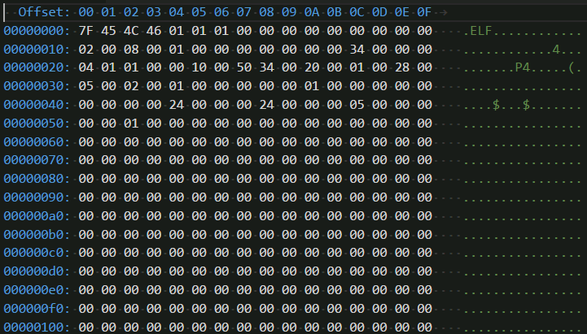
Binary Executable File
ASM
ELF
binary
HEX file
SOF file
FPGA
chip
BIN2HEX converter

Slide 60
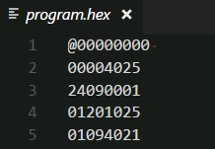
HEX-file
*.v, *.vh
Verilog Sources
ASM
ELF
binary
HEX file
sm_rom.v
$readmemh (…);
SOF file
FPGA
chip
synthesis tool (Quartus Prime)

Slide 61
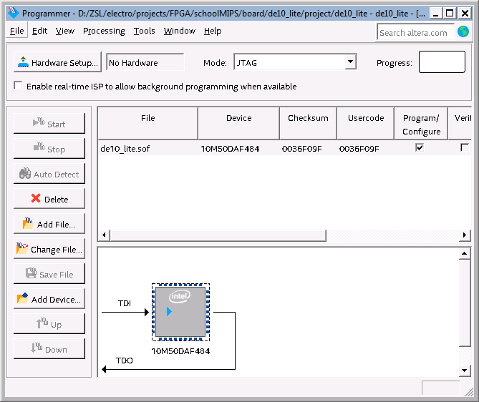
FPGA Configuration File
ASM
ELF
binary
HEX file
SOF file
FPGA
chip

Slide 62
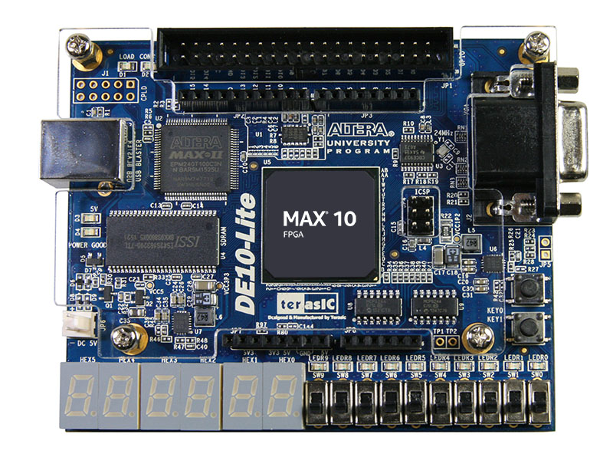
Configured FPGA chip on the Debug Board
ASM
ELF
binary
HEX file
SOF file
FPGA
chip

Slide 63
What is Next?
The great book “Digital Design and Computer Architecture” by David Harris and Sarah Harris
The free translation (Russian) can be downloaded from MIPS Academic Community (link)
MIPSfpga – provides the RTL source code of the MIPS microAptiv UP core for implementation on an FPGA (including SoC and Labs). This core is a member of the same microcontroller family found in many embedded devices, including the popular PIC32MZ & PIC32MK microcontrollers from Microchip and the Artik 1 from Samsung (link)

Slide 64
Thank you!
Your questions?

