Slide 1
Dynamic scheduling
Kosarev Nikolay
MIPT
Apr, 2010

Slide 2
Agenda
In-order execution
Out-of-order execution.
Tomasulo’s algorithm
Implementation in hardware
Demo
Hardware speculation
Demo

Slide 3

In-order execution
Pipeline
DIV R1 = R2, R3
ADD R9 = R1, R4
SUB R8 = R4, R5
DIV R1 = R2, R3
ADD R1 = R2, R4
SUB R6 = R1, R5
(but code has no sense)
Data hazards - RAW, WAW. No WAR.

Slide 4

Out-of-order execution
Split ID into 2 stages:
Issue - IS Decode, check for structural hazards
Read operands - RO Wait until no data hazards, read operands
Pipeline
Out-of-order execution implies out-of-order completion (WB)
Hazards – RAW, WAW, WAR
DIV R0 = R2, R4
ADD R6 = R0, R8
SUB R8 = R10, R14
MUL R6 = R10, R8

Slide 5
Tomasulo’s algorithm
How are data hazards avoided?
RAW – wait for availability of operands
WAR, WAW – register renaming (переименование регистров)
DIV R0 = R2, R4
ADD R6 = R0, R8
ADD R9 = R6, R1
SUB R8 = R10, R14
MUL R6 = R10, R8
DIV R0 = R2, R4
ADD A = R0, R8
ADD R9 = A, R1
SUB B = R10, R14
MUL R6 = R10, B

Slide 6
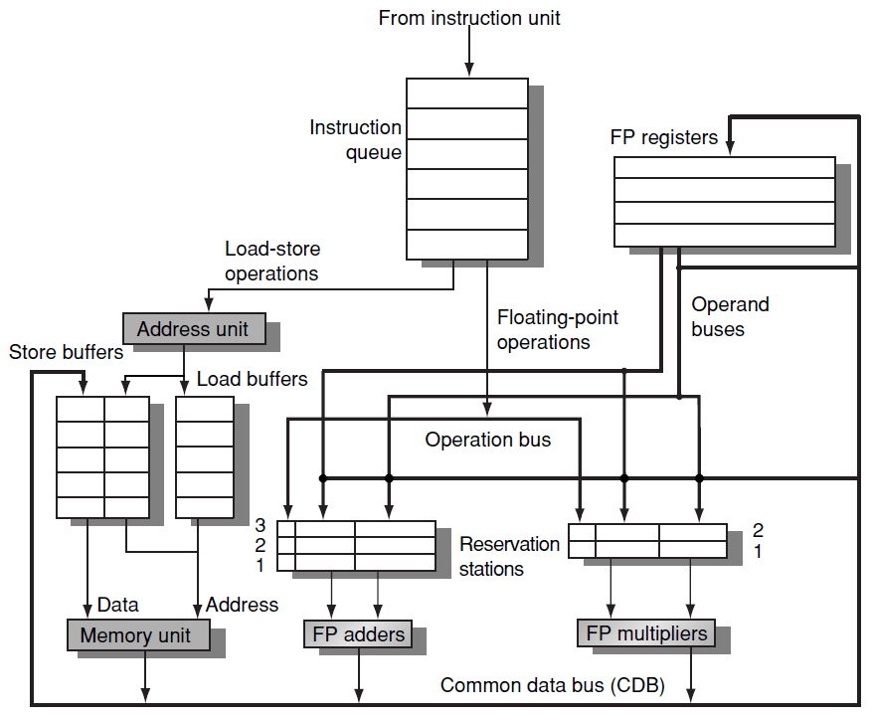
Implementation in HW

Slide 7
Demo
LD F6 = R2, 2
LD F2 = R3, 4
MUL F0 = F2, F4
SUB F8 = F2, F6
DIV F10 = F0, F6
ADD F6 = F8, F2
Tomasulo's algorithm for dynamic scheduling

Slide 8

Hardware speculation
Based on 3 key ideas:
Dynamic branch prediction
Speculative execution
Dynamic scheduling
Extra stage: instruction commit
New buffer: ROB (reorder buffer)
Pipeline

Slide 9
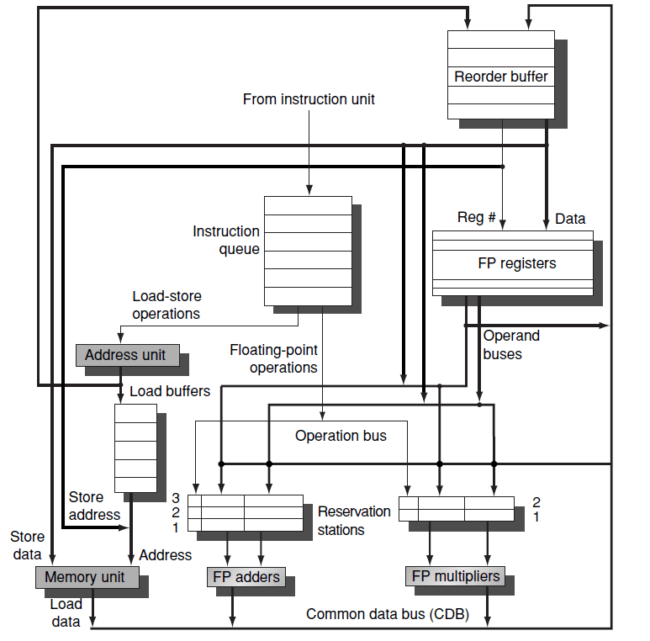
Hardware speculation

Slide 10
Demo
Reorder buffer

Slide 11


