Slide 1
Branch prediction
Titov Alexander
MDSP
November, 2009

Slide 2
Agenda
Reasons to use
Static (software) prediction
Saturating counter
Two-level adaptive predictor
Local/global predictors
Branch target predictor
Competitive approaches
A branch predictor is a digital circuit that tries to guess which way a branching (e.g. an if then-else structure) will go before this is known for sure.

Slide 3
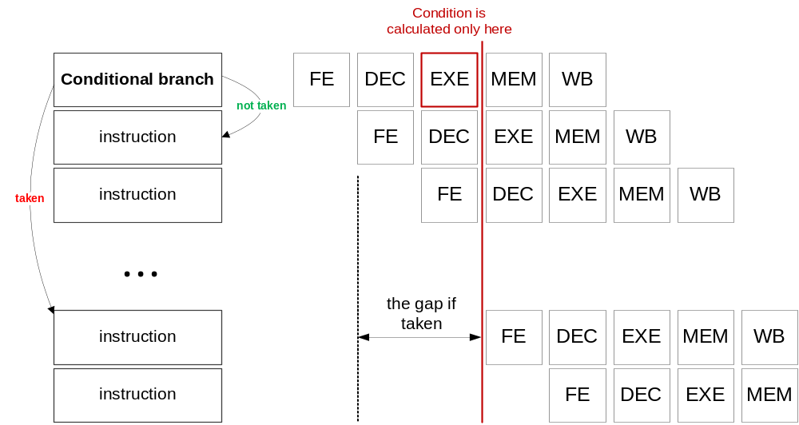
The 1st reason: the gap in pipeline
The time that is wasted in case of a branch misprediction is equal to the number of stages in the pipeline from the fetch stage to the execute stage. Modern microprocessors tend to have quite long pipelines so that the misprediction delay is between 10 and 20 cycles (if not consider misses in caches).

Slide 4
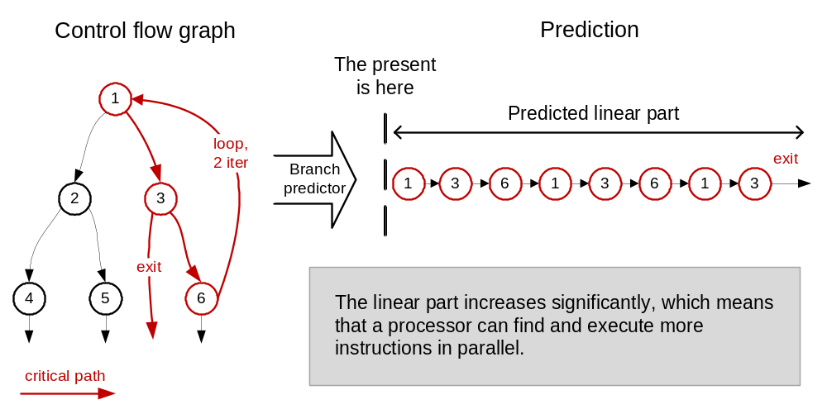
The 2nd reason: parallel execution
A processor use special technique to identify instruction can be executed in parallel, but the linear part (instruction between two branches) is to small to select enough instruction (every 5-8th instruction is a branch).
The branch prediction can increase the linear part:

Slide 5
Static (software) prediction
There are situations as the branch direction can be statically predicted with a good probability:
  Backwards branches
  Exception and error handling
  Some branches meet with specific heuristics
The backwards branch is one that has a target address that is lower than its own address. Therefore SBP can help with prediction accuracy of loops, which are usually backward-pointing branches, and are taken more often than not taken.
Some processors allow branch prediction hints to be inserted into the code to tell whether the static prediction should be taken or not taken. In this case also it is possible to use the profile information (the history of execution of a program).
Static prediction is used as a fall-back technique in some processors with dynamic branch prediction when there isn't any information for dynamic predictors to use.

Slide 6
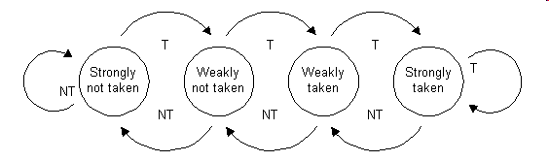
Saturating counter
A saturating counter or bimodal predictor is a state machine with four states:
When a branch is evaluated, the corresponding state machine is updated. Branches evaluated as not taken (NT) decrement the state towards strongly not taken, and branches evaluated as taken (T) increment the state towards strongly taken
The advantage of the two-bit counter over a one-bit scheme is that a conditional jump has to deviate twice from what it has done most in the past before the prediction changes. For example, a loop-closing conditional jump is mispredicted once rather than twice.

Slide 7
Two-level adaptive predictor
Conditional jumps that are taken every second time or have some other regularly recurring pattern are not predicted well by the saturating counter, but a adaptive predictor can easy solve this problem
present
future
past
Pattern history table
00
strongly
NT
weakly
NT
weakly
T
strongly
T
Branch sequence:
1 0 0 1 0 0 1 0 0
01
strongly
NT
weakly
NT
weakly
T
strongly
T
History buffer
10
strongly
NT
weakly
NT
weakly
T
strongly
T
Prediction:
0 0 0 0 0 1 0 0 0
11
strongly
NT
weakly
NT
weakly
T
strongly
T
TRUE
Result:
FALSE
Notes:
The branch sequence is the sequence of the branch behaviour. Zero means “not taken”, one means “taken”.
Default state for all counters in the pattern history table is “weakly NT”. The counters doesn’t change their state while the history buffer isn’t full.

Slide 8
Local/global predictors
Local prediction
  Local branch predictor has a separate history buffer for each conditional jump instruction.
  Pattern history table may be separate as well or it may be shared between all conditional jumps.
  Accuracy of the local predictor is equal about 97.1%.
Global prediction
  Global branch keeps a shared history of all conditional jumps: in this case any correlation between different conditional jumps is utilized in the prediction making, but when there is no correlation the prediction can decrease.
  This predictor must have a long history buffer in order to make a good prediction. The size of the pattern history table grows exponentially with the size of the history buffer. Therefore, the big pattern history table is shared between all conditional jumps.
  Accuracy of the global branch predictor is equal about 96.6%, which is just a little worse than large local predictors.
To do the best prediction real branch predictors are made as a combination of many predictors including global, local and other more specific ones.

Slide 9
Branch target prediction
The address of a dynamic branch isn’t known statically in the moment of compilation. It is calculated in the moment of execution of the program.
A branch target predictor is the part of a processor that predicts the target address of a taken dynamic conditional branch or an dynamic unconditional branch instruction before the target address of the branch instruction is computed by the execution unit of the processor.
Note! Branch target prediction is not the same as branch prediction. Branch prediction attempts to guess whether a conditional branch will be taken or not-taken, but branch target one predicts the value of target address.

Slide 10
Competitive approaches
Almost all x86 processors use the branch prediction approach, but branch prediction is not the just one way to reach the wide parallel execution and to avoid gaps in pipeline.
Branch predictor is a large and very sophisticated circuit. It consumes a lot of energy. Some mobile processors use only a very simple branch predictor to decrease their power and area.
There are architectures provide another approaches. For example, in VLIW (Very Long Instruction Word) architecture independent instructions are combined into a long instruction by compiler and executed in parallel in the processor. And to avoid the gaps delay branches are used.

