Slide 1
Caches
Titov Alexander
13.03.2010

Slide 2
Classic components of a computer
Computer
control
memory
output
datapath
processor
input

Slide 3
The city example (spatial locality)
Factory
Your shop
Shop store
Large storehouse
Storehouse
The delay is decreased, but the cost is increased

Slide 4
The bookshelf example (temporal locality)
Your bookshelf
A-B | C-D | E-F | G-H | I-J | … | … | … | … | … | Y-Z
Places for books
The first latter in the name of the author
fast
slow
City Library
Your table

Slide 5
Simple direct mapped cache
000
001
010
011
100
101
110
111
index
Index length = log2(number of cache block)
Cache capacity is 8 = 2³ , therefore the index takes 3 bites
Cache
data
Main memory
data
00001
00101
01001
01101
10001
10101
address

Slide 6
Simple cache scheme
31 30 29 . . . . . . . . . . . . 12 11 10 9 8 . . . . . . 3 2 1 0
Address
Physical address tag
Cache index
Byte offset
16
12
2
Index
Valid
Tag
Data
0
1
2
…
…
1022
1023
Cache hit
=
32
Data

Slide 7
Associativity
Index length = log2(number of cache block/number of ways)
Direct mapped cache
2-way set-associative
Fully associative cache
data
000
data
data
index
set
index
set
index
set
001
1
00
1
010
2
00
011
3
01
2
1
100
4
01
101
10
Not used
5
3
110
6
10
111
7
11
11
4
8
The miss rate is decreased, but hit time, size, power are increased

Slide 8
Associativity and bookshelf
Direct bookshelf
A-B | C-D | E-F | G-H | I-J | … | … | … | … | Y-Z
Only one place for a book
Two-way set-associative bookshelf
A-D |  | E-F |  | … |  | … |  | W-Z
Only two place for a book
Full associative bookshelf
Any place are available for a book

Slide 9
A four-way set-associative cache
31 30 29 . . . . . . . . . . . . 12 11 10 9 8 . . . . . . 3 2 1 0
Address
Physical address tag
Cache index
Byte offset
22
8
2
Tag
Data
Index
Tag
Data
V
V
Tag
Data
Tag
Data
V
V
0
1
2
…
…
254
255
32
=
=
=
=
multiplexor
OR
32
Hit
Data

Slide 10
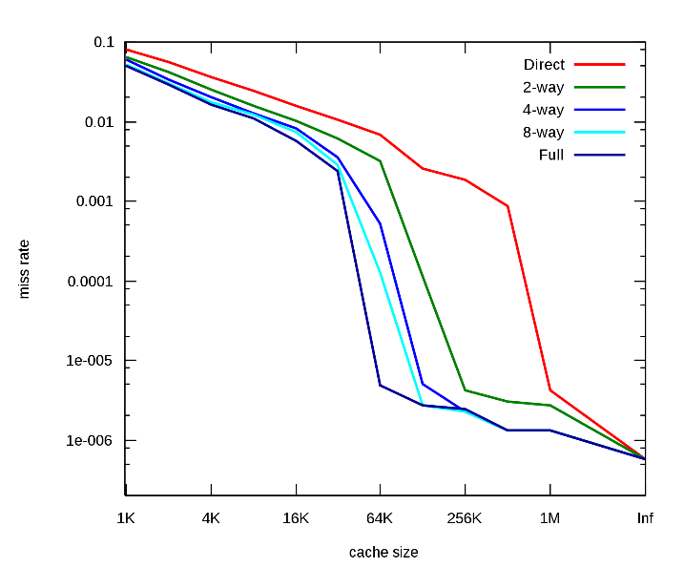
Miss rate diagram
Capacity misses
Conflict
Compulsory
Compulsory misses. They are caused by the first reference to the data.
Capacity misses (due to cache capacity limitation only)
Conflict misses:
  Mapping misses (cache is not fully associative)
  Replacement misses (the replacement policy is not ideal)

