Slide 1
TLP. SMT
Danila Khaidukov
11.04.2022

Slide 2
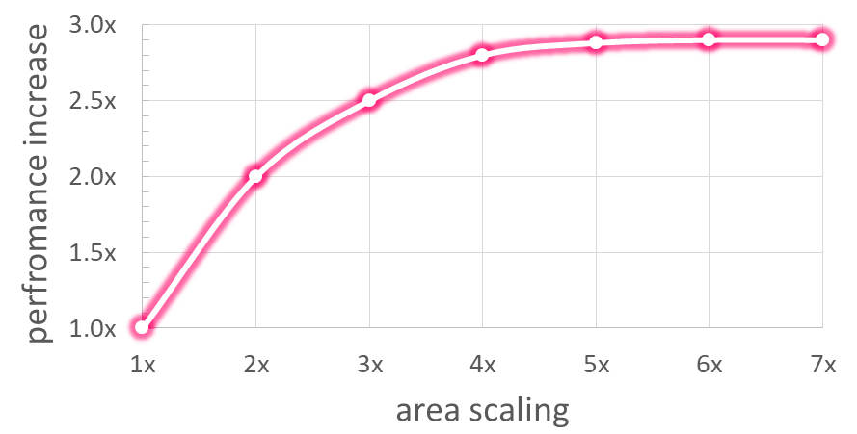
Motivation
Superscalar is hard to scale:
ILP is depleted – all independent instruction are already executed in parallel
Inefficient – power & area grows faster than performance
Alternative way to use area is Multicore:
1 big core - 6x area with 3x performance
3 small cores (2x area & performance each) - 6x area with 6x performance boost in total
2x efficiency!

Slide 3
Thread-level parallelism
Running tasks can be separated into independent execution threads
multiple applications running simultaneously
from a single application – parallelized by a programmer
Single-core CPU utilizes instruction-level parallelism (ILP) of 1 thread
Multicore utilizes thread-level parallelism (TLP)
Each thread is executed on single core

Slide 4
Types of multiprocessors
All processors works with one address space
SMP — Symmetric Multi Processing
Identical processing units with a single shared memory
Fast and effective memory usage
Low scalability due to lots of interconnections and limited memory throughput
NUMA — Non Uniform Memory Access
Each processing unit with its own memory and shared memory bus
Highly scalable
Requires special coherency protocols and OS support

Slide 5
Multiprocessor vs Multicore
Multiprocessor: sharing memory on CPU level
Original approach
Good for independent workloads
Bad for cooperative workloads with data exchange
Multicore: sharing memory between cores of 1 CPU
More advanced approach on a single chip
Shared cache and memory bus
Data exchange through the shared cache
CPU 1
CPU 2
Memory
CPU
core 1
core 2
Cache
Memory

Slide 6
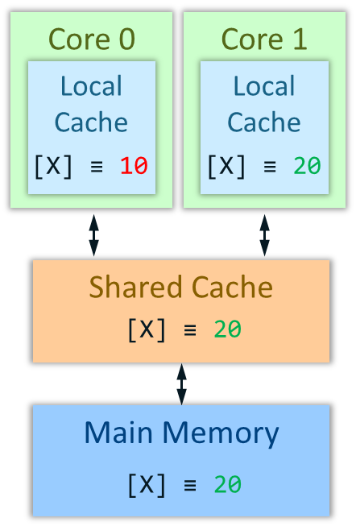
Memory Coherence in a multicore system
Each core has its own local cache
Cores can keep multiple local copies of the same data
Multiplied data can be damaged if one core modifies it:
Core 0
Core 1
Local
Cache
Local
Cache
hit
[X] ≡ 10
[X] ≡ 20
Memory: Mem[X] ≡ 10
Core 0: a = Mem[X] # a = 10
Core 1: Mem[X] = 20
Core 0: b = Mem[X] # b = 10
miss
Shared Cache
20
[X] ≡ 10
miss
Error: read the old value from the local cache
Main Memory
Memory must be coherent:
All cores must see memory identically
All cores must see the latest state of memory
20
[X] ≡ 10

Slide 7
Coherence protocols: MESI
Coherence protocols describe how to handle writes/reads to maintain memory coherence in a multicore system
Example: MESI protocol
Define 4 states of a cache line
Describe transactions between states
State rules:
To modify a line, ownership should be obtained first
There is no state when a line is modified and contained by other cores
 | Valid? | Owned? | Modified?
Invalid | NO | NA | NA
Shared | YES | NO | NO
Exclusive | YES | YES | NO
Modified | YES | YES | YES

Slide 8
MESI: example
Memory: Mem[X] ≡ 25
Core 0: a = Mem[X] # a = 25
Core 0: Mem[X] ≡ 35
Core 1: b = Mem[X] # b = 35
Snoop [X]
Core 0 writeback [X]
Core 1: Mem[X] ≡ 45
Request ownership for [X]
Core 0 invalidate [X]
Core 0
Core 1
Local
Cache
Local
Cache
[X] ≡ 25
[X] ≡ 35
[X]
[X]
35
[X]
45
S
35
I
E
M
S
M
Shared Cache
[X] ≡ 25
35
(1, 0)
(1, 1)
(0, 1)
Main Memory
[X] ≡ 25
[X] ≡ 25

Slide 9
MESI State Diagram
request ownership
request ownership
snoop
snoop
read
Invalid
read shared
Shared
read
snoop
request ownership
snoop
write
snoop
request ownership
read not shared
write
request ownership
write
Exclusive
Modified
write
read
read
write

Slide 10
SMT

Slide 11
Motivation
1st application
2nd application
0
1
2
3
0
Core must be universal at fixed superscalar width
Extract as much ILP as possible
Effective usage of hardware
Threads could interact through shared memory
Coherence protocol limits performance
Previously each thread was executed on separate single core
Now assume each core could handle more than one thread execution
CPU supports ST and MT execution modes
1
2
3

Slide 12
Simultaneous Multithreading
Physically we have the same amount of cores
Logically there are twice more cores
OS schedules tasks on logical CPUs
Each logical processor maintains its own arch state
Complete set of architectural registers (General-purpose registers, Control registers, Machine state registers, Debug registers)
Instruction pointers
Each logical processor has its own interrupt controller
CPU
Core 1
Core 2
Cache
Memory

Slide 13

Resource Sharing
PC
PC
Fetch
Each pipe-stage is occupied by one of the threads
Resources are either replicated, partitioned or shared
Replicated resources are ones which are vital to maintain two fully independent contexts on each logical processor
Main source of HW size growth
Partitioned resources are mostly queues that decouple pipeline stages
Could be unified in ST execution mode
Shared resources are ones which don’t care about threading at all
Queue
Queue
APIC
Decode
APIC
Queue
Queue
Rename & Allocate
Arch State
SQ
Physical Registers
OOO Scheduler / Execute
Arch State
ROB
ROB
Retirement

Slide 14
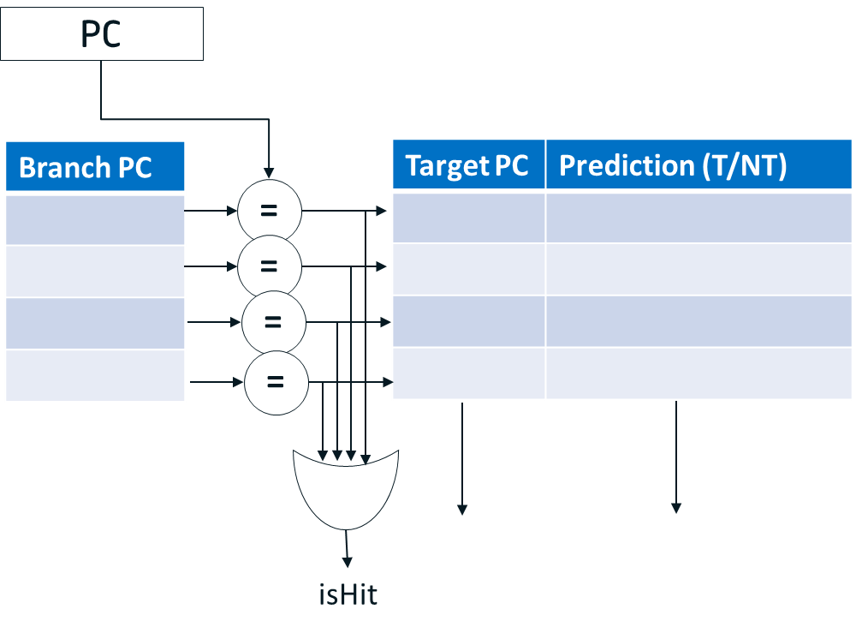
Example: Branch Predictor sharing
BP operates in terms of virtual addresses and has shared structure in MT mode
To avoid potential aliasing problems in case of virtual address overlapping BP entries could be marked with thread ID

Slide 15
Example: Schedule queue sharing
In MT mode schedule queue is dynamically partitioned
Each thread has its own small number of SQ entries
This prevents one thread monopolize whole machine resources
Each thread has ability for forward execution
Remained entries could be allocated by any thread
Schedule queue entries

Slide 16
Example: ROB replication
In MT mode ROB is partitioned, each part contains instructions only from one thread
Provide fairness execution of each thread
It’s complicated to make sharing scheme with dynamic repartitioning
Each thread has its own retirement logic
Stall in one thread doesn’t block retirement of another thread
In case of mispredictions, only instructions from affected thread are cleared
Retirement point (thread 1)
Retirement point (thread 2)

Slide 17
Example: Data cache sharing
Caches are addressed in physical addresses and considered as shared
If the data is common (cooperative workload), both threads hit to cache
Otherwise, LRU algorithm works
Ambiguity is avoided: physical address is thread-independent

Slide 18
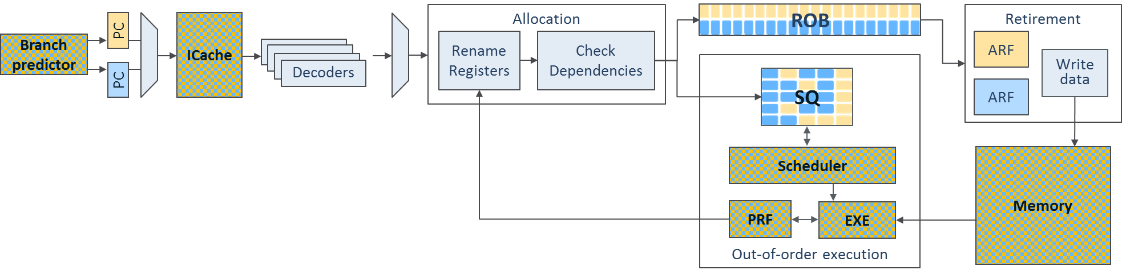
Resource sharing: pipeline overview
Overhead on HW size mostly comes from replicated resources
2x ARF, 2x PC, 2x APIC
Additional HW for thread switching between pipeline stages (thread selectors)
Still overhead is much less than 2x core

Slide 19
SMT pros and cons
Pros:
Increases overall system’s throughput by utilizing machine resources more effectively
Shadow pipeline hazards and allocation stalls
Introduce little addition HW (only replicated resources)
Cons:
ST performance of each thread is smaller
Could significantly drop performance due to cache thrashing
Unlikely help traces with enough ILP or high memory bandwidth

Slide 20
Implementations
SMT technology been around 1950s
First researched by IBM in ACS-360 project (1968)
Dean M. Tullsen et al – Simultaneous Multithreading: Maximizing On-Chip Parallelism – University of Washington (1995)
Major commercial CPU – DEC Alpha 21464 w/ SMT4 (cancelled 2001)
Intel Pentium 4 / Xeon – SMT2 support in NetBurst architecture (2002)
Modern implementations:
2 threads: Intel Atom/Core i7/Xeon (since 2008), AMD Ryzen, IBM Power 6
4 threads: Intel Xeon Phi, IBM Power 7 (8 cores - 32 threads)
8 threads: IBM Power 8/9 (12 cores – 96 threads)

Slide 21
Synchronization

Slide 22
Synchronization
We have already discussed Memory Coherence
Single core: Cache write policies (WriteThrough and WriteBack)
Multicore: MESI protocol
These mechanisms guarantee data correctness, while not algorithm correctness
Due to data races in Concurrent computing
Parallel cooperative tasks with common data require synchronization mechanisms:
Atomic operations
Transactional memory

Slide 23
Atomic operations
Synchronization with atomic operations
Ability to read and modify memory atomically (read-modify-write)
E. g. semaphores, MutEx (mutual exclusion), shared memory
Implemented as extensions of ISA (RISC-V):
Atomic memory operation (AMO) instructions (R-type) – for simple operations:
AMOSWAP.W; AMOADD.W; AMOMAX.W …
Complex Lock-free atomic read-modify-write operation: Load Reserved (Load Linked) + Store Conditional
try:
lr.w t0, (a0) # load value
# <update t0>
sc.w t1, t0, (a0) # try to update
bnez t1, try # retry if SC failed
SC returns 1 to T1 only if (A0) was not changed after LR of (A0)

Slide 24
Transactional memory
Transactional memory – allows a group of loads and stores to execute in an atomic way
Basically, the extension of LR/SC for a memory region
Helps workloads with little conflicts among threads:
Provides Optimistic concurrency control (OCC) – allows threads run in parallel without acquiring locks, assuming the intersection will not occur
Transaction is committed if conflict is not present. Otherwise it is reverted to initial state and rerun until conflicts are resolved.
Avoids deadlocks, while livelocks are still possible

Slide 25
Thank You

