Slide 1
Software Development Code style. Unit testing.
04.04.2022
Kirill Korolev

Slide 2
Agenda
Motivation
VCS (recap)
Code style
Testing
CI
TDD

Slide 3
Motivation
The key difference of industrial code – it’s large!
Very complex programs for solving a wide range of tasks
Gets even larger over time
The following issues arise:
How to write readable code?
How to write easy-to-modify code?
How to make everyone to write similar code?
How to synchronize many developers?
How to write reliable code?
Code style
VCS
Unit testing / CI / TDD

Slide 4
VCS: recap
repository
main
workspace = a file directory of your project
commit = a commented group of changes
refs = commit labels (e. g. main, HEAD)
repository = workspace + commits tree + refs
+++
---
+++
---
+++
---
+++
---
+++
---
+++
---
HEAD
subproj1

Slide 5
Code style

Slide 6
Why good code is important?
Bad code is:
hard to read and understand
hard to change
easy to broke
A programmer spent most of the time with code, reading, writing and debugging it
Bad code makes programmers spend much more time on these things
A programmer should not optimize CPU time, only programmer’s time

Slide 7
Naming rules
Names are the largest part of code
We are constantly creating new names in our programs
int main( int argc, const char* argv[]) try {
config::handleArgs( argc, argv, 1);
ElfLoader elf( config::binary_filename);
auto memory = FuncMemory::create_hierarchied_memory();
elf.load_to( memory.get());
auto sim = Simulator::create_configured_simulator();
sim->set_memory( memory);
sim->init_checker();
sim->set_pc( elf.get_startPC());
sim->run( config::num_steps);
int main( int argc, const char* argv[]) try {
config::handleArgs( argc, argv, 1);
ElfLoader elf( config::binary_filename);
auto memory = FuncMemory::create_hierarchied_memory();
elf.load_to( memory.get());
auto sim = Simulator::create_configured_simulator();
sim->set_memory( memory);
sim->init_checker();
sim->set_pc( elf.get_startPC());
sim->run( config::num_steps);

Slide 8
Name rule #1
Name should reveal original intention
The name is bad, if:
it needs a comment
you need to read code to understand its purpose
void add(int * const a, int * const b) {
int i = 0, t = -1;
for (i = MAX_D; i >= 0; i--) {
if (b[i] == 0) continue;
t = a[i] + b[i];
if (i != 0) {
a[i - 1] += t / 10;
a[i] = t % 10;
} else
a[i] = t;
}
}
size_t s; // array size
size_t array_size;

Slide 9
Name rule #2
Avoid disinformation
Change a name along with code meaning

Slide 10
Name rule #3
Use right parts of speech
Nouns for objects, verbs for methods
template <typename ISA>
void Fetch<ISA>::save_flush( Cycle cycle)
{
/* save PC in the case of flush signal */
if( rp_flush_target->is_ready( cycle))
wp_target->write( rp_flush_target->read( cycle), cycle);
else if( rp_target->is_ready( cycle))
wp_target->write( rp_target->read( cycle), cycle);
}

Slide 11
Name length rules: variables
Short if scale is short
Long if scale is long
std::string PlainMemory::dump() const
{
std::ostringstream oss;
oss << std::setfill( '0') << std::hex;
for ( auto it = arena.begin(); it != arena.end(); ++it)
if ( uint32( *it) != 0)
oss << "addr 0x" << std::distance(arena.begin(), it)
<< ": data 0x" << uint32( *it) << std::endl;
return oss.str();
}

Slide 12
Name length rules: functions
Short for public and frequently used
Long for private or rarely used
std::shared_ptr<Simulator> Simulator::create_configured_simulator()
template<typename T, Endian endian> T FuncMemory::read( Addr addr) const

Slide 13
Name length: self check
If your cannot think of a meaningful function/class name, it is likely too large
const uint64 MAX_NOPS_IN_A_ROW = 10;
template <typename ISA>
void FuncSim<ISA>::update_nop_counter( const typename FuncSim<ISA>::FuncInstr& instr)
{
if ( instr.is_nop())
++nops_in_a_row;
else
nops_in_a_row = 0;
check_nop_counter();
}
template <typename ISA>
void FuncSim<ISA>::check_nop_counter()
{
if (nops_in_a_row > MAX_NOPS_IN_A_ROW)
throw BearingLost();
}
template <typename ISA>
void FuncSim<ISA>::update_nop_counter( const typename FuncSim<ISA>::FuncInstr& instr)
{
if ( instr.is_nop())
++nops_in_a_row;
else
nops_in_a_row = 0;
check_nop_counter();
}
template <typename ISA>
void FuncSim<ISA>::check_nop_counter()
{
if (nops_in_a_row > 10)
throw BearingLost();
}
template <typename ISA>
void FuncSim<ISA>::update_and_check_nop_counter( const typename FuncSim<ISA>::FuncInstr& instr)
{
if ( instr.is_nop())
++nops_in_a_row;
else
nops_in_a_row = 0;
if (nops_in_a_row > 10)
throw BearingLost();
}

Slide 14
Function size rule
Keep functions small
Small functions are easy to read, understand and navigate through
template<typename RegisterUInt>
void BaseMIPSInstr<RegisterUInt>::init( const BaseMIPSInstr<RegisterUInt>::ISAEntry& entry, MIPSVersion version)
{
operation = entry.operation;
mem_size = entry.mem_size;
function = entry.versions.is_supported(version)
? entry.function
: &BaseMIPSInstr<RegisterUInt>::execute_unknown;
shamt = instr.asR.shamt;
src1 = get_register( entry.src1);
src2 = get_register( entry.src2);
dst = get_register( entry.dst);
if ( entry.dst == RegType::HI_LO)
dst2 = MIPSRegister::mips_hi;
const bool print_dst = is_explicit_register( entry.dst);
const bool print_src1 = is_explicit_register( entry.src1);
const bool print_src2 = is_explicit_register( entry.src2);
std::ostringstream oss;
if ( PC != 0)
oss << std::hex << "0x" << PC << ": ";
oss << entry.name;
switch ( operation)
{
case OUT_R_SHAMT:
oss << " $" << dst
<< ", $" << src1
<< ", " << std::dec << shamt;
break;
case OUT_I_ARITHM:
v_imm = instr.asI.imm;
oss << " $" << dst << ", $"
<< src1 << ", "
<< std::hex << "0x" << v_imm << std::dec;
break;
case OUT_I_BRANCH:
v_imm = instr.asI.imm;
oss << " $" << src1 << ", $"
<< src2 << ", "
<< std::dec << static_cast<int16>(v_imm);
break;
case OUT_RI_BRANCH_0:
v_imm = instr.asI.imm;
oss << " $" << src1 << ", "
<< std::dec << static_cast<int16>(v_imm);
break;
case OUT_RI_TRAP:
v_imm = instr.asI.imm;
oss << " $" << src1 << ", 0x"
<< std::hex << static_cast<int16>(v_imm) << std::dec;
break;
case OUT_I_CONST:
v_imm = instr.asI.imm;
oss << " $" << dst << std::hex
<< ", 0x" << v_imm << std::dec;
break;
case OUT_I_LOAD:
case OUT_I_LOADU:
case OUT_I_PARTIAL_LOAD:
v_imm = instr.asI.imm;
oss << " $" << dst << ", 0x"
<< std::hex << v_imm
<< "($" << src1 << ")" << std::dec;
break;
case OUT_I_STORE:
v_imm = instr.asI.imm;
oss << " $" << src2 << ", 0x"
<< std::hex << v_imm
<< "($" << src1 << ")" << std::dec;
break;
case OUT_J_JUMP:
v_imm = instr.asJ.imm;
oss << " 0x" << std::hex << v_imm << std::dec;
break;
default:
if (print_dst) {
oss << " $" << dst;
if (print_src1)
oss << ",";
}
if (print_src1)
oss << " $" << src1;
if (print_src2)
oss << ", $" << src2;
break;
}
if ( instr.raw == 0x0ul)
disasm = "nop ";
else
disasm = oss.str();
}
template <typename ISA>
typename Decode<ISA>::Instr Decode<ISA>::read_instr( Cycle cycle)
{
if ( rp_stall_datapath->is_ready( cycle))
return rp_stall_datapath->read( cycle);
return rp_datapath->read( cycle);
}

Slide 15
Function size: self check
int main( int argc, const char* argv[]) try {
config::handleArgs( argc, argv, 1);
ElfLoader elf( config::binary_filename);
auto memory = FuncMemory::create_hierarchied_memory();
elf.load_to( memory.get());
auto sim = Simulator::create_configured_simulator();
sim->set_memory( memory);
sim->init_checker();
sim->set_pc( elf.get_startPC());
sim->run( config::num_steps);
auto kernel = Kernel::create_kernel();
kernel->set_memory( memory);
kernel->set_simulator( sim);
sim->set_kernel( kernel);
return 0;
}
int main( int argc, const char* argv[]) try {
config::handleArgs( argc, argv, 1);
ElfLoader elf( config::binary_filename);
auto memory = FuncMemory::create_hierarchied_memory();
elf.load_to( memory.get());
auto sim = Simulator::create_configured_simulator();
sim->set_memory( memory);
sim->init_checker();
sim->set_pc( elf.get_startPC());
sim->run( config::num_steps);
auto kernel = Kernel::create_kernel();
kernel->set_memory( memory);
kernel->set_simulator( sim);
sim->set_kernel( kernel);
return 0;
}
A function does ONE thing
If not, split the function into smaller ones
If new functions use common data, combine them into a class

Slide 16
Code style guidelines
template <typename ISA>
void Fetch<ISA>::clock_instr_cache(Cycle cycle){
if(rp_long_latency_pc_holder->is_ready(cycle)){
auto target=rp_long_latency_pc_holder->read(cycle);
tags->write(target.address);
wp_hold_pc->write(target, cycle);
return;}
wp_hit_or_miss->write(false, cycle);
}
An easy way to make code more readable
One style to code them all!
Multiple people always work with one code
Choose one style and use it everywhere in project
Keep code lines short
A code line should fit the screen
template <typename ISA>
void Fetch<ISA>::clock_instr_cache( Cycle cycle)
{
if( rp_long_latency_pc_holder->is_ready( cycle))
{
auto target = rp_long_latency_pc_holder->read( cycle);
tags->write( target.address);
wp_hold_pc->write( target, cycle);
return;
}
wp_hit_or_miss->write( false, cycle);
}

Slide 17
Comments rules
template <typename ISA>
typename FuncSim<ISA>::FuncInstr FuncSim<ISA>::step()
{
// fetch instruction
FuncInstr instr = imem.fetch_instr( PC);
// set sequence_id
instr.set_sequence_id(sequence_id);
sequence_id++;
// read sources
rf.read_sources( &instr);
// execute
instr.execute();
...
Avoid comments if you can
Code should explain itself
Remember name rule!
Comment should add new information
template <typename ISA>
typename FuncSim<ISA>::FuncInstr FuncSim<ISA>::step()
{
FuncInstr instr = imem.fetch_instr( PC);
instr.set_sequence_id(sequence_id);
sequence_id++;
rf.read_sources( &instr);
instr.execute();
...

Slide 18
Unit Testing

Slide 19
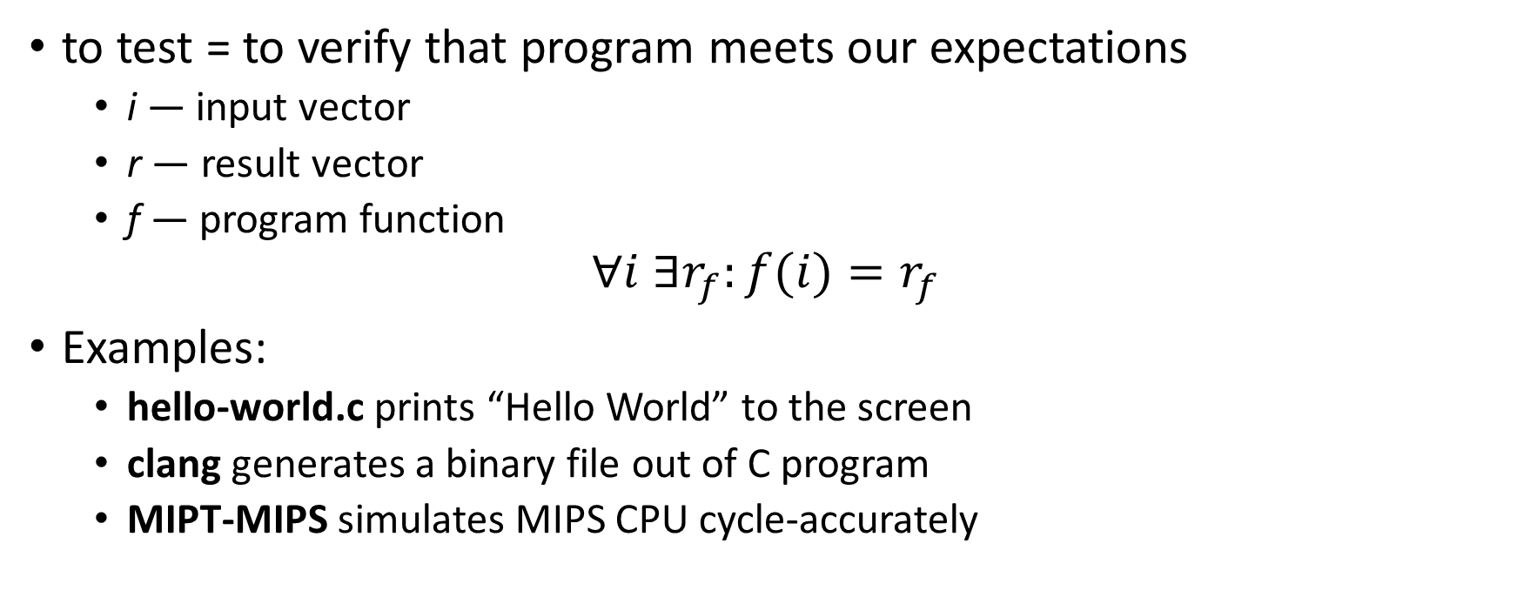
What is testing?
to test = to verify that program meets our expectations
i — input vector
r — result vector
f — program function
$$∀i ∃r_{f}:f(i){=r}_{f}$$
Examples:
hello-world.c prints “Hello World” to the screen
clang generates a binary file out of C program
MIPT-MIPS simulates MIPS CPU cycle-accurately

Slide 20
Units and unit tests
What is a unit?
Functional programming: a function
OOP: a class and its methods
Why testing units is better?
Easier to debug
Tests run faster
Test case — a single input and a single output
Test suite — a set of test cases for a unit

Slide 21
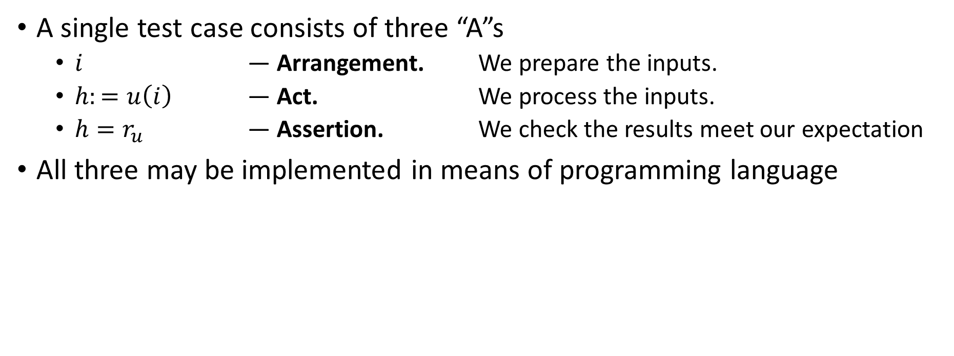
Three A rule
A single test case consists of three “A”s
$i$ — Arrangement. We prepare the inputs.
$h:=u\left(i\right)$ — Act. We process the inputs.
$h=r_{u}$ — Assertion. We check the results meet our expectation
All three may be implemented in means of programming language

Slide 22
Unit tests benefits
Safe refactoring
Can class/function as long as its test suite passes
Motivates structured code
Unit tests require... units – isolated modules with clear interface
Formal agreement with customers/other developers
A test suite contains everything that a unit does
As long as the test suite passes, the unit works 100% correctly

Slide 23
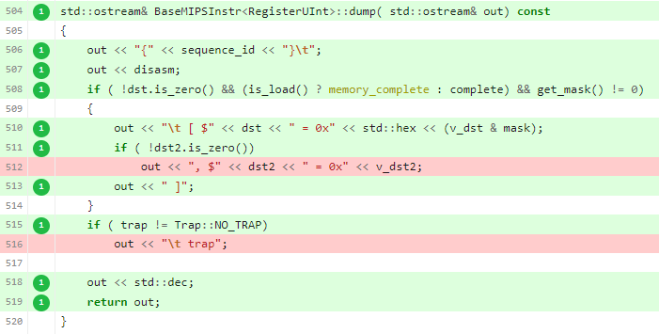
Code coverage
Code coverage system shows control flows never triggered by any test
Highlights unit functionality without a test
A full test suite has 100% coverage of unit code
Drawback: no guarantee that each control flow combination is possible

Slide 24
Continuous Integration
Problem:
More time to develop a feature – more time to merge it into the “main” branch
Solution – CI:
An automated system which for every version of the development branch:
Build the project
Runs tests
Checks merging with “main”
Makes integration faster while keeping “main” stable.

Slide 25
TDD – Test-Driven Development

Slide 26
What is TDD?
Common approach to unit testing: write a program first, then cover it with unit tests to fix bugs and optimize
TDD = Test Driven Development – a more advanced programming technique: write tests first, then write code to make the tests pass

Slide 27
Three ground rules of TDD
Rule #1: Do not write code until you have a failing unit test
Rule #2: Stop writing tests when you have a failing unit test
Rule #3: Write code only enough to make the failing test pass
These rules form a cycle with each iteration a couple minutes long

Slide 28
TDD advantages
Without TDD (writing tests AFTER code)
Design the entire program at once
The program works only in the very end of development
Possible suboptimal or untestable program design
With TDD (writing tests BEFORE code)
Always focus only on a tiny part of functionality
A working program after each TDD iteration
Optimal well-structured design
100% test coverage
Well-organized development process

Slide 29
TDD disadvantages
Successful TDD practice requires experience and self-discipline
High overhead in case of flow errors

Slide 30
TDD guidelines
TDD development is separated in short iterations (2-3 minutes long)
Each iteration consists of 3 steps:
BREAK: write a failing unit test
Remember the Rule #2: Stop writing tests, when you have a failing unit test
FIX: write code to make the test pass
Remember the Rule #3: Write code only to make a failing test pass
REFACTOR: restructure code and remove duplicates

Slide 31
TDD rule of convergence
When tests become more specific, code becomes more general
Correct TDD makes the program write itself
ASSERT_EQ(f(2), 2);
ASSERT_EQ(f(2), 2);
ASSERT_EQ(f(0), 1);
ASSERT_EQ(f(1), 1);
ASSERT_EQ(f(3), 6);
ASSERT_EQ(f(4), 24);
ASSERT_EQ(f(5),120);
int f(int arg) {
int result = 1;
for (int i = 2; i <= arg; i++)
result *= i;
return result;
}
int f(int arg) {
return 2;
}

Slide 32
How to choose unit tests?
Unit test order - the most important part of TDD approach
Start with the simplest the most degenerate unit tests, e. g. corner cases, invalid cases...
Move towards more complex test cases as slow as possible
Self-check: each new unit test should require just a couple of changed code lines
If you jump to complex test cases too fast, you stuck
It takes to finish almost the whole program to make the unit test pass
The only solution is to restart TDD flow from very beginning

Slide 33
References

Slide 34
Code style
Martin, Robert C. (2009). Clean Code: A Handbook of Agile Software Craftsmanship. Upper Saddle River, NJ: Prentice Hall. ISBN 9780132350884.
“Clean Code” video: https://cleancoders.com/episode/clean-code-episode-1/show
MIPT-MIPS Wiki page: https://github.com/MIPT-ILab/mipt-mips/wiki/Code-style-guidelines
MIPT-MIPS code style: https://github.com/MIPT-ILab/mipt-vis/wiki/CodingStyle

Slide 35
Unit tests
Wiki: https://github.com/MIPT-ILab/mipt-mips/wiki/Unit-Tests
CATCH2 tutorial: https://github.com/catchorg/Catch2/blob/master/docs/tutorial.md#top

Slide 36
TDD
Martin, Robert C. (2009). Clean Code: A Handbook of Agile Software Craftsmanship.
Koskela, Lesse (2007) Test Driven: Practical TDD and Acceptance TDD for Java Developers
Wiki note: https://github.com/MIPT-ILab/mipt-mips/wiki/Introduction-to-Test-Driven-Development

