Slide 1
Layers of Computer Architecture
Kirill Korolev
13 September 2021

Slide 2
What is this course about?
Ok… but what is it?
The shortest answer is about Computer Architecture
Computer architecture is the design of the abstraction layers that allow us to implement information processing applications efficiently using available manufacturing technologies
Application
Issue: the gap is too large to cross it over in one step
Decision: create many layers with standardized interfaces
Physics

Slide 3
Layer 1: Application
Application
The general tasks: money accounting, text editing, music/video encoding, games etc.
Excel
Overwatch
Photoshop
Algorithms
Programming Language
Operating System
Instruction Set Architecture
Microarchitecture
Gates/Register-Transfer
Circuits
Physics

Slide 4
Layer 2: Algorithms
Application
High-level math methods to perform the task: quick sort, search in graphs, compression, signal encoding etc.
Algorithms
JPEG
LZ77
Dijkstra
FFT
Programming Language
Operating System
Instruction Set Architecture
Microarchitecture
Gates/Register-Transfer
Circuits
Physics

Slide 5
Layer 3: Programming language
Application
Representation of algorithms in formal languages that can be translated to “machine language”
Algorithms
Programming Language
C++
Java
Python
Operating System
Instruction Set Architecture
Microarchitecture
Gates/Register-Transfer
Circuits
Physics

Slide 6
Layer 4: Operating system
Application
Manages computer resources and provides common interface for user programs
Algorithms
Programming Language
Operating System
Linux
FreeBSD
Windows
Instruction Set Architecture
Microarchitecture
Register-Transfer Level
Circuits
Physics

Slide 7
Layer 5: Instruction Set Architecture
Application
Definition of “machine language” (commands) and available hardware structures/mechanisms
Algorithms
Programming Language
Operating System
Instruction Set Architecture
x86
MIPS
RISC-V
Microarchitecture
Register-Transfer Level
Circuits
Physics

Slide 8
Layer 6: Microarchitecture
Application
High-level definition of hardware structures and operations: caches, buses, registers, pipeline, etc.
Algorithms
Programming Language
Operating System
Instruction Set Architecture
Microarchitecture
Core™
Pentium®
Atom®
Register-Transfer Level
Circuits
Physics

Slide 9
Layer 7: Gates/RTL
Application
Detailed definition of hardware: floor plan, wires, signal distribution, etc
Algorithms
Programming Language
Operating System
Instruction Set Architecture
Microarchitecture
Register-Transfer Level
Latch
XOR
Signal
Circuits
Physics

Slide 10
Layer 8: Circuits
Application
Structure and operation of base hardware elements: transistors, electricity effects
Algorithms
Programming Language
Operating System
Instruction Set Architecture
Microarchitecture
Register-Transfer Level
Circuits
Transistors
Voltage
Current
Physics

Slide 11
Layer 9: Physics
Application
Low level physics effects
Algorithms
Programming Language
Operating System
Instruction Set Architecture
Microarchitecture
Register-Transfer Level
Circuits
Physics
Semiconductor
Electron
Diffusion

Slide 12
Layers of Abstraction
Application
Application
Algorithms
Algorithms
Software (SW)
Programming Language
Programming Language
Computer Science
(CS)
Operating System
Operating System
Instruction Set Architecture
Instruction Set Architecture
HW/SW interface
Microarchitecture
Microarchitecture
Gates/Register-Transfer
Gates/Register-Transfer Level (RTL)
Hardware (HW)
Electrical Engineering
(EE)
Circuits
Circuits
Physics
Physics

Slide 13
Course focus
We will focus our attention mostly on the microarchitecture, but also look through the ISA and the HW levels
Instruction Set Architecture
Microarchitecture
The most focus is here
Gates/Register-Transfer
Circuits
Physics

Slide 14
Performance vs Power vs Cost

Slide 15
Basic Design Tradeoffs
Performance
(speed)
Cost
(complexity, area)
Power
(energy consumption and dissipation)
All three are very important
It is extremely hard to create a feature that improves all factors
Different products (mobile, desktop, etc.) require different balance

Slide 16
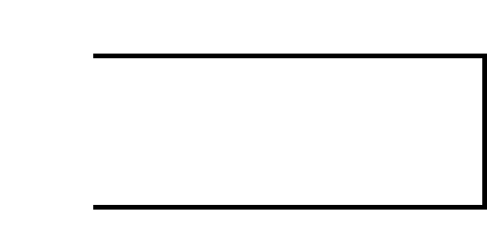
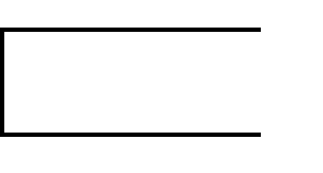
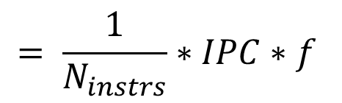
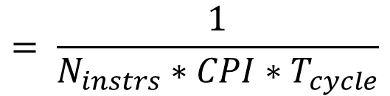


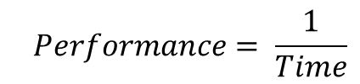
Performance
What does performance depend on?
$$Performance= \frac{1}{Time}$$
$$= \frac{1}{N_{instrs}∗CPI∗T_{cycle}}$$
$$= \frac{1}{N_{instrs}}∗IPC∗f$$
$$Time=Cycles∗T_{cycle}$$
$$=N_{instrs}∗CPI∗T_{cycle}$$
Golden rule of CS

Slide 17

Increasing Performance
Better uArch: pipelining, caching, prediction, etc.
How can we increase it?
$$Performance=\frac{1}{N_{instrs}} ∗ IPC∗f$$
Better SW: algorithms, optimizations, ISA, etc.
Better design: faster circuits, smaller transistors, etc.

Slide 18
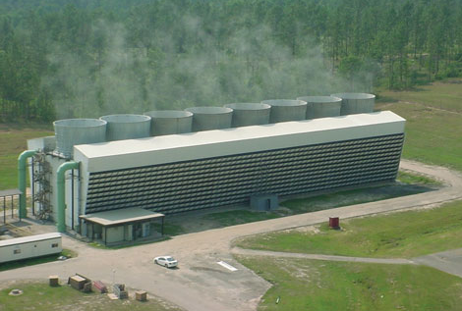
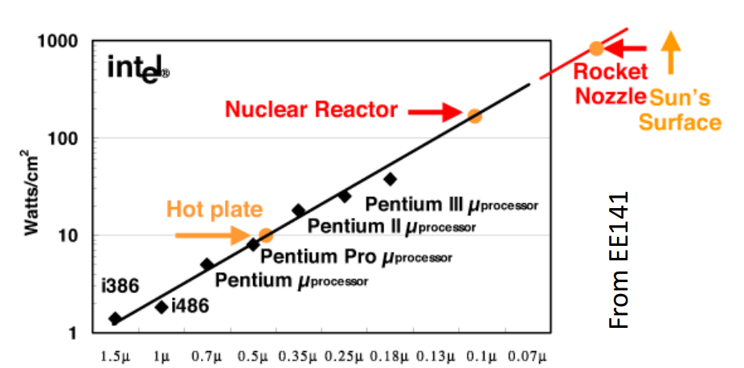
Power
Nuclear reactor? No, power supply for a large data center
Why is power important?
Less power -> smaller battery -> smaller/cheaper devices
Less power -> less money for electricity
Power Wall is reached
Cooling systems cannot dissipate more heat
We cannot spend more power even if we want

Slide 19
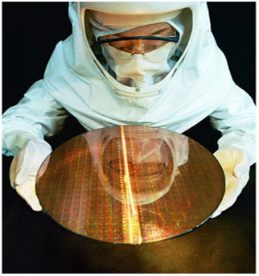
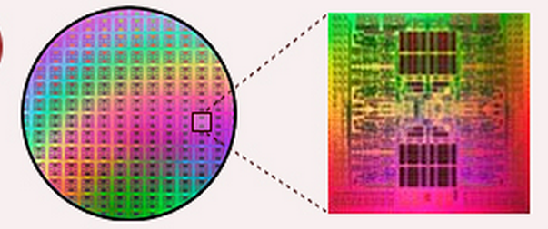
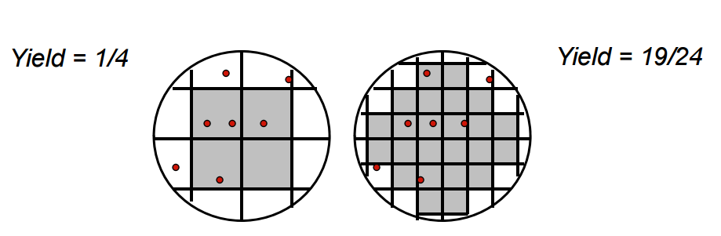
Cost
Fixed Cost (RnD)
Independent of volume (i.e., number of units made/sold)
Examples: design time and effort, mask generation, etc.
Variable Cost (manufacturing/production)
proportional to volume
Examples: silicon processing, packaging, test
Most of these related to chip area
The larger chip size the large production cost
Less chips on one wafer
Larger probability of error

Slide 20
Acknowledgements
These slides contain material developed and copyright by:
Krste Asanovic (MIT/UCB), CS152-L1
David M. Koppelman (LSU), EE4720-L1

Slide 21
Literature
Computer Organization and Design: The Hardware/Software Interface, Patterson D.A., Hennessy J.L., 3rd Edition (Eng) — the main book for this course. It contains all that you need to know about the computer architecture and MIPS ISA.
Computer Architecture: A Quantitative Approach, Hennessy J.L., Patterson D.A., 4th Edition — the classic book about state-of-the-art high-performance computing microarchitectures.

Slide 22
Thank You

