Slide 1
Unit testing. TDD.
29 November 2021
Kirill Korolev

Slide 2
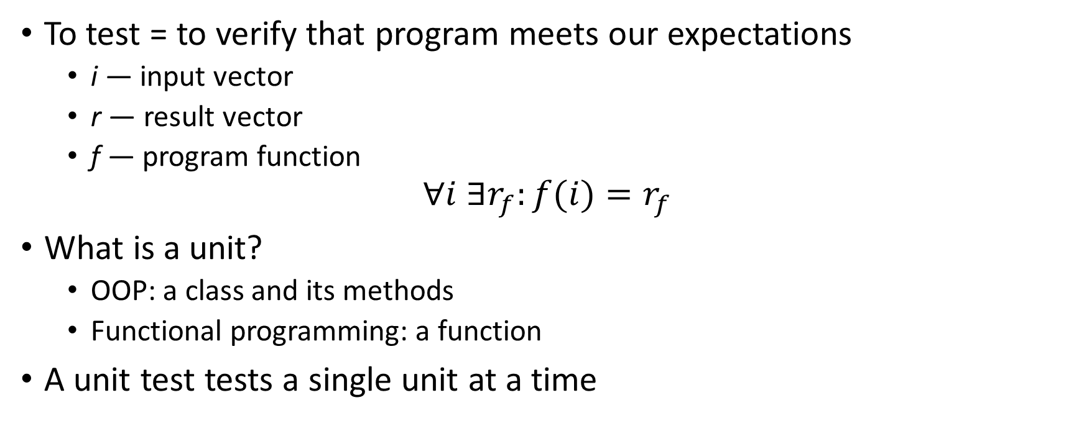
Tests and unit tests
To test = to verify that program meets our expectations
  i — input vector
  r — result vector
  f — program function
$$∀i ∃r_{f}:f(i){=r}_{f}$$
What is a unit?
  OOP: a class and its methods
  Functional programming: a function
A unit test tests a single unit at a time

Slide 3
Unit tests pros and cons
Pros:
  Run fast → fail fast → fast debugging
  Small and simple → easy to understand the cause of failure
  Motivate writing structured code
  Motivate keeping structured code
  Enable safe refactoring
    Tests pass = the program works
Cons:
  Do not test interactions between units
    Integration tests are required for that

Slide 4
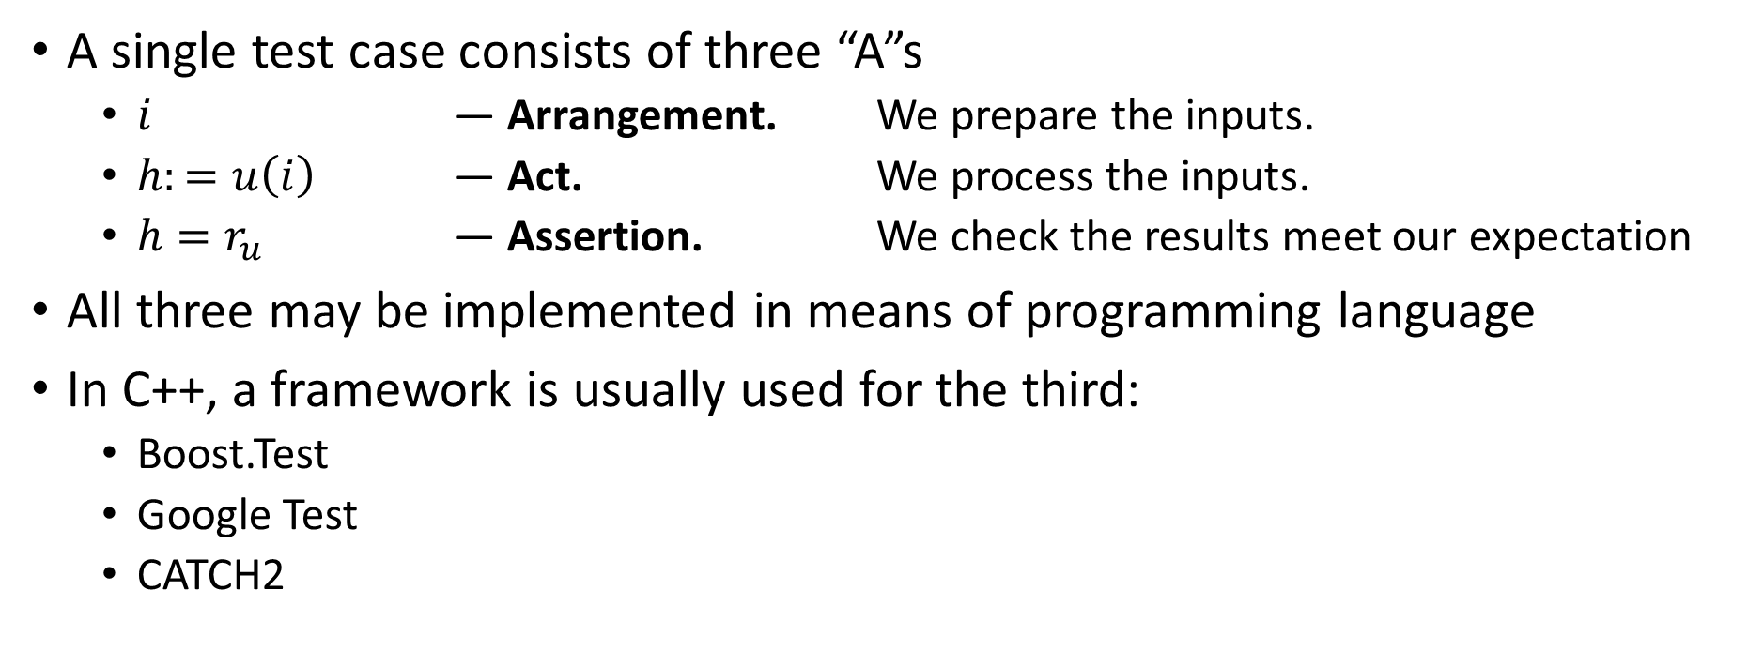
Three A rule
A single test case consists of three “A”s
  $i$ — Arrangement. We prepare the inputs.
  $h:=u\left(i\right)$ — Act. We process the inputs.
  $h=r_{u}$ — Assertion. We check the results meet our expectation
All three may be implemented in means of programming language
In C++, a framework is usually used for the third:
  Boost.Test
  Google Test
  CATCH2

Slide 5
TDD
Common approach to unit testing: write a program first, then cover it with unit tests to fix bugs and optimize
TDD = Test Driven Development – a more advanced programming technique: write tests first, then write code to make the tests pass

Slide 6
Three ground rules of TDD
Rule #1: Do not write code until you have a failing unit test
Rule #2: Stop writing tests when you have a failing unit test
Rule #3: Write code only enough to make the failing test pass
These rules form a cycle with each iteration a couple minutes long

Slide 7
TDD advantages
Without TDD (writing tests AFTER code)
  Design the entire program at once
  The program works only in the very end of development
  Possible suboptimal or untestable program design
With TDD (writing tests BEFORE code)
  Always focus only at a tiny part of functionality
  A working program after each TDD iteration
  Optimal well-structured design
  100% test coverage
  Well-organized development process

Slide 8
TDD disadvantages
Successful TDD practice requires experience and self-discipline
High overhead in case of flow errors

Slide 9
TDD guidelines
TDD development is separated in short iterations (2-3 minutes long)
Each iteration consists of 3 steps:
  BREAK: write a failing unit test
    Remember the Rule #2: Stop writing tests, when you have a failing unit test
  FIX: write code to make the test pass
    Remember the Rule #3: Write code only to make a failing test pass
  REFACTOR: restructure code and remove duplicates

Slide 10
TDD rule of convergence
When tests become more specific, code becomes more general
Correct TDD makes the program write itself
ASSERT_EQ(f(2), 2);
ASSERT_EQ(f(2), 2);
ASSERT_EQ(f(0), 1);
ASSERT_EQ(f(1), 1);
ASSERT_EQ(f(3), 6);
ASSERT_EQ(f(4), 24);
ASSERT_EQ(f(5),120);
int f(int arg) {
int result = 1;
for (int i = 2; i <= arg; i++)
result *= i;
return result;
}
int f(int arg) {
return 2;
}

Slide 11
How to choose unit tests?
Unit test order - the most important part of TDD approach
  Start with the simplest the most degenerate unit tests,
  e. g. corner cases, invalid cases...
  Move towards more complex test cases as slow as possible
Self-check: each new unit test should require just a couple of changed code lines
If you jump to complex test cases too fast, you stuck
  It takes to finish almost the whole program to make the unit test pass
  The only solution is to restart TDD flow from very beginning

Slide 12
Further reading
Unit testing
Wiki: https://github.com/MIPT-ILab/mipt-mips/wiki/Unit-Tests
CATCH2 tutorial: https://github.com/catchorg/Catch2/blob/master/docs/tutorial.md#top
TDD:
Martin, Robert C. (2009). Clean Code: A Handbook of Agile Software Craftsmanship.
Koskela, Lesse (2007) Test Driven: Practical TDD and Acceptance TDD for Java Developers
Wiki note: https://github.com/MIPT-ILab/mipt-mips/wiki/Introduction-to-Test-Driven-Development

