Slide 1
Control Hazards. Branch Prediction
Oleg Ladin
22 November 2021

Slide 2
Refresher: Pipelined vs. Non-Pipelined implementation
Sync signal
(clocks)
4ns
8ns
12ns
16ns
time
PC
F
D
E
M
W
Non-Pipelined
PC + 4
F
D
E
M
W
instructions
F
D
E
M
PC + 8
Sync signal
(clocks)
4ns
8ns
12ns
16ns
time
PC
F
D
wait
E
M
W
wait
Pipelined
PC + 4
F
D
wait
E
M
W
wait
PC + 8
F
D
wait
E
M
W
wait

Slide 3
Refresher: Forwarding + Hazard Detection Unit
Hazard
Detection
Unit
D/E.MemRead
D/E
F/D Write
WB
E/M
PC Write
Control
0
M
WB
M/W
m
u
x
F/D
0
1
EX
M
WB
E/M.RegWrite
0
m
u
x
A
1
M/W.RegWrite
Instruction
Register
File
2
PC
Instruction
Memory
ALU
Data
Memory
1
0
m
u
x
m
u
x
B
0
1
2
F/D.rs1
D/E.rs1
F/D.rs2
D/E.rs2
F/D.rd
D/E.rd
E/M.rd
Forwarding
Unit
M/W.rd

Slide 4
Executing a BEQ Instruction (1)
beq x3, x2, 20;
# if (x3 – x2 == 0)
# then PC ← PC + SignExt(20)*2;
# else PC ← PC + 4;
0 or
4 beq x3, x2, 20 8 and 12 sw
16 sub
0
Calculate branch target
m
u
x
1
F/D
D/E
E/M
M/W
Add
4
4
RegWrite
beq
Add
result
8
Shift
left 1
Add
Branch
[19-15]
MemWrite
PC
Address
[24-20]
Read reg 1
x3
-
8
Read reg 2
Read data 1
MemtoReg
Instruction
and
x2
0
0
Instruction
Memory
Write reg
Read data 2
m
u
x
ALU
result
Address
Read Data
Write data
Register File
1
m
u
x
Data
Memory
1
[31-20]
Write Data
Sign
extend
20
ALU
Control
[11-7]
MemRead
Calculate branch condition

Slide 5
Executing a BEQ Instruction (2)
beq x3, x2, 20;
# if (x3 – x2 == 0)
# then PC ← PC + SignExt(20)*2;
# else PC ← PC + 4;
0 or
4 beq x3, x2, 20 8 and 12 sw
16 sub
0
4+SignExt(20)*2=44
m
u
x
1
F/D
D/E
E/M
M/W
Add
8
4
RegWrite
and
Add
result
12
Shift
left 1
Add
Branch
[19-15]
MemWrite
PC
Address
[24-20]
Read reg 1
12
Read reg 2
Read data 1
beq
MemtoReg
Instruction
sw
Read data 2
0
result
0
Instruction
Memory
Write reg
m
u
x
ALU
x3-x2=0
Address
Read Data
m
u
x
Write data
Register File
1
1
[31-20]
Write Data
Data
Memory
Sign
extend
ALU
Control
[11-7]
MemRead

Slide 6
Executing a BEQ Instruction (3)
beq x3, x2, 20;
# if (x3 – x2 == 0)
# then PC ← PC + SignExt(20)*2;
# else PC ← PC + 4;
0 or
4 beq x3, x2, 20 8 and 12 sw
16 sub
0
m
u
x
1
F/D
D/E
E/M
M/W
Add
12
4
RegWrite
sw
Add
result
16
Shift
left 1
Add
Branch
[19-15]
MemWrite
beq
PC
Address
[24-20]
Read reg 1
16 or 44
Read reg 2
Read data 1
and
MemtoReg
Instruction
sub
Read data 2
0
result
0
Instruction
Memory
Write reg
m
u
x
ALU
Address
Read Data
m
u
x
Write data
Register File
1
1
[31-20]
Write Data
Data
Memory
Sign
extend
ALU
Control
[11-7]
MemRead
If the branch is taken the 3 wrong instructions get into the pipeline (they must be canceled somehow)
=> We are losing 3 cycles after each taken branch!

Slide 7
Decision 1: Stall pipeline
Do not execute instructions until branch condition is resolved
3 cycles penalty for each branch
In average, every 5th executed instruction is a branch
80% of program execution time is spent in loops
How much IPC would we loss?
CPI ideal (Clock per instruction) = 1
CPI real =
CPI ideal +
(% of branches)
× Penalty =
1.6
IPC real = 0.63
~20%
3
37% slower => need to find something better

Slide 8
Decision 2: Always Fetch Not-Taken
Execute instructions from the fall-through (not-taken) path as if there is no branch
If the branch is not-taken (~50%), no penalty is paid
If branch actually taken:
Flush the fall-through path instructions before they change the machine state (memory / registers)
Fetch the instructions from the correct (taken) path
Assuming ~50% branches not-taken on average. How lower it will be that ideal pipeline?
CPI real =
CPI ideal +
(% of branches × 50%)
× Penalty =
1.3
IPC real = 0.77
23% slower => need to find something better

Slide 9
Decision 3: Delayed Branches
Maybe ask the software (SW) to help?
Need to change ISA to give it such possibility
Define branch to take place AFTER n following instructions
Hardware (HW) executes n instructions following the branch regardless of branch is taken or not
SW puts in the n slots following the branch instructions that can be executed regardless of branch resolution
Instructions that are before the branch instruction, or
Instructions from the converged path after the branch
If cannot find independent instructions, put NOPs
Branch
Only if it doesn’t depend on the instructions in T and NT paths
Only if it doesn’t define the branch condition
Not Taken path
Taken path
Converged path

Slide 10
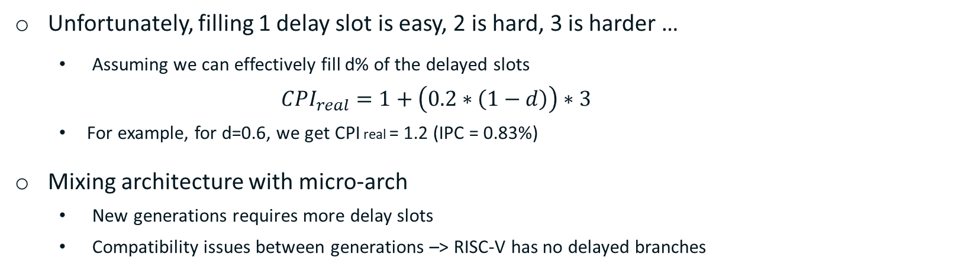
Decision 3: Delayed Branches
Unfortunately, filling 1 delay slot is easy, 2 is hard, 3 is harder …
Assuming we can effectively fill d% of the delayed slots
${CPI}_{real}=1+\left(0.2∗\left(1−d\right)\right)∗3$
For example, for d=0.6, we get CPI real = 1.2 (IPC = 0.83%)
Mixing architecture with micro-arch
New generations requires more delay slots
Compatibility issues between generations –> RISC-V has no delayed branches
Still far from the ideal and mixing Arch and uArch is almost always not the best decision.
Can we do something even better?

Slide 11
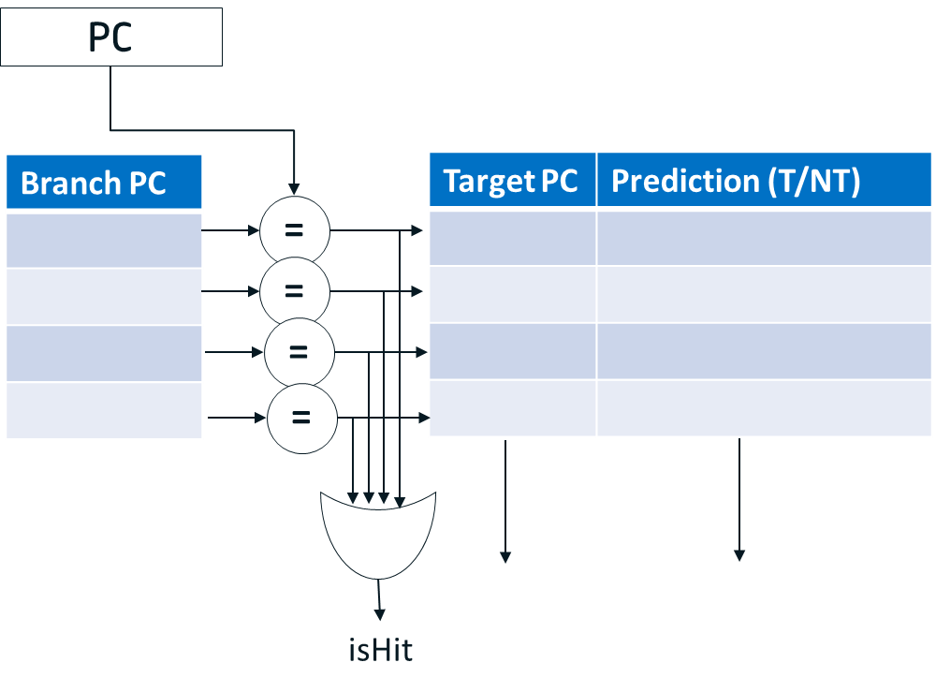
Decision 4: Dynamic prediction
Dynamic branch prediction approach:
As soon as branch is fetched (at IF stage) change the PC to the predicted path.
Switch to the right path after the branch execution if the prediction was wrong.
It required complex hardware at IF stage that will predicts:
Whether the instruction is a branch
Branch taken or not
Taken branch target
Structure performs such function is called Branch Target Buffer (BTB)
In fact, it is organized exactly as a cache

Slide 12
Using The BTB
PC moves to next instruction
Inst Mem gets PC
and fetches new inst
BTB gets PC
and looks it up
IF
yes
no
BTB Hit ?
yes
Br taken ?
no
IF/ID latch loaded
with new inst
PC ← pred addr
PC ← PC + 4
ID
Correct target?
IF/ID latch loaded
with pred inst
Flush pipe &
update PC
IF/ID latch loaded
with seq. inst
Branch ?
EXE
IF/ID latch loaded
with correct inst

Slide 13
Using The BTB
ID
yes
no
Branch ?
EXE
Calculate br
cond & trgt
continue
Update BTB
yes
Corect
pred ?
no
MEM
continue
Flush pipe &
update PC
WB
IF/ID latch loaded
with correct inst

Slide 14
Adding a BTB to the Pipeline
BTB
direction
Mis-prediction detector
branch IP
predictions
flush
target
direction
actual
target
direction
direction
updates
predicted
target
target
branch IP

Slide 15
Adding a BTB to the Pipeline
Flush
taken target
m
u
x
0
PC+4 (Not-taken target)
PCSrc
MEM
/WB
1
EX/MEM
2
3
IF/ID
ID/EX
Mis-
predict
Detection
Unit
predicted direction
predicted target
+
PC+4 (Not-taken target)
Shift
right 2
4
RegWrite
+
PC
BTB
Shift
left 1
Branch
Instruction
Read
reg 1
MemWrite
pred target
Read
reg 2
Read
data 1
ALUSrc
pred dir
Register File
Zero
MemtoReg
direction
Write
reg
Read
data 2
0
result
Address
Read
Data
1
target
m
u
x
ALU
m
u
x
alloc/updt
Write
data
4
−
address
1
Write
Data
Data
Memory
0
Address
[31-20]
ALU
Control
[11-7]
Sign
extend
MemRead
Instruction
Inst.
Memory
ALUOp

Slide 16
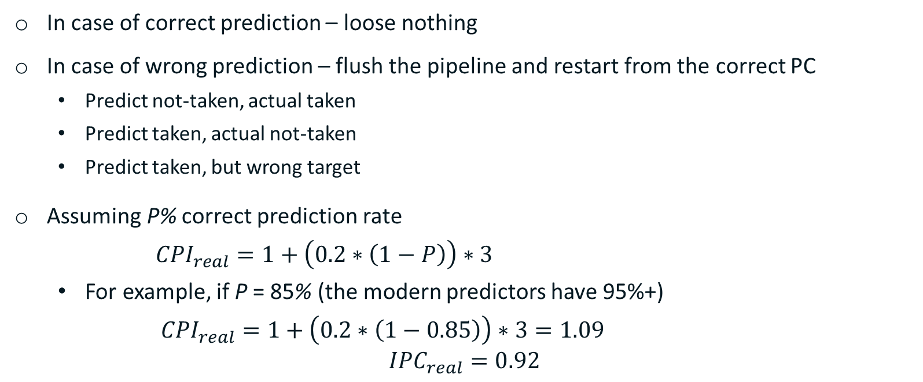
Performance of Dynamic Prediction
In case of correct prediction – loose nothing
In case of wrong prediction – flush the pipeline and restart from the correct PC
Predict not-taken, actual taken
Predict taken, actual not-taken
Predict taken, but wrong target
Assuming P% correct prediction rate
${CPI}_{real}=1+\left(0.2∗\left(1−P\right)\right)∗3$
For example, if P = 85% (the modern predictors have 95%+)
${CPI}_{real}=1+\left(0.2∗\left(1−0.85\right)\right)∗3=1.09$
$${IPC}_{real}=0.92$$

Slide 17

Methods of Branch Prediction

Slide 18
Option 1: Backward Jump Predictor
If target PC is behind than branch PC, predict taken
For most of the cases that would be a backward jump of loop
Loop branches are almost taken

Slide 19
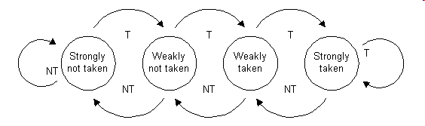
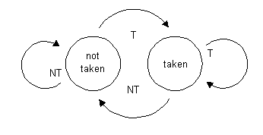
Option 2: Bimodal predictor
A saturating counter or bimodal predictor is a state machine with four states:
Advantages:
Small – only 2 bits per entry in the BTB
Predicts well branches with stable behaviour
Disadvantages
Cannot predict well branches which often change their outcome:
e.g. T, NT, T, NT, T, NT, T, NT, T, …

Slide 20
Why does bimodal BTB work?
Branches are usually used in loops
BTB trains on first iterations and predicts next ones correctly
Loops are not infinite, so once BTB will make a mistake
It won’t affect next outer loop iteration!
while (cond1) // branch 1
{
while (cond2) // branch 2
{
// ...
}
}
Branch 2 history: T, T, T, T, T, T, NT, T, T, T, T, T, T, NT, T, T, T, T, T, T, NT...

Slide 21
Option 3: Two-level adaptive predictor
present
future
past
Pattern history table
00
strongly
NT
weakly
NT
weakly
T
strongly
T
Branch sequence:
1 0 0 1 0 0 1 0 0
01
strongly
NT
weakly
NT
weakly
T
strongly
T
History buffer
10
strongly
NT
weakly
NT
weakly
T
strongly
T
Prediction:
0 0 0 0 0 1 0 0 0
11
strongly
NT
weakly
NT
weakly
T
strongly
T
TRUE
Result:
FALSE

Slide 22
Option 4: Global Prediction
Often branch condition depends on previous control path (branch correlates with other branches)
The idea is to provide prediction per branch history
Branch history is kept as a hash of previous branches (block chain)
Drawbacks:
# of possible “histories” is O(2^{N}), so some filtering is mandatory
Difficult to track and restore if pipeline is deep
There are Neural Network (Perceptron) Branch Predictors introduced

Slide 23

Overview of alternatives

Slide 24
Software Hints
Compiler may provide hints to branches (taken or not)
MIPS II provides “likely taken branches”, while old MIPS I branches are considered as “likely not taken branches”
RISC-V has no hints: BTB has low HW cost now
Cons:
Irremovable (but small) penalty as target is unknown at IF
Almost no value if CPU has a BTB

Slide 25
Predication
The idea is to convert control hazard to data hazard
Better if condition can’t be predicted by BTB
MIPS IV has 2 instructions: movn and movz
movz $d, $t, $s <=> if (t == 0) d = s;
movn $d, $t, $s <=> if (t != 0) d = s;
Example:
add $t0, $t1, $t2
bne $t0, $zero, cond
addi $t0, $t0, $1
cond:
div $t4, $t0
add $t0, $t1, $t2
addi $t3, $t0, $1
movn $t0, $t0, $t3
div $t4, $t0
x86 has a similar instruction cmov ARM has more advanced predication RISC-V has no predication

Slide 26
Summary
Control hazards exist in pipeline
There are many ways to overcome them:
do stalls
speculatively fetch “always-no-taken” path
use delayed branches
use compiler hints
use predication
The best way is dynamic branch prediction using:
direction (forward/backward)
local history
recent local history
global history

Slide 27
Thank You

Slide 28
Acknowledgments
These slides contain material developed and copyright by:
Lihu Rappoport (MAMAS/Intel), 234267, L2

