Slide 1
Sequential Circuits
Oleg Ladin
4 October 2021

Slide 2
Layers of Abstraction in Computer Science (CS)
Application
Algorithms
Programming Language
Operating System
Instruction Set Architecture
Microarchitecture
Gates/Register-Transfer Level (RTL)
Topics of
this lecture
Circuits
Physics

Slide 3
Reminder: Combinational Circuits
If the output of a function is completely defined by the current input, then the function is called combinational :
Qt = F(xt, yt, zt, …)
A lot of things can be implemented using combinational circuits
e. g. adder, decoder, multiplexer…

Slide 4
Sequential Circuits

Slide 5
Sequential Circuits
If the output of a function depends not only on the current input, but on the previous state, then the function is called sequential
Main advantage - ability to remember the previous state
Used to store information
Qt = F(xt, yt, zt, …, Qt-1)
Qt = F(xt, yt, zt, …, Qt-1)
F(xt-1, yt-1, zt-1, …, Qt-2))
F(xt-2, yt-2, zt-2, …, Qt-3)))

Slide 6
SR Latch: Overview
The simplest store element:
SR latch:
SR latch:
reset
reset
Q
Q
S | R | Qt-1 | Qt
Q
0
1
0
1
0
0
Q
Q
!Q
0
1
Q
0
!Q
1
0
Q
1
1
!Q
0
1
0
set
set
1
1
Q
0
Prohibited state
0
1
NOR:
x
out
x
out
x | y | out
0 | 0 | 1
0 | 1 | 0
1 | 0 | 0
1 | 1 | 0
y
y
≡
≡
out
0
out
y

Slide 7
SR Latch: Timing
reset
Q
S | R | Qt-1 | Qt
0 | 0 | Q | Q
0 | 1 | Q | 0
1 | 0 | Q | 1
1 | 1 | Q | 0
R
Q
S
!Q
!Q
set
S
1
0
The output will be determined by the fastest signal
R
1
0
Q
1
But, which signal will be really faster will depend on many factors (e.g., temperature).
?
0
!Q
1
?
0

Slide 8
D Latch
Data
S
!Q
D
Q
D | we | Qt-1 | Qt
D | 0 | Q | Q
0 | 1 | Q | 0
1 | 1 | Q | 1
R
Q
we
Write enable
Don’t have prohibited states
Asserted by a level of the write enable signal (we)
Store one bit of information
Can be used as building block for creating static memory arrays

Slide 9
Edge-triggered D Latch (D flip-flop)
D | we | Qt-1 | Qt
D
Q
D
0
Q
Q
D
1
Q
Q
clk (we)
D
↑
Q
D
D
↓
Q
Q
Don’t open for writing neither at we =0 nor at we =1
It is open for a very small amount of time when the write enable goes from 0 to 1
It is a trigger asserted by the positive edge of write enable signal
Such types of triggers are mostly used to organize pipelined execution
There are several common flip-flop / latch types:
SR (“set-reset”), D (“data” / “delay”), T (“toggle”), JK

Slide 10
Single port 2^{M}xN Memory Array
Memory array has 3 input signals and 1 output
Data buses are N bits wide (each chunk is N bits)
Address is M bits wide if 2^{M} is array size
address
address
M
2
Write enable
Write enable
Memory
Array
Memory
Array
N
1
N
1
input data
input data
output data
output data

Slide 11
Critical paths

Slide 12
What is a critical path of scheme?
Critical path is the slowest logic path in the circuit
Reliable result of whole logic path can not be ready until critical path is passed by signal

Slide 13
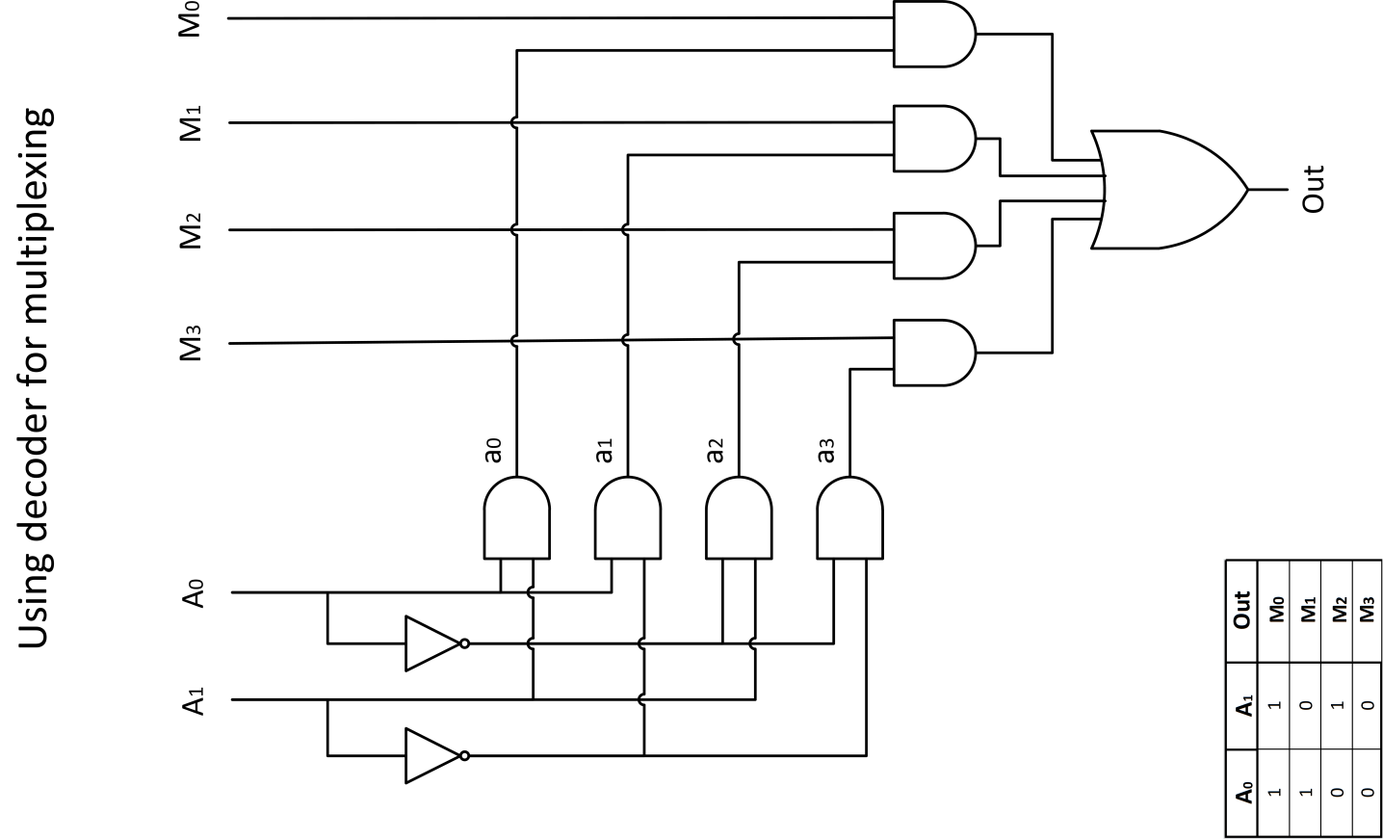
Example of critical path finding: Multiplexer
= 5t
1t
2t
1t
1t

Slide 14
Next time – practice
More examples of combinational and sequential circuits
You will need the Logisim app:
Install Java: https://www.java.com/ru/download/
Download Ligisim: https://sourceforge.net/projects/circuit/

Slide 15
Thank You

