Slide 1
Software Development Version Control Systems
18 October 2021
Kirill Korolev

Slide 2
What is version control
Management of changes to documents:
documents (articles, books, reports...), computer programs, images...
Traditionally people use revision numbering:
e. g. edition 1, edition 2 ...
This approach does not work well with software
There are many developers which work with many parts of the project

Slide 3
git — the best version control for software so far
Invented by Linus Torvalds to maintain changes to Linux kernel
First release: 7 April 2005
Git is more convenient in “digital world”, but requires some mind shift

Slide 4
git repository

Slide 5
Repository
is the main Git object
There are 2 ways to look at a repository:
Workspace – a file directory of your project
A database of changes made in the project
Git repository is a combination of 2 visions

Slide 6
Ch-ch-ch-ch-changes
git operates with per-line changes in files instead of whole files:
diff --git a/simulator/config.cpp b/simulator/config.cpp
index 55737c..d9855ab 10064
---a/simulator/config.cpp
+++b/simulator/config.cpp
@@ -13,7 +13,7 @@ namespace config {
static AliasedSwitch help_option = { “h”, “help”, “print help” };
/* basic method */
-void handleArgs( int argc, const char* argv[])
+void handleArgs( int argc, const char* const argv[])
{
BaseValue::options().parse( argc, argv);

Slide 7
Commit
is a group of changes with metadata
Represents a workspace state
Each commit includes:
a pointer to the previous commit
a description
author’s name and e-mail
a unique hash (e. g. 23fdc78f...)
Merge is a commit with 2 ‘parents’
+++
---
+++
---

Slide 8
Commit tree & refs
repository
main
All commits compose a commit tree
Some commits a labeled by refs
main or master points to the latest main version of the project
HEAD points to the current workspace state
workspace + commit tree + refs = git repository
+++
---
+++
---
+++
---
+++
---
+++
---
+++
---
HEAD
subproj1

Slide 9
Manipulations with repository

Slide 10
How to get a repository
There are 2 ways:
Create a new empty repository:
Make a local copy of an existing repository: git clone
A git workspace will be created
git init

Slide 11
git state machine
Untracked exist only in workspace
Unmodified
same in workspace and commit tree
git rm
git add
text editor
git commit
Staged
Modified different in workspace and commit tree
git add

Slide 12
How to work with the repository
merge conflict!
5 basic steps:
Update your local repository
Make your changes
Choose changes for a commit
Create a new commit
Send your commits to original repository
Steps 2-3 happens locally
Local and remote changes can conflict
a local copy of the original repository
1. git pull
2. make your changes
the original remote repository
3. git add [file1, file2...]
4. git commit –m “...”
5. git push

Slide 13
Resolving conflicts
A
B
clone
B
origin/main
Local and remote changes can conflict
2 ways to resolve:
merge - crate a “merge” commit
rebase - add commits one by one
A
C
D
A
B
a. merge
clone
main
A
C
A
B
main
clone
A
B
C
b. rebase
main

Slide 14
git pull
git pull is just an alias to do 2 commands at once:
git fetch - just get all new commits and refs from the remote repository
git merge - merge local main and the fetched remote main
git pull --rebase will call git rebase instead of git merge as the second command

Slide 15
Other useful commands
git help <command> - get info about any Git command
git status - get status of the current repository
git log - view a list of commits
git diff - view not committed changes
git show <commit> - view changes made by a commit
git branch <name> - create a new branch at the current commit
git checkout <ref> - switch to another ref (branch or tag)

Slide 16
GitHub

Slide 17
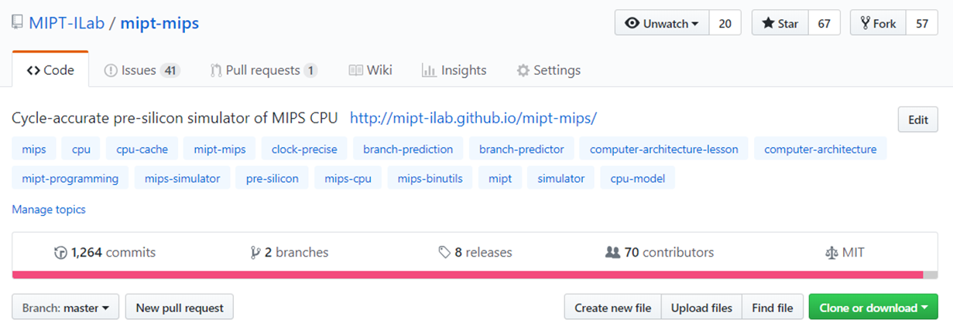
GitHub
is a website which provides remote hosting for Git repositories
Our repository on GitHub: https://github.com/MIPT-ILab/mipt-mips
Fork = git clone
Pull request = git push

Slide 18
Workflow
GitHub
local machine
create
a copy of the main repository on Github
create
a copy of the main repository on your local machine
fork
git clone
the main repository on GitHub
update
update
pull request
git push
update
git pull

Slide 19
Useful links
GitHub repository: https://github.com/MIPT-ILab/mipt-mips
GitHub Wiki: https://github.com/MIPT-ILab/mipt-mips/wiki
Git main page: https://git-scm.com/
Documentation, tutorials, cheat sheets: https://git-scm.com/doc
Downloads: https://git-scm.com/downloads
Pro Git book (EN/RU): https://git-scm.com/book/en/v2
Git flight rules (EN/RU): https://github.com/k88hudson/git-flight-rules

