Slide 1
MIPT-V 2021: Semester 2

Slide 2
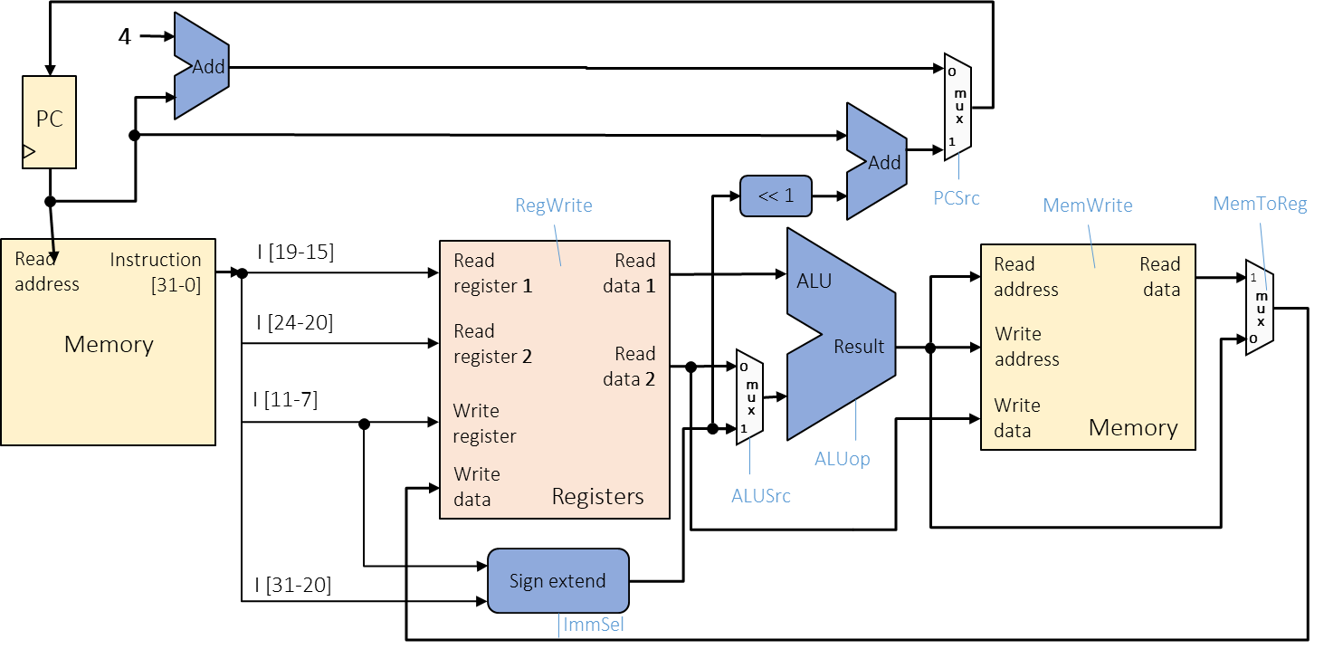
Semester 1 Refresher
Application
Application
Algorithms
Algorithms
Software (SW)
Programming Language
Programming Language
Operating System
Operating System
Instruction Set Architecture
Instruction Set Architecture
HW/SW interface
Microarchitecture
Microarchitecture
Gates/Register-Transfer
Gates/Register-Transfer Level (RTL)
Hardware (HW)
Circuits
Circuits
Physics
Physics

Slide 3
Caches: part 1
Kirill Korolev
7 February 2022

Slide 4
Agenda
Memory Wall
Spatial and temporal locality
Hardware implementations
Performance metrics
Software optimizations
Hardware optimizations
Prefetching
Replacement
Write handling
Multi-level cache organization

Slide 5
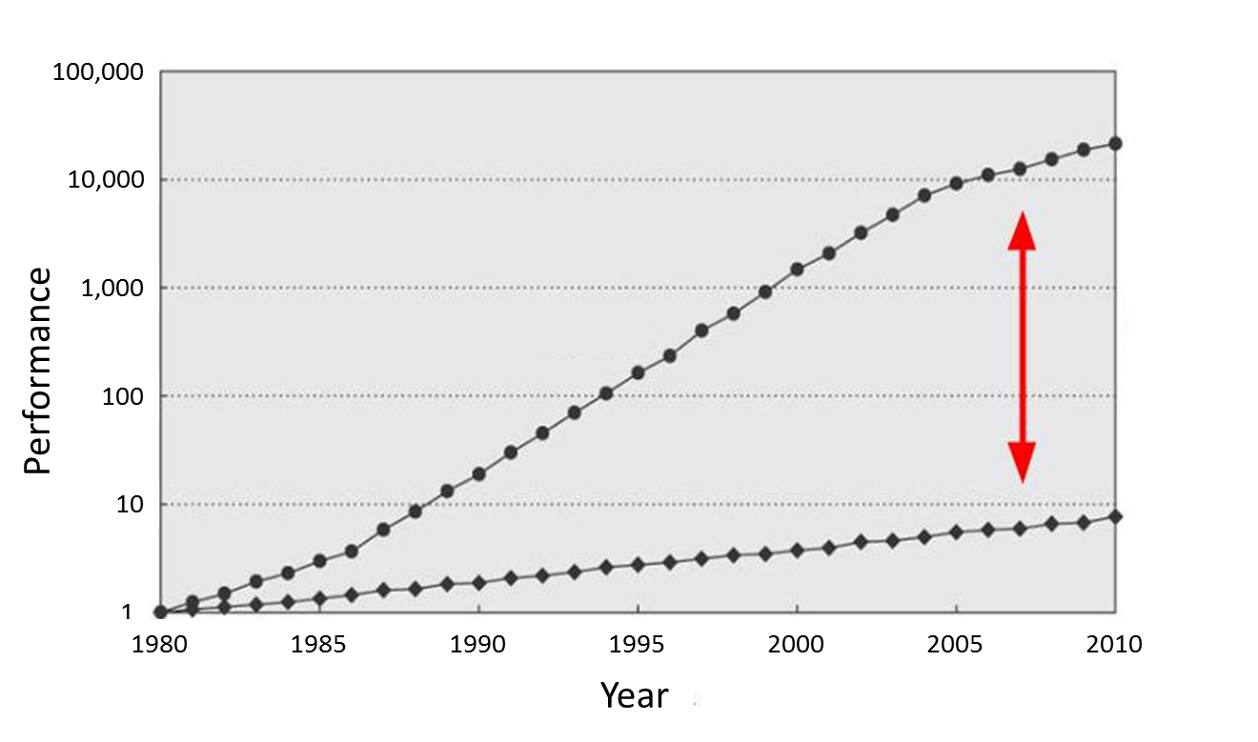
Memory Is Slow
CPU
60% per year
(Doubles every 1.5 year)
Performance gap
9% per year
(Doubles every 10 year)
DRAM

Slide 6
Why is memory slow?
Memory uses DRAM technology, while registers are SRAM
DRAM is slower, but cheaper
This is not the answer: may we use SRAM for memory?
DRAM cell
SRAM cell

Slide 7
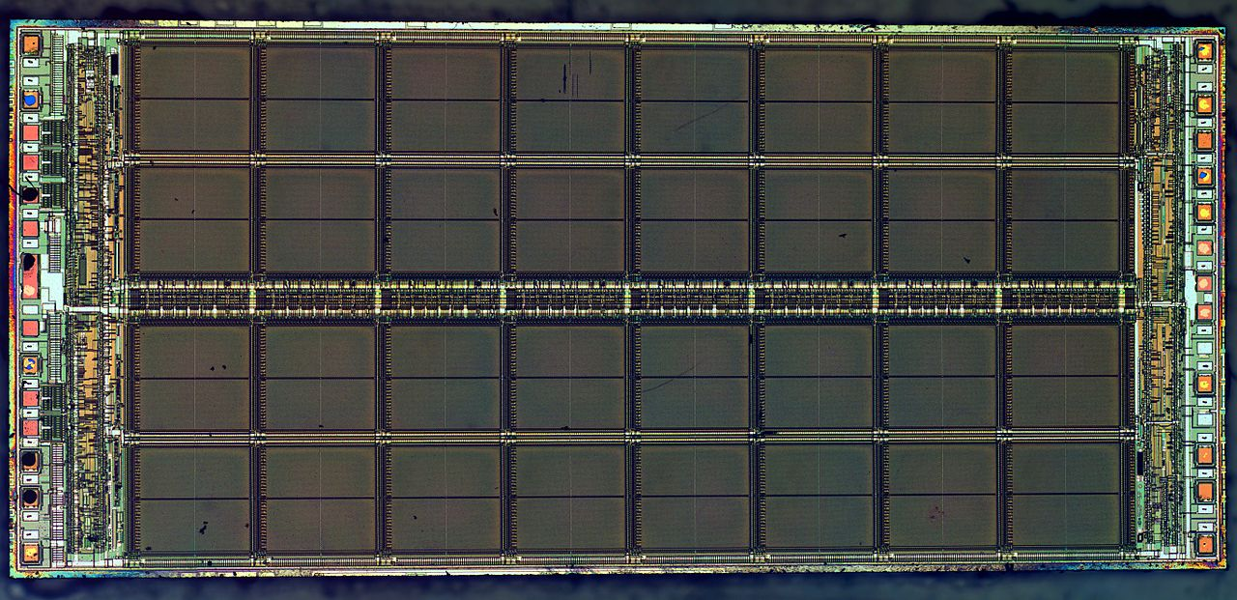
Correct answer is density/latency balance
Large memory arrays have large area, so wires have to be long
Large memory cannot be fast. Fast memory cannot be large.

Slide 8
Refresher: Pipeline limitations
Max speed of the pipeline is one instruction per clock
It is rare achievable in in-order processors due to dependencies among instructions and long latency operations
Load from the memory
F | D | E | M | W
 | F | D | E | M | W
 |  | F | D | E | M | W
M | W
 |  |  | F | D | E | M | W
 |  |  |  | F | D | E | M | W
 |  |  |  |  | F | D | E | M | W
F | Stall
D | E | M | W
F | D | E | M | W
 | F | D | E | M | W

Slide 9
Memory Hierarchy
Main memory is large, but too slow
Small memory is fast, but cannot hold all required data
Solution: take the best of both and combine
Memory hierarchy provides visibility that memory is usually fast
L3
Cache
Main Memory
L1
L2
CPU
smallest, but fastest
slowest, but largest

Slide 10
Real life example: Logistics
Factory
Your shop
Shop store
Large storehouse
Storehouse
The delay is decreased, but the cost is increased

Slide 11
Why Does It Work?
Temporal Locality (Locality in Time):
If an item is accessed, it will tend to be accessed again soon
Example: code and variables in loops
→ Keep recently accessed data closer to the processor
Spatial Locality (Locality in Space):
If an item is accessed, nearby items tend to be accessed soon
Example: scanning an array
→ Move contiguous blocks closer to the processor
Locality + smaller HW is faster memory → hierarchy

Slide 12
Localities are usually contradicting
Read of a large data array (data size >> cache size) has spatial locality, but no temporal locality
Read of a single variable has temporal locality, but no spatial locality
for (size_t i = 0; i < N; ++i)
sum += a[i];
for (size_t i = 0; i < N; ++i)
sum += i + *a;

Slide 13
Cache implementation

Slide 14
Cache: Main Idea
The cache holds a small part of the entire memory
Need to map parts of the memory into the cache
Main memory is virtually partitioned into lines
Typical block size is 32 to 64 bytes
Blocks are aligned
The cache holds data by lines
Only a subset of the blocks is mapped to the cache at a given time
Address of lines is used as a key
Memory
#line
0
1
2
3
4
5
6
…
…
91
92
93
…
…
Cache
#line
2
91
4
5

Slide 15
Cache Lookup
Memory
Case 1: Cache Hit
The requested line is in the cache
The cache returns the requested line (fast)
line#
0
1
2
3
4
5
6
…
…
91
92
93
…
…
Cache
line#
2
91
5
hit
4
4?
CPU

Slide 16
Cache Lookup
Memory
Case 1: Cache Hit
The requested line is in the cache
The cache returns the requested line (fast)
Case 2: Cache Miss
The requested line is not in the cache
Need to fetch it from the main memory (slow) and fill the cache
May need to evict another line from the cache to free space for the new one
line#
0
1
2
3
4
5
6
…
…
91
92
93
…
…
Cache
line#
91
5
2
93
miss
93?
4
93?
CPU

Slide 17
Fully Associative Cache
Address
64 | 5 | 0
Tag = line# | Offset
Tag
Array
Data
Array
Line may be mapped to any cache entry
Lookup line in all entries
Address is partitioned to
Offset within a line (byte#)
Line # (so-called tag)
Each cache entry has a tag
All tags are compared to the line# in parallel
If one of the tags matches the line#, we have a hit
63
0
0
1
…
511
=
=
…
…
=
…
hit/miss
data

Slide 18
Direct Mapped Cache
Address
64 | 14 |  | 5 | 0
Tag | Set |  | Offset
Data
Array
Line is mapped to the fixed entry only
Lookup line in one entry
Address is partitioned to
Offset within a line (byte #)
Set (fixed cache entry #)
Tag (works as a key)
Conflicts are possible
If several lines are mapped to the same entry, only one can reside in the cache
Tag Array
set#
63
0
0
1
…
511
…
=
hit/miss
data

Slide 19
2-Way Set Associative Cache
Conflicts are harmful → multi-ways cache is a solution
Each set holds two entries (way 0 and way 1)
Each line can be mapped into one of two entries in the appropriate set
Address
64 | 13 |  | 5 | 0
Tag | Set |  | Offset
way #0
way #1
Tag Array
Data Array
Tag Array
Data Array
set#
63
0
set#
63
0
0
1
…
255
0
1
…
255

Slide 20
2-Way Set Associative Cache
#lines = cache_size / line_size
#sets = #lines / #ways
offset_bits = log(line_size)
set_bits = log(#sets)
Address
64 | 13 |  | 5 | 0
Tag | Set |  | Offset
Tag Array
Data Array
#lines = 32KB / 64B = 512
#sets = 512 / 2 = 256
offset_bits = log(64) = 6
set_bits = log(256) = 8
way #0
way #1
way #0
way #1
set#
set#
63
0
63
0
0
1
…
255
0
1
…
255
=
=
MUX
hit/miss
data

