Slide 1
Arithmetic Circuits
Igor Smirnov

Slide 2
Topics of The Lecture
Register-Transfer Level (RTL)
Gates
Circuits
Devices (Transistors)
Physics
Fig.: Position in the layers of abstraction

Slide 3
Refresher: Adder
Half Adder (HA)
Full Adder (FA)
take into account the carry from the previous digit
x0
x0 | y0 | s0 | c0
0 | 0 | 0 | 0
0 | 1 | 1 | 0
1 | 0 | 1 | 0
1 | 1 | 0 | 1
ci-1
xi | yi | ci-1 | si | ci
0 | 0 | 0 | 0 | 0
0 | 1 | 0 | 1 | 0
1 | 0 | 0 | 1 | 0
1 | 1 | 0 | 0 | 1
0 | 0 | 1 | 1 | 0
0 | 1 | 1 | 0 | 1
1 | 0 | 1 | 0 | 1
1 | 1 | 1 | 1 | 1
s0
y0
xi
HA
si
HA
yi
c0
Fig.: truth table of HA
Fig.: HA schematic
Fig.: FA schematic
ci
ci-1
Fig.: truth table of FA
x0
HA
xi
FA
y0
s0
yi
si
c0
ci
Fig.: HA symbol
Fig.: FA symbol

Slide 4
Ripple-Carry Adder
xn-1
yn-1
x2
y2
x1
y1
x0
y0
cn-1
ci-1
c1
c0
FA
…
FA
FA
HA
Overflow detection
If cn-1 = 1, then result cannot fit into n digits
sn-1
s2
s1
s0
Fig.: schematic of N-digit Ripple-Carry Adder
What about subtraction and negative numbers?

Slide 5

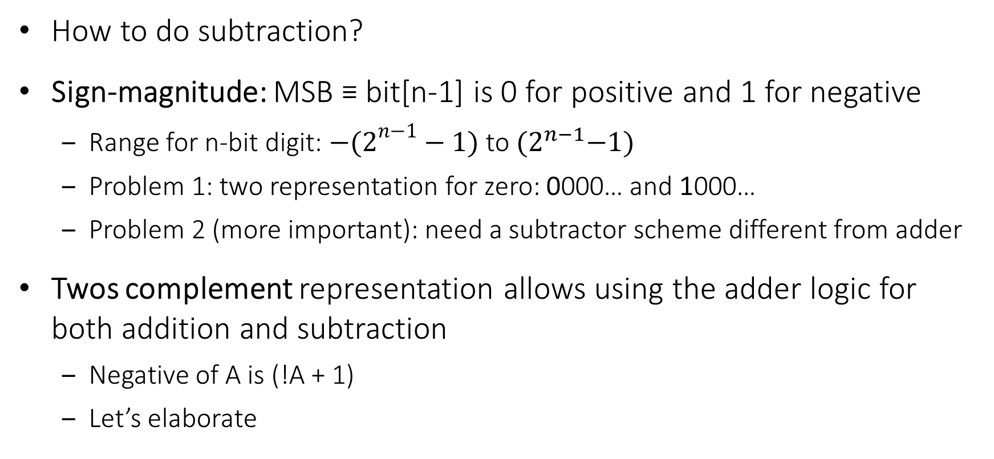
Negative Numbers
How to do subtraction?
Sign-magnitude: MSB ≡ bit[n-1] is 0 for positive and 1 for negative
Range for n-bit digit: ${−(2}^{n−1}−1)$ to ${(2}^{n−1}−1)$
Problem 1: two representation for zero: 0000… and 1000…
Problem 2 (more important): need a subtractor scheme different from adder
Twos complement representation allows using the adder logic for both addition and subtraction
Negative of A is (!A + 1)
Let’s elaborate
→ How to represent negative numbers?
Notes:
Twos complement representation - Дополнительный код

Slide 6
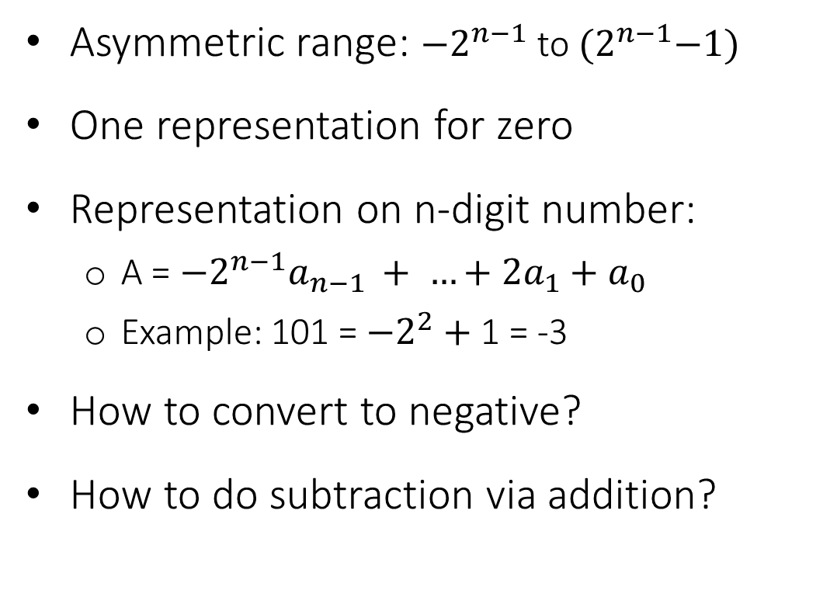
Twos Compliment Representation
Asymmetric range: ${−2}^{n−1}$ to ${(2}^{n−1}−1)$
One representation for zero
Representation on n-digit number:
A = ${−2}^{n−1}a_{n−1 }+ …+2a_{1}+a_{0}$
Example: 101 = ${−2}^{2}+$1 = -3
How to convert to negative?
How to do subtraction via addition?
subtraction
0
addition
-1
000
+1
111
001
-2
110
010
+2
101
011
+3
-3
100
-4
overflow

Slide 7
Example of subtraction (1)
0
Example: 2 – 3 = ?
2 – 3 = 2 + (-3)
2 + (-3) = 010 + 101 = 111
111 = -1
-1
000
+1
111
001
-2
110
010
+2
0
-1
000
+1
101
011
+3
111
001
-3
100
-4
-2
110
010
+2
0
101
011
-1
-3
100
+3
000
+1
111
001
-4
-2
110
010
+2
101
011
+3
-3
100
-4

Slide 8
Example of subtraction (2)
0
Example: -1 – 3 = ?
-1 – 3 = -1 + (-3)
-1 + (-3) = 111 + 101 = 1100
100 = -4
-1
000
+1
111
001
-2
110
010
+2
0
-1
000
+1
101
011
+3
111
001
-3
100
-4
-2
110
010
+2
0
101
011
-1
-3
100
+3
000
+1
111
001
-4
-2
110
010
+2
101
011
+3
-3
100
-4

Slide 9
Overflow
Example: -2 – 3 = ?
-2 – 3 = -2 + (-3)
-2 + (-3) = 110 + 101 = 1011
011 = 3 → Overflow ☹
Overflow conditions
negative + negative = positive
positive + positive = negative
How to check in HW?
If Cn-1 != Cn-2 then overflow
0
-1
000
+1
111
001
-2
110
010
+2
0
-1
000
+1
101
011
+3
111
001
-3
100
-4
-2
110
010
+2
0
101
011
-1
-3
100
+3
000
+1
111
001
-4
-2
110
010
+2
101
011
+3
-3
100
-4

Slide 10
Convert to Negative
How to convert to negative?
School math: – B = (-1 – B) + 1
What is (-1 – B)?
Thus, – B = !B + 1
0
→ Inversion
-1
000
+1
111
001
-1
1 | … | 1 | 1 | 1
Bn-1 |  | B2 | B1 | B0
1 | … | 1 | 1 | 1
Bn-1 |  | B2 | B1 | B0
!Bn-1 |  | !B2 | !B1 | !B0
–
B
-2
110
010
+2
!B
101
011
+3
-3
100
-4

Slide 11
Example of Converting to Negative (1)
Example: -3 = ?
-3 = !3 + 1
-3 = !(011) + 001 = 100 + 001 = 101
-3 = 101
0
0
0
-1
000
+1
-1
000
+1
-1
000
+1
111
001
111
001
111
001
-2
110
010
+2
-2
110
010
+2
-2
110
010
+2
101
011
+3
101
011
+3
101
011
+3
-3
100
-3
100
-3
100
-4
-4
-4

Slide 12
Example of Converting to Negative (2)
Example: -B = 110, B = ?
B = - (-B)
B = (!(-B)+ 1)
B = !(110) + 001 = 001 + 001 = 010 = 2
0
0
0
-1
000
+1
-1
000
+1
-1
000
+1
111
001
111
001
111
001
-2
110
010
+2
-2
110
010
+2
-2
110
010
+2
101
011
+3
101
011
+3
101
011
+3
-3
100
-3
100
-3
100
-4
-4
-4

Slide 13
Adder/Subtractor Schematic
yn-1
!yn-1
y2
!y2
y1
!y1
y0
!y0
0
1
0
1
0
1
0
1
…
xn-1
x2
x1
x0
cn-1
FA
cn-2
ci-1
c1
c0
subtract?
…
FA
FA
FA
sn-1
s2
s1
s0
Fig.: schematic of N-digit Ripple-Carry Adder/Subtractor
Calculation time is O(n)
Carry of each digit depends on the carry of the previous digit
Can we do faster?
overflow

Slide 14
Carry Delay
Carry calculation requires switching 2 gates in worst case
Delay of n-digit ripple adder:
T ≈ n*2t, where t is gate delay
ci-1
xi
si
yi
ci

Slide 15



Carry Lookahead Adder
Can we calculate carry faster?
Propagate/generate functions
Is it faster?
xi | yi | ci-1 | ci | Carry status
0 | 0 | 0 | 0 | kill
0 | 1 | 0 | 0 | propagate
1 | 0 | 0 | 0 | propagate
1 | 1 | 0 | 1 | generate
0 | 0 | 1 | 0 | kill
0 | 1 | 1 | 1 | propagate
1 | 0 | 1 | 1 | propagate
1 | 1 | 1 | 1 | generate

Slide 16
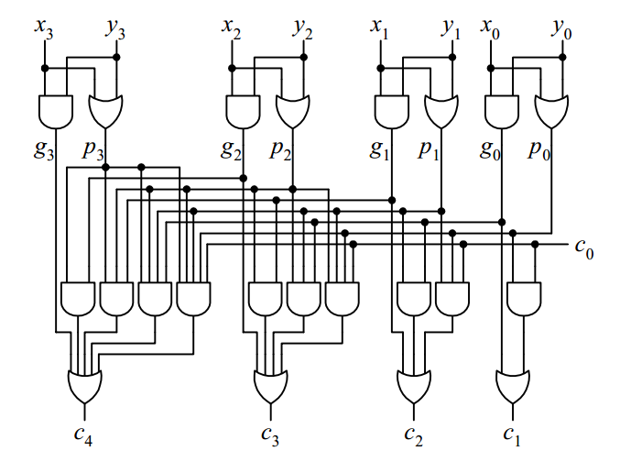
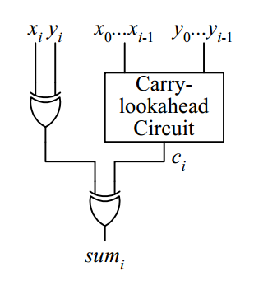
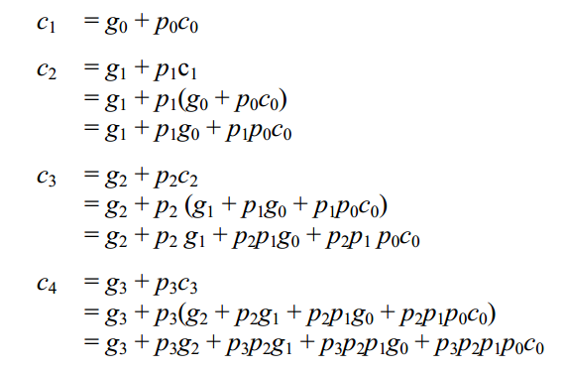
4-digit Carry Lookahead Adder
Fig.: Carry Lookahead Adder schematic
Fig.: Carry-lookahead circuit
T = t + log2(n + 1)*t + log2(n + 1)*t ≈ 2log2(N)*t
Compare to ripple adder: T ≈ 2N*t

Slide 17
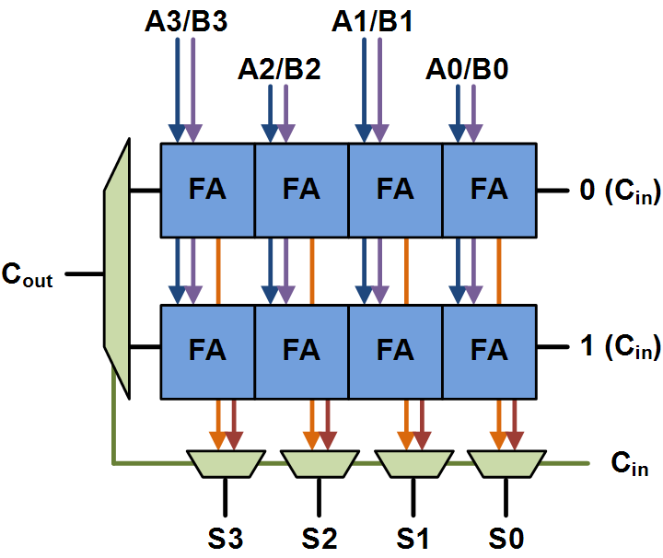
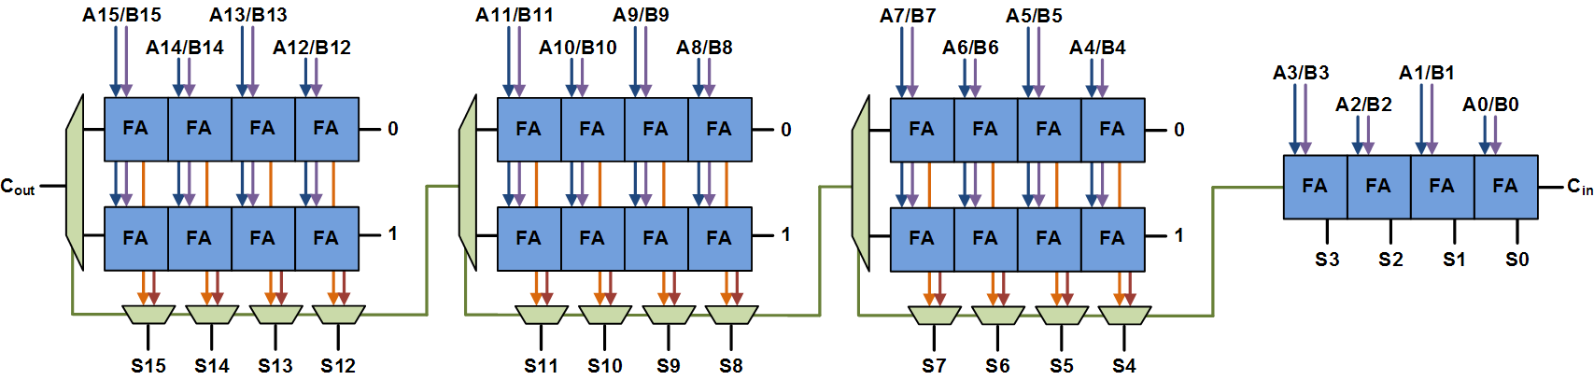

Carry-select Adder
Consists of two ripple carry adders and a multiplexer
Speculatively calculate sum twice (in case carry is 0 & 1)
Correct sum carry-out selected with the mux once the correct carry-in is known
Optimal delay occurs for a block size of $\left\lfloor \sqrt{N}\right\rfloor$
16-bit adder’s delay: 4xFA delays + 3xMUX delays.
Fig.: Basic block of a carry select adder
Fig.: 16-bit carry select adder where each chunk is 4 bits

Slide 18
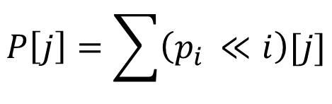

Multiplication
The simplest way to multiply numbers is to do multiple addition
+
1 | 0 | 1 | 1
+
a
1 | 1 | 1 | 0
b
$$p_{i}\left[j\right]=a\left[j\right] \& b\left[i\right]$$
+
0 | 0 | 0 | 0
+
p0
$$P\left[j\right]=\sum{\left(p_{i }≪i\right)[j]}$$
+
1 | 0 | 1 | 1
+
p1
+
1 | 0 | 1 | 1
+
p2
1 | 0 | 1 | 1
p3
1 | 0 | 0 | 1 | 1 | 0 | 1 | 0
P

Slide 19
p-generation
a[3]
a[3]
a[3]
a[3]
a[3]
a[3]
a[3]
a[1]
a[0]
a[2]
a[0]
a[2]
b[0]
b[0]
b[1]
b[1]
b[2]
b[2]
b[3]
b[3]
0
p3[6]
p2[5]
p1[4]
p0[3]
p3[3]
p2[2]
p1[1]
p0[0]
p3[3]
p2[2]
p1[1]
p0[0]
p3[2]
p3[1]
p3[0]
p2[1]
p3[5]
p2[4]
p1[3]
p0[2]
p3[4]
p2[3]
p1[2]
p0[1]
p2[0]
p1[0]

Slide 20
Multiplier
a[3]
b[3]
a[2]
b[2]
a[1]
b[1]
a[0]
b[0]
p-generator
p3
p2
p1
p0
+
+
+
P

Slide 21
Questions?

