Slide 1
Digital Integrated Circuits Design Lecture 1: Introduction
Igor Smirnov

Slide 2
Intro
Who am I?
Hardware Architect
10 years in hardware industry
5 years of teaching experience
Why are we here?
To study key concepts in the circuit design (CD) – major part of Computer Engineering
To better understand modern design tradeoffs and limitation
Useful even for “SW persons”: it is always good to see “the whole picture”
BTW, it is about how Intel makes money

Slide 3

ONE DOES NOT SIMPLY
STUDY COMPUTER ENGINEERING

Slide 4
Layers of Abstractions in Computer Engineering
Your courses this year:
Application
Algorithms
Software (SW)
Andrey Dobrov
Programming Language
Computer Science
(CS)
Operating System
Interface between HW and SW
Pavel Kryukov
Instruction Set Architecture
Microarchitecture
Register-Transfer Level (RTL)
Gates
Hardware (HW)
Electrical Engineering
(EE)
This course
Circuits
Devices (Transistors)
Physics

Slide 5
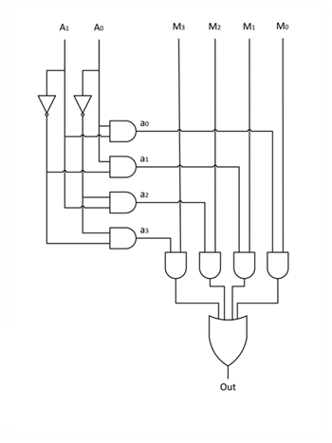
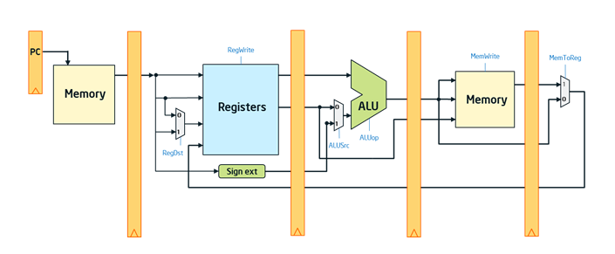
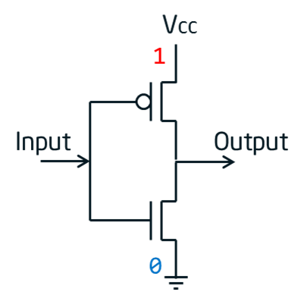
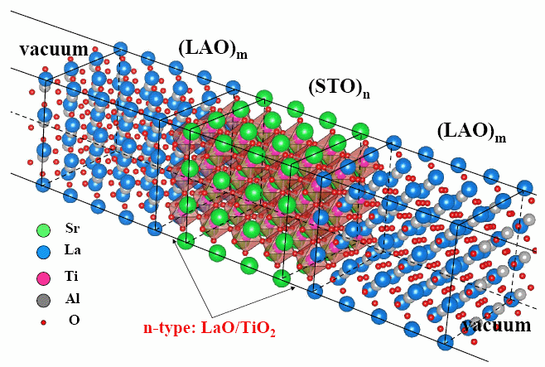
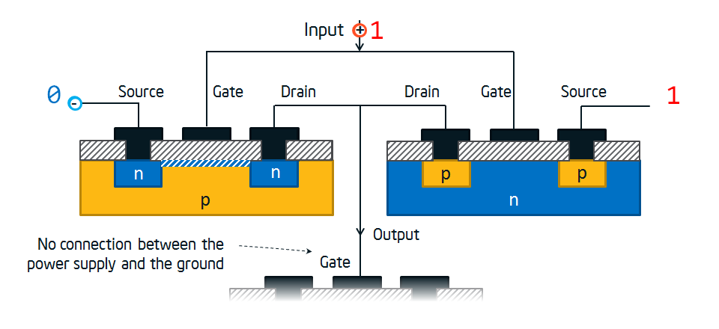
This course focus
Microarchitecture
Register-Transfer Level (RTL)
Gates
Circuits
Devices (Transistors)
Physics

Slide 6
Reminder: Perf, Power, Cost

Slide 7
Basic Design Tradeoffs
Performance
(speed)
CE Triangle
Cost
(complexity, area)
Energy
and
Power
All three are very important
It is extremely hard to create a feature that improves all of them
Different products (mobile, server, etc.) require different balances

Slide 8
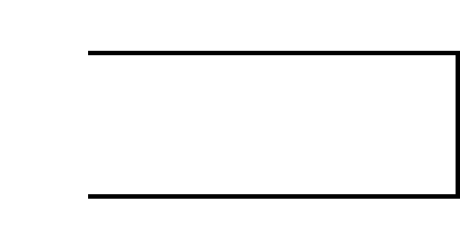
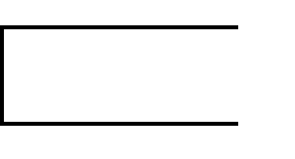
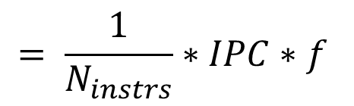
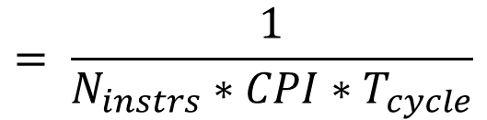


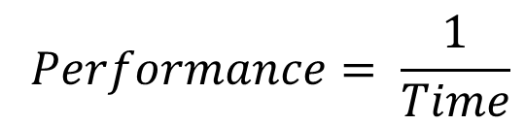
Performance
What does performance depend on?
Instructions Per Clock
$$Performance= \frac{1}{Time}$$
$$= \frac{1}{N_{instrs}∗CPI∗T_{cycle}}$$
$$= \frac{1}{N_{instrs}}∗IPC∗f$$
$$Time=Cycles∗T_{cycle}$$
$$=N_{instrs}∗CPI∗T_{cycle}$$
Performance Golden Rule
Clocks Per Instruction

Slide 9
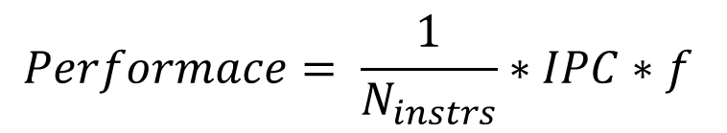
Increasing Performance
How can we increase it?
SW: algorithms, optimizations, ISA, etc.
CD: faster circuits, smaller transistors, etc.
$$Performace= \frac{1}{N_{instrs}}∗IPC∗f$$
uArch: pipelining, caching, prediction, etc.
But, CD enables these approaches
(e.g., more transistors)

Slide 10
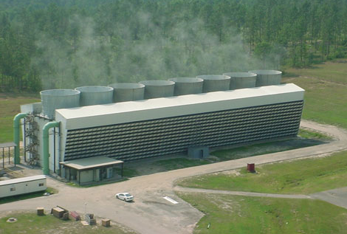
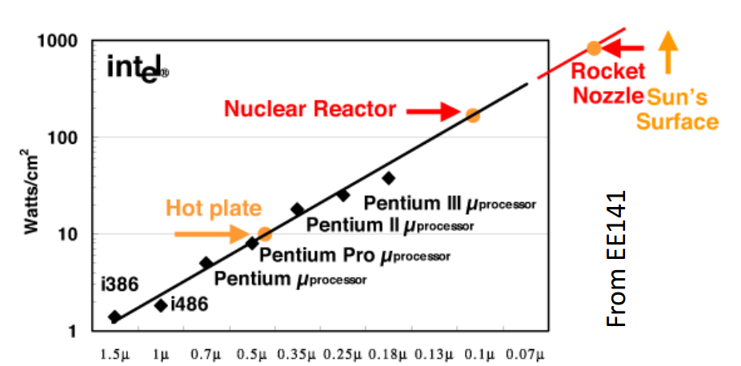
Energy Consumption
Nuclear reactor? No, power supply for a large data center
Why is power important?
Less power -> smaller battery -> smaller/cheaper devices
Less power -> less money for electricity
Power Wall is reached
The maximum power dissipation that cooling systems can handle is reached
We cannot spend more power even
if we want

Slide 11
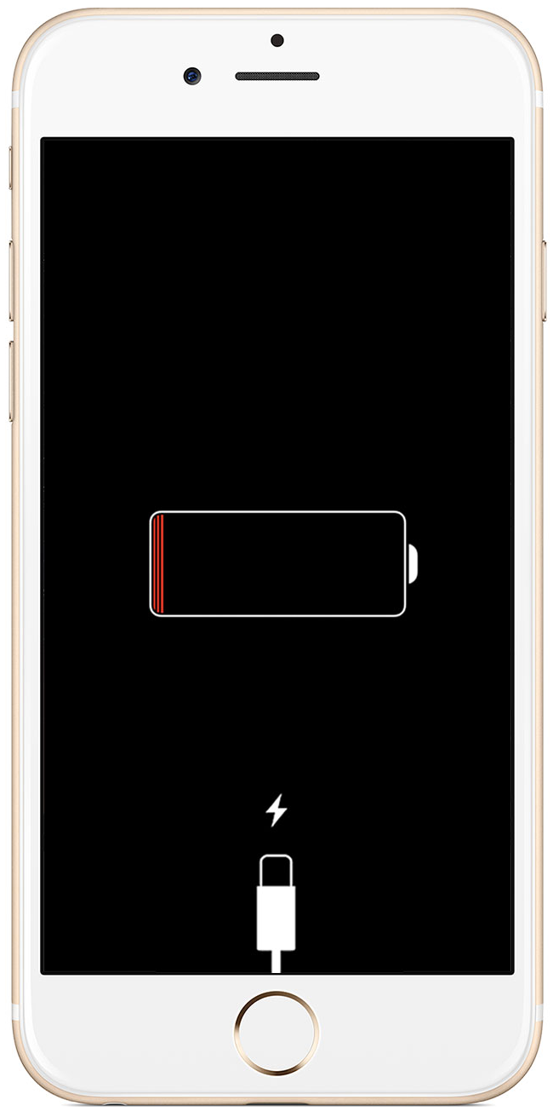
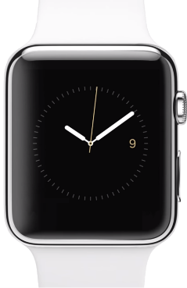
Energy
Why is energy per task important?
Battery life of a device
Less energy -> longer battery life or smaller battery
Smaller battery -> smaller devices (e.g., wearables)
Electricity bills
Less energy -> less money for electricity
Huge expense item for large data centers
A nuclear reactor?
No, power supply for a large data center

Slide 12
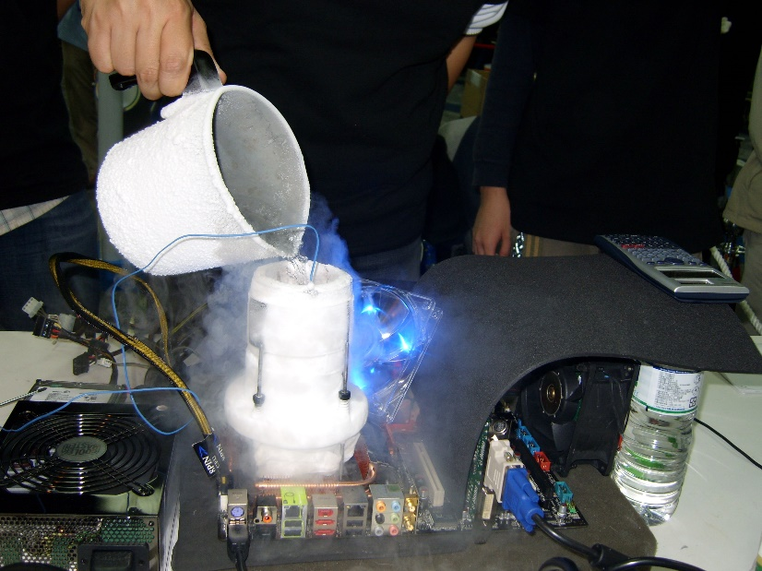
Power
Why is power important?
Power Wall has been reached
Reasonable cooling systems cannot handle more power
New reality: we cannot spend more power even if we want
Power Wall
Too expensive and unreliable

Slide 13

Dynamic Power
Two components: dynamic + static
Dynamic power is caused by changing an input signal
It looks like we repeatedly recharge capacitors
How to decrease it?
Decrease frequency…
but it decreases performance
$$P_{dyn}=C_{dyn}∗V^{2}∗f$$
Better uArch and CD:
decrease number of transistors and wires,
decrease number of signal changes
Decrease voltage…
but it decreases transistor switching speed -> makes us decrease frequency -> decrease performance

Slide 14
Static Power
Two components: dynamic + static
Static power is caused by leakage currents in transistors
The smaller transistor the larger leakage
It is roughly proportional to chip area
How to decrease static power?
Switch off unused transistors (power gating)
New types of transistors (e.g., Intel’s 3d transistor)
New types of materials

Slide 15
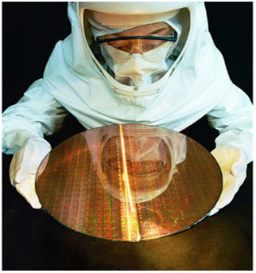
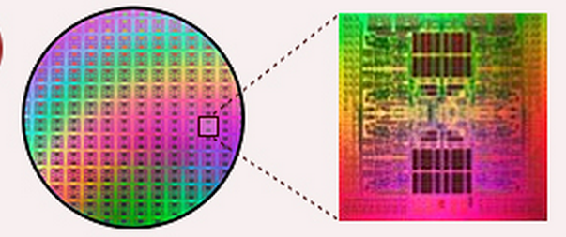
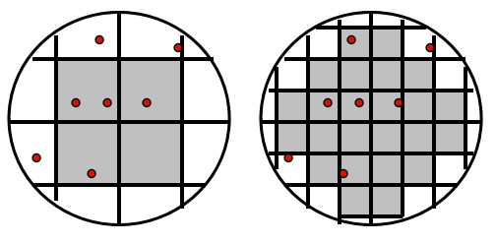
Cost
Fixed Cost (RnD)
Independent of volume (i.e., number of units made/sold)
Examples: design time and effort, mask generation, etc.
Variable Cost (manufacturing/production)
proportional to volume
Examples: silicon processing, packaging, test
Most of these related to chip area
The larger chip size the large production cost
Less chips on one wafer
Larger probability of error
Yield = 1/4
Yield = 19/24

Slide 16
Questions?
Performance
(speed)
CS Triangle
Cost
(complexity, area)
Energy
and
Power

Slide 17
Orgs
9-10 lectures in semester
2 tests
1 attempt / test
Tests take one lecture slot
Final score is an average of 2 tests
Course materials: https://github.com/igorsmir-ilab/public
Contact mail: igor.smirnov@phystech.edu

