Slide 1
Secure Data Hiding in Images Using Steganography
CAPSTONE PROJECT
Presented By: Pranjal Prakash
Student Name: Pranjal Prakash
College Name: Lakshmi Narain College of Technology & Science Department: MCA

Slide 2
OUTLINE
Problem Statement
Technology used
Wow factor
End users
Result
Conclusion
Git-hub Link

Slide 3
Problem Statement
• Digital communication now demands methods that keep sensitive data hidden from unauthorized eyes. • Traditional encryption often signals the existence of secret data, attracting potential attacks. • Cyber threats are on the rise, necessitating covert communication channels. • Images serve as an ideal medium to camouflage secret messages without noticeable alterations. • Steganography embeds data directly within pixel values, preserving the overall image quality. • Maintaining data integrity and confidentiality is critical in today’s security landscape. • There is an ongoing need for robust methods that can resist advanced steganalysis techniques. • This approach ensures that only authorized users can access and decode the concealed information.

Slide 4
Technology used
Least Significant Bit (LSB) Substitution for data hiding.
OpenCV (cv2) for image processing in Python.
ASCII-based encoding and decryption algorithms.
Password protection for added security.
Automatic image modification and retrieval. Windows Operating System is used
Python Language is used in Visual Studio code

Slide 5
Wow factors
Secret messages are invisibly stored in images.
Only the correct password can decrypt the hidden data.
Data remains secure even if intercepted.
Simple yet effective cryptographic integration.
Image quality remains nearly unchanged after embedding.

Slide 6
End users
• Government & Military: Secure communication and intelligence operations. • Corporate Security Teams: Protection of trade secrets and sensitive business data. • Cybersecurity Professionals: Tools for secure data exchange and digital forensics. • Journalists & Whistleblowers: Safe channels to transmit confidential information. • Digital Rights Management Experts: Protecting intellectual property and media assets.

Slide 7
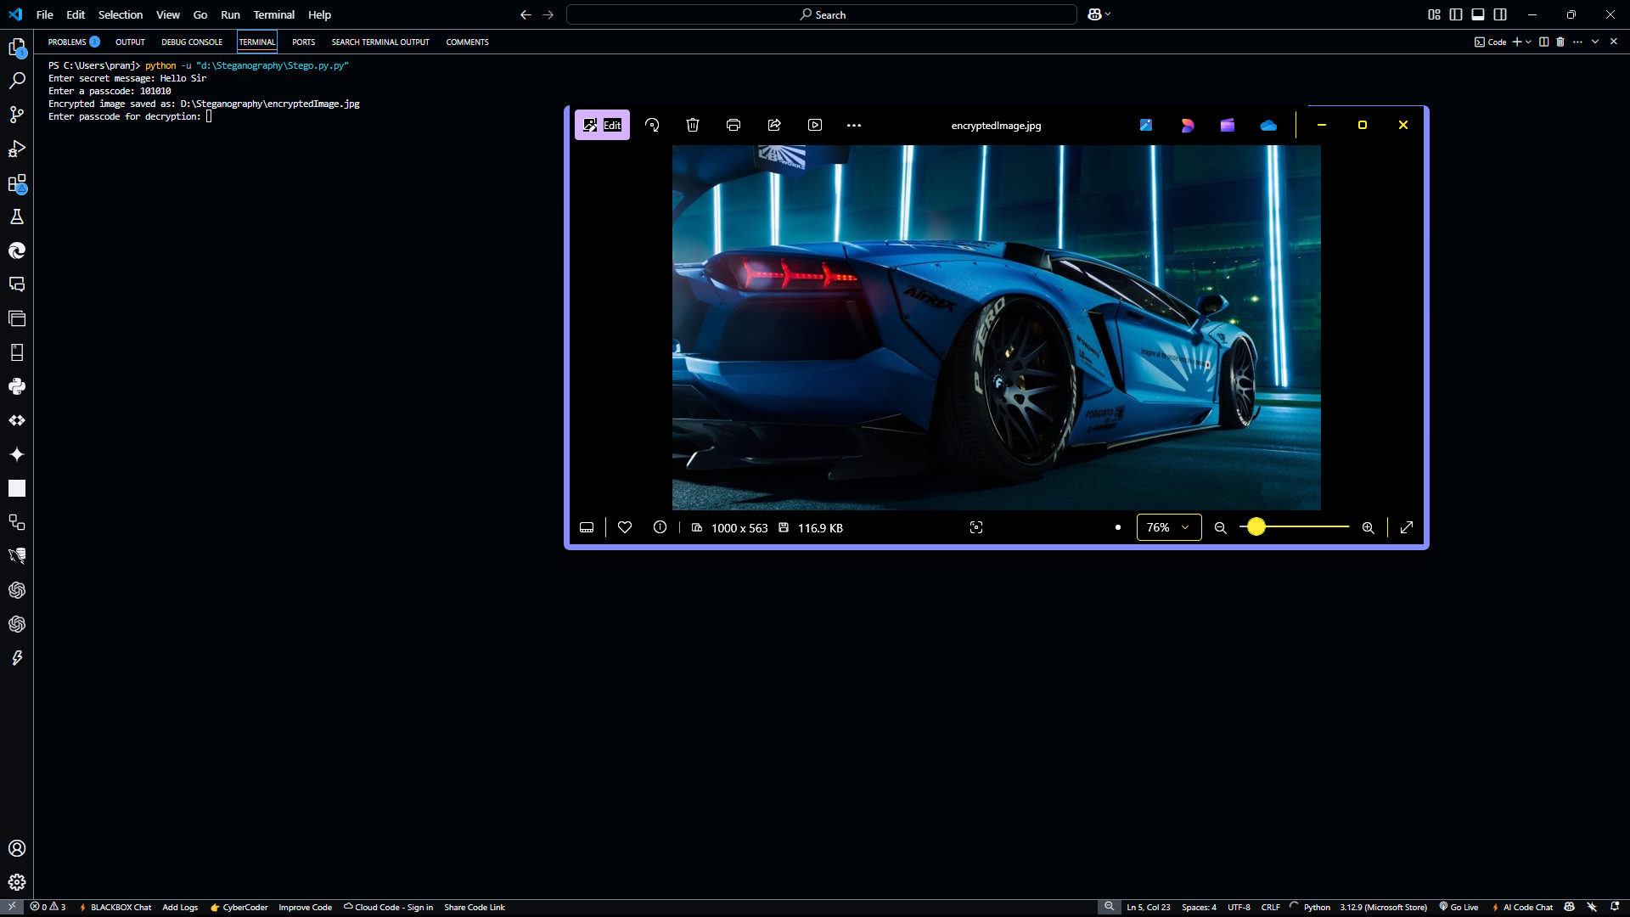


Results

Slide 8
Conclusion
• Steganography provides an innovative method for secure data hiding by embedding information directly into images. • The combination of advanced encryption with image-based data concealment offers unmatched security benefits. • It enables covert communication in environments where even the hint of secret data can attract unwanted attention. • As cyber threats evolve, this technique stands out as a resilient, adaptable solution for protecting sensitive information.

Slide 9
GitHub Link
https://github.com/MIRAGE1500/steganography.git

Slide 10
THANK YOU

