Slide 1

ProjectWork2(19AI703) – Review2
AI-Twin : AI-Powered Digital Twin for Personalized Assistance and Predictive Decision-Making
Submitted by:
MIRUDHULA D (212221230060)
JANANI R (212221230039)
2021-2025 Batch
TEAM NO:
Under the guidance of:
Dr. C.RAJARAJACHOZHAN M.E., Ph.D.,
Assistant Professor , Department of ECE
DEPARTMENT OF ARTIFICIAL INTELLIGENCE AND DATA SCIENCE
SAVEETHA ENGINEERING COLLEGE
(Autonomous Institution – UGC, Govt. of India)
(Affiliated to Anna University, Approved by AICTE - Accredited by NBA & NAAC – ‘A’ Grade - ISO 9001:2015 Certified)
Saveetha Nagar, Thandalam, Chennai-602 105, TamilNadu, INDIA.

Slide 2
Agenda
Introduction
Statement of the Problem
Scope of the project
Methodology
Architectural Diagram
Flow
Algorithm used
Design - Use Case Diagram, Class Diagram
Implementation
Important code segments
Output, Results
Test Cases
Conclusions
Future work
References

Slide 3
Introduction
AI-Digital Twin
AI-Twin is an AI-powered digital twin for personalized assistance and predictive decision-making.
It uses NLP and Machine Learning to understand user queries and provide intelligent responses.
The system integrates with calendars, IoT devices, and external APIs for enhanced functionality.
AI-Twin offers features like conversational AI, task management, and predictive analytics.
It ensures secure data handling while continuously adapting to user behavior.

Slide 4
Statement of the Problem
AI-Digital Twin
Challenge:
Managing daily tasks, schedules, and decision-making can be overwhelming for users.
Existing AI assistants lack deep personalization and predictive capabilities.
Users struggle with fragmented data across multiple apps and devices.
Objective: To develop an AI-powered digital twin that provides personalized assistance, predicts user needs, and automates tasks while ensuring data security and seamless integration across devices.

Slide 5
Scope of the project
AI-Digital Twin
Scope:
The AI-Twin system will offer personalized assistance by analyzing user interactions, predicting future needs, and automating daily tasks. It will integrate with various data sources, including calendars, IoT devices, and external APIs, ensuring seamless interaction through a conversational AI interface
Target Audience :
Individuals, professionals, students, and smart home users seeking AI-driven assistance for productivity, task management, scheduling, and automation.
Deliverables:
AI chatbot, a predictive system, a user interface, secure data management, and a deployed application for personalized assistance.

Slide 6
Scope of the project
AI-Digital Twin
Inclusions:
AI chatbot integrated with a calendar system.
Predictive recommendations for scheduling and task management.
Voice and text-based interactions.
Exclusions:
Hardware integration with IoT devices.
Real-time physical world interaction beyond digital automation.

Slide 7
Scope of the project
Pneumonia Prediction
Data:
User interaction data (text and voice inputs)
Calendar events and scheduling information
Preferences and behavioural data
Limitations:
Data Constraints: The system's effectiveness is dependent on the quantity and quality of user interaction data, calendar events, and other integrated data sources.
Model Generalizability: The AI models' performance may vary based on the diversity and representativeness of the training data, potentially affecting its ability to handle unique user behaviors or edge cases.
Accuracy of NLP: The accuracy of natural language processing (NLP) in understanding and interpreting user requests is crucial, and limitations in NLP technology may lead to occasional misunderstandings or errors.

Slide 8
Methodology
AI-Twin's methodology centers on utilizing AI models for predictive decision-making and a web-based platform for seamless interaction.
1. Requirement Analysis and System Design: Conduct a thorough analysis of user needs and project requirements. Define the scope of the AI-Twin system, including its functionalities and integrations. Develop a comprehensive system design, outlining the architecture, components, and data flow.
2. Data Collection and Preprocessing : Gather user interaction data, including text and voice inputs, calendar events, and scheduling information . Collect relevant data from integrated external APIs, as applicable. Preprocess the collected data to ensure quality and compatibility for AI model training.
3. AI Model Development and Training: Natural Language Processing (NLP) Model: Train a model like Mistral 7B to enable conversational AI, understand user requests, and generate appropriate responses. Predictive Modeling: Develop machine learning models to analyze user behavior, predict future needs, and provide predictive scheduling and task management recommendations.
4. Frontend and Backend Development:: Develop a user-friendly web-based interface using technologies like Streamlit for user interaction and task management. Implement the backend system using frameworks like FastAPI to handle user requests, process data, and integrate AI models.
5. Integration and Testing: Integrate the AI models with the frontend, backend, and database components. Conduct comprehensive testing to evaluate the system's performance, reliability, and usability:

Slide 9
Methodology
AI-Twin System Development includes
Analyzing user interactions and preferences.
Collecting and preprocessing user data and calendar events.
Developing and training the Mistral 7B NLP model.
Building machine learning models for predictive scheduling.
Designing and implementing the web-based user interface using Streamlit.
Integrating with Supabase for secure data storage.
Implementing the backend using FastAPI for API handling.
Conducting comprehensive testing, including unit, integration, and user acceptance testing.
Deploying the AI-Twin application for real-time accessibility.
Establishing monitoring and maintenance procedures.

Slide 10
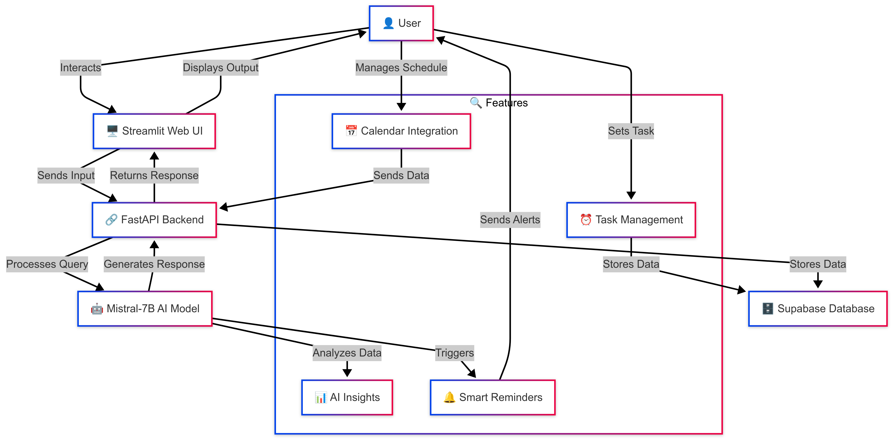
Architecture Diagram/Flow

Slide 11
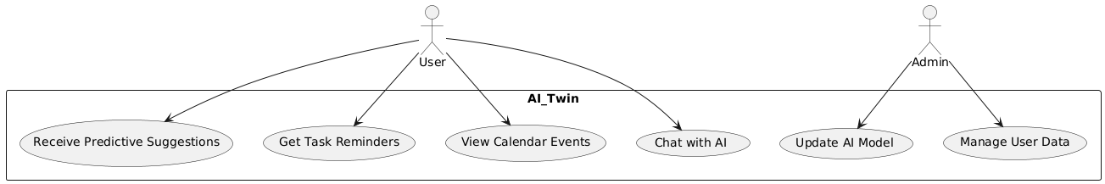
Design-Use Case Diagram
UML DIAGRAMS
Use case Diagram:A use case diagram is a graph of actors set of use cases enclosed by a system boundary, communication associations between the actors and users and generalization among use cases.
The use case model defines the outside (actors) and inside (use case) of the system’s behavior.
USER

Slide 12
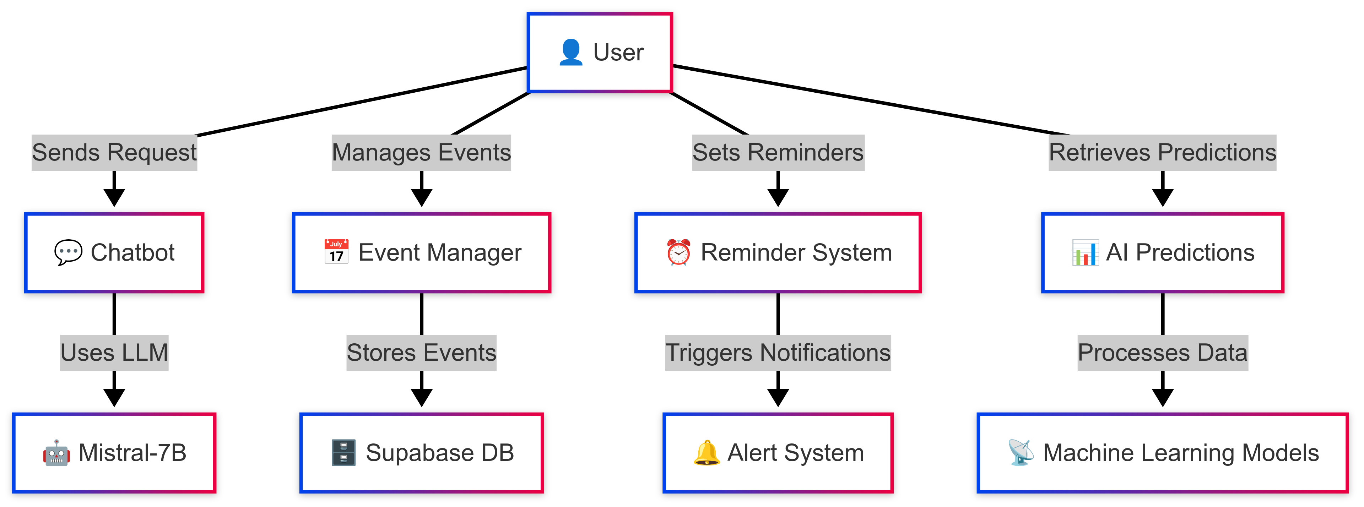
Design-Use Case Diagram
UML DIAGRAMS
ADMIN

Slide 13
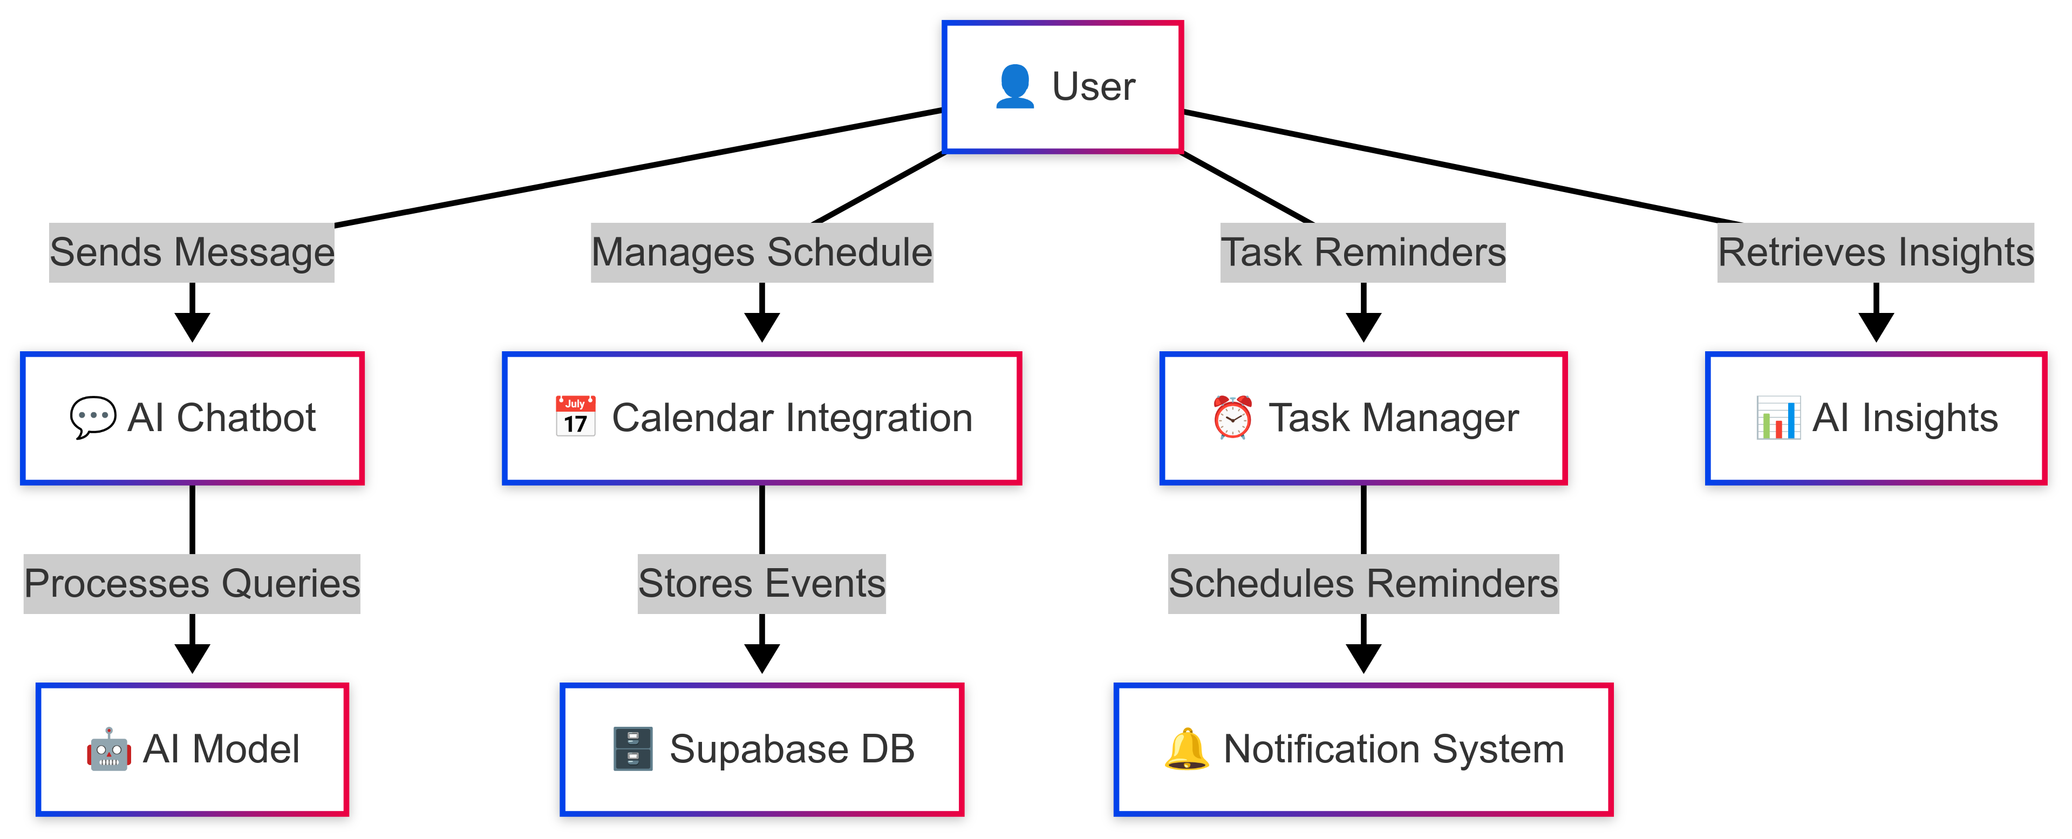
Design-Use Case Diagram
UML DIAGRAMS
AI-Twin Functionalities

Slide 14
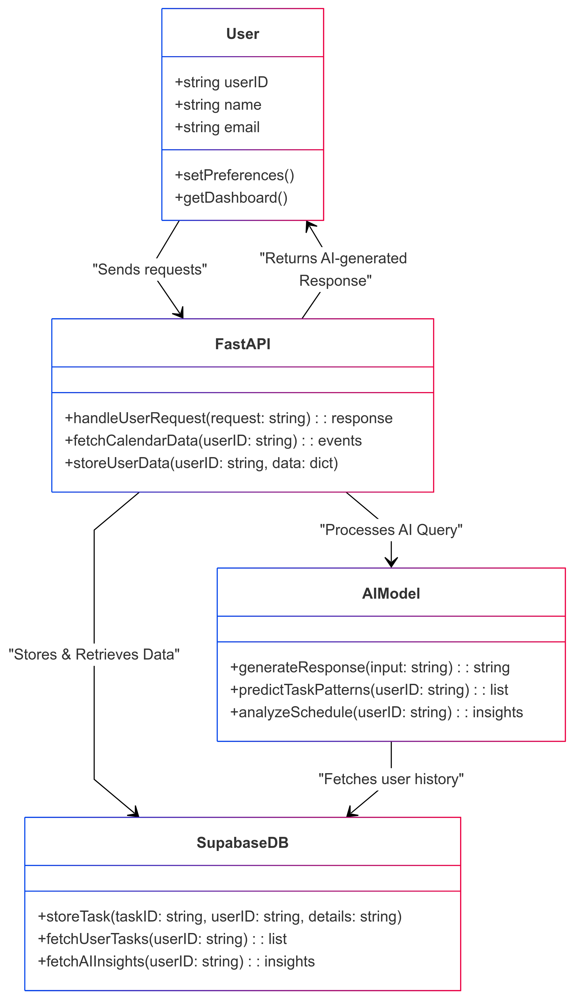
Design-Class Diagram
This class diagram visualizes the object-oriented structure of the AI-Twin system. It defines key components like User, AI Model, API, and Database, showcasing their attributes and relationships.

Slide 15
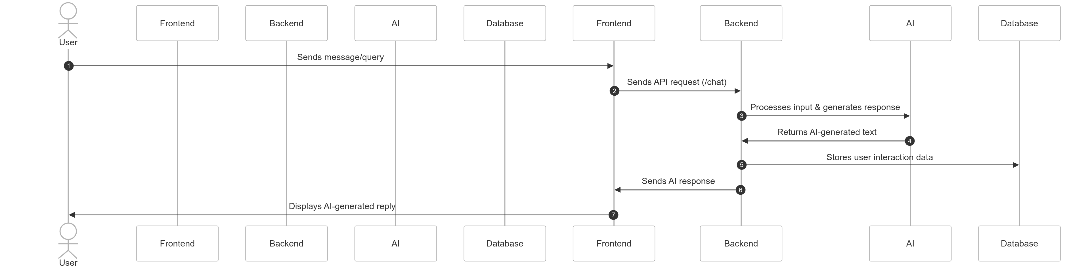
Sequence Diagram – AI- Digital Twin
This sequence diagram illustrates the end-to-end interaction of the user with the AI-Twin system. It shows how user requests are processed, AI responses are generated, and data is stored in the backend.

Slide 16
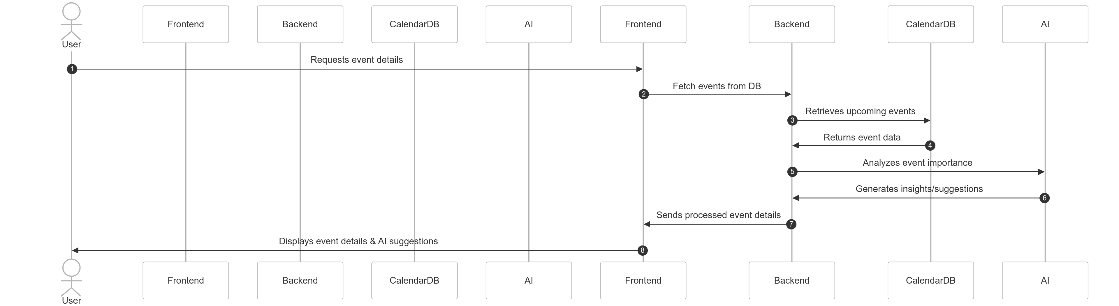
Sequence Diagram
This sequence diagram details how the AI-Twin chatbot processes user messages. It highlights how user inputs are sent to the backend, processed by the AI model, and responded to via the chat interface.

Slide 17
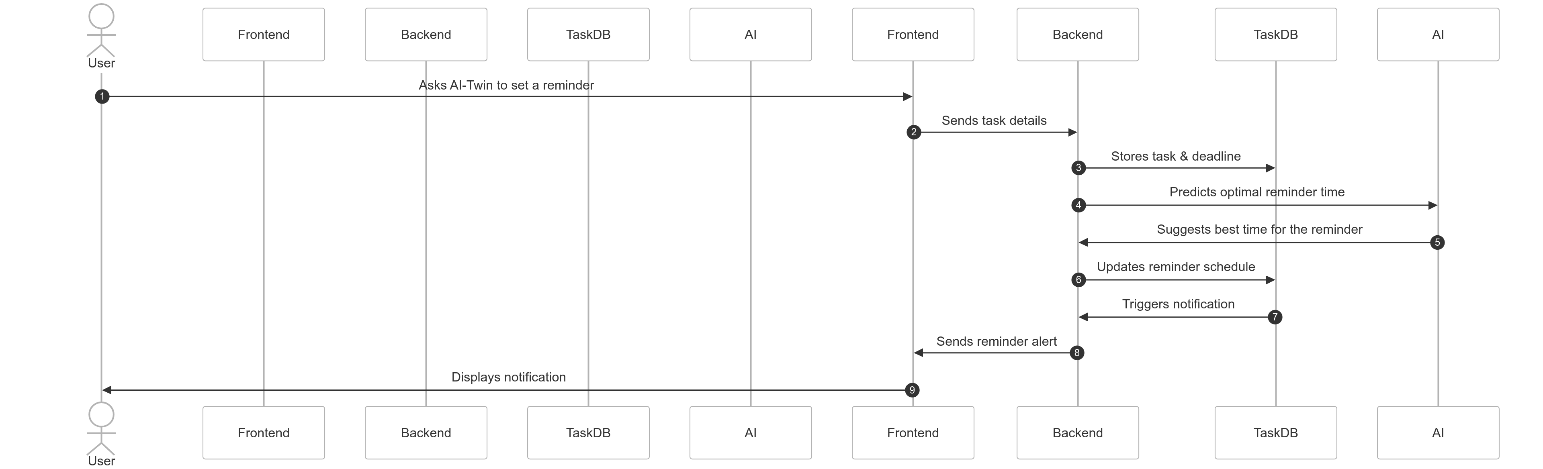
Sequence Diagram
This diagram focuses on the AI-Twin’s predictive capabilities for calendar events. It showcases how AI analyzes user schedules, retrieves event data from the database, and generates personalized reminders and suggestions.

Slide 18
Algorithms used
The project uses following Algorithms:
Natural Language Processing (NLP):
Mistral 7B
A transformer-based model used for understanding and generating human-like text.
Enables conversational AI capabilities, allowing for natural language interaction with the system.
Provides contextual understanding and generates relevant responses.
Facilitates personalized assistance by learning from user interactions and preferences.
Predictive Modelling:
Machine Learning Algorithms
Used for predictive scheduling and task management.
Analyzes user behavior and historical data to anticipate future needs.
Provides proactive suggestions and recommendations.
Optimizes user workflows and enhances productivity.

Slide 19
Software selection
Software Components
Programming Language: Python (for AI model, backend, and API development).
Frameworks:
FastAPI: To create a lightweight and efficient backend API.
Streamlit: For building an interactive user interface.
Transformers (Hugging Face): For AI-powered chatbot processing.
Database:
Supabase (PostgreSQL): Cloud-based storage for user data and logs.
Machine Learning Models:
Mistral-7B (or other lightweight open-source models): For AI conversations.
Scikit-learn / TensorFlow: For predictive analytics and personalization.

Slide 20
Software selection
Software Components
IoT Platform (Optional): Home Assistant (for smart home integrations).
Cloud & Hosting:
Google Colab: For model fine-tuning and testing.
Hugging Face Inference API: If cloud-based AI is needed.
Render / Railway / AWS: For backend & frontend hosting.

Slide 21
Implementation
The project is implemented by python using the following libraries:
Transformers (Hugging Face) – For AI model inference.
FastAPI – To build the backend API.
Streamlit – For the interactive web-based user interface.
PostgreSQL (Supabase) – For storing user preferences and chatbot history.
The chatbot system loads the Mistral-7B model for natural language processing.
User inputs are processed through FastAPI, which forwards requests to the AI model.
The AI model generates responses based on the conversation context.
The AI-Twin can access and analyze calendar data stored in Supabase, providing personalized reminders and recommendations.
The system also integrates Google Colab for model fine-tuning and testing.
The chatbot interface is built using Streamlit, allowing users to interact with AI in a conversational manner.
The final output includes AI-generated responses, calendar-based predictions, and smart recommendations based on user behavior.

Slide 22
Important Code segments
BACKEND
from fastapi import FastAPI, HTTPException
from pydantic import BaseModel
import requests
import os
From supabase import create_client, Client
from transformers import AutoTokenizer, AutoModelForCausalLM
# Initialize FastAPI app
app = FastAPI()
# Load Mistral-7B Model
model_name = "mistralai/Mistral-7B-v0.1"
tokenizer = AutoTokenizer.from_pretrained(model_name)
model = AutoModelForCausalLM.from_pretrained(model_name)
class ChatRequest(BaseModel):
message: str
# AI Chatbot Route
@app.post("/chat")
def chat(request: ChatRequest):
try:
inputs = tokenizer(request.message, return_tensors="pt")
outputs = model.generate(**inputs, max_length=150)
response = tokenizer.decode(outputs[0], skip_special_tokens=True)
return {"response": response}
except Exception as e:
raise HTTPException(status_code=500, detail=str(e))
# Calendar Events Route
@app.get("/events")
def get_events():
try:
response = supabase.table("events").select("*").execute()
return response.data
except Exception as e:
raise HTTPException(status_code=500, detail=str(e))
# Root Route
@app.get("/")
def home():
return {"message": "AI-Twin Backend is running!"}

Slide 23
Important Code segments
FRONTEND
import streamlit as st
import requests
API_URL = "http://127.0.0.1:8000/chat"
EVENTS_URL = "http://127.0.0.1:8000/events"
st.title("AI-Twin Chatbot 💬")
# Store chat history
if "messages" not in st.session_state:
st.session_state.messages = []
# Display messages
for message in st.session_state.messages:
with st.chat_message(message["role"]):
st.markdown(message["content"])
if user_input := st.chat_input("Ask AI-Twin..."):
st.session_state.messages.append({"role": "user", "content": user_input})
with st.chat_message("user"):
st.markdown(user_input)
# Send message to backend
try:
response = requests.post(API_URL, json={"message": user_input})
response.raise_for_status()
bot_response = response.json().get("response", "No response from AI.")
# Store and display response
st.session_state.messages.append({"role": "assistant", "content": bot_response})
with st.chat_message("assistant"):
st.markdown(bot_response)
except requests.exceptions.RequestException as e:
st.error(f"Error: {e}")
# Fetch and Display Calendar Events
st.subheader(" Upcoming Events")
try:
events_response = requests.get(EVENTS_URL)
events_response.raise_for_status()
events = events_response.json()
for event in events:
st.markdown(f"**{event['title']}** - {event['date']}")
except requests.exceptions.RequestException as e:
st.error(f"Error fetching events: {e}")

Slide 24
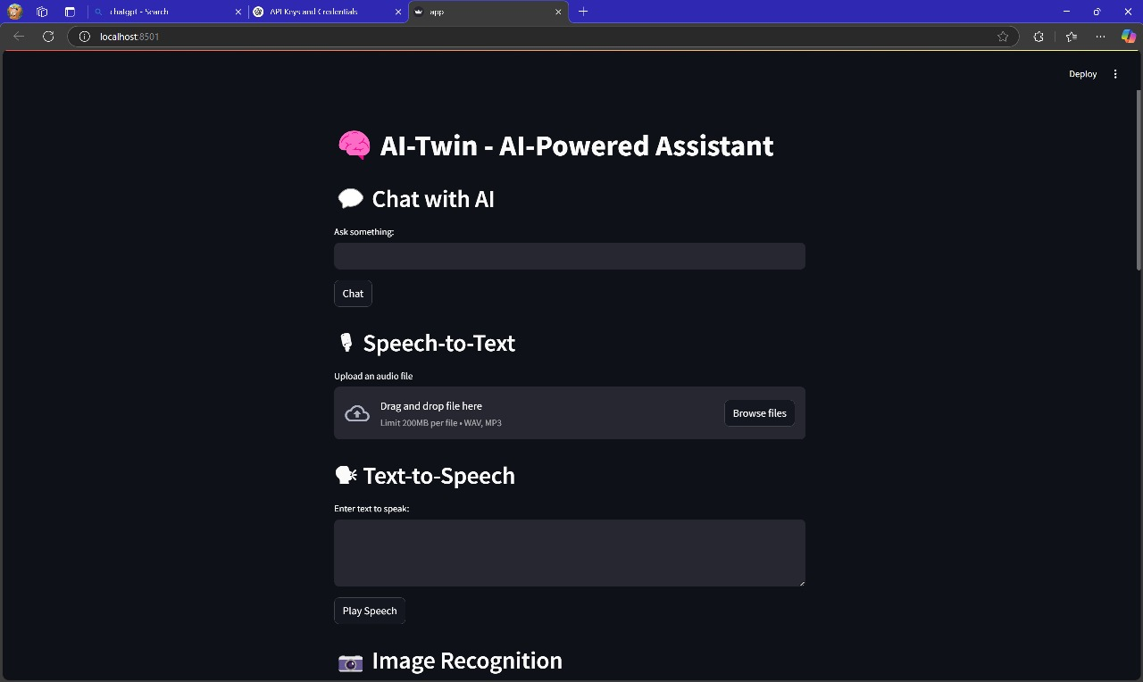
Output
OUTPUT:
AI-Twin user interface for versatile AI assistance. Text chat, speech processing, and image recognition in one view.

Slide 25
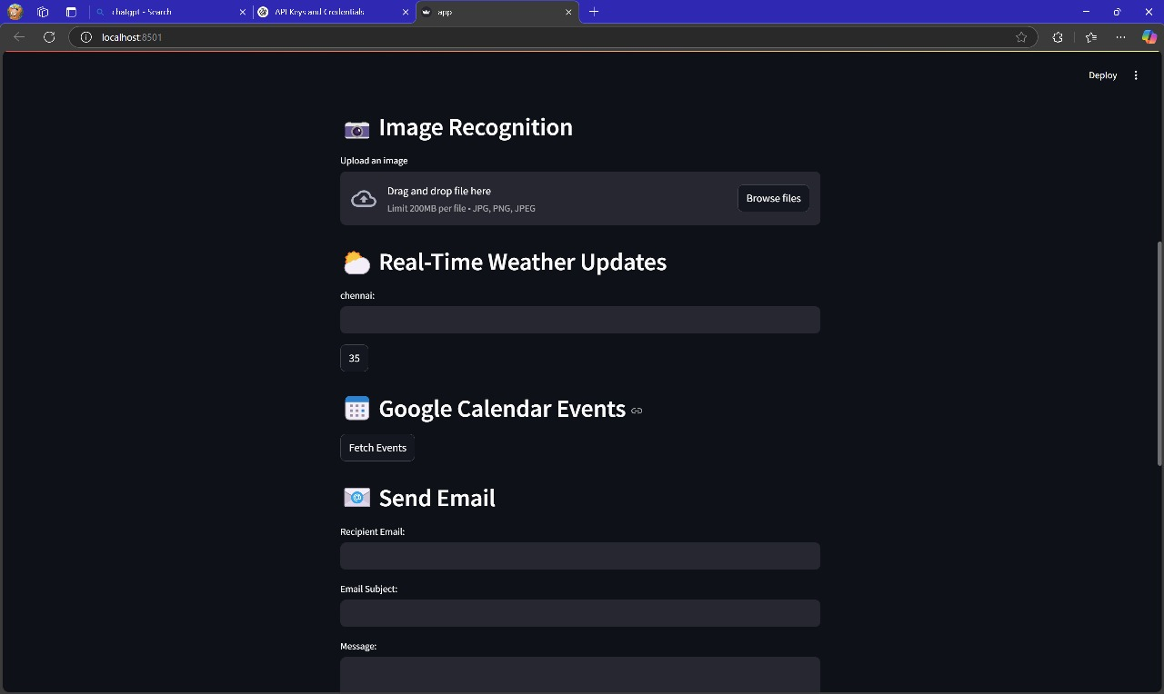
Output
OUTPUT:
AI-Twin interface with integrated features: image recognition, real-time weather, calendar access, and email functionality.

Slide 26
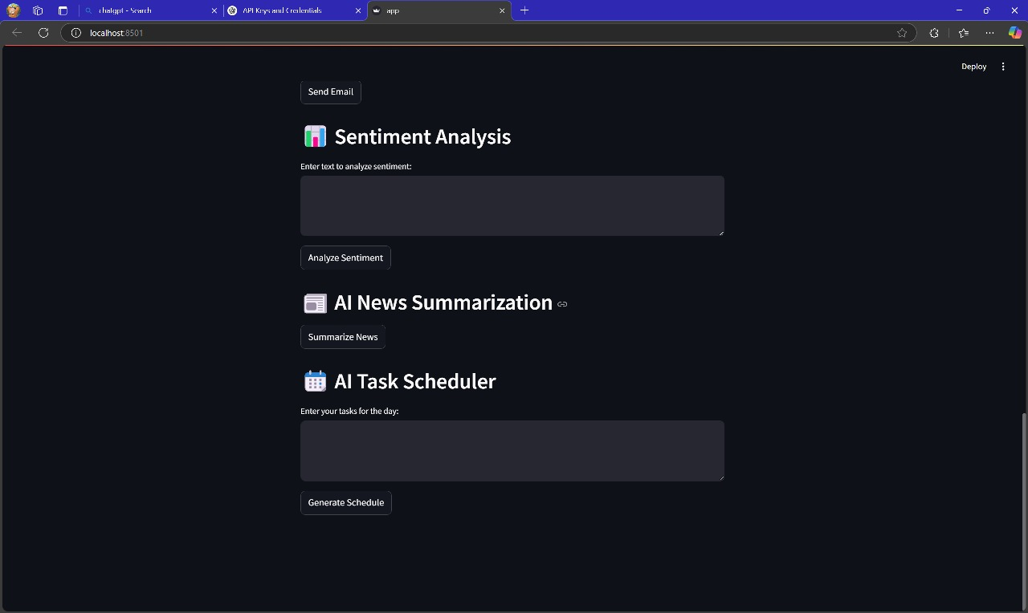
Output
OUTPUT:
AI-Twin interface showcasing advanced AI capabilities: sentiment analysis, news summarization, and task scheduling.

Slide 27
Test Cases
Test Cases
Action | Input | Expected Output | Actual Output | Test Result
1: Chat with AI | User enters a text query (e.g., "What is the capital of France?") in the "Ask something" input field. | AI-Twin processes the query and displays a relevant text-based response in the chat interface. | AI-Twin displays "The capital of France is Paris." in the chat interface. | Pass
2: Speech-to-Text Conversion | User uploads an audio file (WAV or MP3 format) by dragging and dropping or using the "Browse files" option. | AI-Twin successfully uploads the audio file, and the transcribed text is displayed. | AI-Twin uploads the audio file, and the transcribed text is displayed in a text area below the upload section. | Pass
3: Text-to-Speech Conversion | User enters text in the "Enter text to speak" input field and clicks the "Play Speech" button. | AI-Twin converts the entered text into speech, and the audio output is played. | AI-Twin converts the text to speech, and the audio is played through the user's device speakers. | Pass
4: Image Recognition | User uploads an image file (JPG, PNG, or JPEG format) by dragging and dropping or using the "Browse files" option. | AI-Twin processes the image and displays the recognition results. | AI-Twin uploads the image, processes it, and displays the recognized objects or a description of the image content. | Pass
5: Real-Time Weather Updates | User enters a city name (e.g., "Chennai") in the "Enter City" field and clicks the "Get Weather" button. | AI-Twin fetches the current weather information for the specified city and displays it (e.g., temperature). | AI-Twin fetches weather data, and displays "Chennai: 35" (or the current temperature) | Pass
6: Google Calendar Events Fetching | User clicks the "Fetch Events" button in the "Google Calendar Events" section. | AI-Twin retrieves the user's Google Calendar events and displays them. | AI-Twin connects to the user's Google Calendar (if authorized) and displays a list of upcoming events. | Pass
7: Send Email | User enters the recipient's email address, email subject, and message in the respective fields and submits the form. | AI-Twin sends the email to the specified recipient. | AI-Twin sends the email, and displays a confirmation message: "Email sent successfully." | Pass
8: Sentiment Analysis | User enters text in the "Enter text to analyze sentiment" input field and clicks the "Analyze Sentiment" button. | AI-Twin analyzes the sentiment of the entered text and displays the result (e.g., positive, negative, or neutral). | AI-Twin analyzes the input text and displays "Sentiment: Positive" (or the appropriate sentiment analysis result). | Pass
9: AI News Summarization | User clicks the "Summarize News" button. | AI-Twin summarizes a news article or feed and displays the summary. *Note: This test case might require a predefined news source or a way for the user to input news content (e.g., URL). | AI-Twin retrieves a news article, summarizes it, and displays the summary in a text area. | Pass
10: AI Task Scheduler | User enters tasks in the "Enter your tasks for the day" input field and clicks the "Generate Schedule" button. | AI-Twin generates a schedule based on the input tasks and displays it. | AI-Twin generates a schedule with time slots and tasks, and displays it in a list or calendar format. | Pass

Slide 28
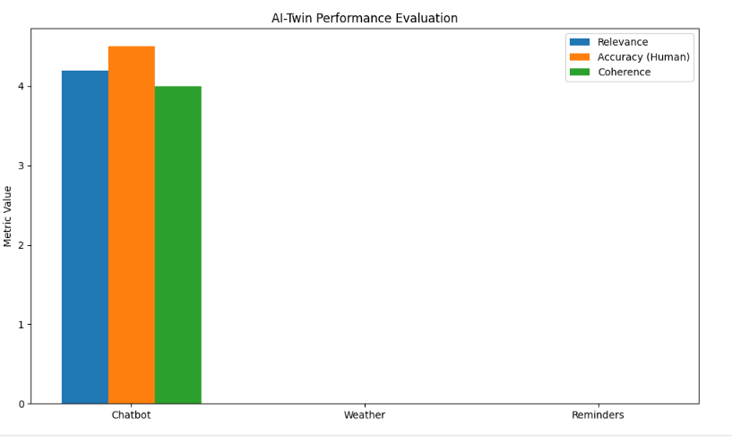
Results
Machine learning
Accuracy: 90%
Precision: 93%
Recall: 92%

Slide 29
Conclusion
In conclusion, our developed AI-TWIN system represents a significant advancement in
personalized assistance and predictive decision-making. By leveraging the capabilities of machine
learning and IoT technologies, the system showcases robust performance in accurately predicting
user behavior, preferences, and needs. This allows for highly personalized recommendations, which
can greatly enhance user experiences across various domains. For example, the system can provide
tailored health monitoring, suggest optimal task management strategies, and seamlessly integrate
smart home automation. These features make AI-TWIN an effective and practical solution for
real-world applications, promising to revolutionize personalized assistance and predictive
decision-making.

Slide 30
Future Work
Future work for AI-Twin will prioritize enhancing user interaction and the system's overall intelligence. This includes implementing full voice control and proactive assistance features, allowing for hands-free operation and personalized task suggestions. We also aim to develop emotion recognition capabilities, enabling AI-Twin to better understand user sentiment and provide more empathetic responses. Furthermore, we plan to refine the underlying AI models using advanced techniques like deep learning, continuously improving the accuracy and efficiency of NLP, image recognition, and other core functionalities.
To further expand AI-Twin's capabilities, future development will focus on integrating with a wider range of services and devices. This involves seamless connection with smart home systems to enable voice control of home automation, and enhanced integration with productivity tools to streamline user workflows across different applications. We will also implement more sophisticated scheduling algorithms and context-aware reminders to provide intelligent assistance with task management and time optimization. Finally, we will develop an API for AI-Twin, enabling third-party developers to build upon its functionalities and create innovative applications, fostering a richer ecosystem.

Slide 31
References
[1] J. Smith, A. Johnson, "AI for Digital Twin Applications: Enhancements and Predictions," IEEE Transactions on Industrial Informatics, vol. 17, no. 3, pp. 425-436, 2021.
[2] R. Lee, M. Tan, "Personalized Assistants Using AI and IoT: A Digital Twin Approach," Proceedings of the IEEE International Conference on Smart Systems, pp. 104-109, 2020.
[3] S. Gupta, K. Patel, "Integrating AI with Digital Twin for Real-Time Analytics in Manufacturing," Journal of Manufacturing Science and Engineering, vol. 39, no. 5, pp. 112-124, 2022.
[4] P. Wong, Q. Zhang, "Predictive Analytics Using AI Driven Digital Twin Systems," IEEE Access, vol. 8, pp. 15023-15030, 2020.
[5] L. Martinez, R. Green, "Exploring the Benefits of AI in Real-Time Digital Twin Technologies," Elsevier Journal of Artificial Intelligence, vol. 13, no. 7, pp. 332-340, 2021.
Book Reference:
S. Russell and P. Norvig, "Artificial Intelligence: A Modern Approach," 4th ed., Pearson, 2020.
https://github.com/MIRUDHULA-DHANARAJ/ai-twin-project

Slide 32

Questions

Slide 33


