Slide 1

MIS 547
Cloud Computing

Slide 2

Admin
D2L Groups for Proposal Upload
01
Next Thursday (September 21) Lecture will be pre-recorded
03
Another Syllabus Update
04
Feedback for Proposal by September 21
02
Special topics
Yogita office hours
Updated timeline

Slide 3
Lecture 8
Networking Day 1

Slide 4
AGENDA
What’s covered in this lecture:
OSI Model
Agenda
Networking foundations
Key terms
What's not covered:
Wrap up Lecture 7
In-depth TCP/IP protocol (see readings)
What’s covered next:
Classical network topologies
Actually, so many things.
Cloud networking
DNS

Slide 5
Lecture 7, Cont.
More about SQL
Structured Query Language
More about NoSQL
Not only SQL / No SQL

Slide 6
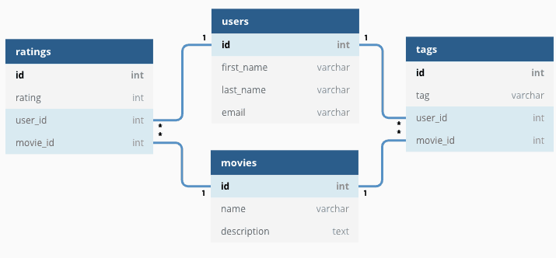
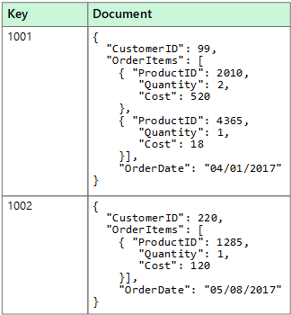
Relational Vs Non-Relational DATABASES
Relational
Non-Relational

Slide 7
Relational VS. Non-Relational DATABASES
Relational
Non-Relational
Stores data in tables
Need to define schema (structure of tables)
Structured data
ACID:
Atomicity, consistency, isolation, durability
Stores data as key-value, JSON, nodes
Schema-less
More flexible
BASE:
Basically available, soft-state, eventually consistent

Slide 8
Relational Vs. Non-Relational Databases
Relational
Non-Relational
Performance relies on disk subsystem
Use SSD and optimize the disk by configuring with RAID arrays
Redundant array of independent disks
Have to optimize indexes, table structures, queries
Performance depends on network latency, hardware cluster size, calling application
Increase cluster size, minimize network latency, index and cache
Higher performance and scalability for specific use cases

Slide 9
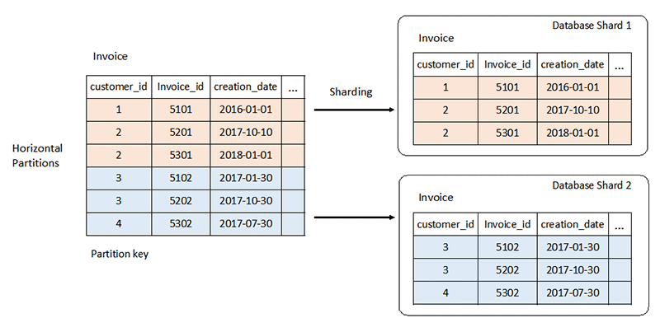
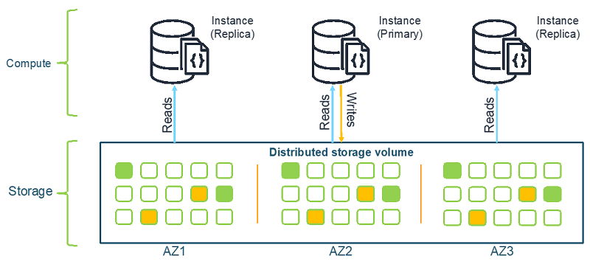
Scaling Databases
Relational
Non-Relational

Slide 10
NoSQL Databases
Key/ value databases
Document databases
Graph databases
Search databases
Time series databases
Ledger databases
In-memory and caching databases

Slide 11
Types of Cloud Databases
SELF-MANAGED
(CLOUD) MANAGED
TRADITIONAL
CLOUD-NATIVE
SQL
NoSQL
SQL
NoSQL
MySQL
MongoDB
Azure: CosmosDB
Azure: CosmosDB
SQL Server
Cassandra
AWS: Aurora
AWS: DynamoDB
Oracle
CouchDB
GCP: Cloud Spanner
GCP: Datastore
PostgreSQL
MariaDB

Slide 12
NETWORKING FOUNDATIONS
What’s a Network?

Slide 13
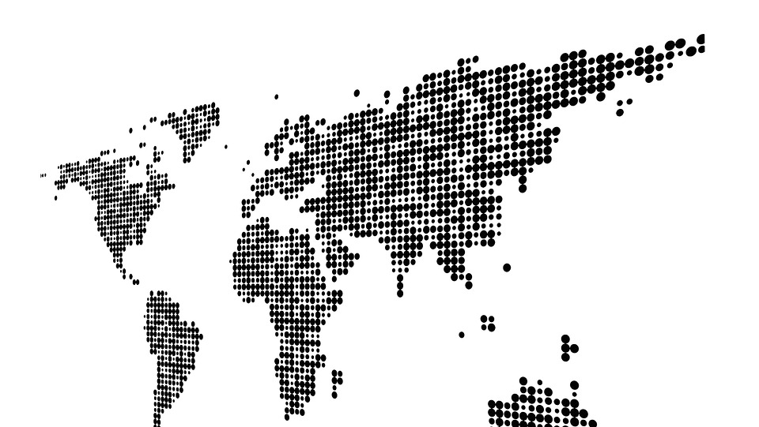
…But How does it do that?

Slide 14
Why Are We Learning This?
Cloud-based virtual networking can be complex, but it still has to use the foundational tooling of physical networking!
If we learn about traditional networking, then the virtualized versions of these resources become a lot less scary.

Slide 15
The OSI Model
Networking from the Ground Up

Slide 16
The OSI Model: Overview
Layer 7: Application
Layer 6: Presentation
Open Systems Interconnection (OSI) Model
Describes seven layers that computer systems use to communicate over a network
See also: TCP/IP model
5 Layers
OSI gives a comprehensive, protocol-independent framework
Layer 5: Session
Layer 4: Transport
Layer 3: Network
Layer 2: Data Link
Layer 1: Physical

Slide 17
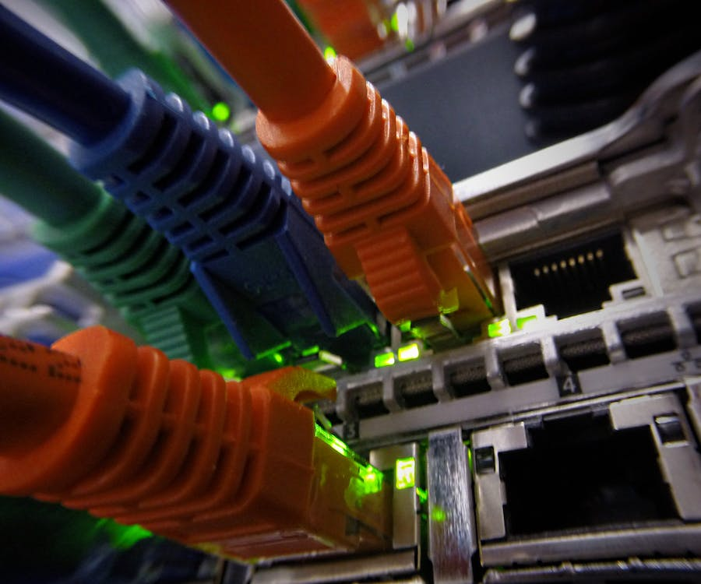
Layer 1: Physical Layer
Layer 1: Physical

Slide 18
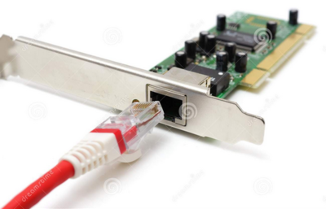
Layer 2: Data Link
NIC
Layer 2: Data Link
Every NIC has a unique MAC address
00-B0-D0-63-C2-26
ipconfig /all (Windows)
Ifconfig (MAC)
Broadcast address: FF-FF-FF-FF-FF-FF

Slide 19
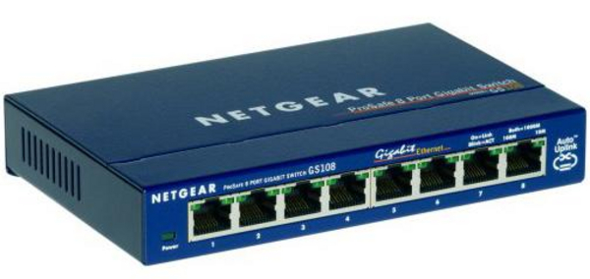
Layer 2: Data Link
NIC
Layer 2: Data Link
Switch

Slide 20
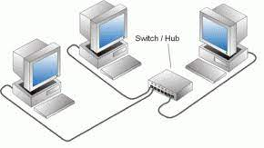
How do We go from This…..

Slide 21
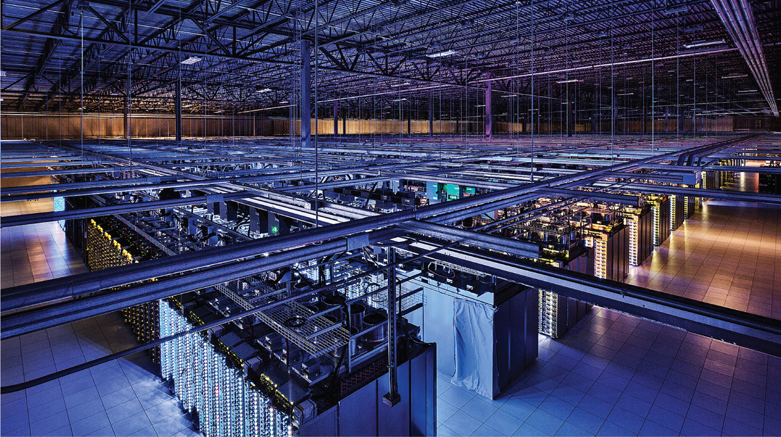
…To This?

Slide 22
Layer 3: Network Layer
TCP/IP Protocol
Actually a protocol suite
TCP: Transmission Control Protocol
IP: Internet Protocol
IP Addresses
Logical address
Four 8-bit numbers (octets)
Each octet ranges from 0 to 255
No two machines on the network share the same IP address; these are configured by the network admin
Layer 3: Network

Slide 23
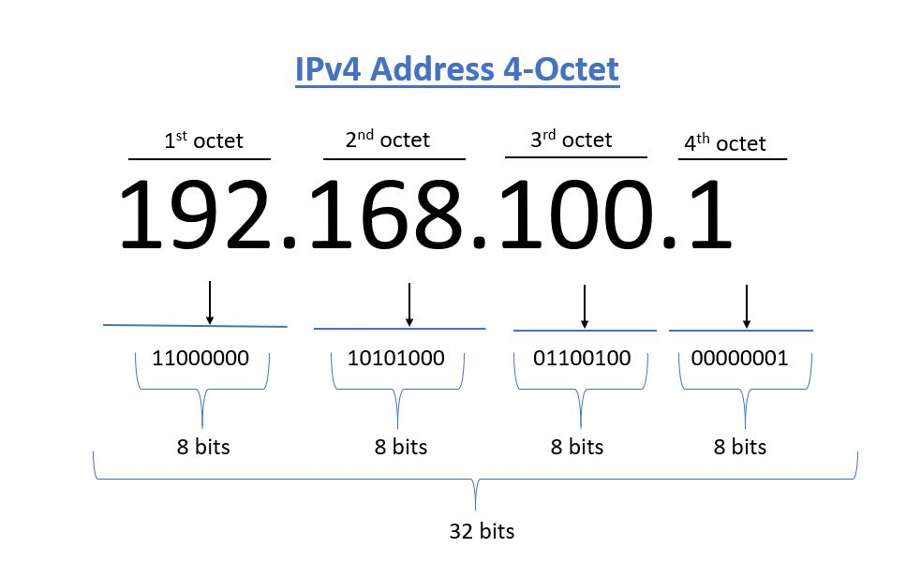
Layer 3: Network: IP ADDRESSES
IP Addresses
Humans read IP addresses in dotted decimal notation
But computers read these in binary

Slide 24
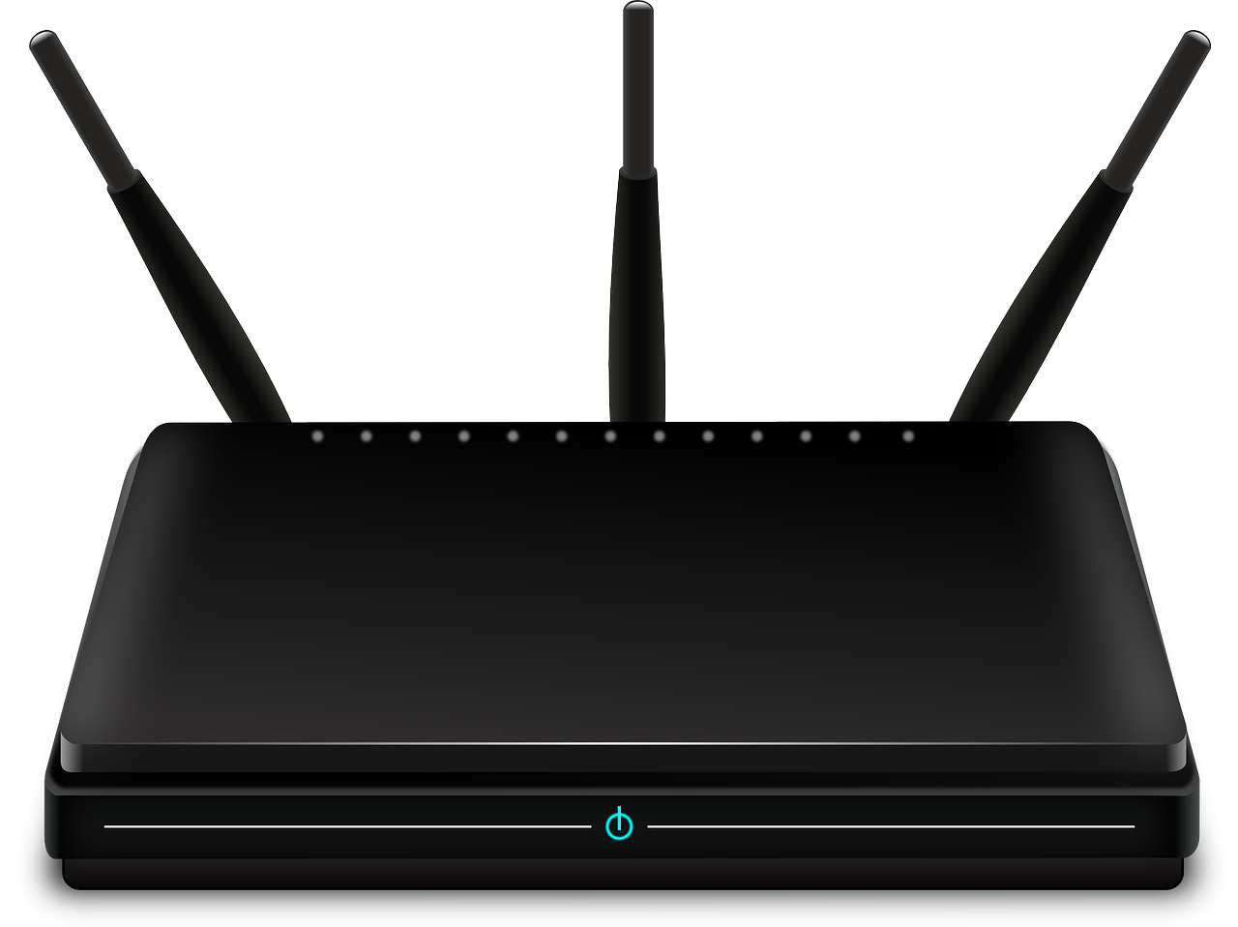
Layer 3: Network: Routers
Routers use IP addresses to forward data
This enables networks to connect across data lines that don’t use Ethernet

Slide 25
Layer 3: Network IP Packets
Sending Packets
Packets contain:
Destination IP address | Source IP address | Data
IP packet is handed to the NIC, which then encloses the IP packet in a regular frame:
Frame header | Packet header | Data | FCS (checksum)
FRAME
FRAME HEADER
PACKET HEADER
DEST IP | SRC IP | DATA
PACKET
FCS

Slide 26
Layer 4: Transport
Segmentation and Reassembly
TCP: Transmission Control Protocol
UDP: User Datagram Protocol
Ports: Logical value assigned to a specific application or service
Number between 1 and 65,536
DATA:
SRC Port | DEST Port | SEQ # | ACK # | More Data…

Slide 27
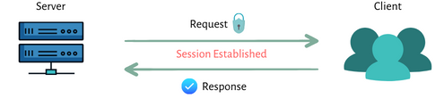
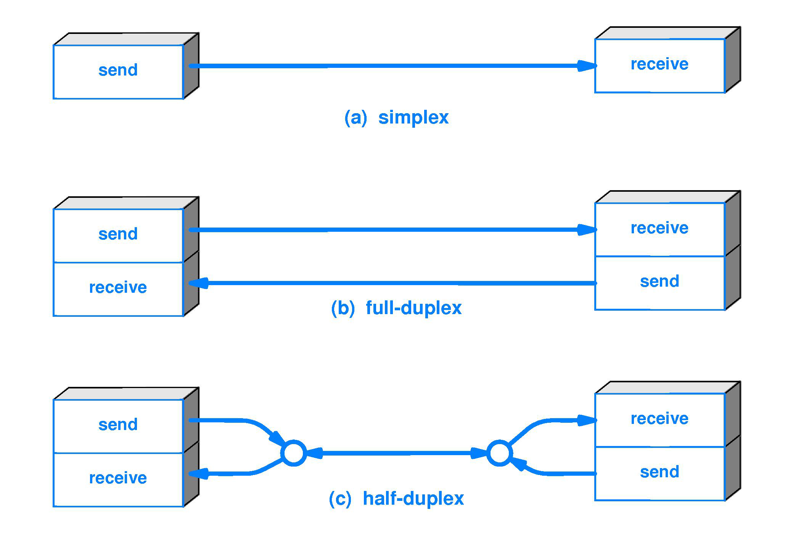
Layer 5: Session
Layer 5: Session

Slide 28
Layer 6: Presentation
Translates data from lower layers into a format usable by the application layer and vice versa
Sets system-dependent representation of data
Encryption protocol Transport Layer Security (TLS) initiates at layer 5, encrypts and decrypts at layer 6.
This is the lowest layer that application developers consider data structure and presentation
Layer 6: Presentation

Slide 29
Layer 7: Application
Operating System functions that enable network-aware applications
Layer 7 protocols include HTTP, FTP, IRC, SSH, and DNS
Layer 7: Application

Slide 30
OSI Model Overview
Layer 7: Application
Layer 6: Presentation
Software layers
Layer 5: Session
Layer 4: Transport
Heart of OSI
Layer 3: Network
Layer 2: Data Link
Hardware layers
Layer 1: Physical

Slide 31
OSI Model: Encapsulations and PDUs
Sender
Layer 7: Application
Layer 6: Presentation
Data
Layer 5: Session
Layer 4: Transport
Segment
Layer 3: Network
Packet
Layer 2: Data Link
Frame
Layer 1: Physical
Binary
Receiver

