Slide 1

MIS 547
Cloud Computing

Slide 2
Working with VPCs
Steps:
Create a VPC
Investigate the routing tables
Create a security group
Add Resources
VPC Flow Logs
Clean up resources

Slide 3
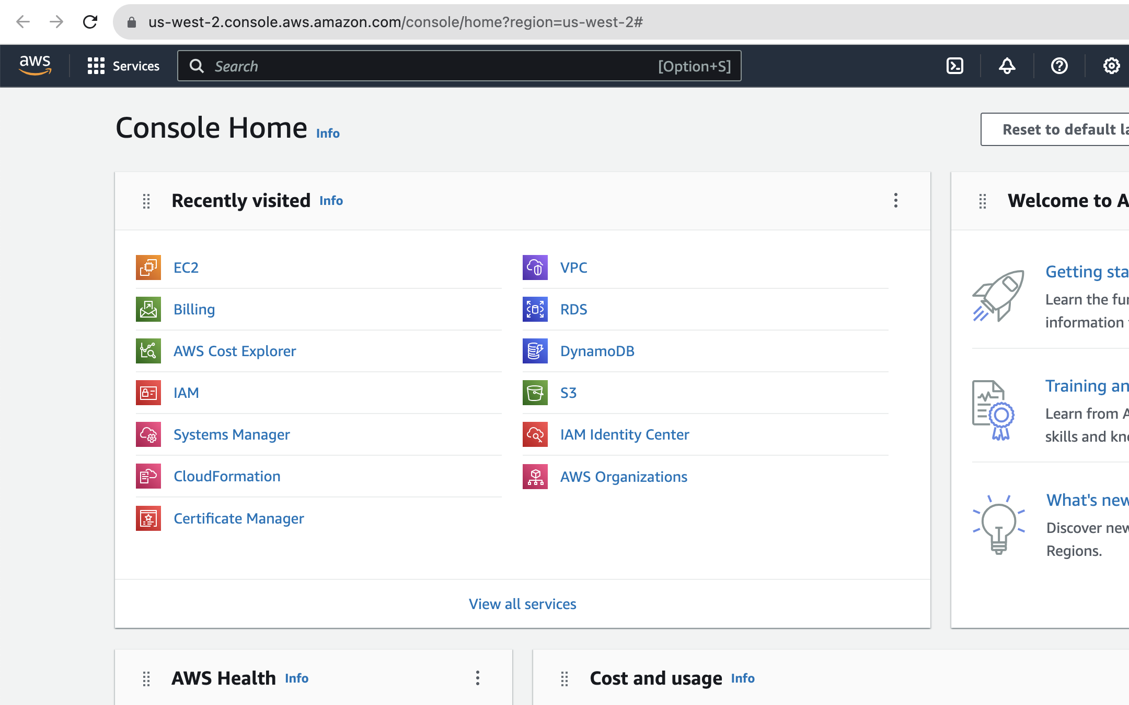
1. Create a VPC

Slide 4
1. Create a VPC
Settings:
CIDR block 10.0.0.0/16
Availability Zones: 2
Number of public subnets: 2
Number of private subnets: 2
Create NAT Gateway: 1 per AZ

Slide 5
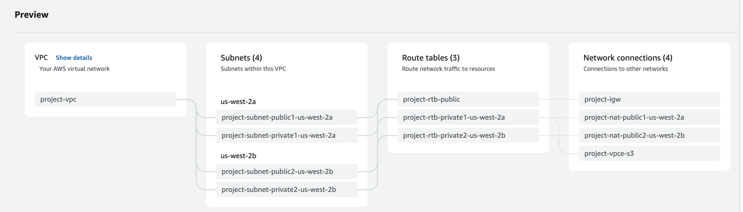
1. Create A VPC

Slide 6
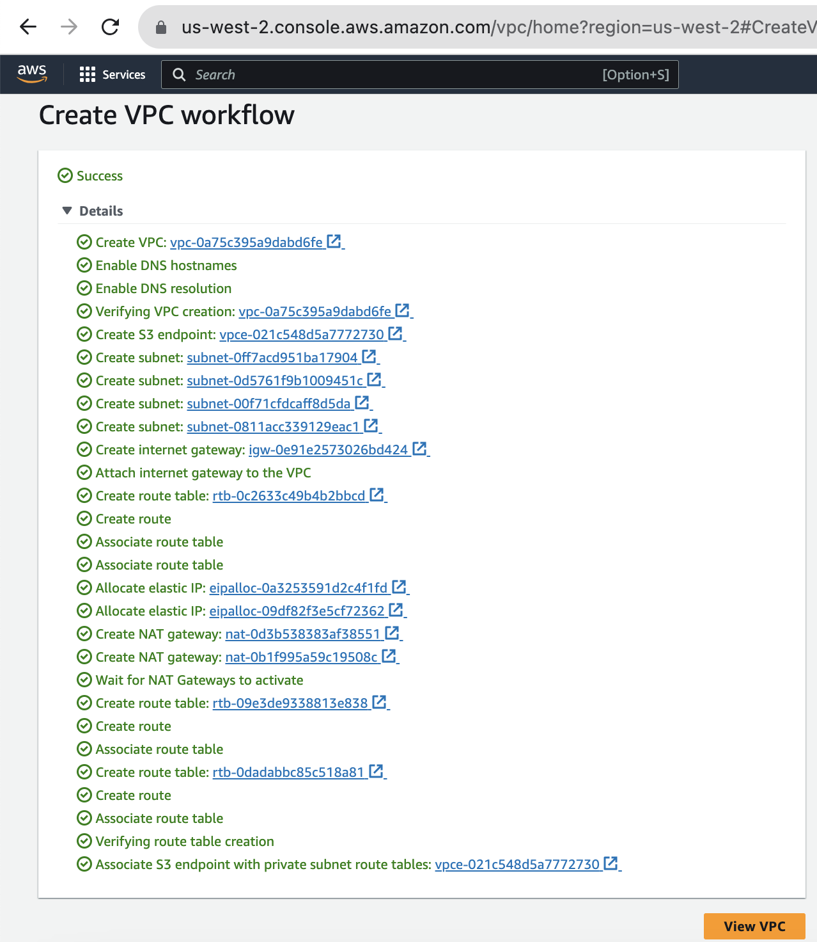
1. Create a VPC

Slide 7
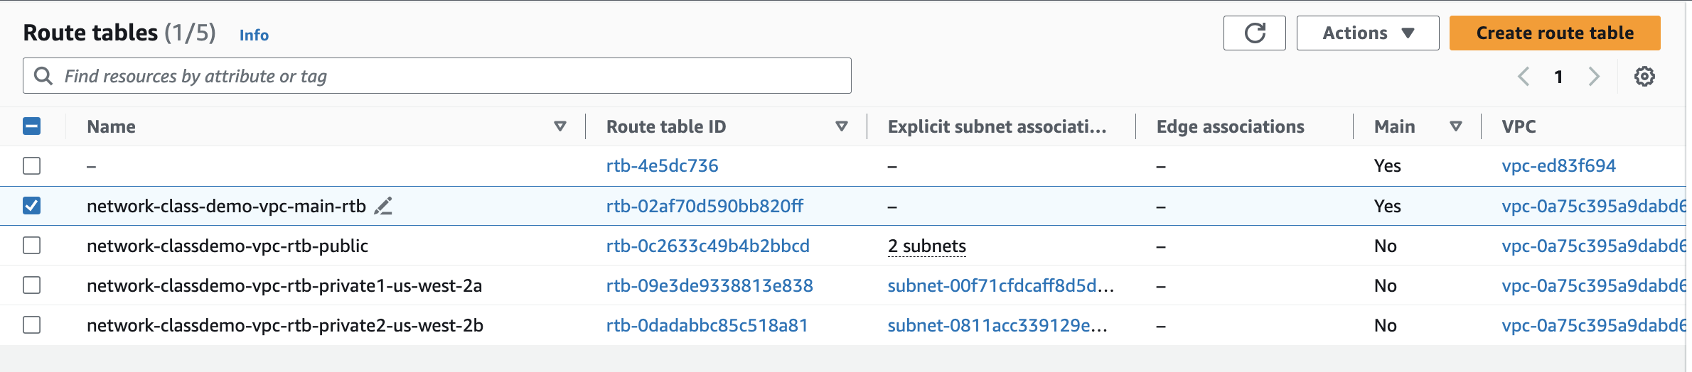
2. Investigate the Routing Tables: Main Route Table

Slide 8
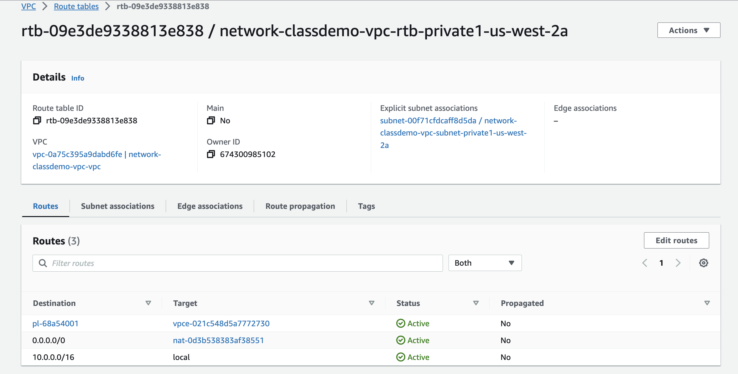
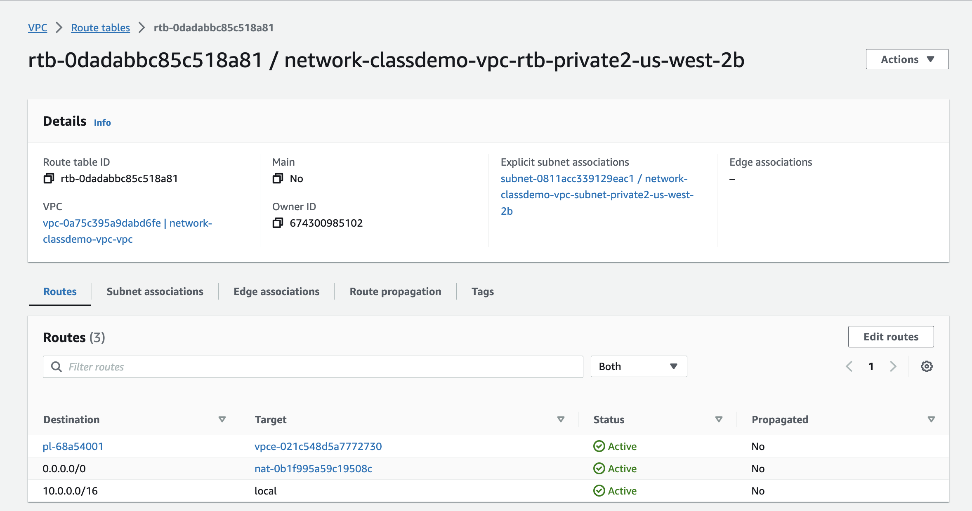
2. Investigate the Routing Tables: Private Subnet Routes
Destination traffic: same values
Target traffic: different values (NAT Gateways, VPC Endpoints to access S3 resources)

Slide 9
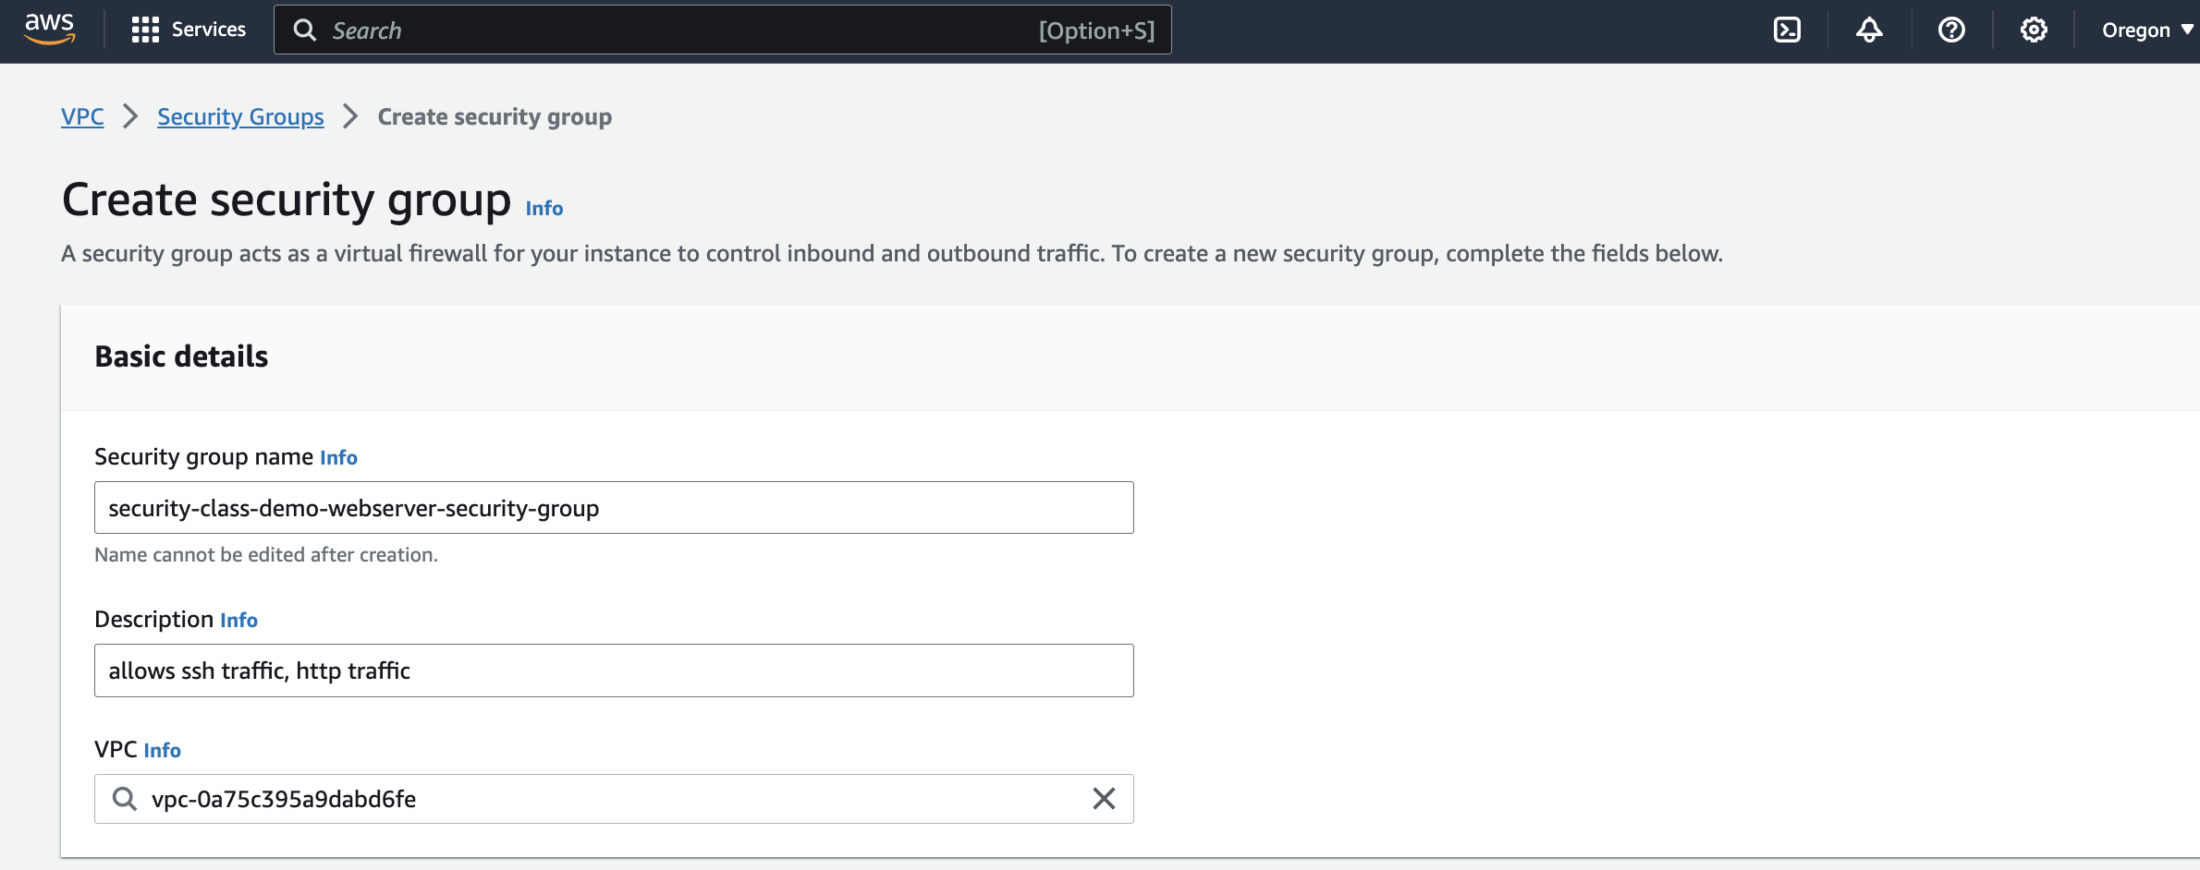
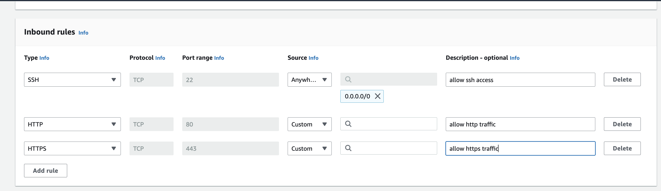
3. Create a security Group

Slide 10
4. Add Resources and Flow Logs
Next, we’ll use AWS CloudFormation to create resources and set up our Flow Logs so that we can monitor network traffic.
We won’t get into the details of CloudFormation templates- we’ll look at this much more in depth during our Infrastructure as Code lecture.

Slide 11
4. Add Resources and Flow Logs
VPC Flow Logs capture information about the IP traffic going to and from network interfaces in your VPC.
Flow log data can be published to Amazon CloudWatch Logs or to Amazon S3.
After you create a flow log, you can retrieve and view its data in the chosen destination.

Slide 12
4. Add Resources and Flow Logs
Flow logs help with a number of tasks:
Diagnosing overly restrictive security group rules
Monitoring the traffic reaching your instance
Determining the direction of the traffic to and from the network interfaces
We’ll use CloudFormation to deploy and configure the following resources:
IAM Role (used by flow logs to publish logs to CloudWatch)
Cloud Watch Log Group: flow logs will be published to this group
EC2 Instance: a test EC2 server with http configured to generate traffic

Slide 13
4. Add Resources and Flow Logs
Search for CloudFormation in the AWS Console
In the CloudFormation console select the Create stack button
Under “Template source” select Upload a template file and then select the Choose file button. Select the YAML file you downloaded from D2L.
Notes:
Link to CloudFormation template: https://static.us-east-1.prod.workshops.aws/public/444df362-a211-4686-869b-77496f0dd3be/static/common/vpc/vpc-flow-logs.yml

Slide 14
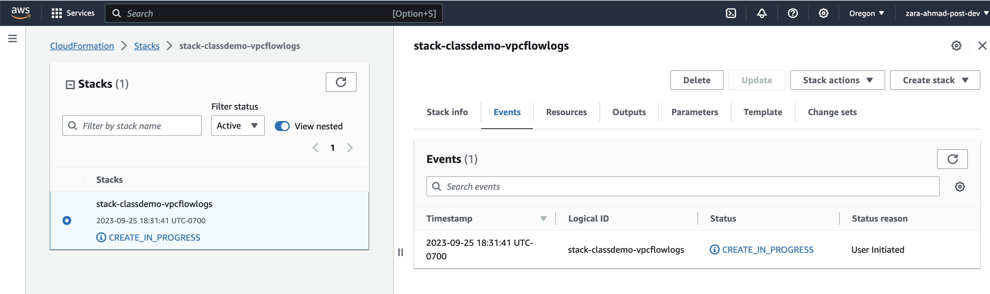
4. Add Resources and Flow Logs

Slide 15
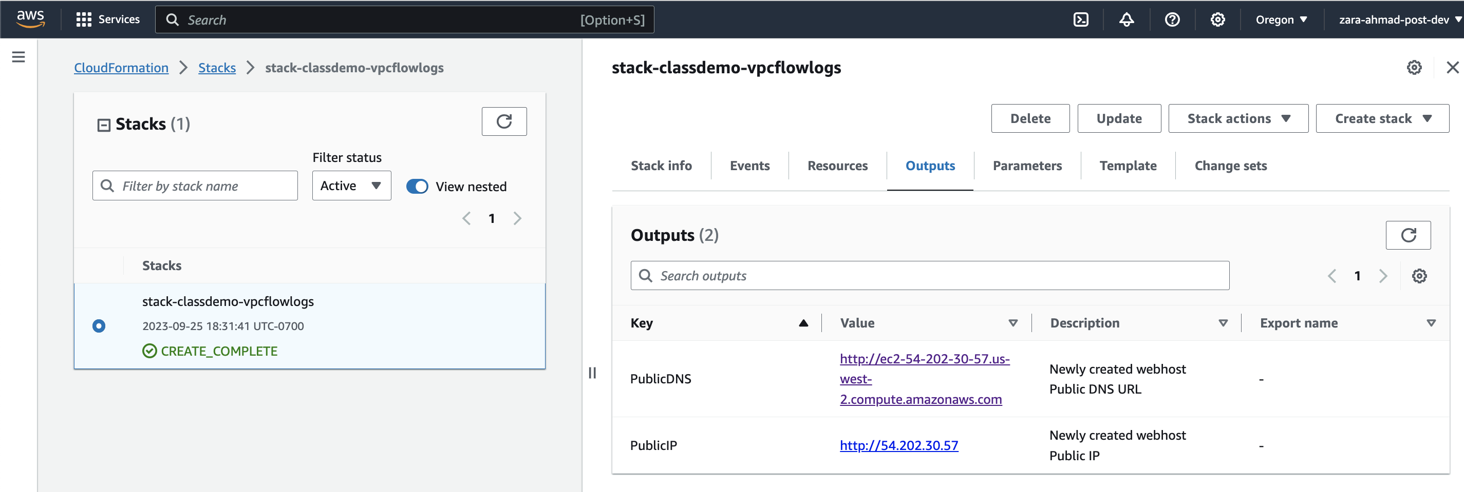
4. Add Resources and Flow Logs
Go to outputs tab, and click on Public DNS
We’ve just created an EC2 instance on a public subnet. This instance can be used to generate traffic that can be viewed in VPC Flow logs

Slide 16
4. Add Resources and Flow Logs
In the AWS Console, search for VPC
In the VPC page, click the Your VPCs menu, then select the demo VPC
In the bottom, navigate to Flow Logs and click on Create flow log

Slide 17
4. Add Resources and Flow Logs
Fill in the following settings:
Name
Max aggregation interval: 1 minute
Destination: Send to CloudWatch Logs
Destination log group: VPCFlowLogGroup (this was created in the CloudFormation template)
IAM Role: RoleforVPCFlowLogs
Log record format: AWS default format

Slide 18
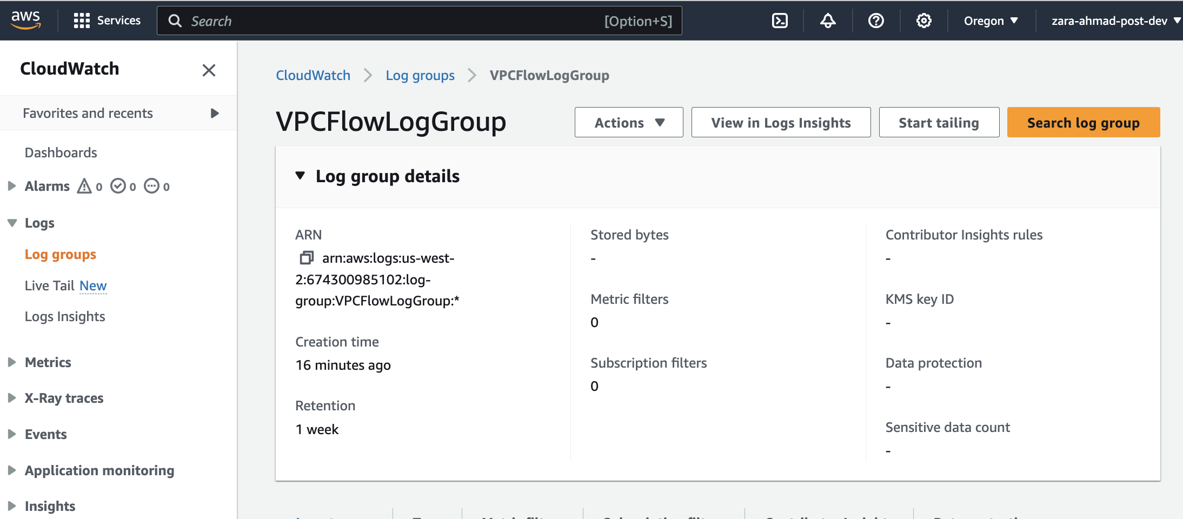
4. Add Resources and Flow Logs
Search for CloudWatch under “Management & Governance”

Slide 19
Clean Up Your Resources
CloudFormation Console
Select Stack
Delete
NAT Gateways
Network Interfaces
VPC Console
Select VPC
Delete

Slide 20
Land Acknowledgement Statement
We respectfully acknowledge the University of Arizona is on the land and territories of Indigenous peoples. Today, Arizona is home to 22 federally-recognized tribes, with Tucson being home to the O’odham and the Yacqui. Committed to diversity and inclusion, the University strives to build sustainable relationships with sovereign Native Nations and Indigenous communities through education offerings, partnerships, and community service.

