Slide 1
lightweight PUB/SUB for WEB APPS using MQTT
Jason Follas Sr. Software Engineer Quicken Loans

Slide 2
Abstract
MQTT is an extremely lightweight publish/subscribe messaging transport. It is commonly used as a machine-to-machine connectivity protocol for IoT devices, and usually runs over TCP/IP using sockets. But, recent efforts have implemented the protocol in JavaScript using web sockets, making it possible to use MQTT from within a web browser. This session will introduce the MQTT protocol, discuss various brokers, talk about messaging and Quality of Service, and provide examples of how to use Pub/Sub to enhance your web application and interact with IoT devices.
Notes:
MQTT
Problem definition (IoT, wearable, etc)
- Distributed network of devices communicating
- Battery or limited power
- Unreliable networks (cellular, satellite, wireless in general)
Agenda
- Introducing MQTT
- What is Publish / Subscribe
- Client, Broker, connection
- MQTT Publish, Subscribe, Unsubscribe
- MQTT Topics
- MQTT Quality of Service
- Persistent Sessions and Queueing Messages
- Retained Messages
- Last Will and Testament
- Keep Alive and Client Take-Over
- Demo
Lightweight pub/sub protocol with reliable bi-directional message delivery
Key aspects
- High volume of data in low bandwidth networks
- Small code footprint
- Runs on top of TCP/IP
- Avoids polling
- Event oriented
- Recovery, store and forward, and pub/sub are part of the implementation
Topic: ASCII string
Connection is initiated by client - helpful for NAT
CONNECT ->
<- CONNACK
Client ID: Unique ID (per broker)
Clean Session (false: QoS 1 and 2 messages will be stored if client goes offline and delivered on next connection)
Username/Password
Will: If unexpected disconnect, broker sends Will message to the Will topic on the client's behalf
Keepalive
Publish
Topic name
QoS
Retain-flag: Broker can save one message per topic to automatically provide to new subscriptions (vehicle odometer problem if car is offline)
Payload: Binary
Packet Identifier
DUP flag
Subscribe
Packet Identifier
List of subscriptions
Persistent Session:
- All subscriptions maintained while offline
- All QoS 1/2 messages not confirmed by client
- All new QoS 1/2 sent while offline
Retained messages:
- "last good message" for the topic
- To delete, send a zero byte payload as retained
Keep Alive and Client Take-Over
- TCP/IP does not always notify when a socket breaks. Broker could think connection is alive but really is dead.
- Client must send a command or keepalive message periodically (defined by client at connection)
- Max keepalive is 18h 12m 15s (65535 seconds)
- Takeover is when a client connects using the same client id of a session that the broker thinks is still connected. Prev is closed, and new connection takes over prev
MQTT vs HTTP
MQTT overhead is about 20% of HTTP
Where used:
- POS
- Slot machines
- Automotive/Telematics
- Medical
- Home Automation
- Railway
- Asset Tracking/Management
- Space probe communication (?)
- Oil, Gas, Solar
Facebook Messenger:
- First pass had issues with long latency. Was reliable but slow.
- With only weeks before launch, refactored to use MQTT
- Designed to use bandwidth and battery sparingly (important for mobile apps)
- "By maintaining a MQTT connection and routing messages through our chat pipeline, we were able to often achieve phone-to-phone delivery in the hundreds of milliseconds rather than multiple seconds"
Amazon AWT IoT
Microsoft Azure IoT Hub

Slide 3
The Petroleum Pipeline Problem

Slide 4

Shutterstock

Slide 5
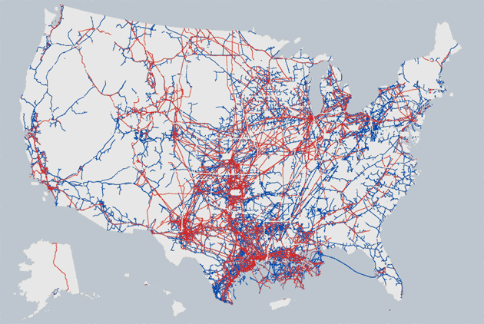

Slide 6
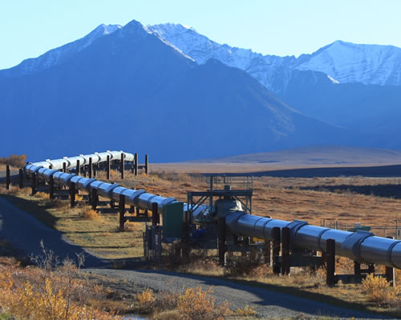

Slide 7
Oil Pipeline
Equipment and Sensors (data origination):
Equipment status
Pump status
Pump Bearing temperature
Product temperature
Flow rates
Valve status
Valve control
Tank levels
Etc.
One very important data consumer: SCADA host system
(Supervisory Control and Data Acquisition)
Need to deliver real-time data to SCADA

Slide 8
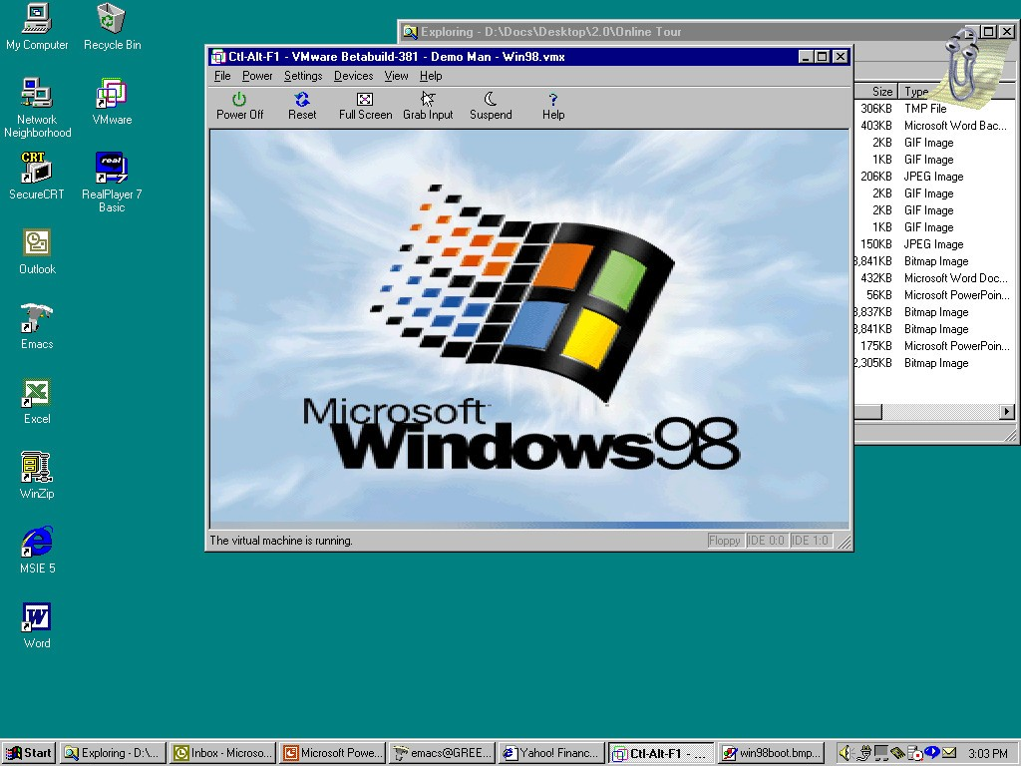
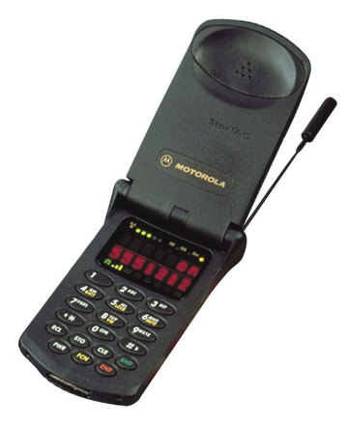
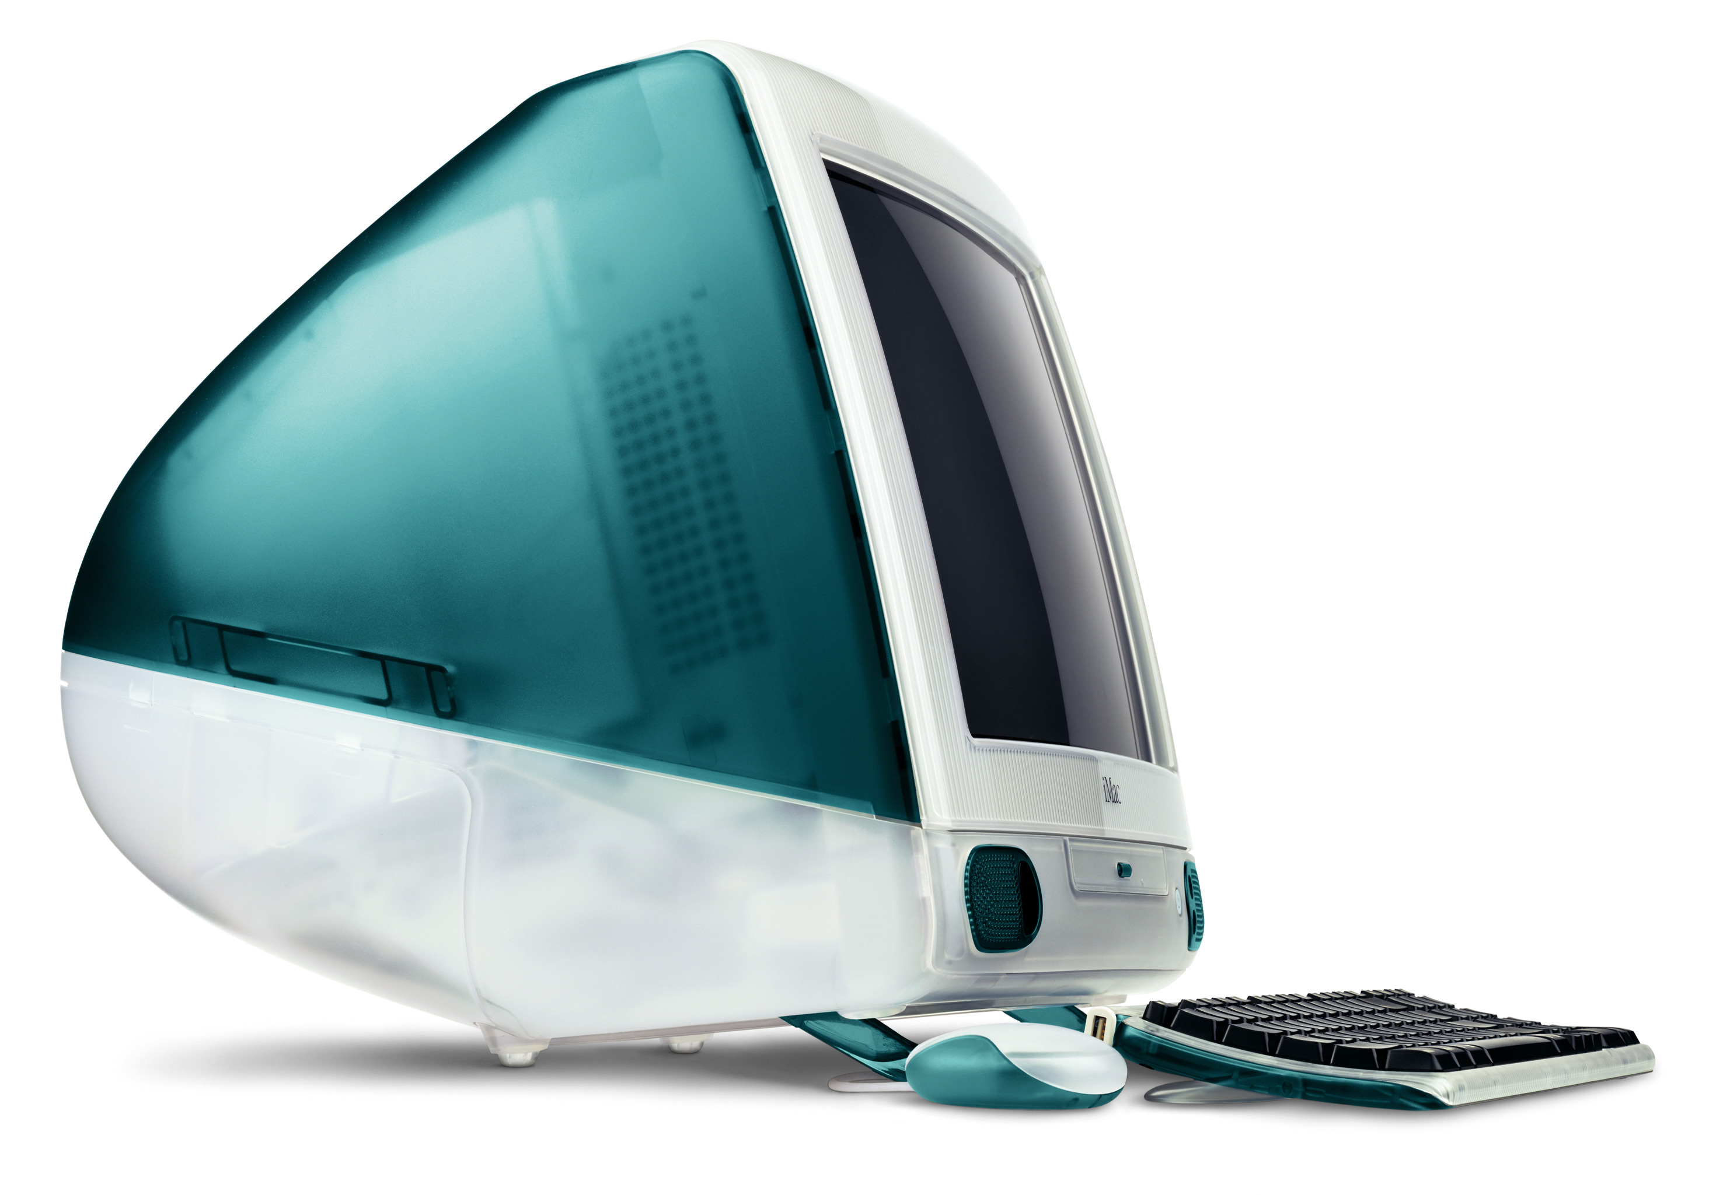
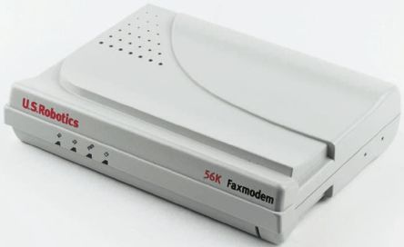
1998
Pentium II 300MHz
128MB RAM
9GB Hard Drive

Slide 9
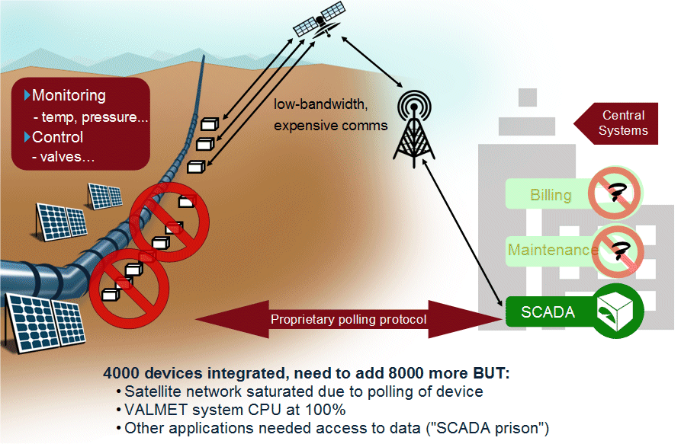

Slide 10
Goals
Energy-friendly and low-bandwidth protocol for connecting oil pipelines using satellite connections
Simple to Implement
Quality of Service for Data Delivery
Low processor/memory requirements
Bandwidth efficiency (wireless communication costs were significant in 1999)
Data Agnostic
Continuous Session Awareness
Multiple simultaneous data consumers

Slide 11
Their Solution

Slide 12
Solution: MQTT
MQ Telemetry Transport
Invented 1999 by Andy Stanford-Clark (IBM) and Arlen Nipper (Arcom/Cirrus Link/Eurotech)
Used internally by IBM, v3.1 released royalty free in 2010.
MQTT is no longer an acronym

Slide 13
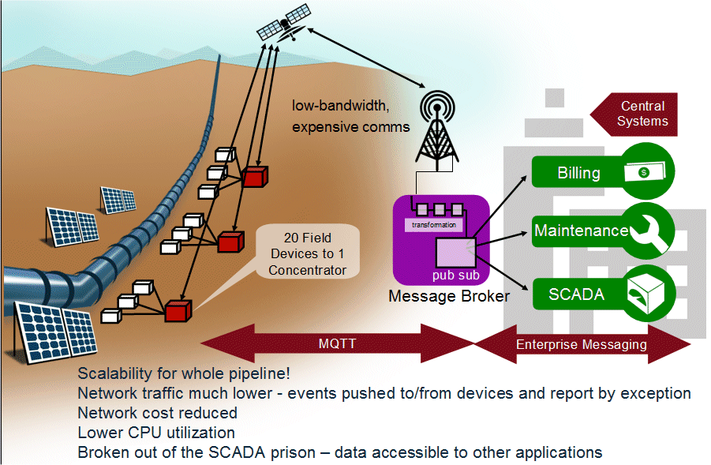

Slide 14
What is MQTT?
A binary-based protocol
built on top of TCP/IP that
enables publish/subscribe
for machine-to-machine communication

Slide 15
Not a Message Queue
Was a transport protocol for IBM MQ Series, but has no traditional queues itself

Slide 16
Standards
OASIS standard (MQTT 3.1.1) as of 2014
IANA TCP ports 1883/8883

Slide 17
Publish/Subscribe

Slide 18
Application
Broker
Publish
Publish
Mobile Device
Sensors
IoT Device
Publish
Publish
Web App
Publisher
Subscribers

Slide 19
Application
Broker
Publish
Mobile Device
Sensors
IoT Device
Publish
Web App
Subscriber
Publisher

Slide 20
Some Brokers
Mosca (node.js)
Mosquitto (Python)
Emitter (.NET)
emqttd (Erlang/OTP)
VerneMQ (Erlang/OTP)
RabbitMQ (via plugin)
HiveMQ (“Enterprise” Broker)
Azure IoT Hub
AWS (Amazon) IoT Message Broker

Slide 21
MQTT VERBS
Connect
Disconnect
Subscribe
Unsubscribe
Publish

Slide 22
Connect
Client ID
Clean Session?
Username and Password
Keepalive Duration
Last Will and Testament

Slide 23
Keep Alive
TCP/IP does not always notify when a socket breaks.
Broker could think connection is alive but really is dead.
Client must send a command or keepalive message periodically (defined by client at connection)
Max keepalive is 18h 12m 15s (65535 seconds)

Slide 24
Client Takeover
When a client connects using the same client id of a session that the broker thinks is still connected.
Previous session is closed
New connection takes over previous session

Slide 25
Last Will and Testament
MQTT often used in environments with loss of connectivity
Unreliable networks
Battery dies
Equipment failure
What if your publisher suddenly goes offline?

Slide 26
Last Will and Testament
Message to broadcast if a client goes offline:
If server detects I/O or network failure
Client fails to communicate within Keep Alive timeout
Client closes without an appropriate DISCONNECT first
Server closes the connection because of a protocol error
The Broker will publish one last message on your behalf

Slide 27
PUBLISH
Topic name
QoS
Retain Flag
Payload (Binary)

Slide 28
Topics
pipeline/3/pump/1239/temperature
Hierarchy string with / delimiters (resembles a directory path)
No “root” slash needed – just wasting space
Case sensitive!

Slide 29
Quality of Service (QoS)
0: At most once delivery
1: At least once delivery
2: Only once delivery

Slide 30
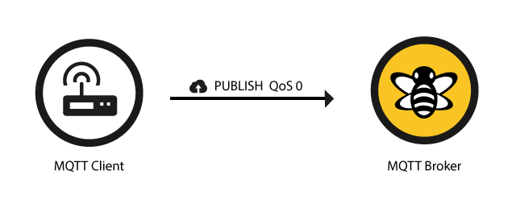
Quality of Service (QoS)
http://www.hivemq.com/blog/mqtt-essentials-part-6-mqtt-quality-of-service-levels

Slide 31

Quality of Service (QoS)
http://www.hivemq.com/blog/mqtt-essentials-part-6-mqtt-quality-of-service-levels

Slide 32
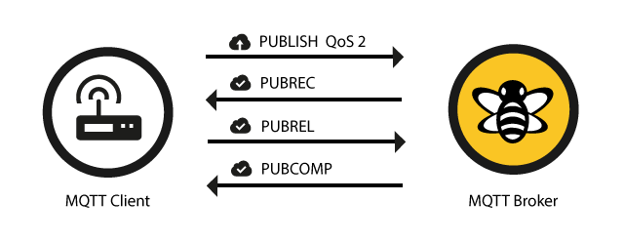
Quality of Service (QoS)
http://www.hivemq.com/blog/mqtt-essentials-part-6-mqtt-quality-of-service-levels

Slide 33
Retain Flag
The broker will store the last message published to a topic if it is marked as “retain”.
Retained messages are sent immediately upon new subscription
Can be used as “seed” data for newly connected clients

Slide 34
SUBSCRIBE
QoS
Topic(s) to subscribe to

Slide 35
Wildcard Characters
Wildcards for subscriptions: # and +
Example: pipeline/3/pump/+/temperature pipeline/3/pump/1239/temperature pipeline/3/pump/4445/temperature pipeline/3/pump/3224/temperature
Example: pipeline/3/# pipeline/3/pump/1239/temperature pipeline/3/pump/1239/pressure pipeline/3/valve/1239/state

Slide 36
Persistent Connection
When Clean Session Flag = False during CONNECT:
All subscriptions are maintained while offline
All QoS 1 & 2 messages not confirmed by client will finish up upon reconnect
All new QoS 1 & 2 sent while offline will be saved and sent upon reconnect
Note: QoS 0 subscription messages are not preserved while offline

Slide 37
Publisher/Subscriber Decoupling
Application
"Subscriber"
"Publisher"
Broker
Publish QoS 0
Subscriber
Publisher
Publish
Mobile Device
Sensors
IoT Device
Publish QoS 1
Publish QoS 2
Web App
Publisher
Subscribers

Slide 38
Facebook Messenger Story

Slide 39
Facebook Messenger
First implementation had issues with long latency. Was reliable but slow.
With only weeks before launch, refactored to use MQTT
Designed to use bandwidth and battery sparingly (important for mobile apps)

Slide 40
“By maintaining a MQTT connection and routing messages through our chat pipeline, we were able to often achieve phone-to-phone delivery in the hundreds of milliseconds rather than multiple seconds”
– Lucy Zhang, Facebook
https://www.facebook.com/notes/facebook-engineering/building-facebook-messenger/10150259350998920/

Slide 41
Web Apps

Slide 42
Websockets
Communication protocol that provides full-duplex communication channels over a single TCP connection
Note: Not supported by all MQTT Brokers

Slide 43
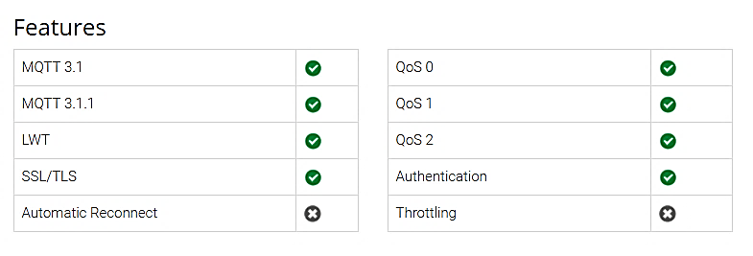
Eclipse Paho JavaScript Client
https://github.com/eclipse/paho.mqtt.javascript

Slide 44
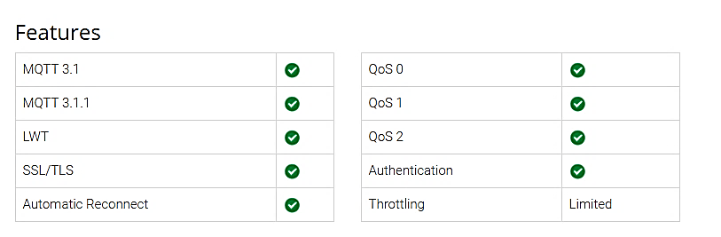
MQTT.js
https://github.com/mqttjs/MQTT.js

Slide 45
Putting it all Together

Slide 46
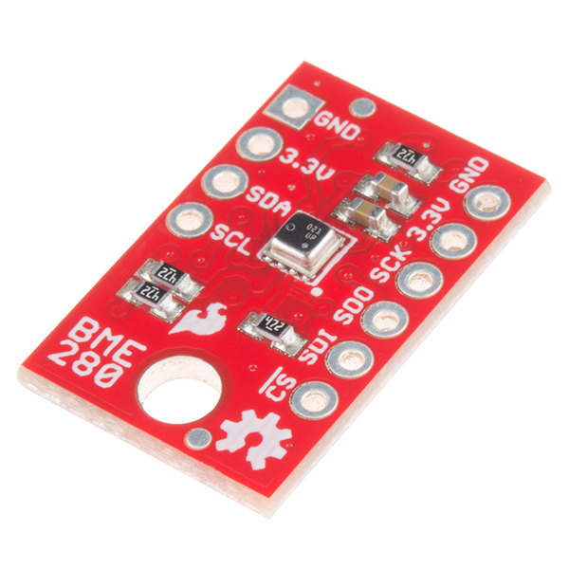
SparkFun BME280

Slide 47
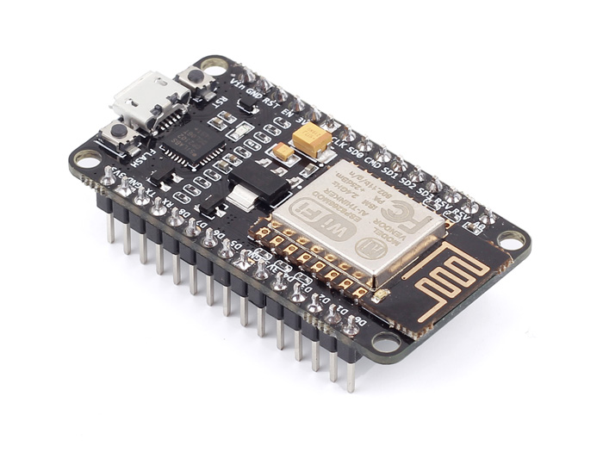
403539
Broker
readings/403539 { "t": 2471, "h": 45681,
"p": 998365
}
Publish
Sleep
Read Sensor
readings/403539 { … }
Web Page
Web Page
Web Page

Slide 48
DEMO: MQTT Pub/Sub

Slide 49


Contact Information
Jason Follas
Quicken Loans
jasonfollas@quickenloans.com
Twitter: @jfollas
This presentation and code can be found here: https://github.com/jfollas/mqttdemo
#10
#1

Slide 50
Photo Credits
https://access.redhat.com/documentation/en-US/Fuse_Message_Broker/5.4/html/Getting_Started/files/FuseMBStartedKeyJMS.html
Shutterstock 172364009
https://www.ibm.com/developerworks/community/blogs/c565c720-fe84-4f63-873f-607d87787327/entry/tc_overview?lang=en
Pipeline and Hazardous Materials Safety Administration
http://www.unitedenergytrading.com/crude-oil-trading/pipelines/

