Slide 1
MISP and threat intelligence
MISP Project - https://www.misp-project.org
Koen Van Impe - https://www.cudeso.be
koen.vanimpe@cudeso.be
@cudeso
June 2021
TLP:White

Slide 2

What is threat intelligence?
Threat Intelligence (TI)
evidence-based knowledge, including context, mechanisms, indicators, implications and actionable advice.
about an existing or emerging menace or hazard to IT or information assets.
It can be used to inform decisions regarding the subject's response to that menace or hazard.

Slide 3
What is threat intelligence?
Threat Intelligence (TI)
evidence-based knowledge, including context, mechanisms, indicators, implications and actionable advice.
about an existing or emerging menace or hazard to IT or information assets.
It can be used to inform decisions regarding the subject's response to that menace or hazard.
Understand threats targeting an organisation.
Attackers motives and behaviours.
Faster and better informed decisions.
To prepare, protect, detect and respond to these threats.

Slide 4
Intelligence is more than Information. Or data.
Intelligence
Operational Environment
Information
Data
Analyse
Process
Collect

Slide 5
Threat intelligence use cases
“What”, “Where” and “When”
Atomic indicators
Security controls
Defend organisation
Threat data feeds
“How”
TTPs, capabiliities and infrastructure
Prioritize operations
Address blind spots in detection
Threat feeds with context
Operational threat reports
“Why” and “Who”
High level risks and trends
Business decision making
Threat landscapes
Tactical
Operational
Strategic

Slide 6



Threat intelligence use cases
“What”, “Where” and “When”
Atomic indicators
Security controls
Defend organisation
Threat data feeds
“How”
TTPs, capabiliities and infrastructure
Prioritize operations
Address blind spots in detection
Threat feeds with context
Operational threat reports
“Why” and “Who”
High level risks and trends
Business decision making
Threat landscapes
Tactical
Operational
Strategic
SOC analyst
Firewall
Proxy
SIEM
SOC analyst
Incident response
Vulnerability mgmnt
Threat monitoring
CISO
CTO
Board
Capability

Slide 7
Threat intelligence use cases
“What”, “Where” and “When”
Atomic indicators
Security controls
Defend organisation
Threat data feeds
“How”
TTPs, capabiliities and infrastructure
Prioritize operations
Address blind spots in detection
Threat feeds with context
Operational threat reports
“Why” and “Who”
High level risks and trends
Business decision making
Threat landscapes
Tactical
Operational
Strategic
IP-address: 1.2.3.4
File hash: abcd1234
File name: malware.exe
malware.exe has file hash abcd1234 and exfiltrates data to 1.2.3.4 beween
1-Jan-21 and 2-Jan-21
Threat group ZXY attacks energy facilities in Europe with objective to steal company secrets
Capability

Slide 8
Threat intelligence use cases
“What”, “Where” and “When”
Atomic indicators
Security controls
Defend organisation
Threat data feeds
“How”
TTPs, capabiliities and infrastructure
Prioritize operations
Address blind spots in detection
Threat feeds with context
Operational threat reports
“Why” and “Who”
High level risks and trends
Business decision making
Threat landscapes
Tactical
Operational
Strategic
SOC analyst
Firewall
Proxy
SIEM
SOC analyst
Incident response
Vulnerability mgmnt
Threat monitoring
CISO
CTO
Board

Slide 9
What is MISP?

Slide 10



What is MISP?
MISP is a Threat Information Sharing Platform
Free and Open Source and exists >10 years
CIRCL leads development
Used by >6000 organisations worldwide
Security teams, national and government CSIRTs, commercial providers
Collect
Disseminate
Share
Normalize
Enrich
Correlate
Analyse

Slide 11
Diferent users. Different objectives.
Blocking
Intelligence
Identify infected systems
Security incidents
Discover anomalous actions
Prevent infections
Detection
Protect your organisation
Improve security controls
Who is targeting your organisation?
What are they trying to achieve?

Slide 12
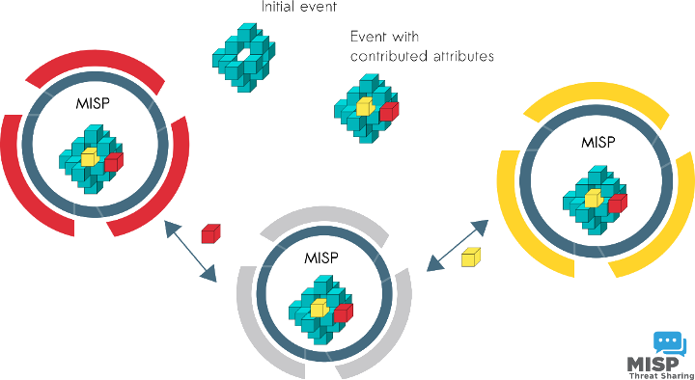
Everyone can receive data. Everyone can contribute to data.
Core functionality is sharing
Everyone can be a consumer and/ or a contributor/producer
Quick benefit without the obligation to contribute
Low barrier to get acquainted to the system

Slide 13
How does it work?

Slide 14

How does it work?
Setup MISP server
Your environment

Slide 15

How does it work?
Setup MISP server
Your environment
Connect to threat data feeds
Free and commercial feeds
IP addresses, file hashes, domains, TTPs

Slide 16
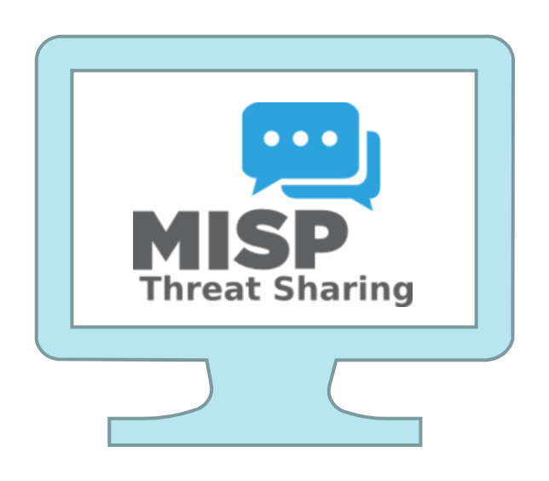
How does it work?
Setup MISP server
Your environment
Connect to threat data feeds
Free and commercial feeds
IP addresses, file hashes, domains, TTPs
Connect to trusted providers
Government and sector/industry MISP

Slide 17



How does it work?
Setup MISP server
Your environment
Connect to threat data feeds
Free and commercial feeds
IP addresses, file hashes, domains, TTPs
Connect to trusted providers
Government and sector/industry MISP
Query and update security controls
Proxy server, firewall, logs, endpoints
SIEM, IDS

Slide 18

Typical process
Analysis
Identifies threat for a sector / organisation
Detection package
Indicators of compromise
Victim
Receives MISP event
Activities and behaviour
Trusted provider
Threat event
Verification and approval
Infrastructure
Query for activity
Block activity
Share back and report back

Slide 19
Use cases for received threat events
Block IP address on firewall
Scan endpoints with custom rules
IDS signatures
SIEM alerts
Block malicious URL on proxy
Query logs for activity

Slide 20
What do you need?

Slide 21
What do you need?
Hardware and software
One server with Linux (preferably Ubuntu Linux)
Average storage and memory (250GB/64GB)
MISP uses a web server (Apache) and database server (MariaDB)
Installation
MISP is usually installed from source via Github
Infrastructure integration
Customizations for integration with security controls
Base capabilities are included
Needs to be tuned to your environment

Slide 22
MISP details

Slide 23
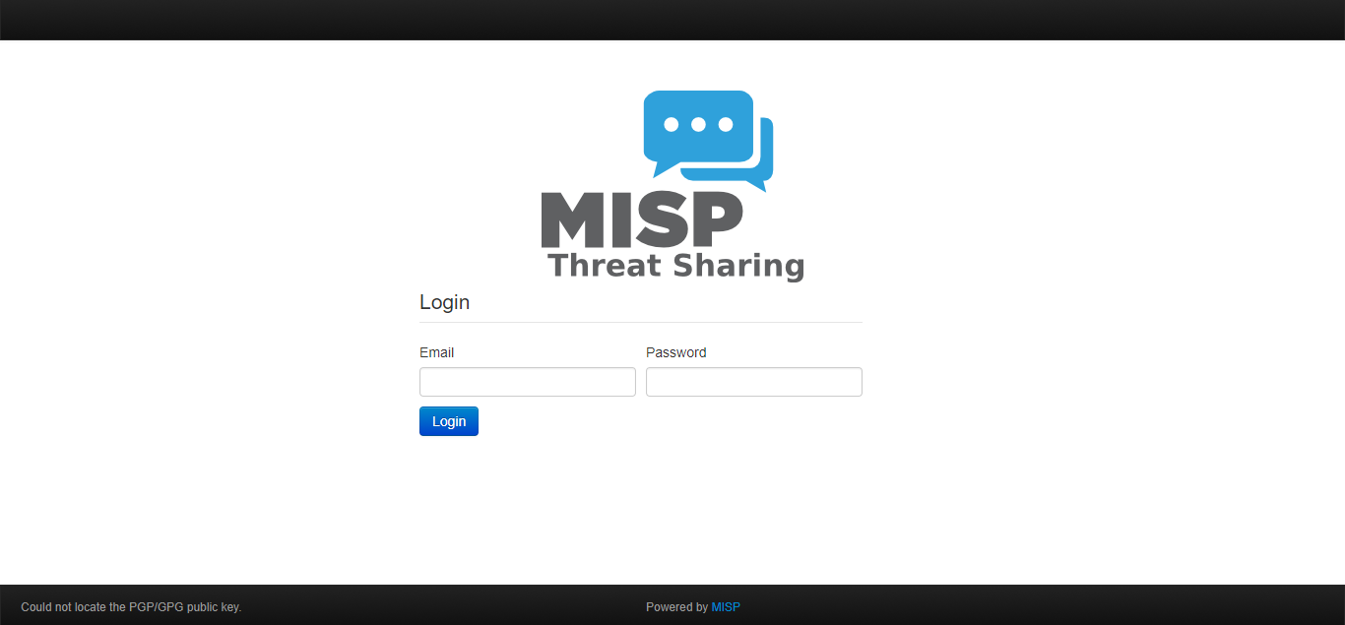
Access to MISP
Web interface
Multiple users and groups
Role based access
API access for automation
Integration with other tools
Synchronization with security controls
Python library

Slide 24
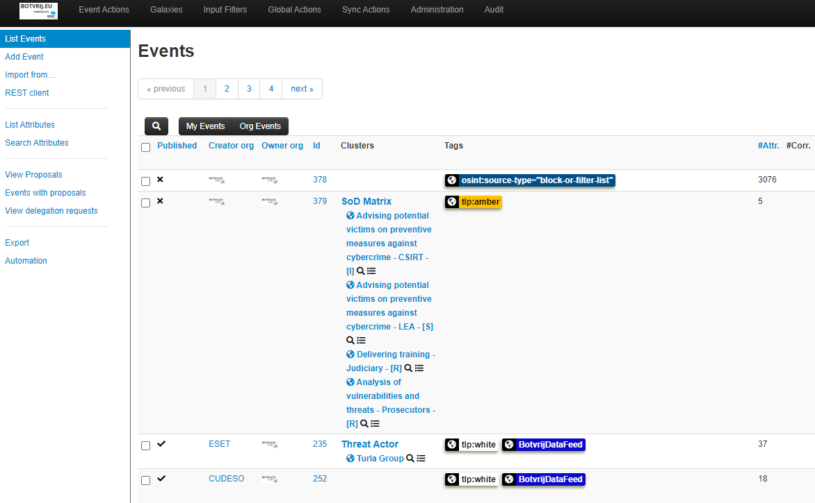
MISP user interface
Events are containers of contextually linked information
From an incident, a security report or a threat actor analysis
Contains attributes with indicators
Tools, techniques and procedures
Your desired (or expected) actions
Block, detect

Slide 25
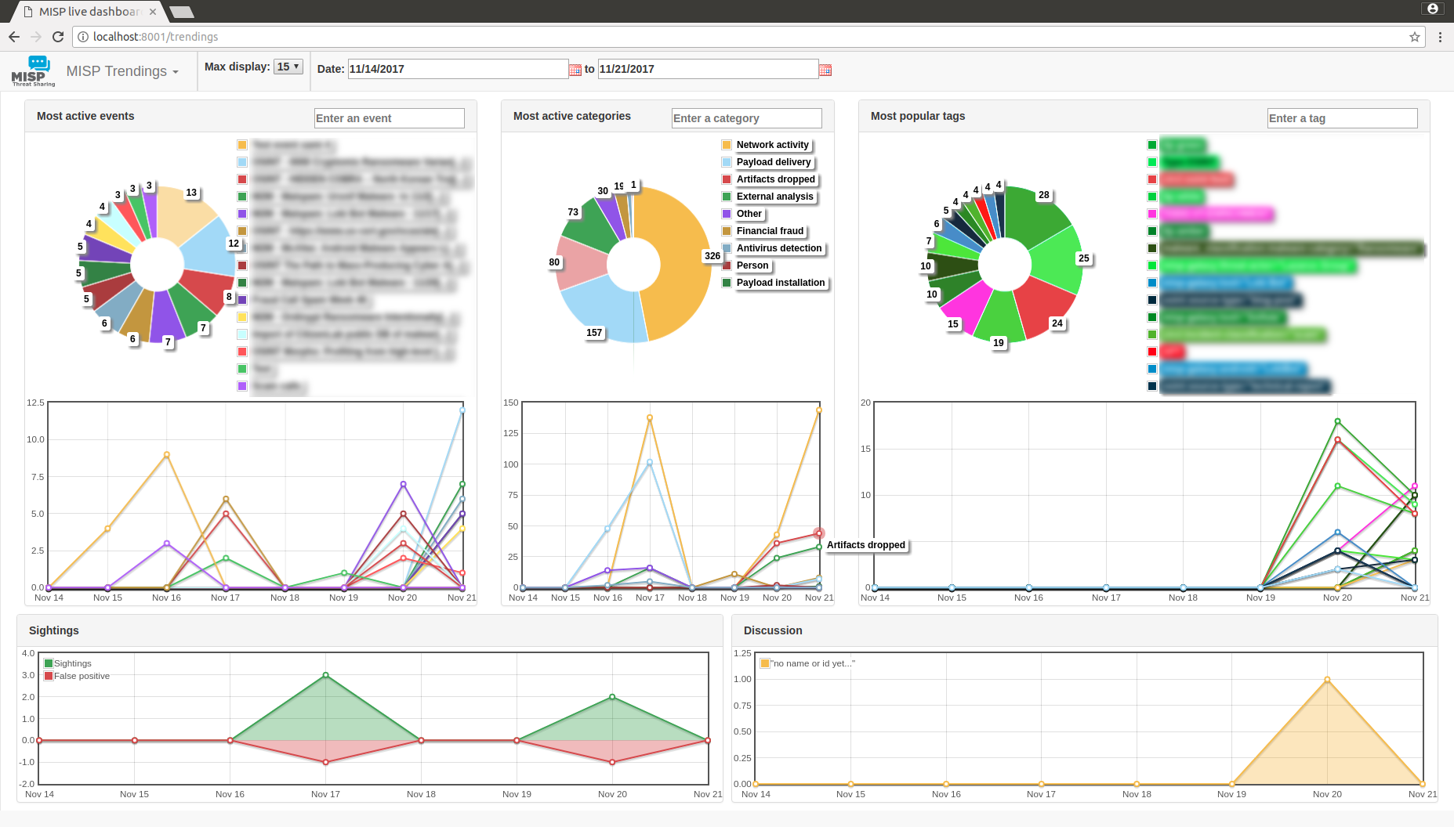
MISP dashboard with trends and statistics

Slide 26
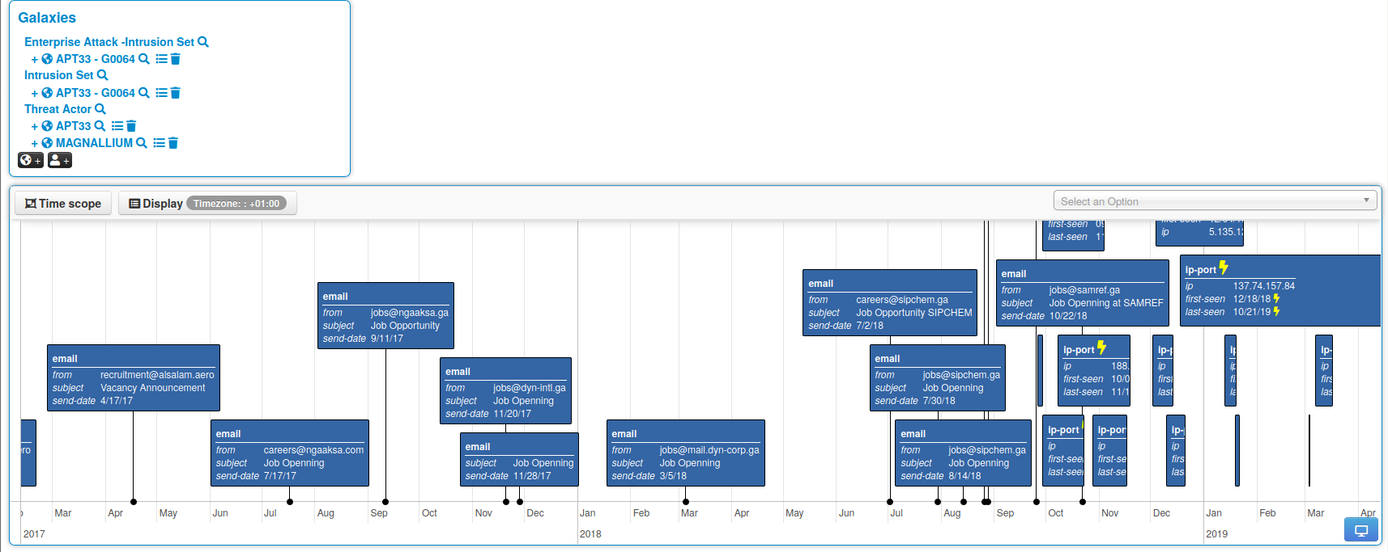
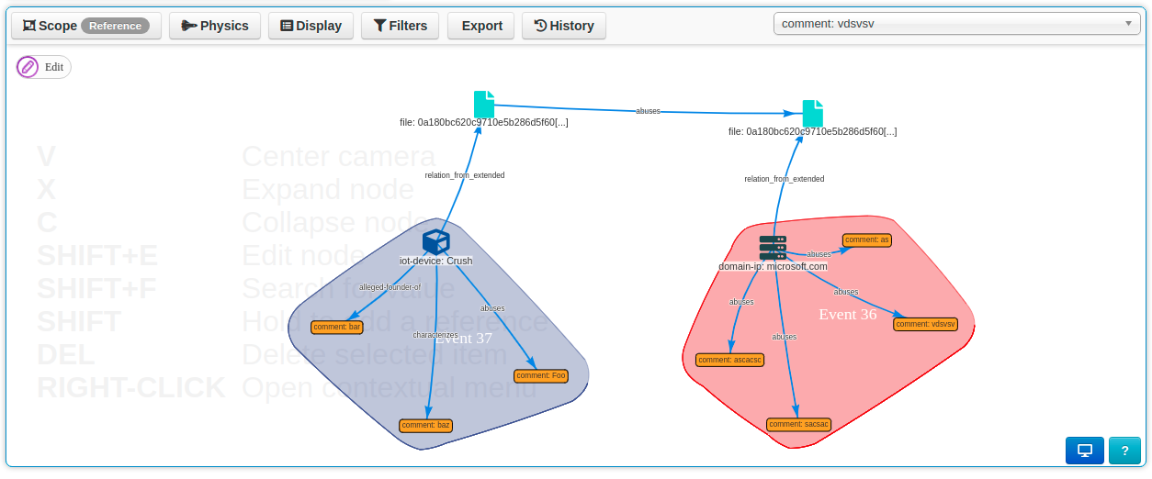
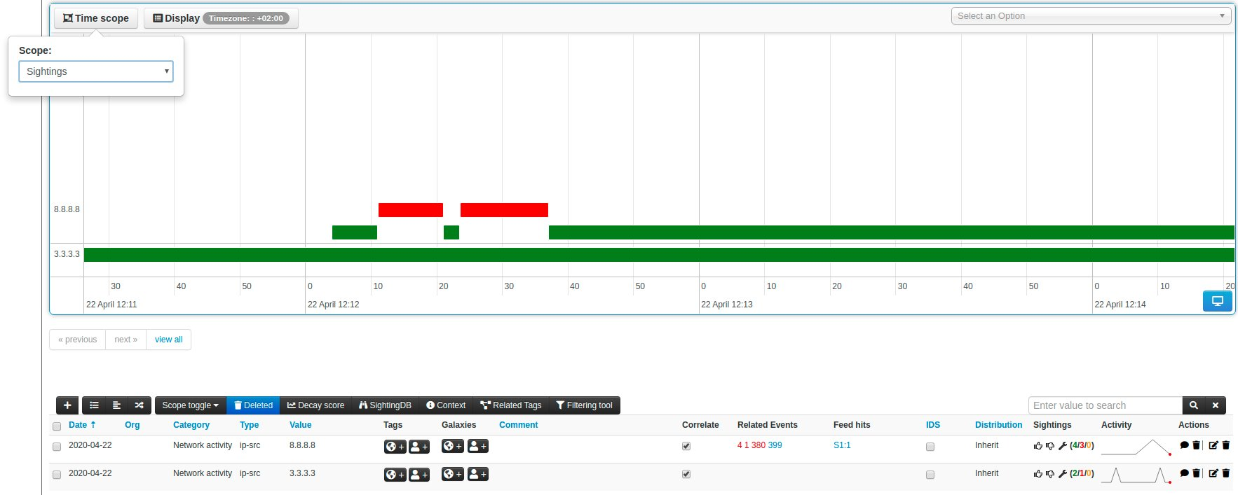
Timeline and clusters of activities

Slide 27
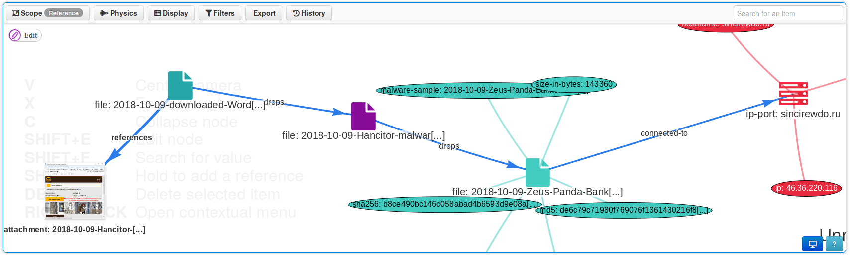
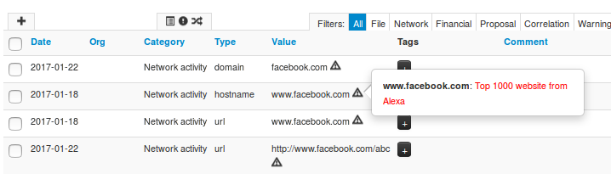
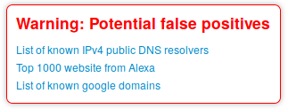
Information quality management
Contextualization
False positive management

Slide 28
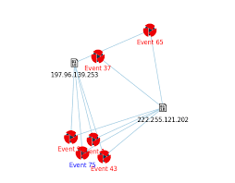
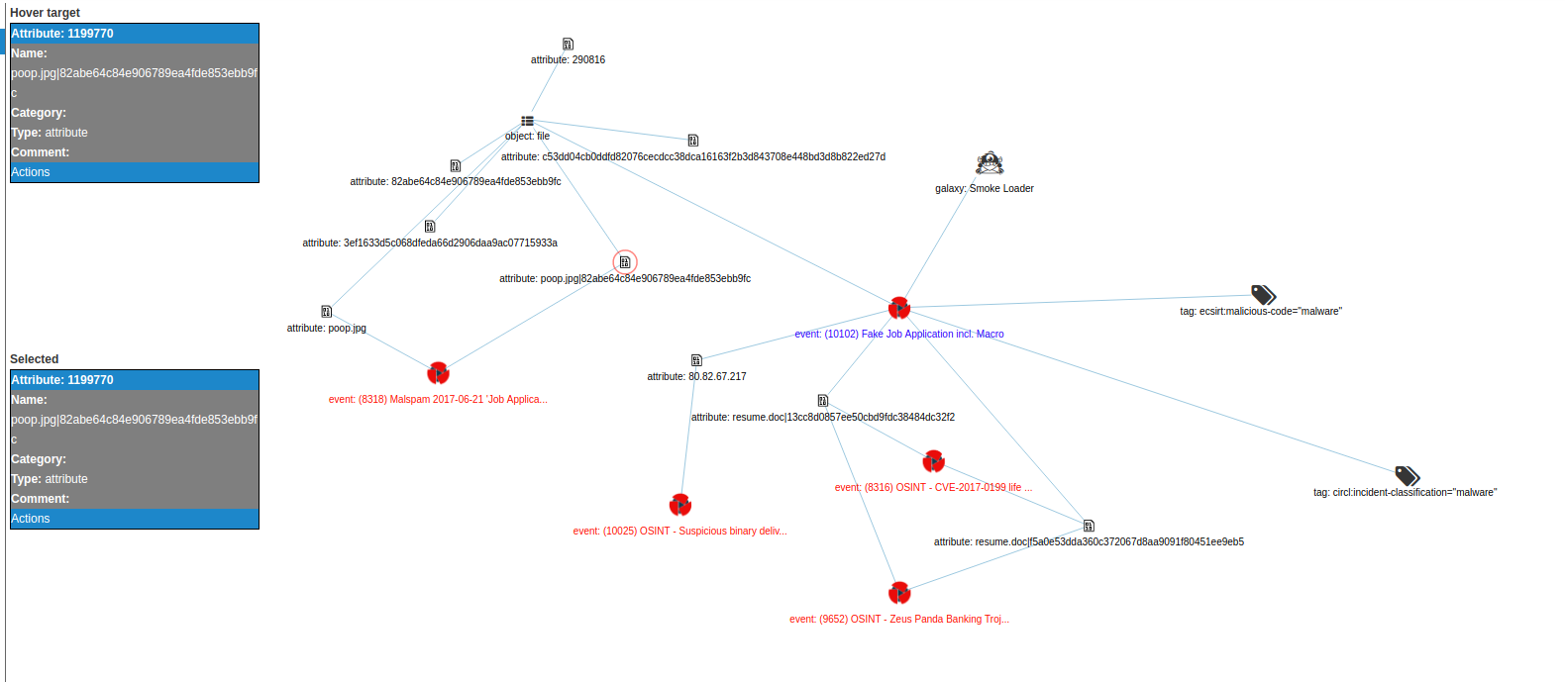
Correlating data
Correlate on indicators and context

Slide 29
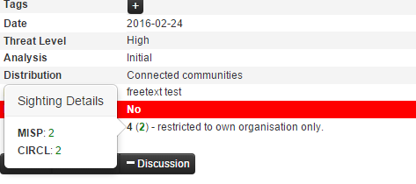
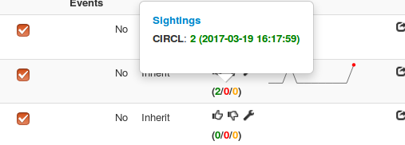
Continuous feedback loop
Feedback on observed indicators
Confirm presence of activity

Slide 30
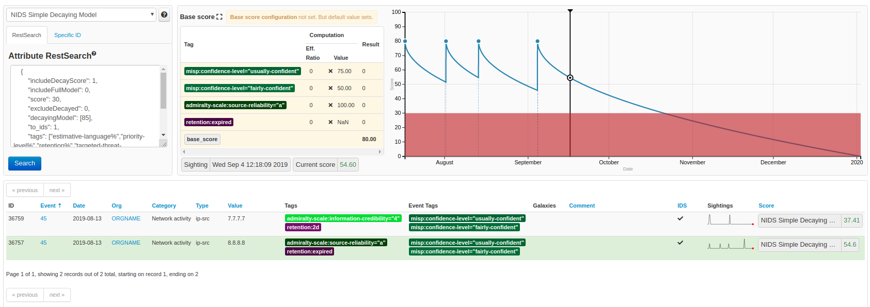
Relevant indicators
Remove older (less- / non relevant) indicators

Slide 31
MISP in industrial environment

Slide 32

MISP in industrial / ICS environment
“Normal” MISP
Export threat events

Slide 33

MISP in industrial / ICS environment
“Normal” MISP
Export threat events
Transfer via USB
Scan via kiosk

Slide 34

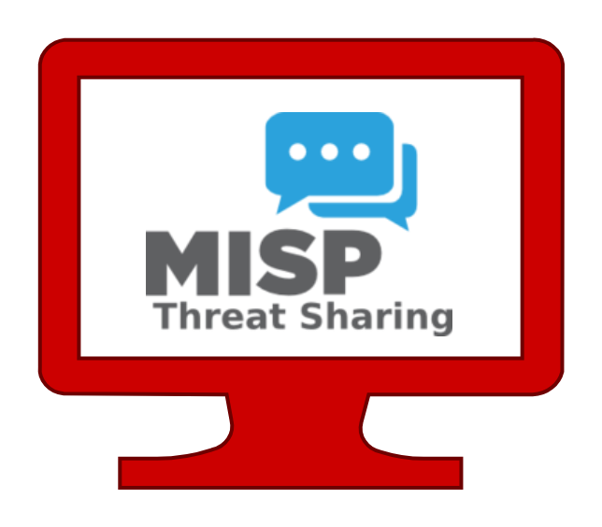
MISP in industrial / ICS environment
“Normal” MISP
Export threat events
Transfer via USB
Scan via kiosk
Import threat events
ICS – Airgapped

Slide 35
Questions?

