Slide 1
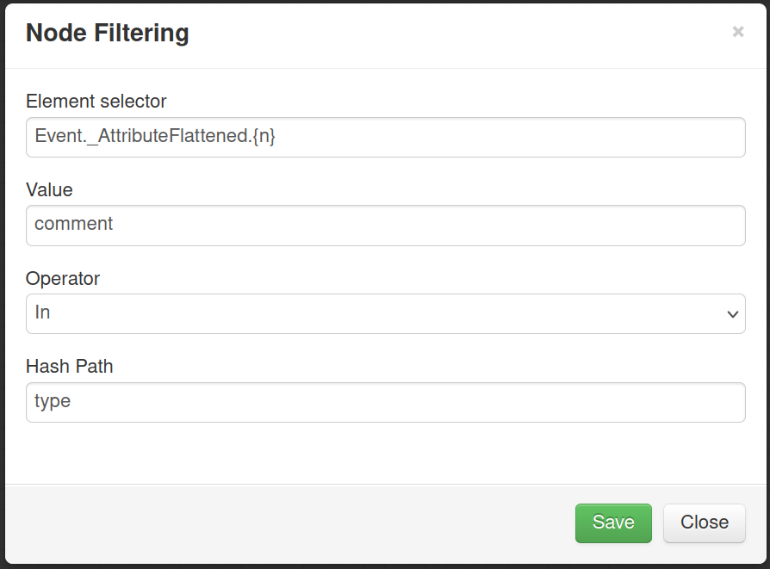
Select elements on which
to apply the filtering
Fixed value
Comparison operator
Data point to get the value

