Slide 1

IMPLEMENTATION OF FILE TRANSFER PROTOCOL USING NETWORK SIMULATION TOOL Project Synopsis Presentation Date: 23/09/2022
BTech Data Science (I-nurture) 3rd Semester
COURSE CODE - IDS353
Project Guide:
Er. Ghufran Khan
Manas Chauhan (TCA2166012)
Ankur Gangwar (TCA2166005)
Avi Kumar (TCA2166009)
FACULTY OF ENGINEERING & COMPUTING SCIENCES
TEERTHANKER MAHAVEER UNIVERSITY, MORADABAD

Slide 2

Team Details
Student Name | Role
Manas Chauhan | Presentative etc.
Ankur Gangwar | Helper
Avi Kumar | Developer
Guidelines: Mention Team Names & their role in project
2
T011A/ Template Version 5.0

Slide 3
Contents
FTP (File Transfer Protocol)-
Server FTP is a standard network protocol built on a client-server model architecture for transferring computer files between a server and a client. It also can be used to backup and restore router configuration. To use FTP in Packet Tracer, its service must be enabled first.
Guidelines: Mention brief about the project and it’s functions/ modules
3
T011A/ Template Version 5.0

Slide 4
Project Brief
Research Importance and Limitation-
The research given a good direction in accessing the effectiveness of Cisco Packet Tracer utilization in Computer Networking subject. The Cisco Packet Tracer allows students to build self-contained computer networks as well as implement all necessary configurations such as placing physical wire connections, setting IP addresses and simulating data transmission simulations. Generally, Cisco is a renowned company which giving training, teaching and learning and certification of Computer Networks commercially. Using the Packet Tracer, the students will gain the experience of using the software and hardware base from Cisco without the need for registration and attendance to training which is apparently costly for them.
Guidelines: Mention brief about the project and it’s functions/ modules
4
T011A/ Template Version 5.0

Slide 5
Methodologies/ Technologies/ Tools to be used
Cisco Packet Tracer Simulation as Effective Pedagogy in Computer Networking Course.
Introduction-
On the basis of the 11th Malaysia Plan (2016 - 2020), the Malaysian Public Sectors ICT Strategic Planning had drawn Infinite Computer Network connections as vital infrastructure and framework to help drive the nation economies in achieving its sustainability (MAMPU, 2016). On top of that, the significant and relevancy of Computer Networking based subject in Malaysia Higher Education setting is ever-essential as it. Cisco Packet Tracer Simulation as Effective Pedagogy in Computer Networking Course had been included as Body of Knowledge in all Computer Science, Software Engineering, Information Technology and Information System domains (Malaysian Qualifications Agency (MQA), 2015). Thus, the quality of teaching and learning of Computer Network subject in higher education is prominent as to nurture graduates who are subject-matter competent and qualified especially when corresponded to the industrial standard.
5
T011A/ Template Version 5.0

Slide 6
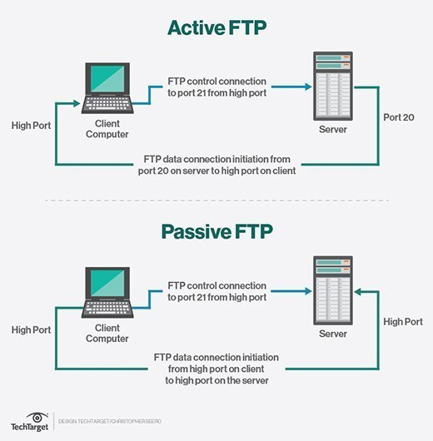
Context Diagram (Overall Project)
6
T011A/ Template Version 5.0

Slide 7
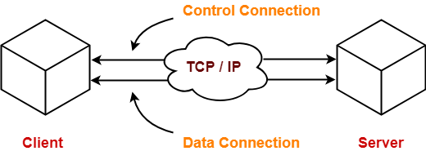
Entity Relationship Diagram (ERD)
7
T011A/ Template Version 5.0

Slide 8
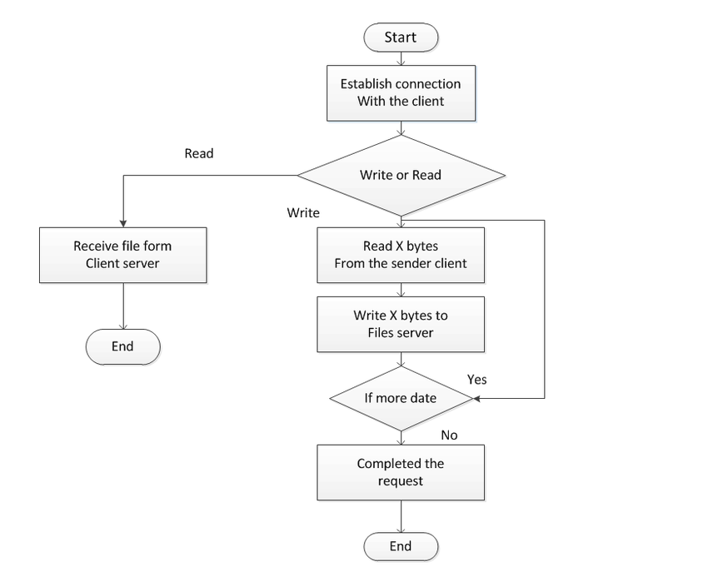
Data Flow Diagram (DFD)
Guidelines: Add more slides, if required to show all DFDs
8
T011A/ Template Version 5.0

Slide 9
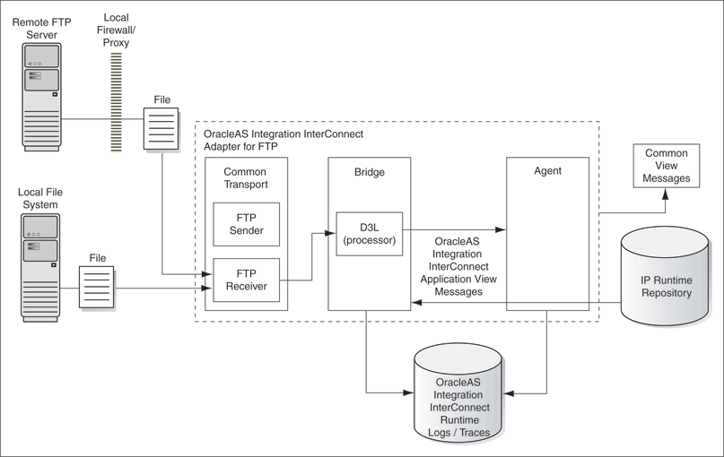
Flow Chart
Guidelines: This slide is optional
9
T011A/ Template Version 5.0

Slide 10
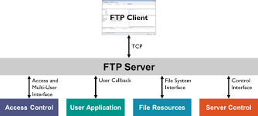
Use Case Diagram
Guidelines: This slide is optional. May add more slide, if the details are available
10
T011A/ Template Version 5.0

Slide 11
\
Advantage of The Project
Advantages of FTP Clients
Over the years, we’ve worked with countless companies that have benefitted from an FTP client. In fact, we can even help users across your organization connect to the proper files. Here are just a few advantages of this time-tested transfer method:
Allows the transfer of multiple files and directories
Ability to resume a transfer if the connection is lost
Ability put items into a queue to be uploaded or downloaded
Allows you to schedule transfers
No size limitation on single transfers (browsers only allow up to 2 GB)
Scripting capabilities through command line
Synchronizing utility
Faster transfers then HTTP
Supported on almost all hosts (per Randy Downs at Downs Consulting Services)
Guidelines: Mention advantage from this project, the audience/ users who will get benefitted
11
T011A/ Template Version 5.0

Slide 12
References, if any
[1] Leon-Garcia and I. Widjaja. (2004). Communication Networks: Fundamental Concepts and Key Architectures (2nd ed.). McGraw-Hill. [2] Tanenbaum. (2003). Computer Networks, 891. https://doi.org/10.1016/B978-0-12-385059- 1.00013-
12
T011A/ Template Version 5.0

Slide 13
THANKS

