Slide 1
Project Wepic
Audio CODEC module
I/O solution

Slide 2
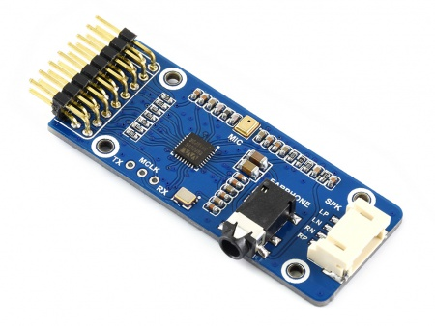
Waveshare WM8960 Audio Board
Features:
Low power consumption (3.3 V)
24-bit sigma-delta ADC and DAC
PLL
Sample rates in kHz: 8, 11.025, 12, 16, 22.05, 24, 32, 44.1, 48
On-chip 3.5mm 4-pole Headphone Driver (40mW into 16 Ohm at 3.3 V)
Stereo Class D Speaker Driver (1W into 8 Ohm at 5.5 V)

Slide 3
Waveshare WM8960 Audio Board
Features:
Low Supply Voltage
Analogue (2.7 V to 3.6 V)
Dicital core and I/O (1.71 V to 3.6 V)
Onboard interface I²S
Control interface I²C
Link: https://www.waveshare.com/wiki/WM8960_Audio_Board

Slide 4
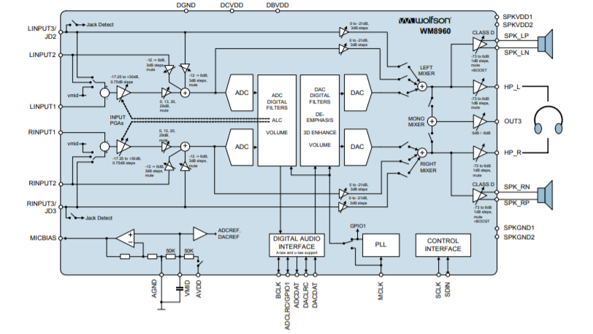
Board Scheme

Slide 5
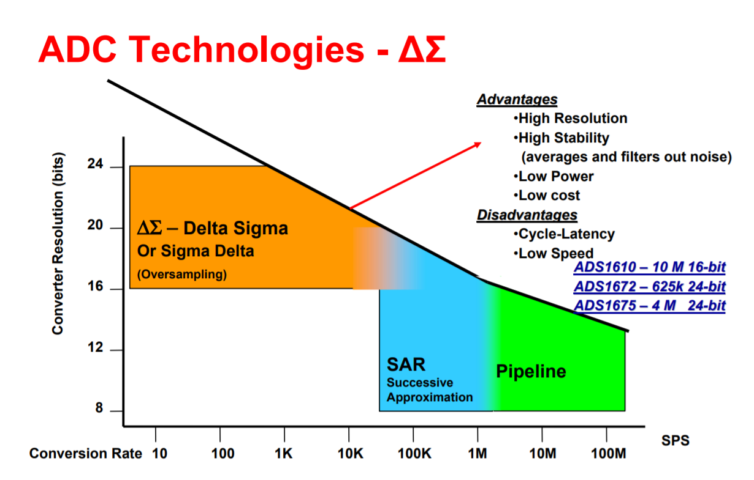
Why use sigma-delta ADC?

Slide 6
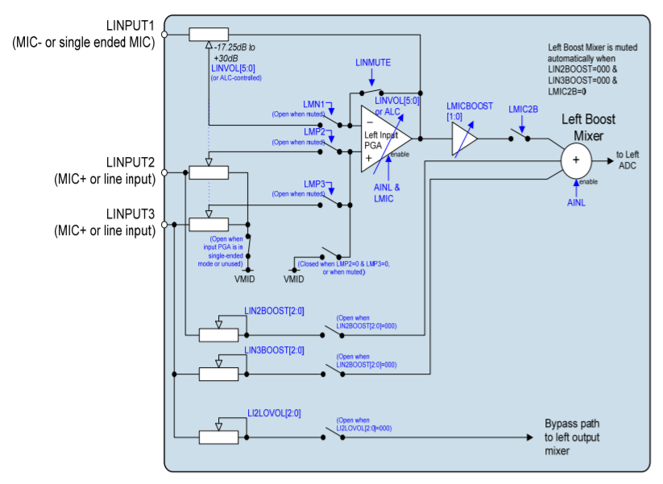
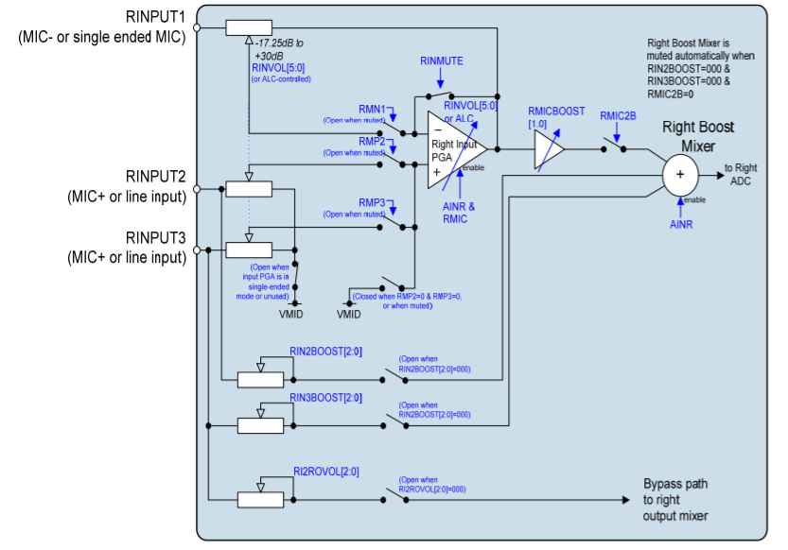
Line Inputs
Two pairs of stereo line inputs (LINPUT2/RINPUT2 and LINPUT3/RINPUT3) are available as analogue inputs into the ADC path. Differential microphones can be connected betwen LINPU1 and LINPUT2 or LINPUT3, and betwen RINPU1 and RINPUT2 or RINPUT3.

Slide 7
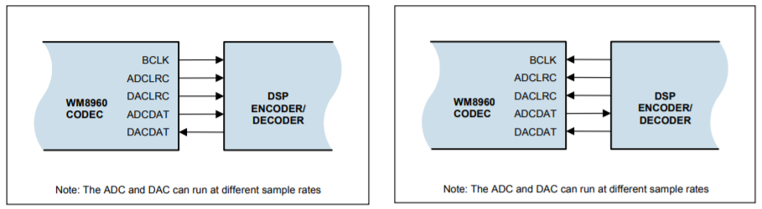
Digital Audio Interface
ADCDAT: ADC data output
ADCLRC: ADC data alignment clock
DACDAT: DAC data input
DACLRC: DAC data alignment clock
BCLK: bit clock, for synchornisation

Slide 8
Audio Data Formats
Left justified
Right justified
I²S
DSP mode

Slide 9
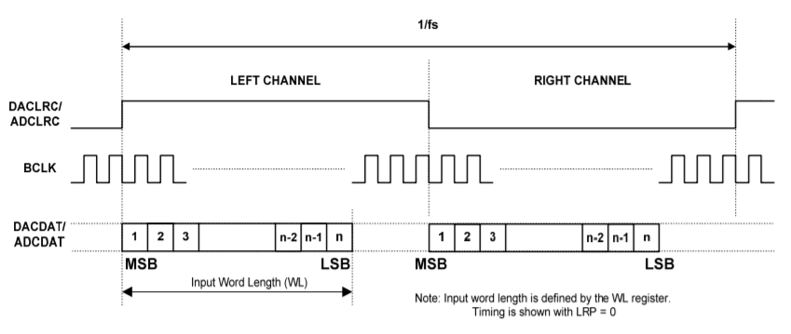
Left Justified Audio Interface

Slide 10
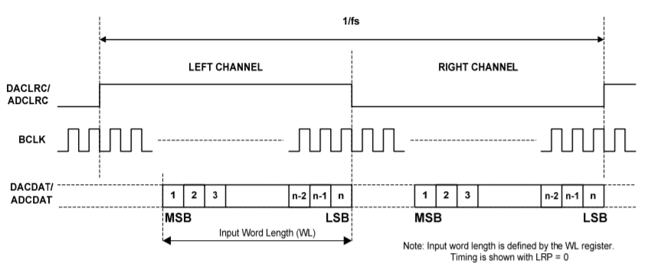
Right Justified Audio Interface

Slide 11
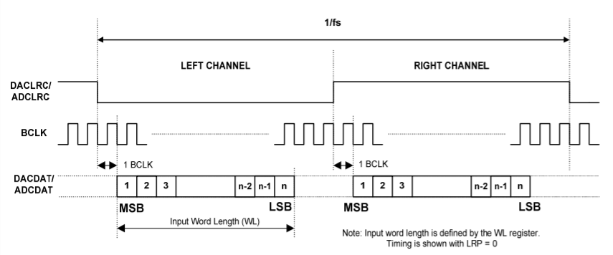
I²S

Slide 12
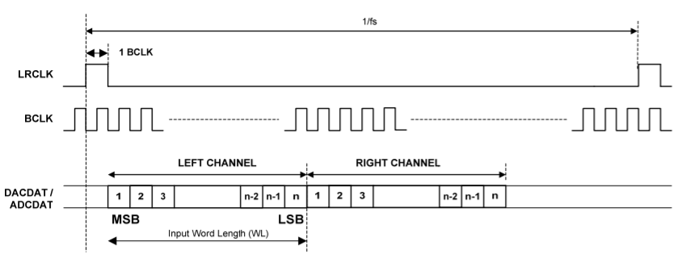
DSP Mode Audio Interface
Left channel MSB is available on 1st (mode B) or 2nd (mode A) rising edge of BCLK following a rising edge of LRC
Master and slave modes

