Slide 1
Cluster-based Penalty Scaling for Robust
Pose Graph Optimization
Fang Wu
Engage Project: June ~ November 2019

Slide 2
Overview
Background and motivation
Simultaneous Localization and Mapping
Perceptual aliasing
Prerequisites and related works
Pose graph optimization
Methodology
Clustering strategy
Robust formulation
Experimental results

Slide 3
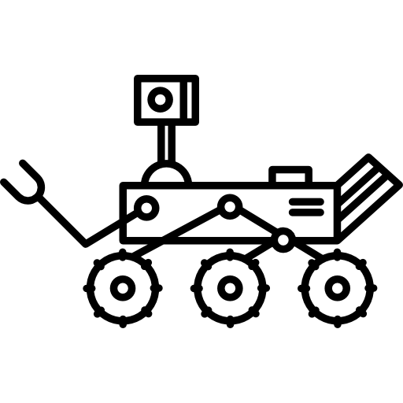
Simultaneous location and mapping
Drifted Estimates
Optimized Estimates
Loop closure
(place recognition)
Pose Estimates
(Translation + Rotation)
Noisy Odometry
Drift

Slide 4
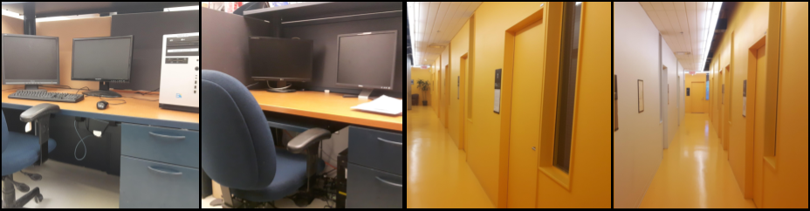
One link to break them all: Perceptual Aliasing
Correct trajectory estimate
Accurate loop closure
Outlier due to perceptual aliasing
Initial pose graph
Distorted trajectory estimate

Slide 5
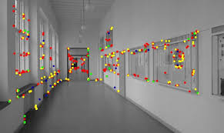
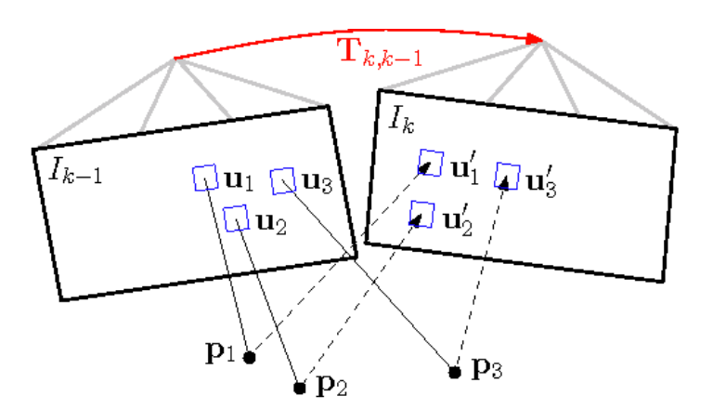
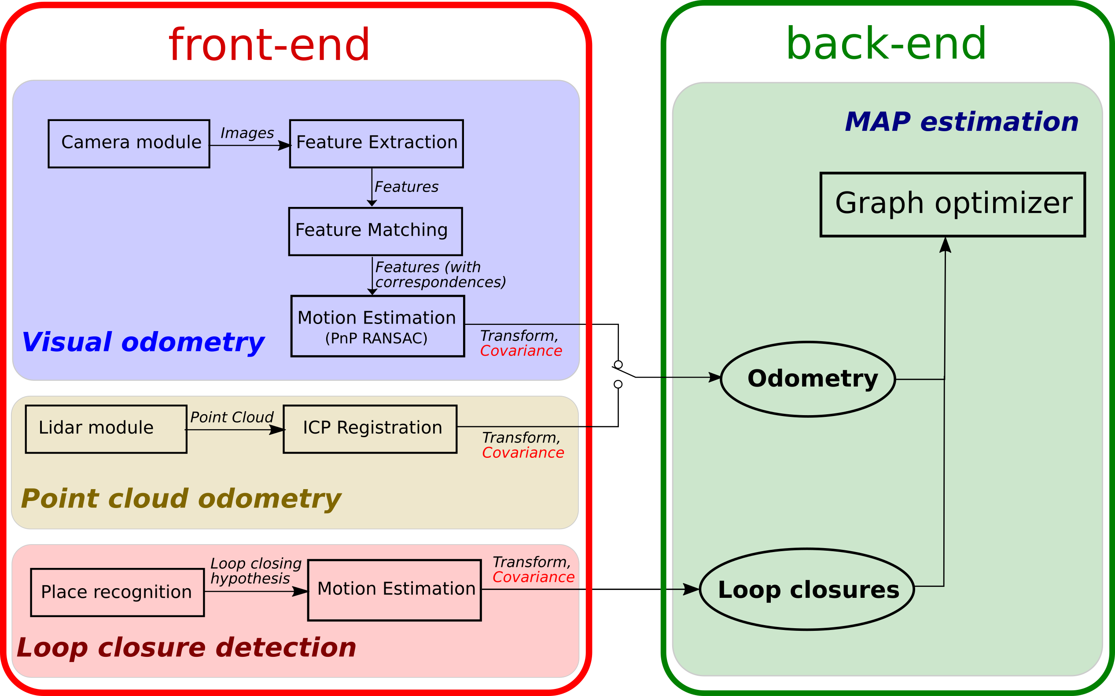
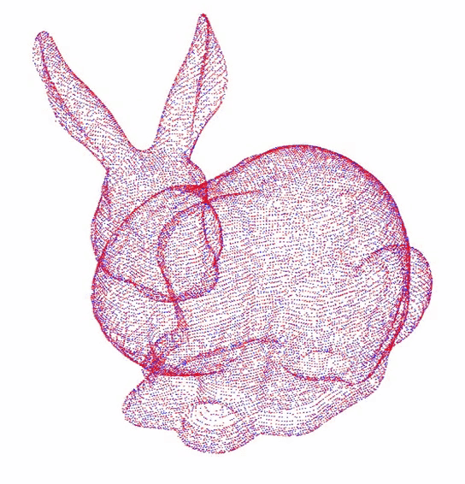
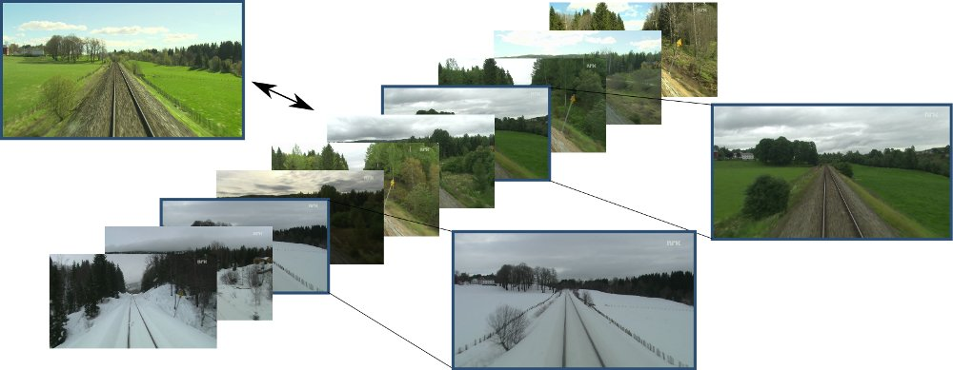
SLAM Pipeline

Slide 6
Overview
Background and motivation
Simultaneous Localization and Mapping
Perceptual aliasing
Prerequisites and related works
Pose graph optimization
Methodology
Clustering strategy
Robust formulation
Experimental results

Slide 7
Classical formulation for PGO
Factor Graph
Maximum A Posteriori (MAP) Problem
Pose Graph
Measurement
Posterior Estimation
Bayes’ rule
Gaussian noise
assumption
Prior information

Slide 8
Nonlinear Least Square Problem
Odometry
Loop Closure
The objective function has a quadratic form,
Now we can apply nonlinear optimization techniques, such as Gauss-Newton method, to iteratively solve this problem.

Slide 9
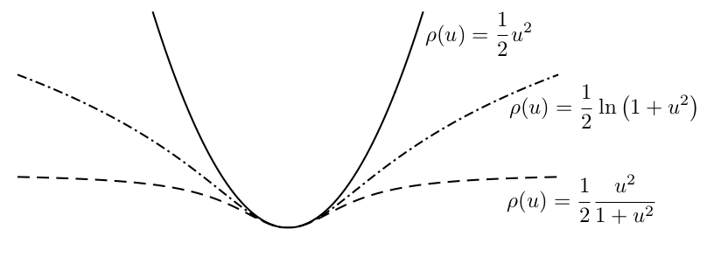
Related works
SC
[5]
DCS
[6]
Assumption on maximal admissible error
Introduce extra variable to allow outliers to be scaled down during optimization
Scale down the outliers by dynamically scaling the covariance
No extra variable
Proposed tuning parameter
Maximal Admissible error
Plots of quadratic, Cauchy and German-McClure cost functions for scalar inputs

Slide 10
Related works
Conservative
Only based on past measurements
RRR
[4]
OFCC
[8]
Preprocessing
Extract spatial clusters of loop closures
Check intra-cluster consistency and inter-cluster consistency based on test
Performance sensitive to clustering size
Incremental setting
Predict the objective function change
Use difference test
Outlier
Outlier
Inlier
Inlier
Inlier
Heterogeneous cluster
Spatial clusters

Slide 11
Overview
Background and motivation
Simultaneous Localization and Mapping
Perceptual aliasing
Prerequisites and related works
Pose graph optimization
Methodology
Clustering strategy
Robust formulation
Experimental Result

Slide 12
Clustering
Spatially clustering
Outlier
Two spatial clusters
“Good” Cluster:
Intra-consistent
Consistent with Odometry
Quality indicator set to 1
Inlier
Inlier
difference test

Slide 13
Clustering
Extract the majority set
regardless of its quality
Inlier
Outlier
Outlier
Outlier
Outlier
Inlier
Inlier

Slide 14
Clustering
“Bad” Cluster:
Intra-consistent
Not consistent with Odometry
Quality indicator set to 0
Inlier
Inlier
Inlier
Accept the first edge
system state changed

Slide 15
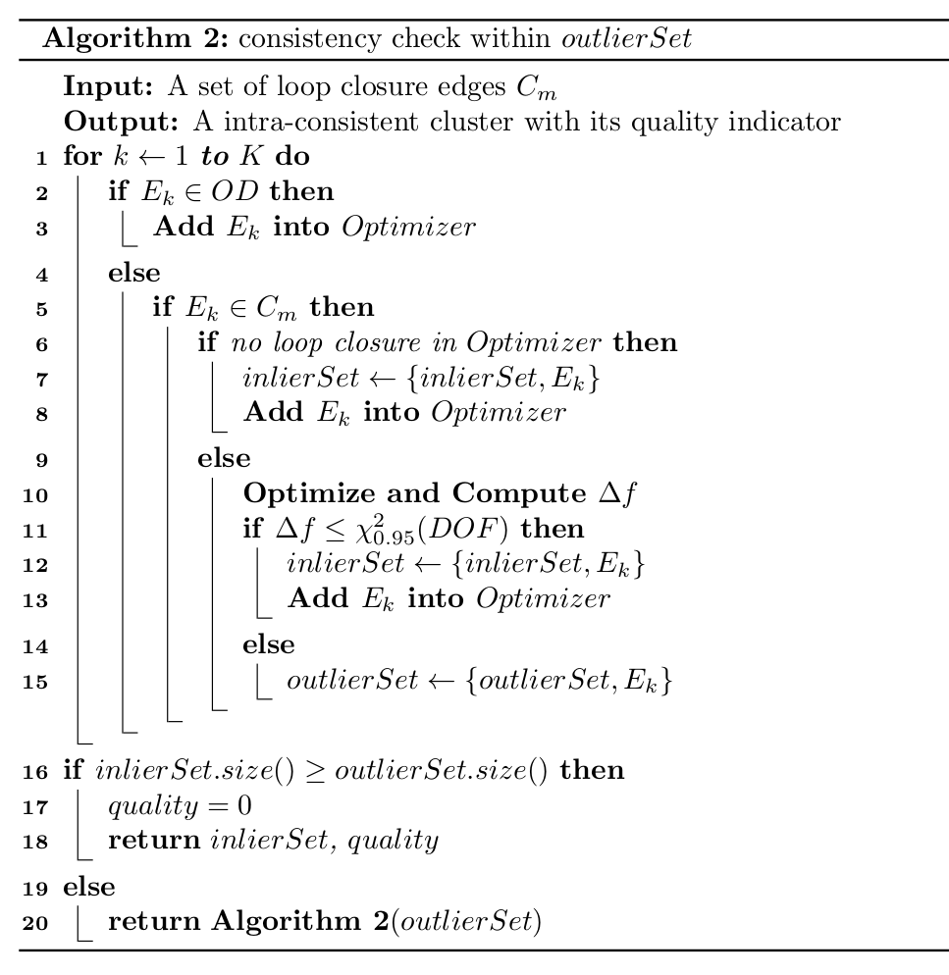
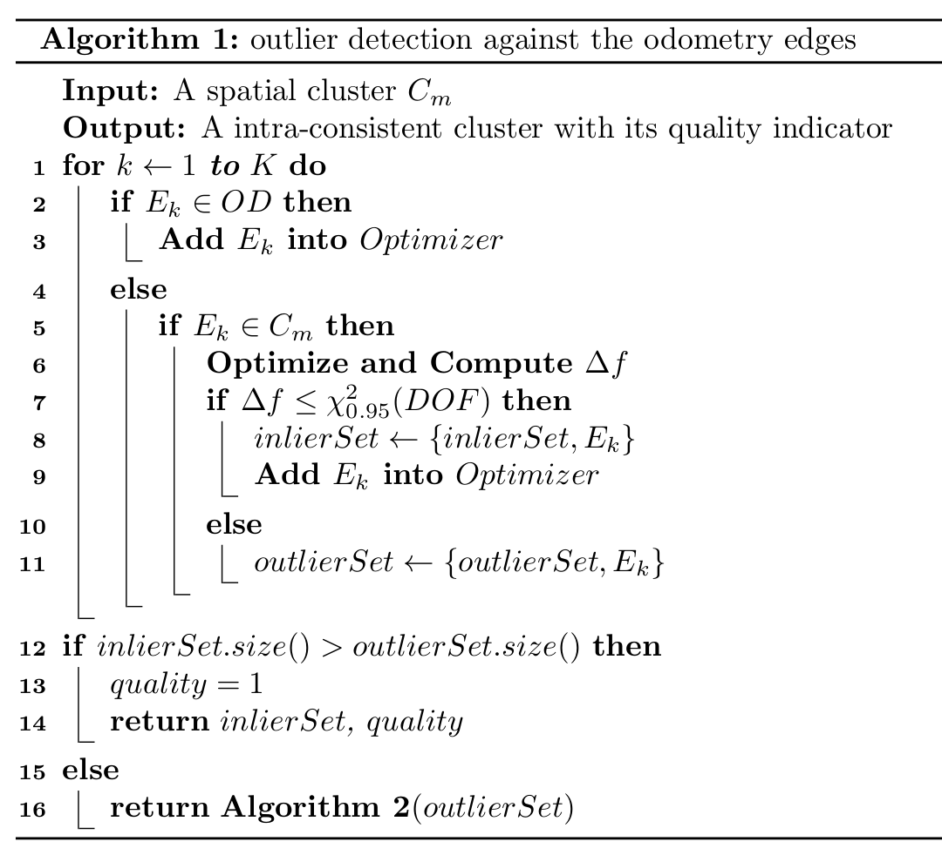
Pseudo Code

Slide 16
Robust formulation
Normalizing the coefficients by the size
of cluster
clustering factor should not be the
dominant penalty

Slide 17
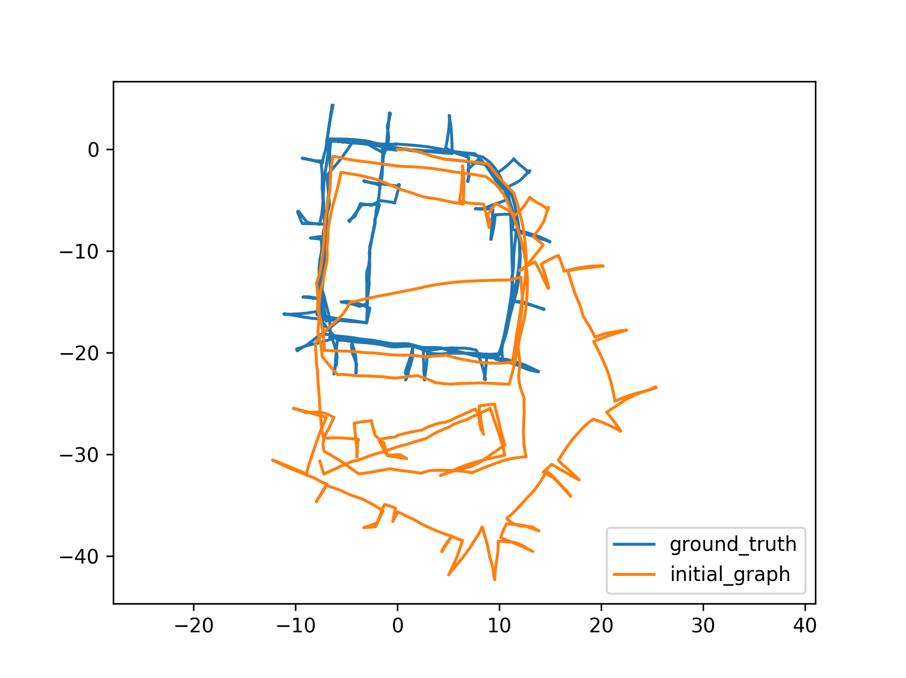
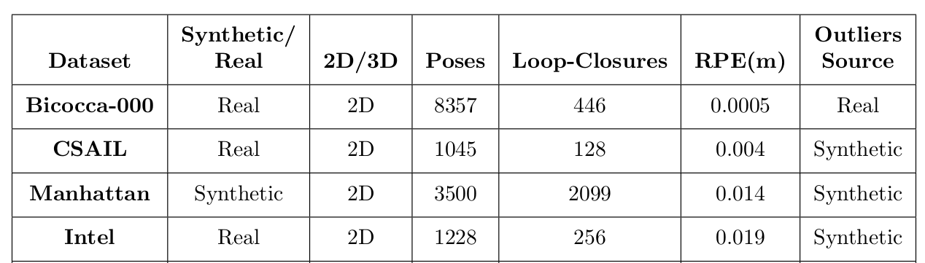
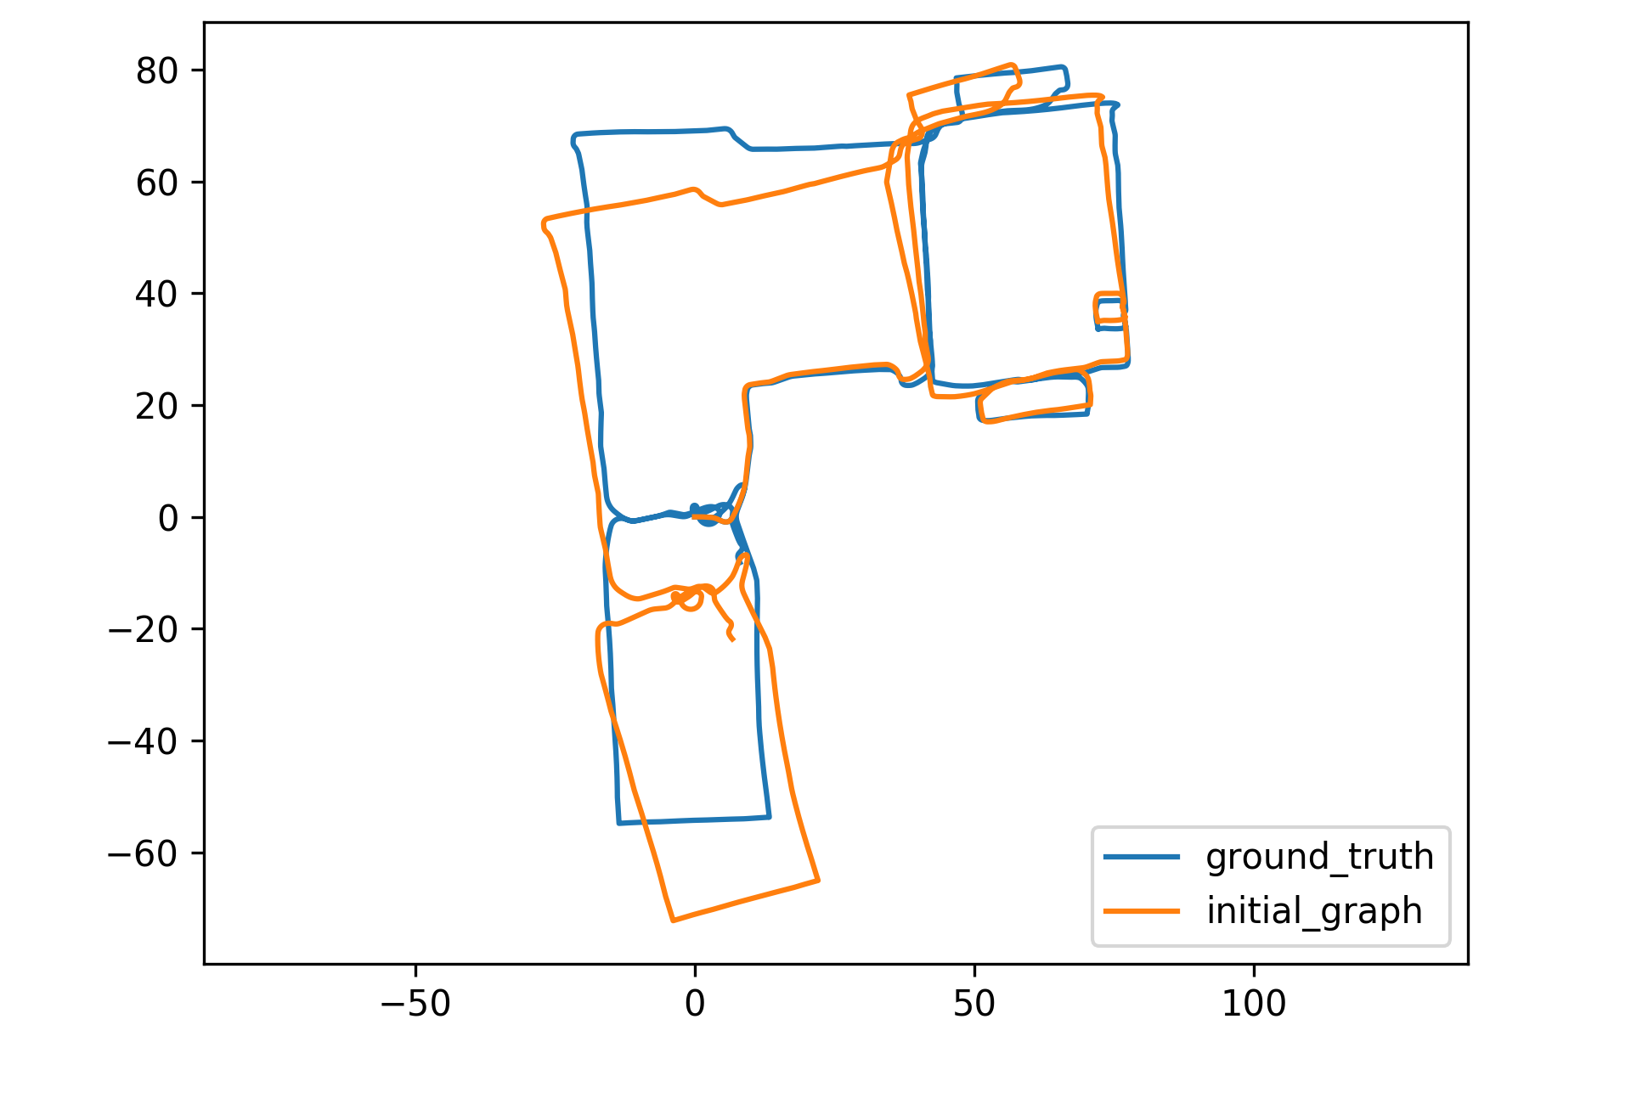
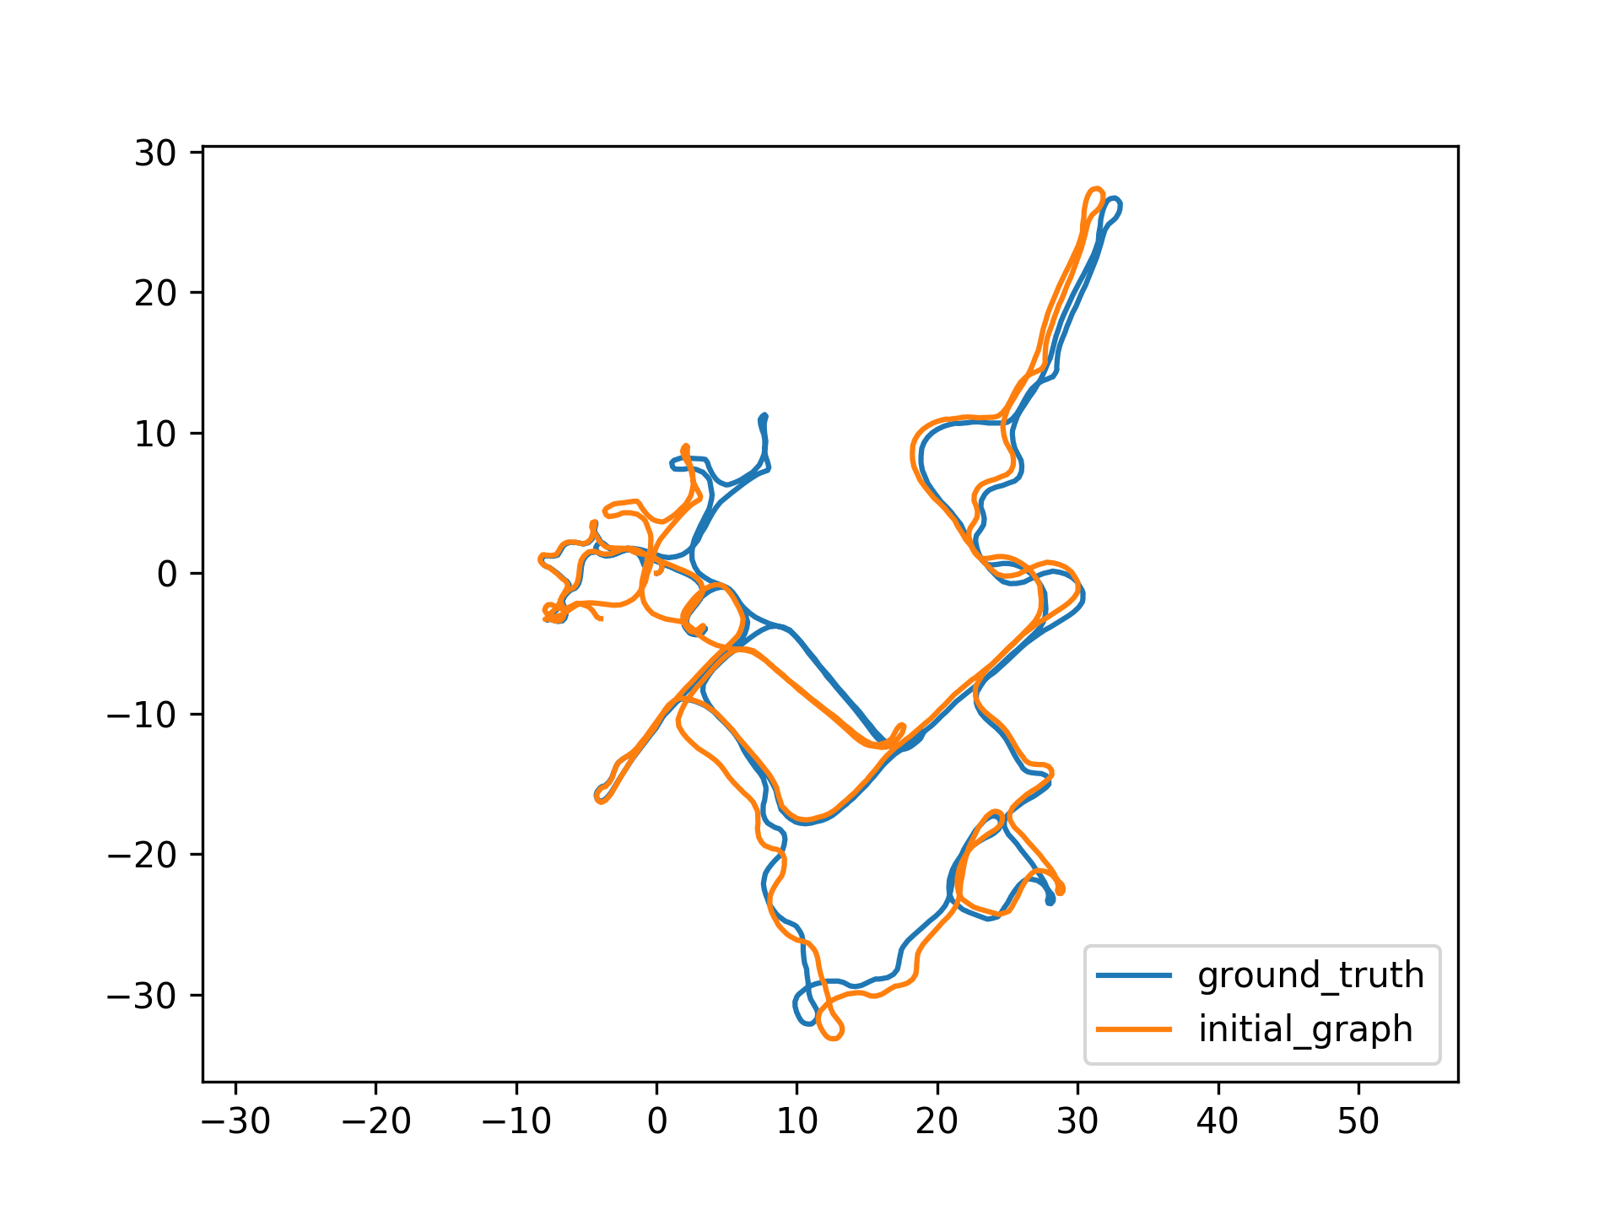
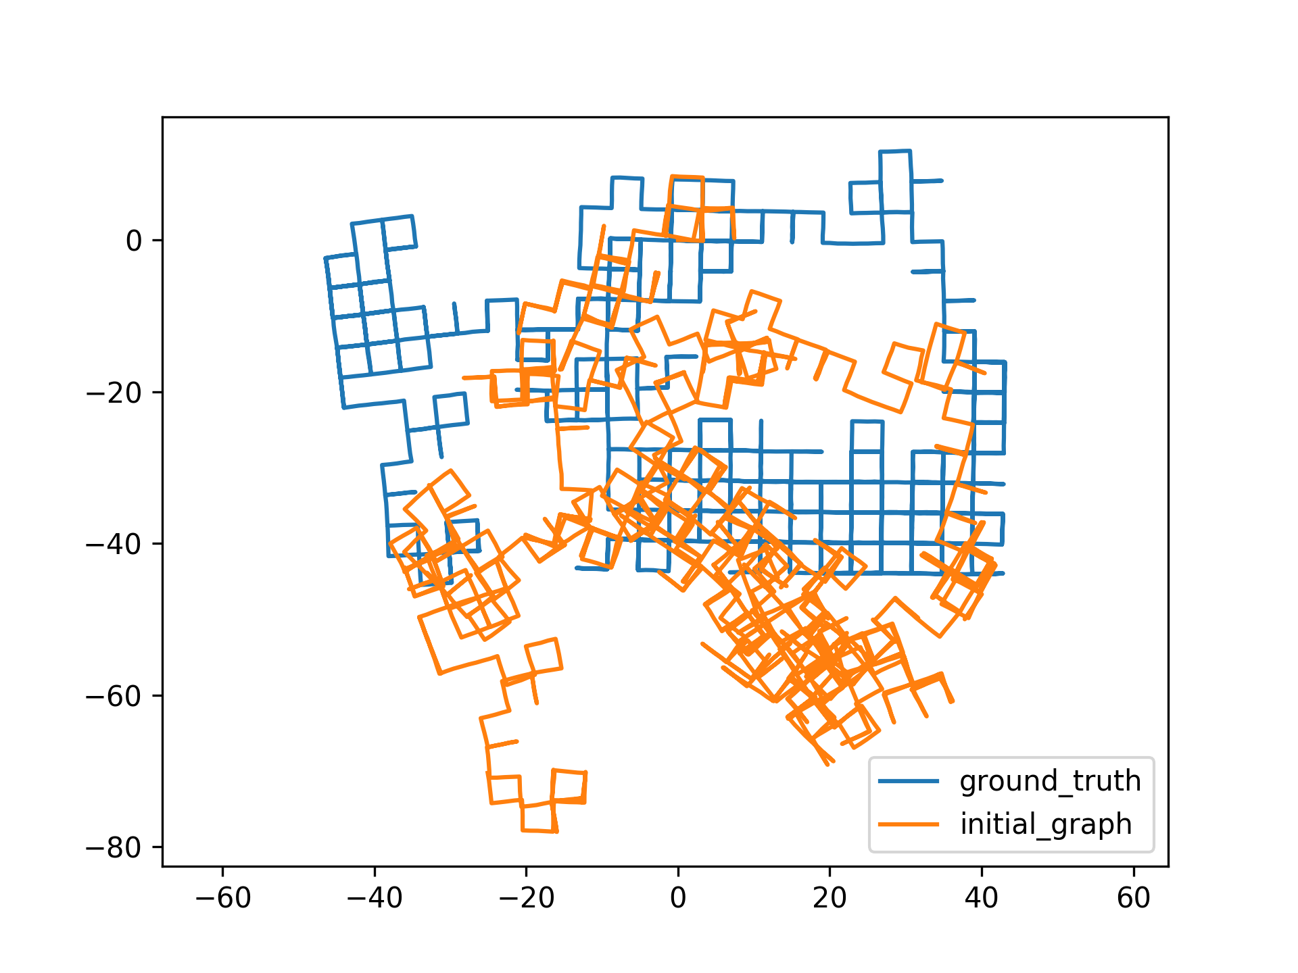
Experiments
Intel
Bicocca
Csail
Manhattan

Slide 18
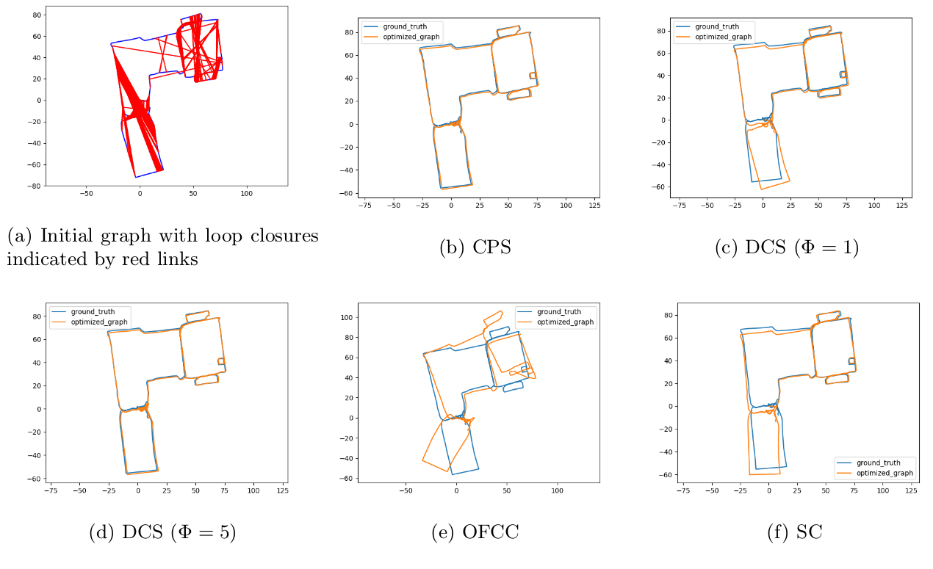
Bicocca

Slide 19
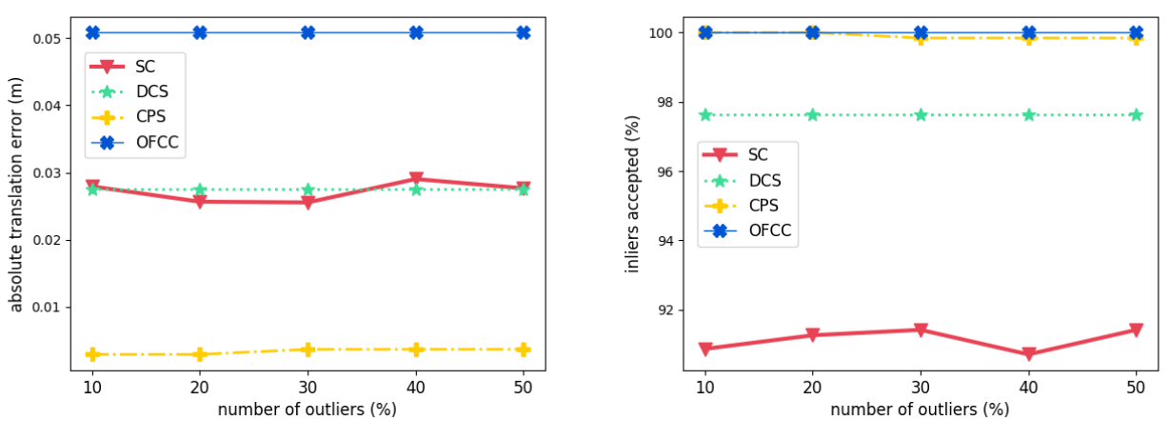
Csail
All four methods rejected all outliers in all the trials
CPS accepted more inliers than DCS and SC, and achieved lowest ATE
OFCC accepted all inliers, however have highest ATE

Slide 20
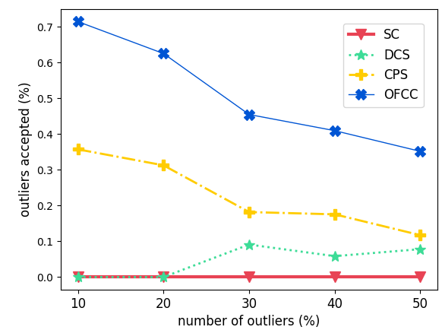
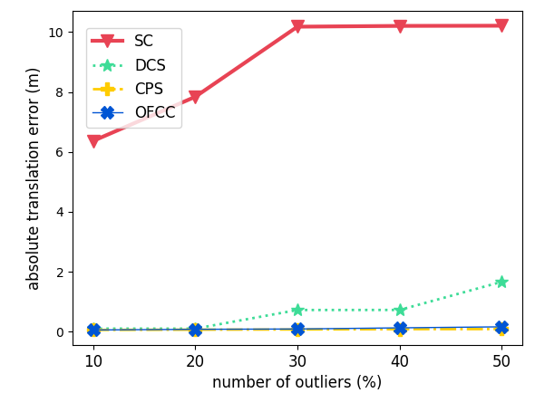
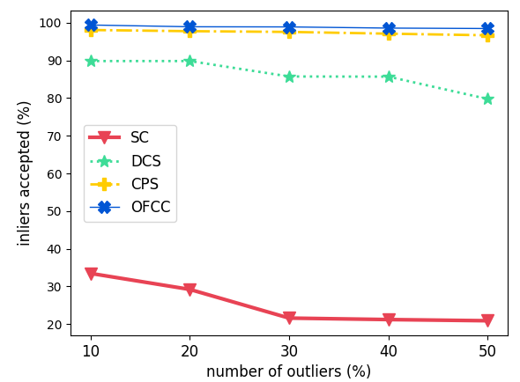
Intel
CPS accepted a lot more inliers than DCS
and SC, and also slightly more outliers
OFCC accepted the highest percentage
of outliers
CPS achieved lowest ATE

Slide 21
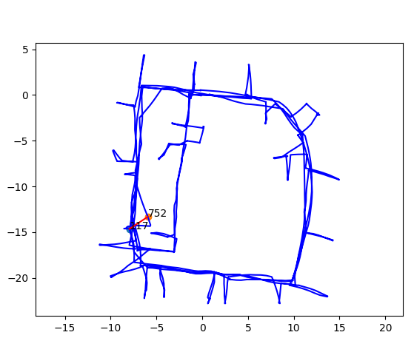
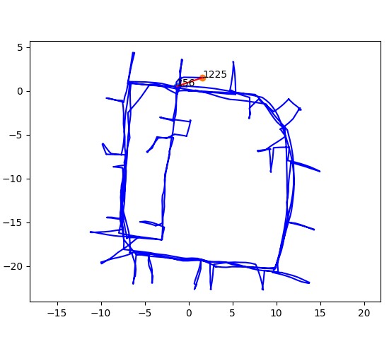
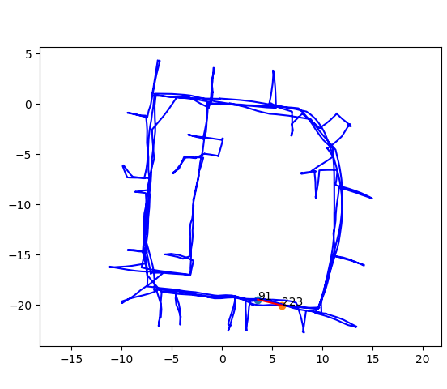
Intel
A few failure cases from CPS
Only outliers that cause local distortions are accepted

Slide 22
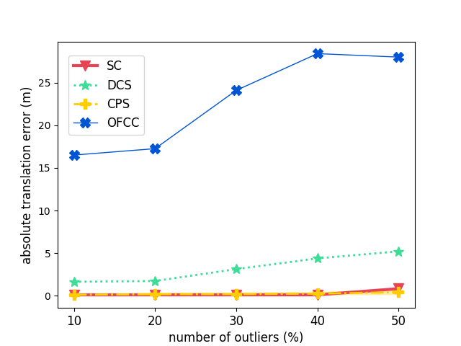
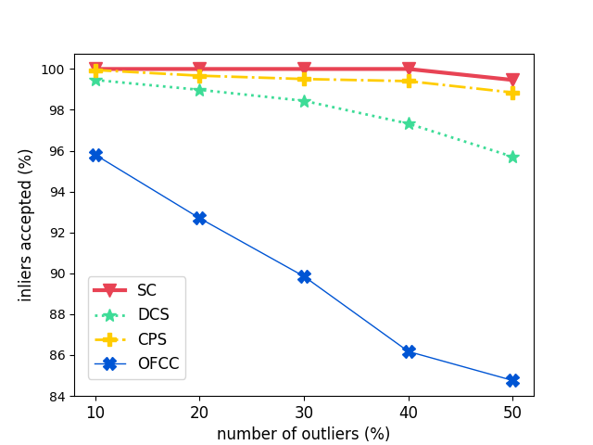
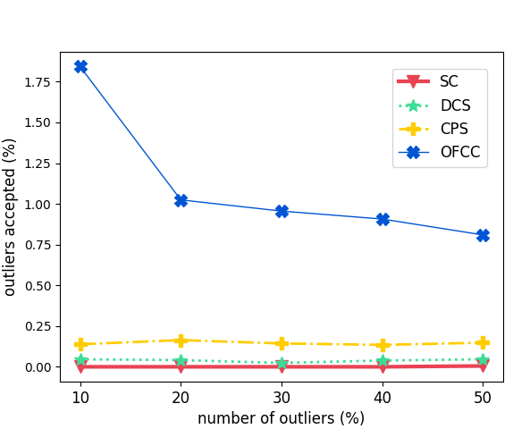
Manhattan
CPS accepted more inliers than DCS, and also more outliers than DCS as well SC
OFCC accepted some outliers and rejected large quantity of inliers, therefore had
highest ATE
DCS and SC failed to reject outliers that cause global distortion
CPS achieved lowest ATE

Slide 23
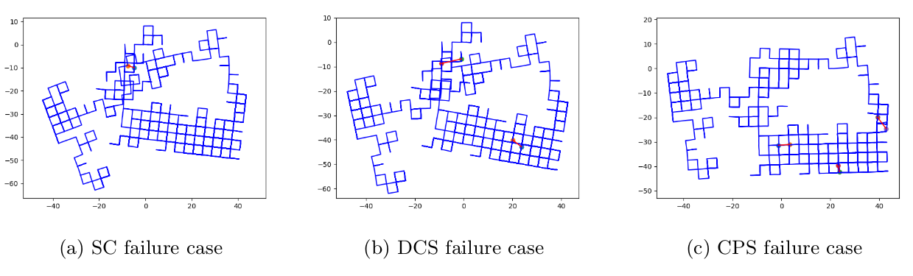
Manhattan

Slide 24
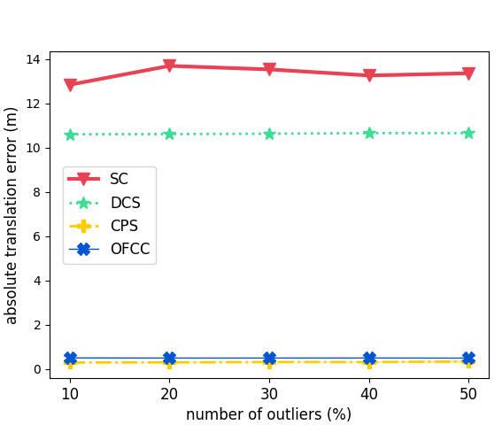
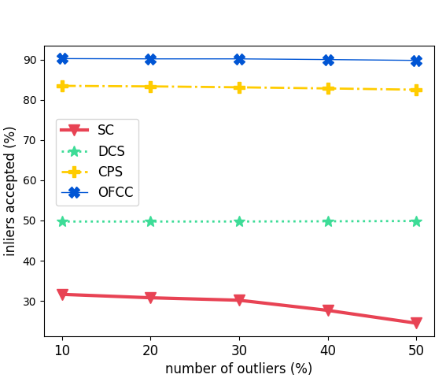
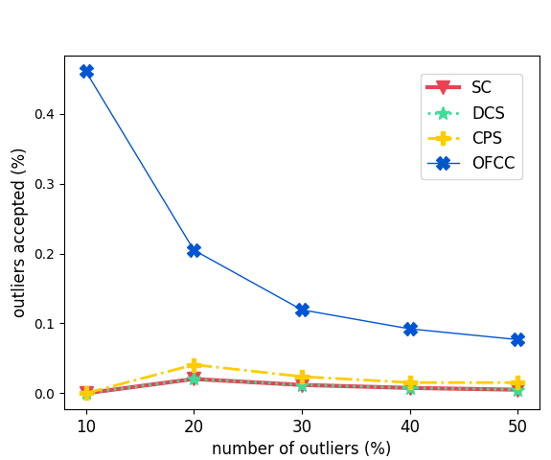
Manhattan
A fun little experiment
Original information matrix:
Modified to:

Slide 25
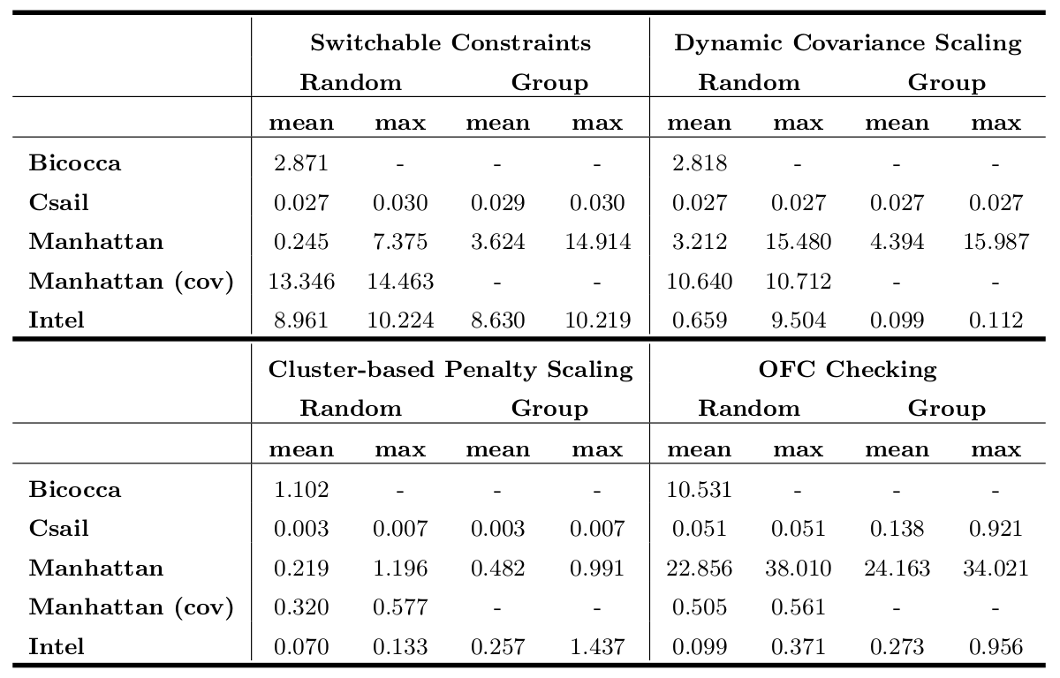

Slide 26
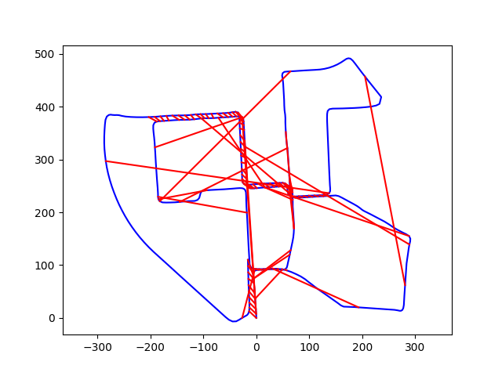
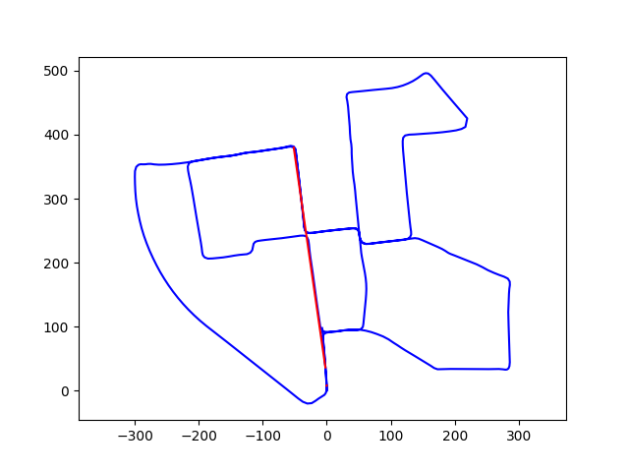
Kitti-00
[9]
RTABMAP is used for tuning front-end parameters in order to produce more outliers
Initial graph
Optimized graph

Slide 27
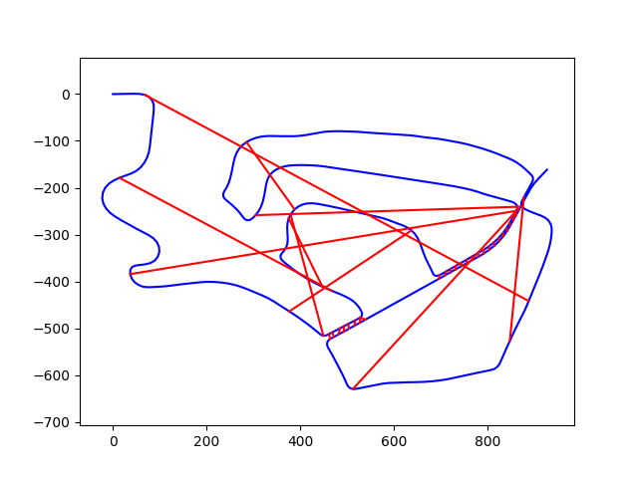
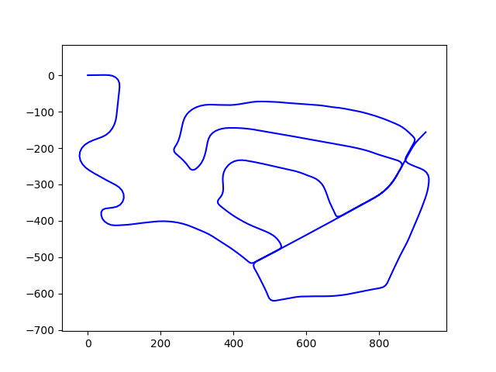
Kitti-02
Initial graph
Optimized graph

Slide 28
Conclusion
Without fine tuning the parameters, our method performed better than other
state-of-the-art outlier rejection methods on data sets with varying odometry noise,
trajectory length, and graph sparsity.
We circumvent the difficulty in finding the reasonable threshold for outlier rejection by
extracting information on local consistence and dynamically scaling the penalty term.
We advocate that rather than testing a single edge against the odometry backbone,
testing clusters are more robust.
Identifying the nature of a cluster instead of individual edge is less sensitive to the
odometry noise level.

Slide 29
References
[1] T. D. Barfoot, “State estimation for robotics,” State Estimation for Robotics, pp. 1–368, 2017.
[2] Lukas Polok, “Accelerated Sparse Matrix Operations in Nonlinear Least Squares Solvers,” Ph.D. Thesis at Faculty of Information Technology, Brno University of Technology, 2016.
[3] V. Ila, L. Polok, M. Solony, P. Smrz, and P. Zemcik, “Fast covariance recovery in incremental nonlinear least square solvers,” Proceedings - IEEE International Conference on Robotics and Automation, vol. 2015-June, no. June, pp. 4636–4643, 2015.
[4] Y. Latif, C. Cadena, and J. Neira, “Robust loop closing over time for pose graph SLAM,” International Journal of Robotics Research, vol. 32, no. 14, pp. 1611–1626, 2013.
[5] N. Sunderhauf and P. Protzel, “Switchable constraints for robust pose graph SLAM,” IEEE International Conference on Intelligent Robots and Systems, pp. 1879–1884, 2012.
[6] P. Agarwal, G. D. Tipaldi, and L. Spinello, “Robot Map Optimization using Dynamic Covariance Scaling,” 2013 IEEE International Conference onRobotics and Automation (ICRA), 2013.
[7] P.-Y. Lajoie, S. Hu, G. Beltrame, and L. Carlone, “Modeling Perceptual Aliasing in SLAM via Discrete-Continuous Graphical Models,” pp. 1–13, 2018.
[8] F. Bai, T. Vidal-Calleja, S. Huang, and R. Xiong, “Predicting Objective Function Change in Pose-Graph Optimization,” in IEEE/RSJ 2018 International Conference on Intelligent Robots and Systems, 2018.
[9] M. Labbé and F. Michaud, “RTAB-Map as an open-source lidar and visual simultaneous localization and mapping library for large-scale and long-term online operation,” Journal of Field Robotics, vol. 36, no. 2, pp. 416–446, 2019.

Slide 30
Thanks!
Questions?

Slide 31
Nonlinear Least Square Problem
Mahalanobis Distance
Odometry
Loop Closure

Slide 32
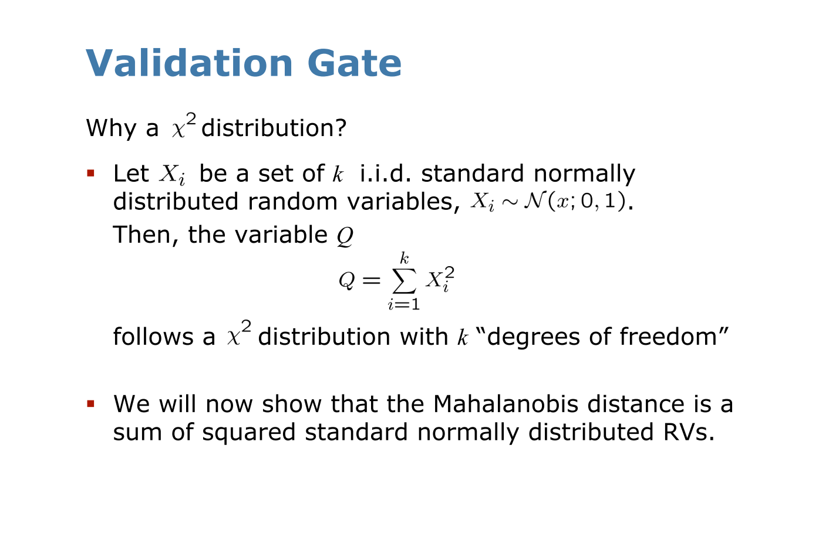

Slide 33
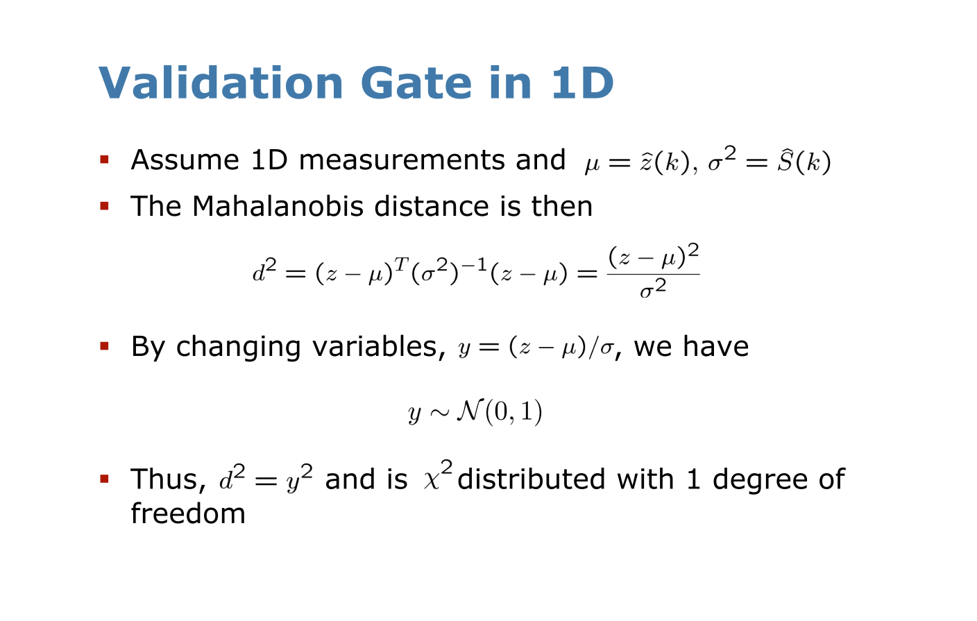

Slide 34
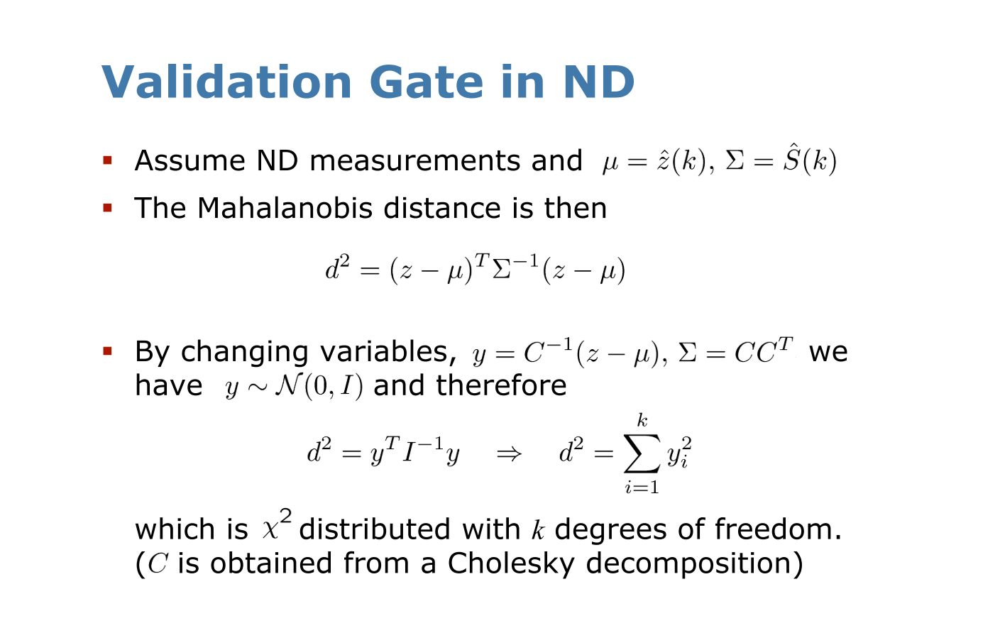

Slide 35
Nonlinear Least Square Problem
Odometry
Loop Closure
Stack all residual error into a vector, and all covariance into a matrix
Quadratic form after factorization
where
Now we can perform iterative solving with Gauss-Newton method or its variations

