Slide 1

ATMOSFEAR
The Invisible Killer: Air Pollution
Notes:
Hello everyone. We’re Atmosfear, and we reveal the hidden health impacts of air pollution. Have you ever wondered if air pollution could actually cause more deaths than crime in your own country? Let’s find out together.

Slide 2
The Real Problem
7 million premature deaths annually (WHO)
Mostly invisible and easy to ignore
A global health crisis, not just an environmental issue
Notes:
every year air pollution is responsible for about 7 million premature deaths, that’s more than violence and traffic accidents combined. The danger is that it’s mostly invisible. so it’s easier to ignore. Yet, it remains one of the greatest public health crises of our time that's affecting everyone

Slide 3
Challenges & Pivots
We used IHME Global Burden of Disease dataset
Incomplete & unreliable data
Limited access to hospital records & causes of death
Hard to match city-level health and pollution data
Notes:
We aimed to study pollutants’ health effects at the city level, but data was incomplete and hospital records inaccessible. So, we focused on one of the most dangerous Pollutants PM2.5 at the country level and used the trusted IHME Global Burden of Disease datasets for health impact

Slide 4
Our Question
We focused on three part:
How do PM₂.₅ affect cardiovascular and respiratory disease burdens?
Do these health impacts differ across countries at various development levels?
Is long-term pollution related to increased COVID-19 death rates?
Notes:
We focused on PM2.5, which most strongly affects cardiovascular and respiratory diseases. We asked whether its impact varies by a country’s development level, using data from 2010–2019, then we also looked whether long-term exposure influenced COVID-19 mortality in 2020

Slide 5
Our Findings
1
2
3
4
Development levels Matters Most
Pollution effects are comulative
PM2.5 hits harder in less developed countries
COVID-19 link is weaker but consistent
Notes:
We found that development level matters most: less developed countries suffer the most. Pollution’s effects accumulate over years, and COVID-19 link was weaker in mortality, due to the complexity of pandemic outcomes

Slide 6

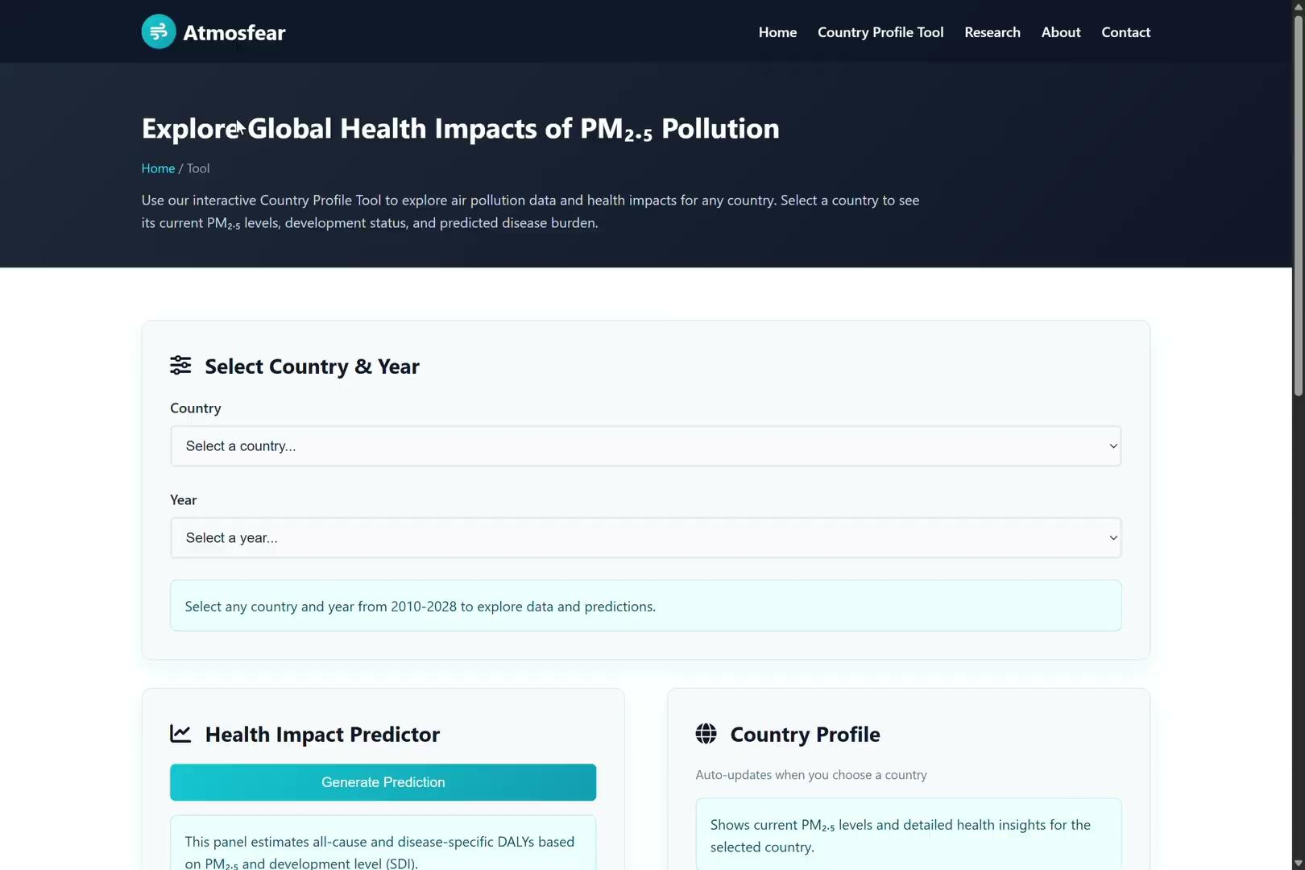
Communicating Our Results
Notes:
To share our results, we built a website with a country profile tool. Here’s a short demo to show how it works and how anyone can explore the data.

Slide 7
Communication Strategy
We Targeted Two Key Audiences
1. Public Health & Environmental Organizations (IHME, WHO, OpenAQ)
  Why: Key actors shaping policy and interventions
  How: Contact directly via email, share policy briefs and dashboards
  Impact: Integrate the tools and findings into health frameworks & advocate targeted interventions
2. Researchers & Professionals
  Why: Advance the scientific evidence base
  How: Share our GitHub repository through research networks and academic forums
  Impact: Apply and adapt our model to expand understanding of pollution’s health impacts
Notes:
We targeted two key audiences.. organizations like IHME, WHO, and OpenAQ, the aim is not just to share our research but to see it used by shaping health frameworks and guiding targeted interventions. For researchers and professionals, we offer open code, datasets, and methods so they can adapt and expand our model, strengthening the evidence base on pollution’s health impacts.

Slide 8






Meet Atmosfear Team
Falaq Youniss
Mohamed Tilal
Said Ibrahim
Lina Khayri
Saliha Kalender
Salih Adam
Hussaini Ahmed, Obay Salih, Mervil Pierre, Ridwan Ayinde, Mithchell Lawensky, Safiya Hashimi
Contact us: atmosfear.group@gmail.com

