Slide 1


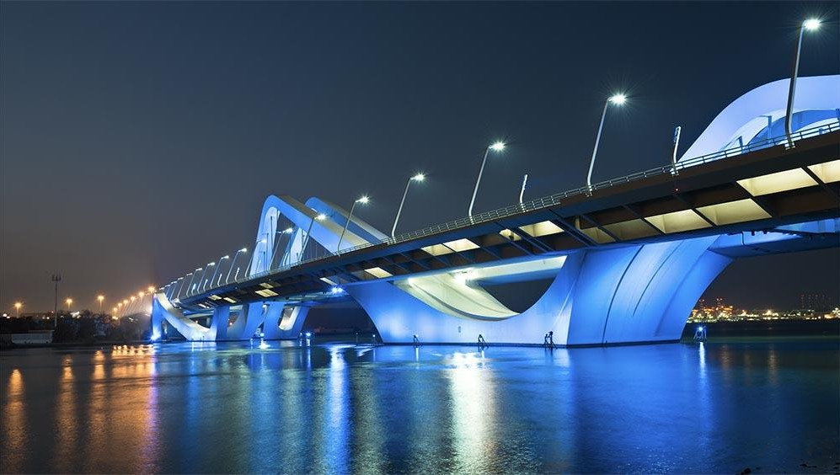
Construction Sites & Renewable Energy
Group#10: Data Nerds
Date: 28-08-2025

Slide 2
Contents
Introduction
The Problem
Our Approach
Key Findings
Conclusion
Communication & Impact
Q&A

Slide 3
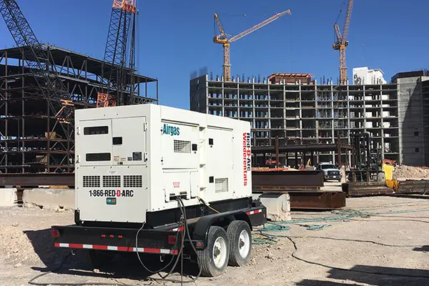
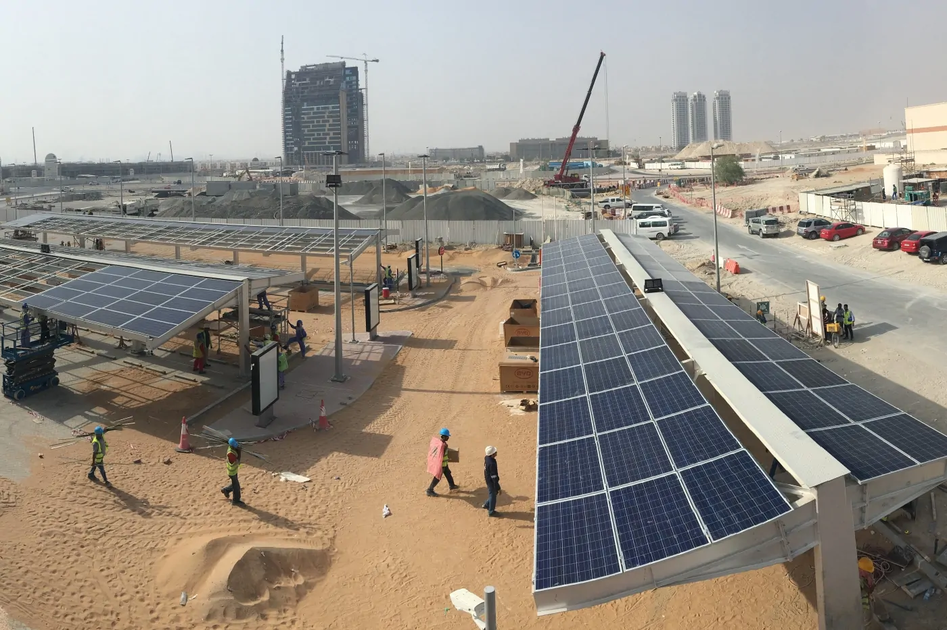
Introduction
The Research
How would the use of renewable energy affect construction sites in terms of cost , energy usage and carbon emissions within the Middle Eastern and African regions?
VS.

Slide 4

The Problem
Construction runs on diesel, Construction is costly & unsustainable
High diesel dependency | Most sites in MEA still rely on diesel generators
Rising operating costs | Frequent fuel deliveries, expensive maintenance, and fuel price volatility.
Environmental impact | Diesel use leads to significant CO₂ emissions and noise pollution
Reliability issues | Generators often break down, causing project delays and inefficiencies
Growing pressure | Contractors face new client demands and policy pushes for sustainability

Slide 5


Our Approach
From data to decisions
Data Collection
Data was collected via Google Forms
20+ results (Greater than expected as compared to other researches
Datasets: IRENA renewable energy stats + UN Comtrade imports
Data Analysis
Exploratory Data Analysis
Cost simulation comparing diesel vs. hybrid (diesel + solar)

Slide 6
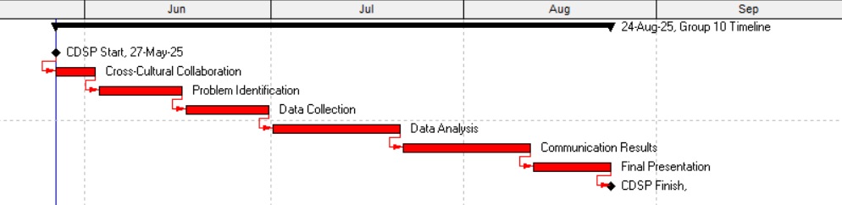

Slide 7
Key Findings
Surprise! Cost is the Main Driver
Observations
- Nearly 80%+ of surveyed sites rely on diesel generators
- 8–12 hours runtime daily
- USD 200–400/month per generator in maintenance
Why go Hybrid?
- Hybrids save money & cut emissions
- 25–35% less diesel consumption
- USD 10k–15k per medium site

Slide 8


Conclusion:
One Hand Doesn’t Clap; Hybrid Beats Diesel Alone
Diesel alone is no longer enough
Hybrid systems are cheaper, cleaner & reliable
Upfront cost, regulation, technical know-how
Barriers: Directing Attention & Calling to Action
This is a description of the whole thing

Slide 9
Communications & Impact
Reaching Out
The Message: Encourage Hybrid Energy Sources During Construction
Why: To Save Costs
To: Contractors & PMs
Through: WhatsApp, LinkedIn, professional networks
With: Infographic campaigns

Slide 10






Meet the Nerds
Ghyath Ibrahim
Electrical Engineer
Nimatullahi Masuud
Data Scientist
Tamir El-Waleed
Planning Engineer
Lukmon Olamilekan
Biomaterials Engineer
Yool Malaak
Civil Engineer

Slide 11
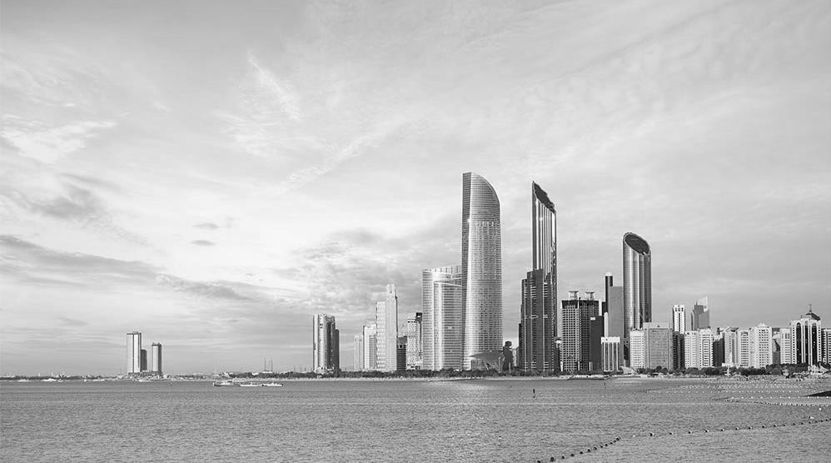
Thank you

Slide 12
Q&A

