Slide 1


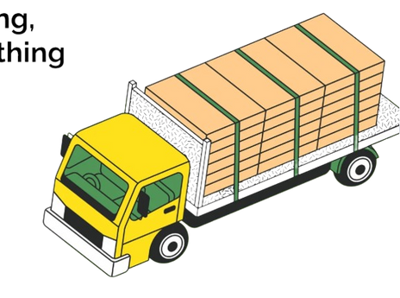



Welcome to The Express MIT GROUP 22
DELIVERY DELAYS IN RETAIL SUPPLY CHAINS
Customer
Packages

Slide 2
ORIGINAL PROBLEM STATEMENT
Fast delivery expected
Delays break trust
Causes: traffic, weather, drivers
Our focus: data solutions
MIT Emerging Talent – Group 22

Slide 3

Final Research Question
What causes delivery delays in the retail supply chain in Southern California

Slide 4
KEY CHALLENGES ENCOUNTERED
Confused: USA, China, or other datasets?
Picked Southern California
Weird values: 0.843 instead of 0 or 1
Data from individual contributor → unsure reliability
MIT Emerging Talent – Group 22
Notes:
The main challenges our group faced were choosing the dataset initially and then the inconsistencies in the dataset we chose during the analysis phase . First, it was difficult to choose a clear country of origin for analysing delivery delays, since options included the U.S., China, and others. We also had trouble deciding among the three datasets we initially reviewed. Ultimately, for our project, we selected the Southern California Supply Chain Dataset, which showed different aspects of supply chain operations. However, as we explored the data, we found several mismatches between the dataset and its description on Kaggle, which turned into a key challenge for our group. We noticed some values that seemed unrealistic or incorrect.
For example, the variable _order_fulfillment_status _should have only shown 0 or 1, but instead included unusual values such as 0.843.
In the same way, the feature _temperature_ showed very low and unlikely numbers such as –10°C in California.
As well, since the data was collected by individual contributor and not an official source, we started questioning possible errors in measurement or reporting
Thus, these are the main issues we faced.

Slide 5
key Finding
Weak signals → small factors add up
Busy ports → biggest cause
Other factors: customs, long lead times, risky routes
Combined risk: busy ports + customs
MIT Emerging Talent – Group 22

Slide 6
Communication Strategy
Primary target: MIT CTL PhD student (supply chain analytics)
Why them? Similar challenges, approachable, potential bridge to MIT CTL faculty
How we reach them: LinkedIn + GitHub repo -> transparent + direct
Goal: Feedback -> enhancement -> possible broader CTL Engagement
Secondary: Retail supply chain analyst -> industry relevance
MIT Emerging Talent – Group 22

Slide 7
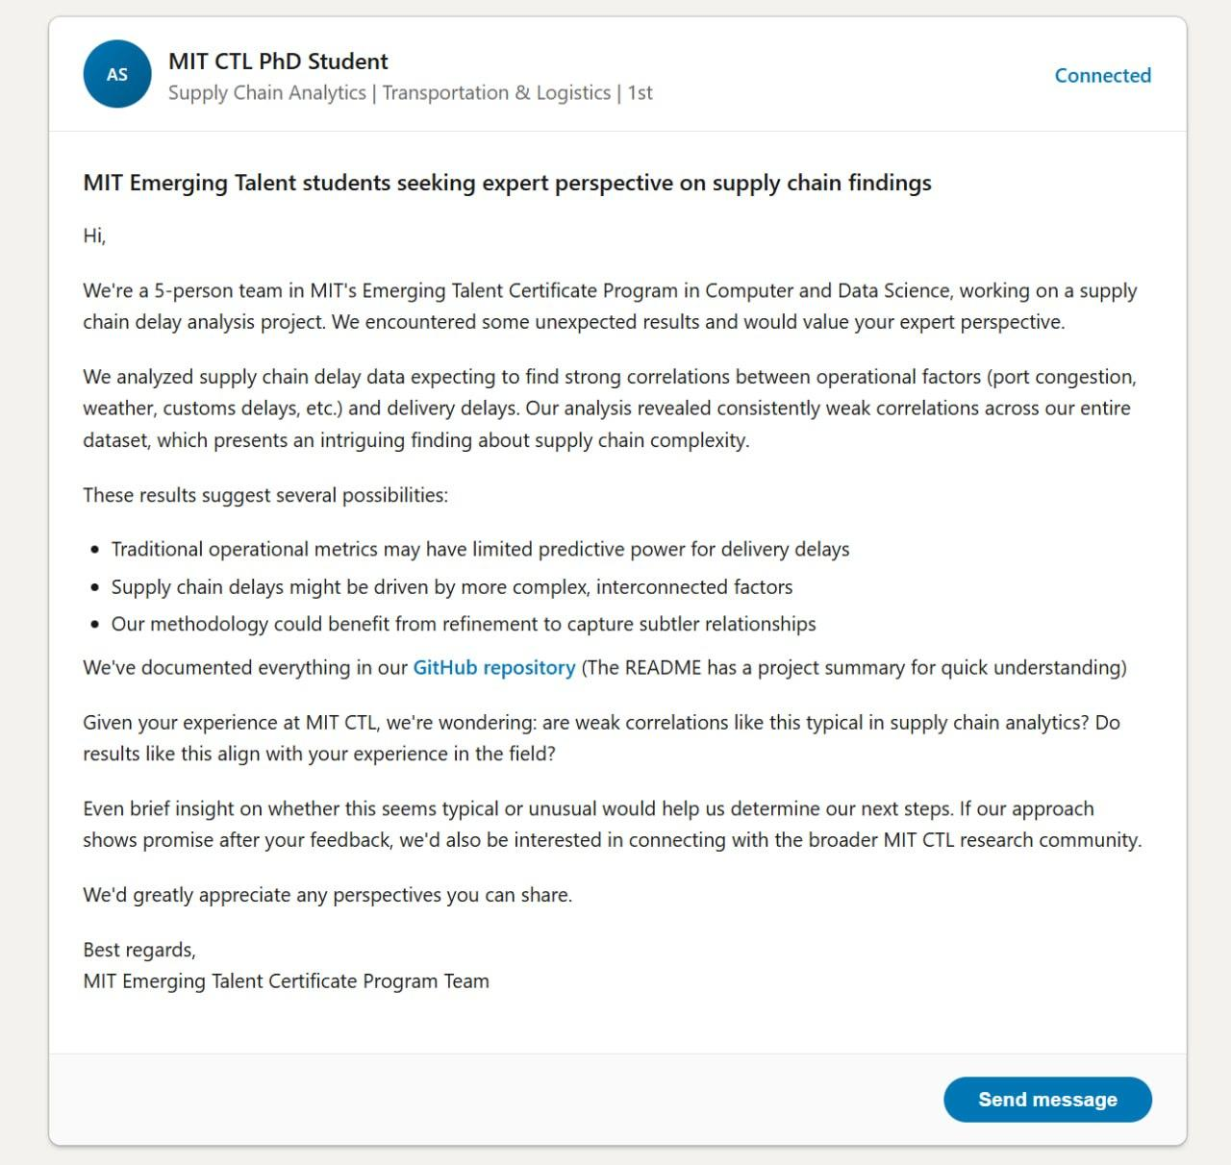
Primary target: MIT CTL PhD student (supply chain analytics)
Why them? Similar challenges, approachable, potential bridge to MIT CTL faculty
How we reach them: LinkedIn + GitHub repo -> transparent + direct
Goal: Feedback -> enhancement -> possible broader CTL Engagement
Secondary: Retail supply chain analyst -> industry relevance
MIT Emerging Talent – Group 22

Slide 8

THANK YOU
FOR YOUR ATTENTION!!!
Contact Us
📧 group22.mit@gmail.com

