Slide 1
How Many Copies Is Enough?
- A Flexible, Replicable Simulation Framework for Assessing Storage Risk
MIT Digital Document Preservation Simulation
iPRES 2015, Chapel Hill, NC
Micah Altman
Richard Landau
- MIT Libraries, Program on Information Science
- http://informatics.mit.edu

Slide 2
Problem to Solve
How to protect a large, valuable, digital document collection
  How many copies do you need to keep it safe?
  Where to put the copies?
  When to check they are still there?
  Whether to use compression, encryption, … ?
Not much hard data on which to base policy decisions
We develop a flexible, replicable simulation framework?
We aim to provide some guidance, based on some common, but not universal calibration points.
New England NDSA 2015 - MIT Digital Document Preservation Simulation Project

Slide 3
The Model We're Using
You have a collection of digital documents
You contract with some outside agencies to store copies of your collection
  Specialized servers
  Commercial cloud storage providers
    Amazon, Google, Rackspace, BackBlaze, Dropbox, ...
You "audit" the servers with some frequency
  Do they still have copies of all documents?
  Replace any copies missing or corrupted
New England NDSA 2015 - MIT Digital Document Preservation Simulation Project

Slide 4
Our Basic Data, to Extrapolate
Not keyed to any specific problems
Will supply many hints on how to extrapolate from our data to your situations
  Number of docs, doc sizes, storage shelf sizes
  Server failure rates
  Audit strategies
Experimental results
– you can simulate with your own parameters
New England NDSA 2015 - MIT Digital Document Preservation Simulation Project

Slide 5
Assumptions
Everything costs
  Storing multiple copies
  Higher quality services to store your docs
    Data generally not available about "quality"
  Bandwidth for auditing
Our goal:
  Provide data showing general tradeoffs –
  use to set broad policies
  Provide a framework to model specific characteristics—
  use to check specific practices
New England NDSA 2015 - MIT Digital Document Preservation Simulation Project

Slide 6
Two Types of Failures
One document at a time
  Cosmic ray, disk block failure
All documents in a collection
  Local catastrophe
  Economic downturn, change of business strategy
  Loss of encryption key
All failures are silent (to the client = library)
  Until you try to retrieve a document
Some failures are correlated
  Local environment can affect block failures
  Global conditions can affect multiple providers
New England NDSA 2015 - MIT Digital Document Preservation Simulation Project

Slide 7
Single Document Failure
Common:
A copy of a document dies on a particular server
Documents are fragile
  Compressed and/or encrypted:
  single block failure makes document unreadable
Variation: Repairable documents
    Small failure damages only one segment
    Model this as a set of smaller docs
New England NDSA 2015 - MIT Digital Document Preservation Simulation Project

Slide 8
Institutional Failure
Less common: A server dies, losing all the documents it contains
  Institutional failure due to fire, flood, war, economic downturn, etc.
New England NDSA 2015 - MIT Digital Document Preservation Simulation Project

Slide 9
Digital Simulation Programs
Input
error rates, numbers of copies, auditing rate, etc.
Output
number of documents permanently lost over the life of the test
Discrete-event Simulation
  Failure events happen at random intervals
  Audits are regularly scheduled
Open source
  Open licence; On Github
New England NDSA 2015 - MIT Digital Document Preservation Simulation Project

Slide 10
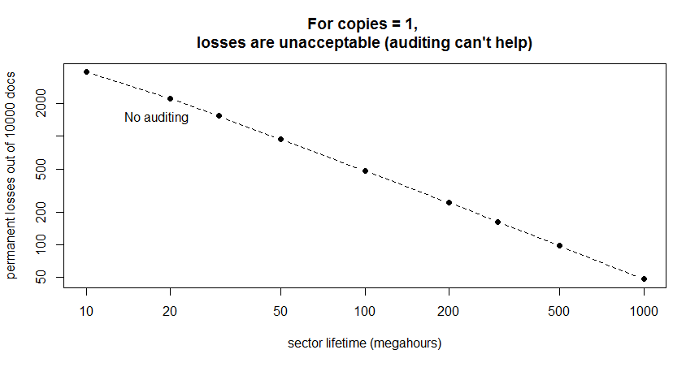
One Copy? All Losses Are Permanent Losses
Decreasing
document
losses
Increasing "quality" of storage
Length of time for storage to deteriorate and lose a document
New England NDSA 2015 - MIT Digital Document Preservation Simulation Project

Slide 11
Observations
For one copy, simple Poisson calculation yields failure rates
New England NDSA 2015 - MIT Digital Document Preservation Simulation Project

Slide 12
Good News & Bad News
Bad news: if anyone really understands the "quality" of modern storage, he/she is not talking
Good news: we *think* that modern storage methods, like those used in cloud storage, are very reliable, high quality
Strategy: Structure storage to protect your collection from variations in reliability
New England NDSA 2015 - MIT Digital Document Preservation Simulation Project

Slide 13
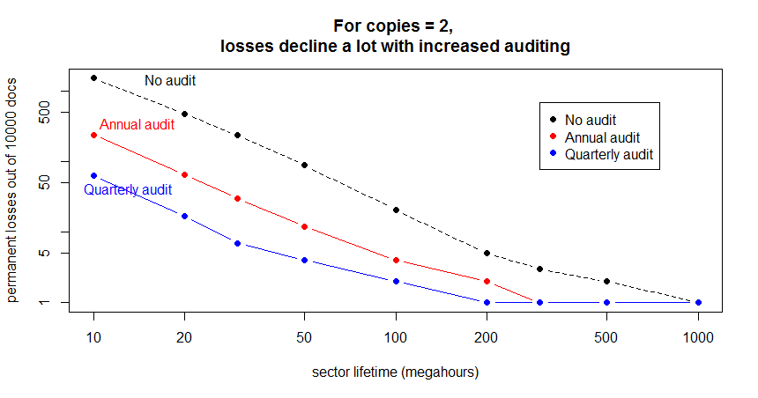
Two Copies? Definitely Not Enough
New England NDSA 2015 - MIT Digital Document Preservation Simulation Project

Slide 14
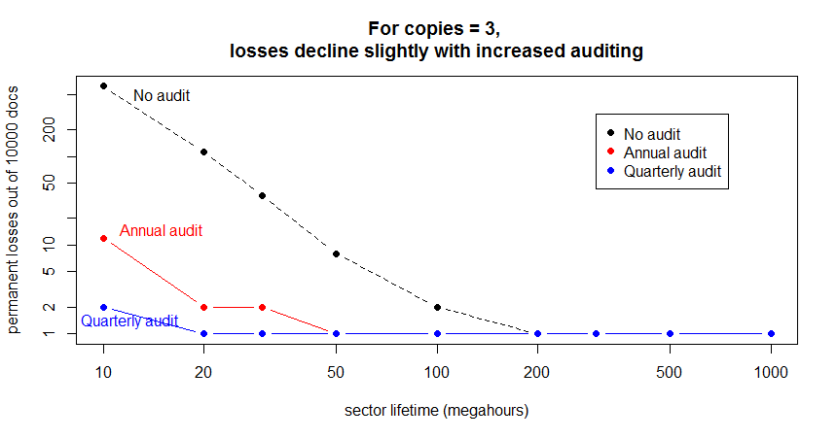
Three Copies? Marginal
New England NDSA 2015 - MIT Digital Document Preservation Simulation Project

Slide 15
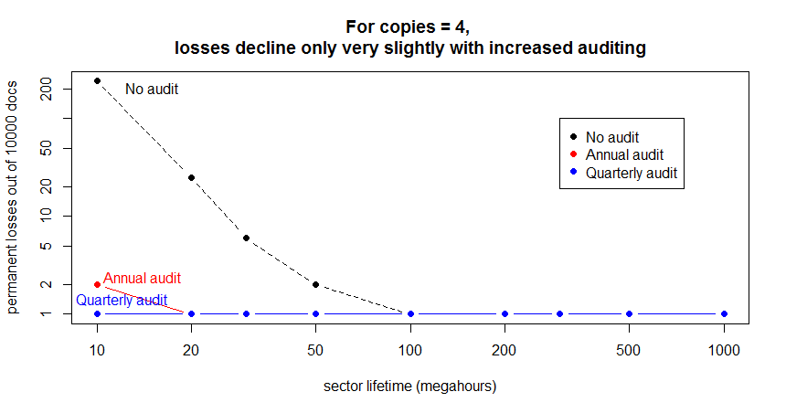
Four Copies? Looks Good
New England NDSA 2015 - MIT Digital Document Preservation Simulation Project

Slide 16
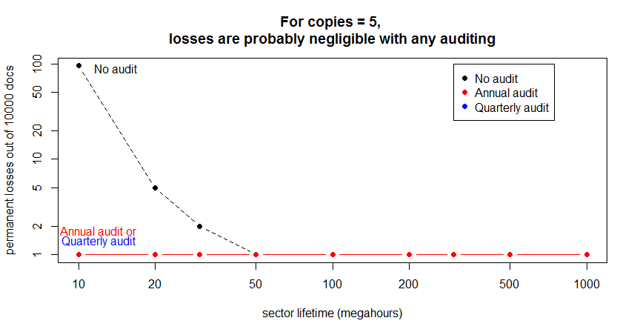
Five Copies? Works
New England NDSA 2015 - MIT Digital Document Preservation Simulation Project

Slide 17
Size Doesn't Matter
(for modeling)
Document sizes and error rates scale easily
  Larger doc presents a larger target area
  For a constant rate of block errors, larger doc will be hit more often
Scales precisely as you would expect
  10x larger doc is hit 10x as often
  OR
  10x larger doc + 1/10 block error rate is hit 1x as often
New England NDSA 2015 - MIT Digital Document Preservation Simulation Project

Slide 18
Size/Rate Comparison
Conceptual diagram – red block in graph paper
New England NDSA 2015 - MIT Digital Document Preservation Simulation Project

Slide 19
Effect of Compression
Assume recoverablility rate R and compression rate C
Show how this is equivalent to changing collection and document size
Note that if C>R always a win
Note areas where if C<R still saves sufficient space to store another copy – does this make up for higher failure rate from compression?
New England NDSA 2015 - MIT Digital Document Preservation Simulation Project

Slide 20
Institutional Failures
GRAPH
Assume baseline # of copies, quality and auditing yields 0 loss in the absence of institutional failure
Closed form – compare expected loss vs. frequency of business failure events (inverse of business half-life?)
Recession → pushes failure curbe out
New England NDSA 2015 - MIT Digital Document Preservation Simulation Project

Slide 21
Tricky Audits Don't Help
[GRAPH] Show systematic audit dominates random audiot
New England NDSA 2015 - MIT Digital Document Preservation Simulation Project

Slide 22
Preliminary Conclusions - 1
More copies are better (duh!)
Auditing is essential to collection health
  Protects collection over huge range of "quality"
  Very frequent auditing is probably overkill
  Tricky auditing (subsets, random) is less effective
New England NDSA 2015 - MIT Digital Document Preservation Simulation Project

Slide 23
Other Observations- 2
Institutional failures are pernicious -- but how often do they occur?
  The problem: a silent institutional failure reduces the number of redundant copies you have stored
  Risk is increased until you discover the problem (in auditing) and provision a new server
    Thought you had four copies? Well, for a period of time, you actually have only three.
    And another failure before the audit reduces copies to two
    Failures may be correlated due to economic conditions, wars
New England NDSA 2015 - MIT Digital Document Preservation Simulation Project

Slide 24
Other Observations - 3
How many copies do you need to limit losses?
  Limit permanent losses to some part of the collection?
  Better: How many to keep likelihood of any permanent loss under some percentage?
    5 per cent, 1 per cent, 0.1 per cent?
  For institutional failures, how many copies to keep likelihood of total loss under some percentage?
New England NDSA 2015 - MIT Digital Document Preservation Simulation Project

Slide 25
Audit We Must
Auditing is expensive (in bandwidth, bytes moved, time)
  Read back all the contents of all the documents?
  We should work toward efficient auditing functions
New England NDSA 2015 - MIT Digital Document Preservation Simulation Project

Slide 26
What Next?
Q: What information do you need to manage your libraries?
New England NDSA 2015 - MIT Digital Document Preservation Simulation Project

Slide 27
Backup
New England NDSA 2015 - MIT Digital Document Preservation Simulation Project

Slide 28
Form of the Data
Fixed number of documents, fixed time
  Scale to your needs
Number of copies varies, 1 to 10
Reliability of storage servers varies
  Very little real data in this area
Auditing strategies vary
Document size varies (but doesn't matter)
New England NDSA 2015 - MIT Digital Document Preservation Simulation Project

