Slide 1
How Many Copies Are Enough?
MIT Digital Document Preservation Simulation
New England NDSA Meeting 2015
Micah Altman
Richard Landau
- MIT Libraries, Program on Information Science
- http://informatics.mit.edu

Slide 2
Problem to Solve
You have a large, valuable, digital document collection
  How many copies do you need to keep it safe?
  On what quality level of servers?
  How often should you audit the servers?
    Do they still have all the docs?
Not much hard data on which to base policy decisions
We are trying to provide some data, admittedly hypothetical
New England NDSA 2015 - MIT Digital Document Preservation Simulation Project

Slide 3
Assumptions
Everything costs $
  Storing multiple copies
  Higher quality services to store your docs
    Data generally not available about "quality"
  Bandwidth for auditing
Trying to provide data you can use for your policies
New England NDSA 2015 - MIT Digital Document Preservation Simulation Project

Slide 4
Basic Data to Extrapolate
Not keyed to any specific problems
Many hints on how to extrapolate from our data to your situations
  Number of docs, doc sizes, storage shelf sizes
  Server failure rates
  Audit strategies
Very preliminary results
New England NDSA 2015 - MIT Digital Document Preservation Simulation Project

Slide 5
Two Type of Failures
Common: A copy of a document dies on a particular server
Less common: A server dies, losing all the documents it contains
  "Institutional failure:" fire, flood, war, economic downturn, etc.
All failures are silent (to the client = library)
Auditing is *really* essential
New England NDSA 2015 - MIT Digital Document Preservation Simulation Project

Slide 6
Form of the Data
Fixed number of documents, fixed time
  Scale to your needs
Number of copies varies, 1 to 10
Reliability of storage servers varies
  Very little real data in this area
Auditing strategies vary
Document size varies (but doesn't matter)
New England NDSA 2015 - MIT Digital Document Preservation Simulation Project

Slide 7
Digital Simulation Programs
Input = error rates, numbers of copies, auditing rate, etc.
Output = number of documents permanently lost over the life of the test
Failure events happen at random intervals
  Audits are regularly scheduled
The programs are "open source," will be freely available for others to use, test, verify
  "It's just computer time."
New England NDSA 2015 - MIT Digital Document Preservation Simulation Project

Slide 8
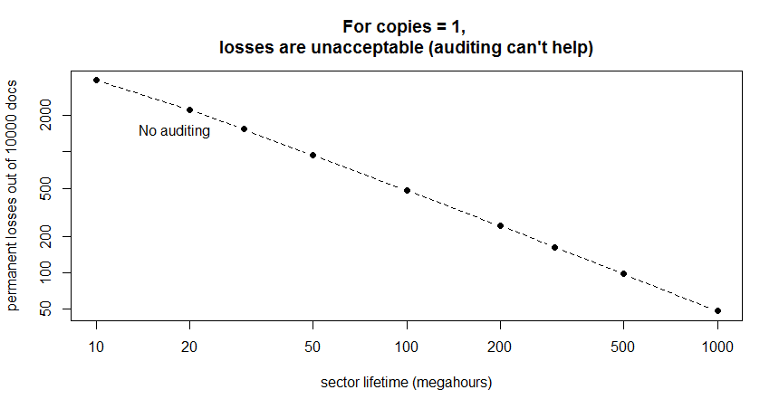
One Copy? All Losses Are Permanent Losses
Decreasing
document
losses
Increasing "quality" of storage
Length of time for storage to deteriorate and lose a document
New England NDSA 2015 - MIT Digital Document Preservation Simulation Project

Slide 9
Good News & Bad News
Bad news: if anyone really understands the "quality" of modern storage, he/she is not talking
Good news: we *think* that modern storage methods, like those used in cloud storage, are very high quality
New England NDSA 2015 - MIT Digital Document Preservation Simulation Project

Slide 10
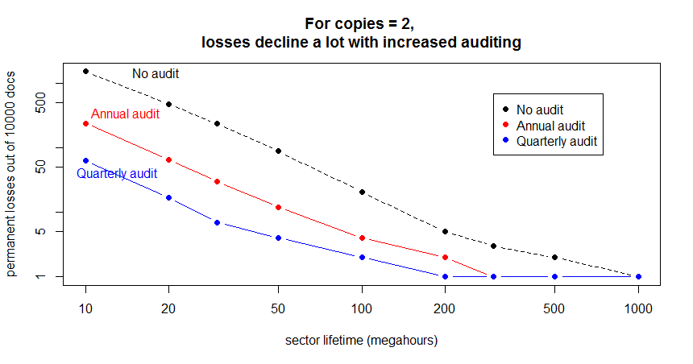
Two Copies? Definitely Not Enough
New England NDSA 2015 - MIT Digital Document Preservation Simulation Project

Slide 11
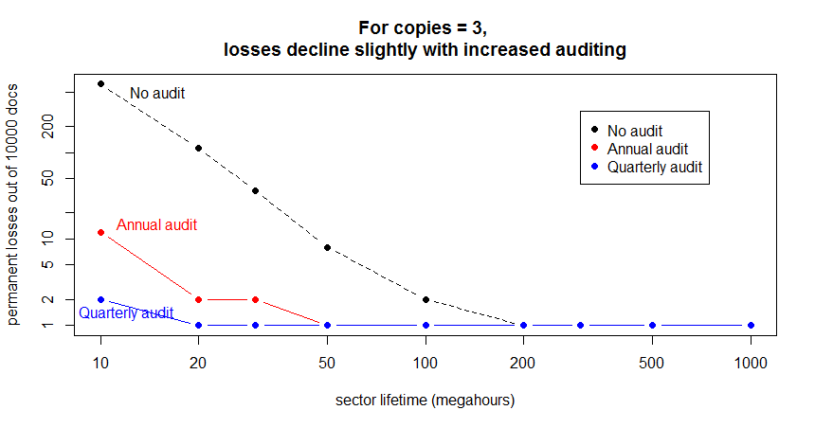
Three Copies? Marginal
New England NDSA 2015 - MIT Digital Document Preservation Simulation Project

Slide 12
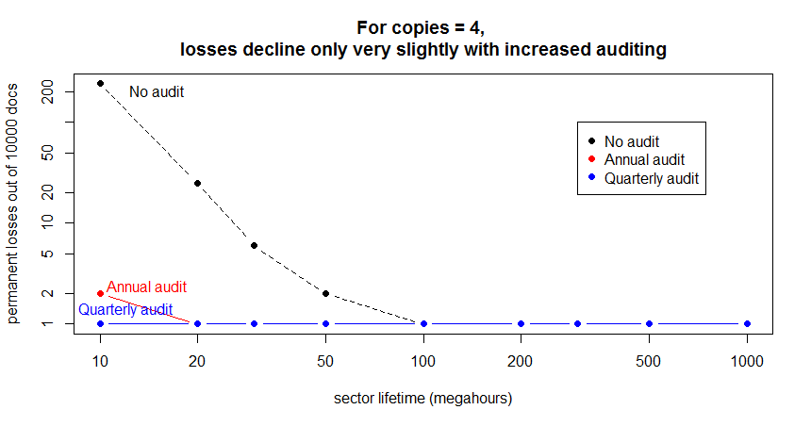
Four Copies? Looks Good
New England NDSA 2015 - MIT Digital Document Preservation Simulation Project

Slide 13
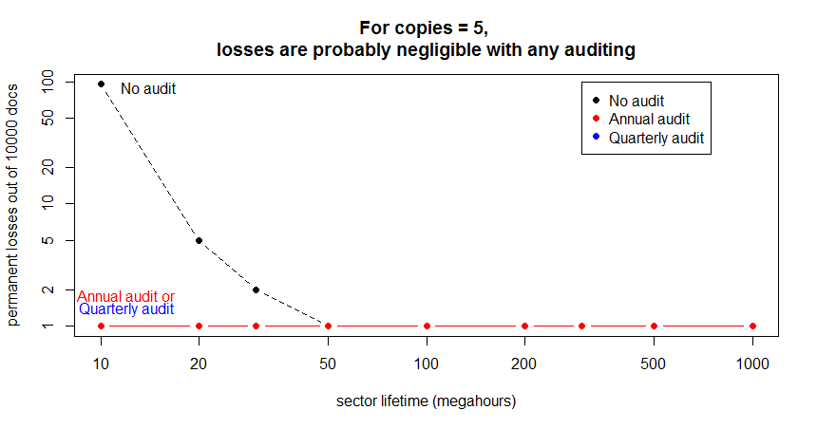
Five Copies? Works
New England NDSA 2015 - MIT Digital Document Preservation Simulation Project

Slide 14
Preliminary Conclusions - 1
More copies are better (duh!)
Auditing is essential to collection health
  Very frequent auditing is probably overkill
  Tricky auditing (subsets, random) is less effective
  Auditing is expensive (in bandwidth, bytes moved, time)
    We should work toward an efficient cryptographic auditing function
New England NDSA 2015 - MIT Digital Document Preservation Simulation Project

Slide 15
Preliminary Conclusions - 2
Institutional failures are pernicious -- but how often do they occur?
  The problem: a silent institutional failure reduces the number of redundant copies you have stored
    Thought you had four copies? Well, for a period of time, you actually have only three.
    And another failure before the audit reduces copies to two
    Failures may be correlated due to economic conditions
  Risk is increased until you discover the problem (in auditing) and provision a new server
New England NDSA 2015 - MIT Digital Document Preservation Simulation Project

Slide 16
Preliminary Conclusions - 3
How many copies do you need to limit losses?
  Limit permanent losses to some fraction of the collection?
  Better: How many to keep likelihood of any permanent loss under some percentage?
    5 per cent, 1 per cent, 0.1 per cent?
  For institutional failures, how many copies to keep likelihood of total loss under some percentage?
Q: What information do you need to manage your libraries?
New England NDSA 2015 - MIT Digital Document Preservation Simulation Project

Slide 17
Backup
New England NDSA 2015 - MIT Digital Document Preservation Simulation Project

Slide 18
  [Ten-ish slides is probably too many for a short session.
  How long is the session?
  How active is the audience likely to be in questioning?
  Relegate some of the slides to "backup." You know the audience; you pick.]
New England NDSA 2015 - MIT Digital Document Preservation Simulation Project

