Slide 1
How Many Copies Is Enough?
A Flexible, Replicable Simulation Framework for Assessing Storage Risk
MIT Digital Document Preservation Simulation
iPRES 2015, Chapel Hill, NC
Micah Altman
Richard Landau
- MIT Libraries, Program on Information Science
- http://informatics.mit.edu

Slide 2
Problem to Solve
How to protect a large, valuable, digital document collection
  How many copies do you need to keep it safe?
  Where to put the copies?
  Are you sure they're still there?
  Whether to use compression, encryption, … ?
Not much hard data on which to base policy decisions
We developed a flexible, replicable simulation framework
We aim to provide some guidance, based on some common, but not universal, calibration points.
iPRES 2015 - MIT Digital Document Preservation Simulation Project

Slide 3
The Model We're Using
You have a collection of digital documents
You contract with some outside agencies to store copies of your collection
  Specialized servers
  Commercial cloud storage providers
    Amazon, Google, Rackspace, BackBlaze, Dropbox, ...
You "audit" the servers with some frequency
  Do they still have copies of all documents?
  Replace any copies missing or corrupted
iPRES 2015 - MIT Digital Document Preservation Simulation Project

Slide 4
Our Basic Data, to Extrapolate
Not keyed to any specific problems
Will supply many hints on how to extrapolate from our data to your situations
  Number of docs, doc sizes, storage shelf sizes
  Server failure rates
  Audit strategies
Experimental results
– you can simulate with your own parameters
iPRES 2015 - MIT Digital Document Preservation Simulation Project

Slide 5
Assumptions
Everything costs
  Storing multiple copies
  Higher quality services to store your docs
    Data generally not available about "quality"
  Bandwidth for auditing
Our goal:
  Provide data showing general tradeoffs
    Use to set broad policies
  Provide a framework to model specific characteristics
    Use to check specific practices
iPRES 2015 - MIT Digital Document Preservation Simulation Project

Slide 6
Two Types of Failures
One document at a time
  Cosmic ray, disk block failure
All documents in a collection
  Local catastrophe
  Economic downturn, change of business strategy
  Loss of encryption key
All failures are silent (to the client = library)
  Until you try to retrieve a document
Some failures are correlated
  Local environment can affect block failures
  Global conditions can affect multiple providers
iPRES 2015 - MIT Digital Document Preservation Simulation Project

Slide 7
Single Document Failure
Common: A copy of a document dies on a particular server
Documents are fragile
  Compressed, encrypted: small failure makes document unreadable
Variation: Repairable documents
    Small failure damages only one segment
    Model this as a set of smaller docs
iPRES 2015 - MIT Digital Document Preservation Simulation Project

Slide 8
Institutional Failure
Less common: A server dies, losing all the documents it contains
  Institutional failure due to fire, flood, war, economic downturn, etc.
Infrequent but dangerous, particularly if correlated
iPRES 2015 - MIT Digital Document Preservation Simulation Project

Slide 9
Digital Simulation Programs
Input
  error rates, numbers of copies, auditing rate, etc.
Output
  number of documents permanently lost over the life of the test
Discrete-event simulation
  Failure events happen at random intervals
  Audits are regularly scheduled
Open source
  Open license, available on Github
iPRES 2015 - MIT Digital Document Preservation Simulation Project

Slide 10
Observations
For one copy, simple Poisson calculation yields failure rates
  But hard to observe on simple graphs
iPRES 2015 - MIT Digital Document Preservation Simulation Project

Slide 11
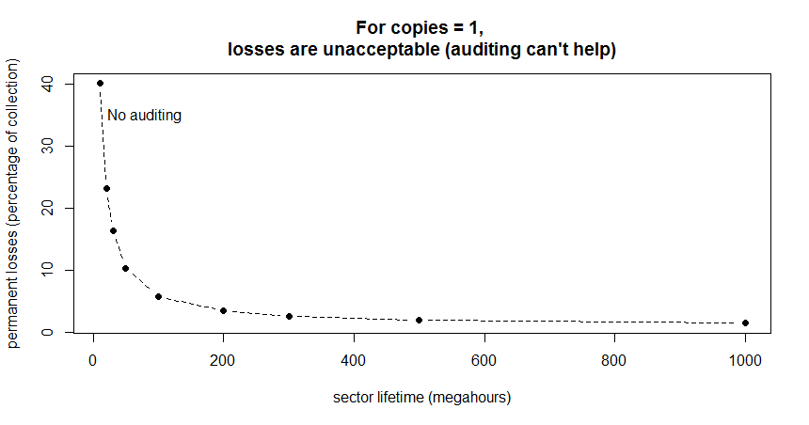
Hard to Compare Curves
e^{-something} is a fading exponential curve
Easier to compare if plotted as logs to straighten the lines
iPRES 2015 - MIT Digital Document Preservation Simulation Project

Slide 12
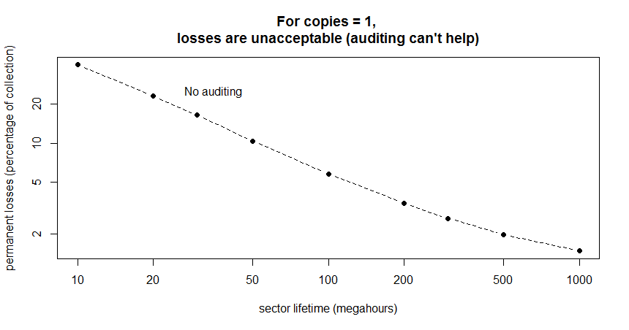
One Copy? All Losses Are Permanent Losses
Decreasing
document
losses
Increasing "quality" of storage
Length of time for storage to deteriorate and lose a document
iPRES 2015 - MIT Digital Document Preservation Simulation Project

Slide 13
Good News & Bad News
Bad news: if anyone really understands the "quality" of modern storage, he/she is not talking
Good news: we *think* that modern storage methods, like those used in cloud storage, are very reliable, high quality
Strategy: Structure storage to protect your collection from variations in reliability
iPRES 2015 - MIT Digital Document Preservation Simulation Project

Slide 14
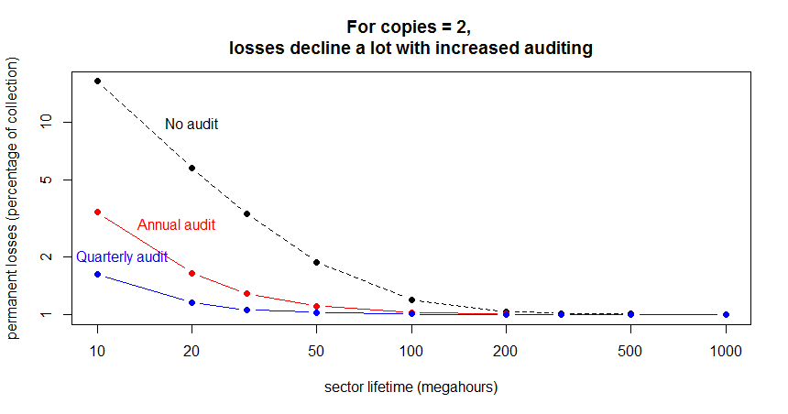
Two Copies? Definitely Not Enough
0
iPRES 2015 - MIT Digital Document Preservation Simulation Project

Slide 15
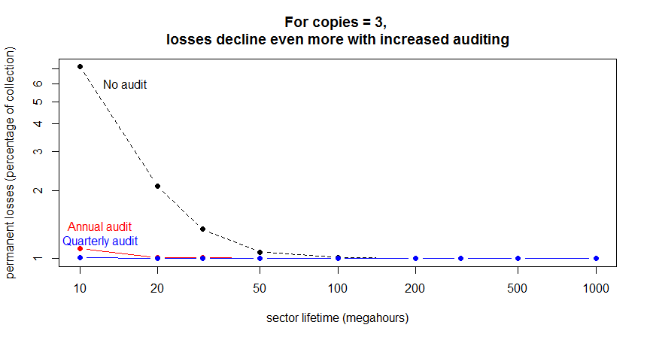
Three Copies? Marginal
0
iPRES 2015 - MIT Digital Document Preservation Simulation Project

Slide 16
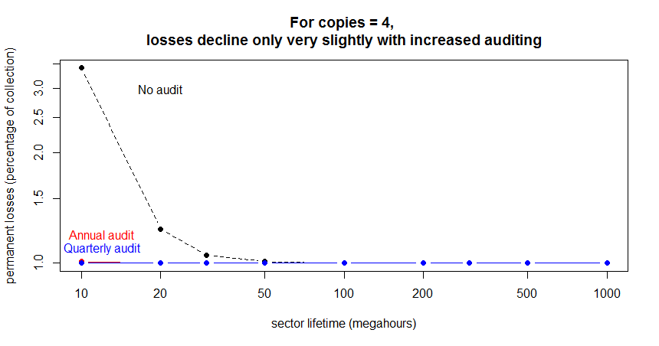
Four Copies? Looks Good
0
iPRES 2015 - MIT Digital Document Preservation Simulation Project

Slide 17
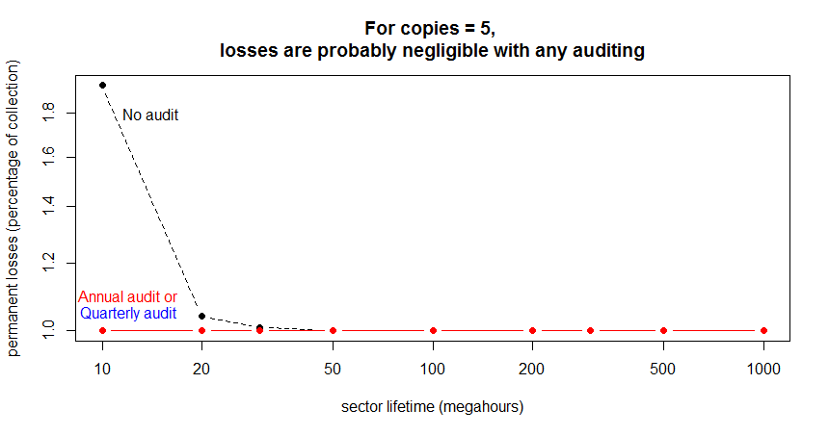
Five Copies? Works
0
iPRES 2015 - MIT Digital Document Preservation Simulation Project

Slide 18
Size Doesn't Matter
(for Modeling)
Document sizes and error rates scale easily
  Larger doc presents a larger target area
  For a constant rate of block errors, larger doc will be hit more often
Scales precisely as you would expect
  10x larger doc is hit 10x as often
  OR
  10x larger doc + 1/10 block error rate is hit 1x as often
  (or 10x larger doc with 10x longer block lifetime)
iPRES 2015 - MIT Digital Document Preservation Simulation Project

Slide 19
Initial State With
Small and Large Files
small file
10X
larger
file
iPRES 2015 - MIT Digital Document Preservation Simulation Project

Slide 20
Errors Are More Likely to Strike
Larger Targets, Proportionally
before
after a while
small file
10X
larger
file
(errors strike in
unused space,
too)
iPRES 2015 - MIT Digital Document Preservation Simulation Project

Slide 21
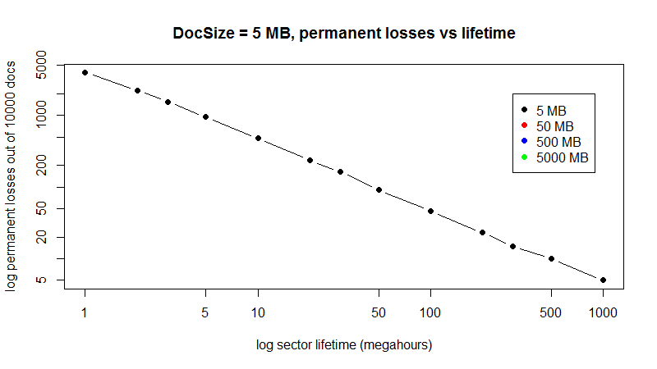
Measured Doc Losses vs Sizes and Lifetimes
iPRES 2015 - MIT Digital Document Preservation Simulation Project

Slide 22
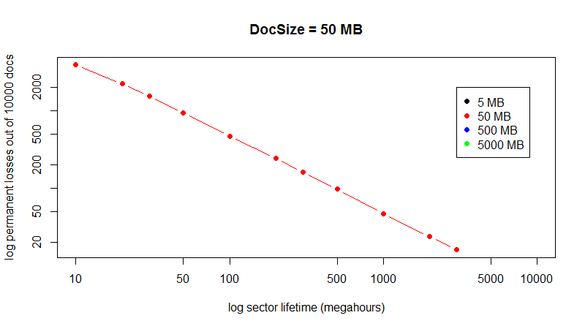
10X Larger Docs (50 MB)
iPRES 2015 - MIT Digital Document Preservation Simulation Project

Slide 23
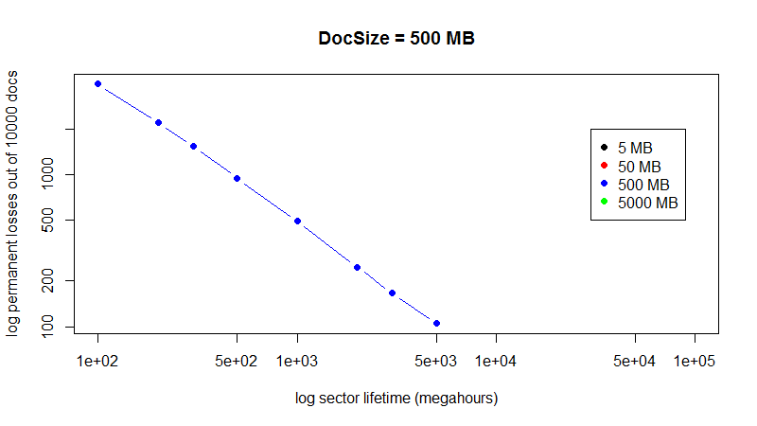
100X Larger (500 MB)
iPRES 2015 - MIT Digital Document Preservation Simulation Project

Slide 24
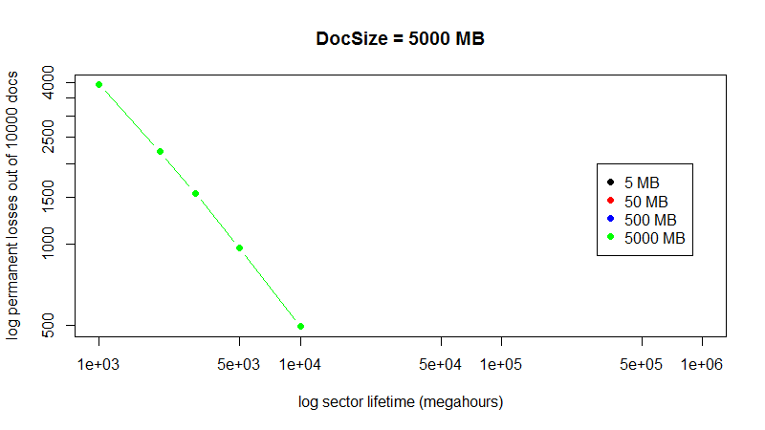
1000X Larger (5000 MB)
iPRES 2015 - MIT Digital Document Preservation Simulation Project

Slide 25
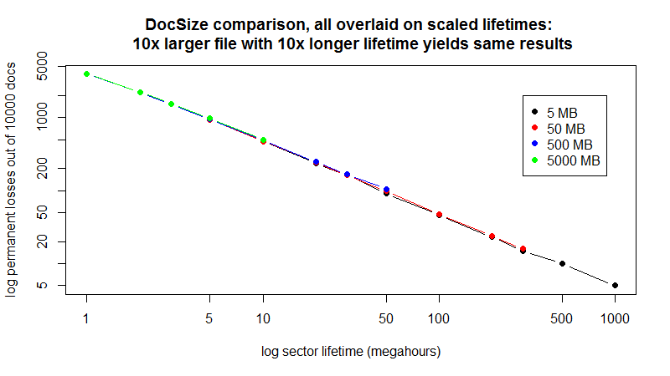
Re-scale Lifetimes to
Match Various Sizes
iPRES 2015 - MIT Digital Document Preservation Simulation Project

Slide 26
Effect of Compression
Assume recoverablility rate R and compression rate C
Show how this is equivalent to changing collection and document size
Note that if C>R always a win
Note areas where if C<R still saves sufficient space to store another copy
  Does this make up for higher failure rate from compression?
New England NDSA 2015 - MIT Digital Document Preservation Simulation Project

Slide 27
Institutional Failures Are Dangerous
You protect your collection with N copies
An institution fails, removing one copy entirely
  Until this is discovered during the next audit cycle, you actually have only N-1 copies
If a second institution should fail near the same time, then only N-2 copies
Correlation of institutional failures?
  Economic downturn
  Regional conditions
  Copies kept too close together, e.g, in-house
iPRES 2015 - MIT Digital Document Preservation Simulation Project

Slide 28
Recession → Failures → Losses
recessions increase rate
of institutional failure
failure
every
10 years
expected permanent document losses
due to institutional failures
you store enough copies to
ensure no losses -- in
normal circumstances
every
20 years
every
50 years
0
time
iPRES 2015 - MIT Digital Document Preservation Simulation Project

Slide 29
Several Auditing Strategies
TOTAL: every audit cycle, check every copy of every document
SEGMENTED: check part of collection at intervals during the audit cycle
    Entire collection checked every audit cycle (sampled without replacement)
RANDOM SEGMENTED: check randomly selected part of collection at intervals during the audit cycle
  Selected with replacement: some documents will be missed in the cycle
POPULARITY: divide collection into pieces, audit some more frequently
iPRES 2015 - MIT Digital Document Preservation Simulation Project

Slide 30
Tricky Audits Don't Help
Total or segmented audit is always better than random audit
  E.g., auditing randomly selected 1/4 of the collection every quarter
    Some documents will be missed entirely if the audit set is selected with replacement
  (Note: segmented is very slightly better than total, because it looks at some failures earlier when failure rates are very high)
iPRES 2015 - MIT Digital Document Preservation Simulation Project

Slide 31
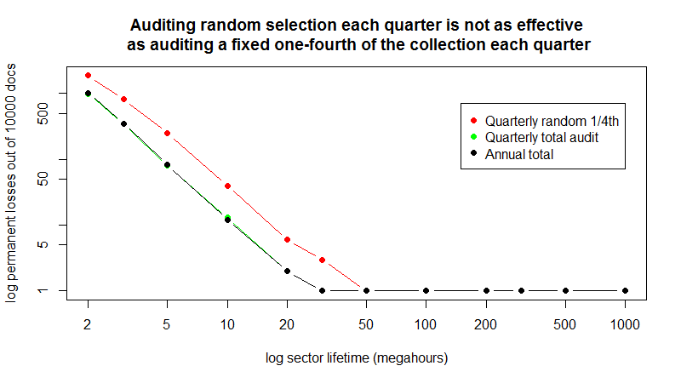
Random Selection Leaves Errors
iPRES 2015 - MIT Digital Document Preservation Simulation Project

Slide 32
Preliminary Conclusions - 1
More copies are better (duh!)
Auditing is essential to collection health
  Protects collection over huge range of "quality"
  Very frequent auditing is probably overkill
  Tricky auditing (subsets, random) is less effective
iPRES 2015 - MIT Digital Document Preservation Simulation Project

Slide 33
Other: Questions- 2
Institutional failures are pernicious -- but how often do they occur?
  The problem: a silent institutional failure reduces the number of redundant copies you have stored
  Risk is increased until you discover the problem (in auditing) and provision a new server
    Thought you had four copies? Well, for a period of time, you actually have only three.
    And another failure before the audit reduces copies to two
    Failures may be correlated due to economic conditions, wars
iPRES 2015 - MIT Digital Document Preservation Simulation Project

Slide 34
Other: Questions - 3
How many copies do you need to limit losses?
  Limit permanent losses to some part of the collection?
  Better: How many to keep likelihood of any permanent loss under some percentage?
    5 per cent, 1 per cent, 0.1 per cent?
  For institutional failures, how many copies to keep likelihood of total loss under some percentage?
iPRES 2015 - MIT Digital Document Preservation Simulation Project

Slide 35
Audit We Must
Auditing is expensive (in bandwidth, bytes moved, time)
  Read back all the contents of all the documents?
  We should work toward efficient auditing functions
iPRES 2015 - MIT Digital Document Preservation Simulation Project

Slide 36
What Next?
Q: What information do you need to manage your libraries?
iPRES 2015 - MIT Digital Document Preservation Simulation Project

Slide 37
Backup
iPRES 2015 - MIT Digital Document Preservation Simulation Project

Slide 38
Form of the Data
Fixed number of documents, fixed time
  Scale to your needs
Number of copies varies, 1 to 10
Reliability of storage servers varies
  Very little real data in this area
Auditing strategies vary
Document size varies (but doesn't matter)
iPRES 2015 - MIT Digital Document Preservation Simulation Project

Slide 39
Institutional Failures
(NEED GRAPH)
Assume baseline # of copies, quality and auditing yields 0 loss in the absence of institutional failure
Closed form – compare expected loss vs. frequency of business failure events (inverse of business half-life?)
Recession → pushes failure curve out
iPRES 2015 - MIT Digital Document Preservation Simulation Project

