Slide 1


Examining Racial Differences in Patterns of Opioid Prescribing in the ICU
Pui Ning Pauline Yeung
Asimina Lazaridou
Marcela Marsiglia
Rui Dong
Niklas Adams
Fredrik Willumsen Haug

Slide 2
Problem Definition
Prescription opioids still account for a large proportion of overdose deaths and contribute to opioid use dependence (OUD).
In the ICU, there are occasions when opioids are indicated and necessary
Studies earlier in the epidemic suggest clinicians were less likely to prescribe opioids to racial/ethnic minorities.
No data exploring racial disparities of opioid prescriptions at the ICU
Flores MW, Sharp A, Lu F, Cook BL. Examining Racial/Ethnic Differences in Patterns of Opioid Prescribing: Results from an Urban Safety-Net Healthcare System. J Racial Ethn Health Disparities. 2023 Mar 9:1–11. doi: 10.1007/s40615-023-01555-z. Epub ahead of print. PMID: 36892815; PMCID: PMC9997438.
Ahmed A, McHenry N, Gulati S, Shah I, Sheth SG. Racial and Ethnic Disparities in Opioid Prescriptions for Patients with Abdominal Pain: Analysis of the National Ambulatory Medical Care Survey. Journal of Clinical Medicine. 2023; 12(15):5030. https://doi.org/10.3390/jcm12155030

Slide 3
Database Selection and Issues
MIMIC-IV
How did patients get into dataset?
  Boston area
  Education / insurance / social class differences
  Triage threshold
  Year (2008-2019)

Slide 4
Inclusion Exclusion Criteria
Inclusion criteria:
  All adults >18 years
  Medical ICU
  Full code
Exclusion criteria:
  “Others” category in race
Sampling selection bias

Slide 5
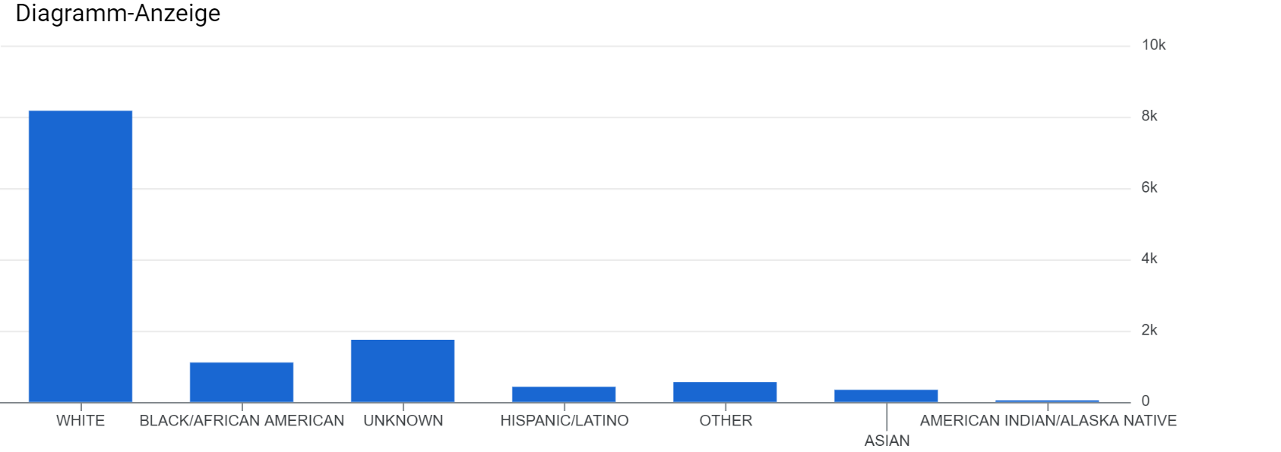
*
*
*
*
*Included in analysis

Slide 6
Exposures and Outcomes
Exposure: Race
Outcome: Average daily Morphine Equivalent Dose (MED) within an ICU admission
  Opioids included: fentanyl, morphine, oxycodone, hydrocodone, oxymorphone, methadone, codeine, buprenorphine, pethidine
(we considered adjusting dose per weight, missing data)
Model: multivariable linear regression

Slide 7
Features / mediators
Insurance type (masshealth vs other)
Disease severity
  APACHE score, SOFA score
Liver failure
Kidney failure
Number of procedures (procedure events)
Language proficiency
Calendar year
Duration of ICU admission

Slide 8
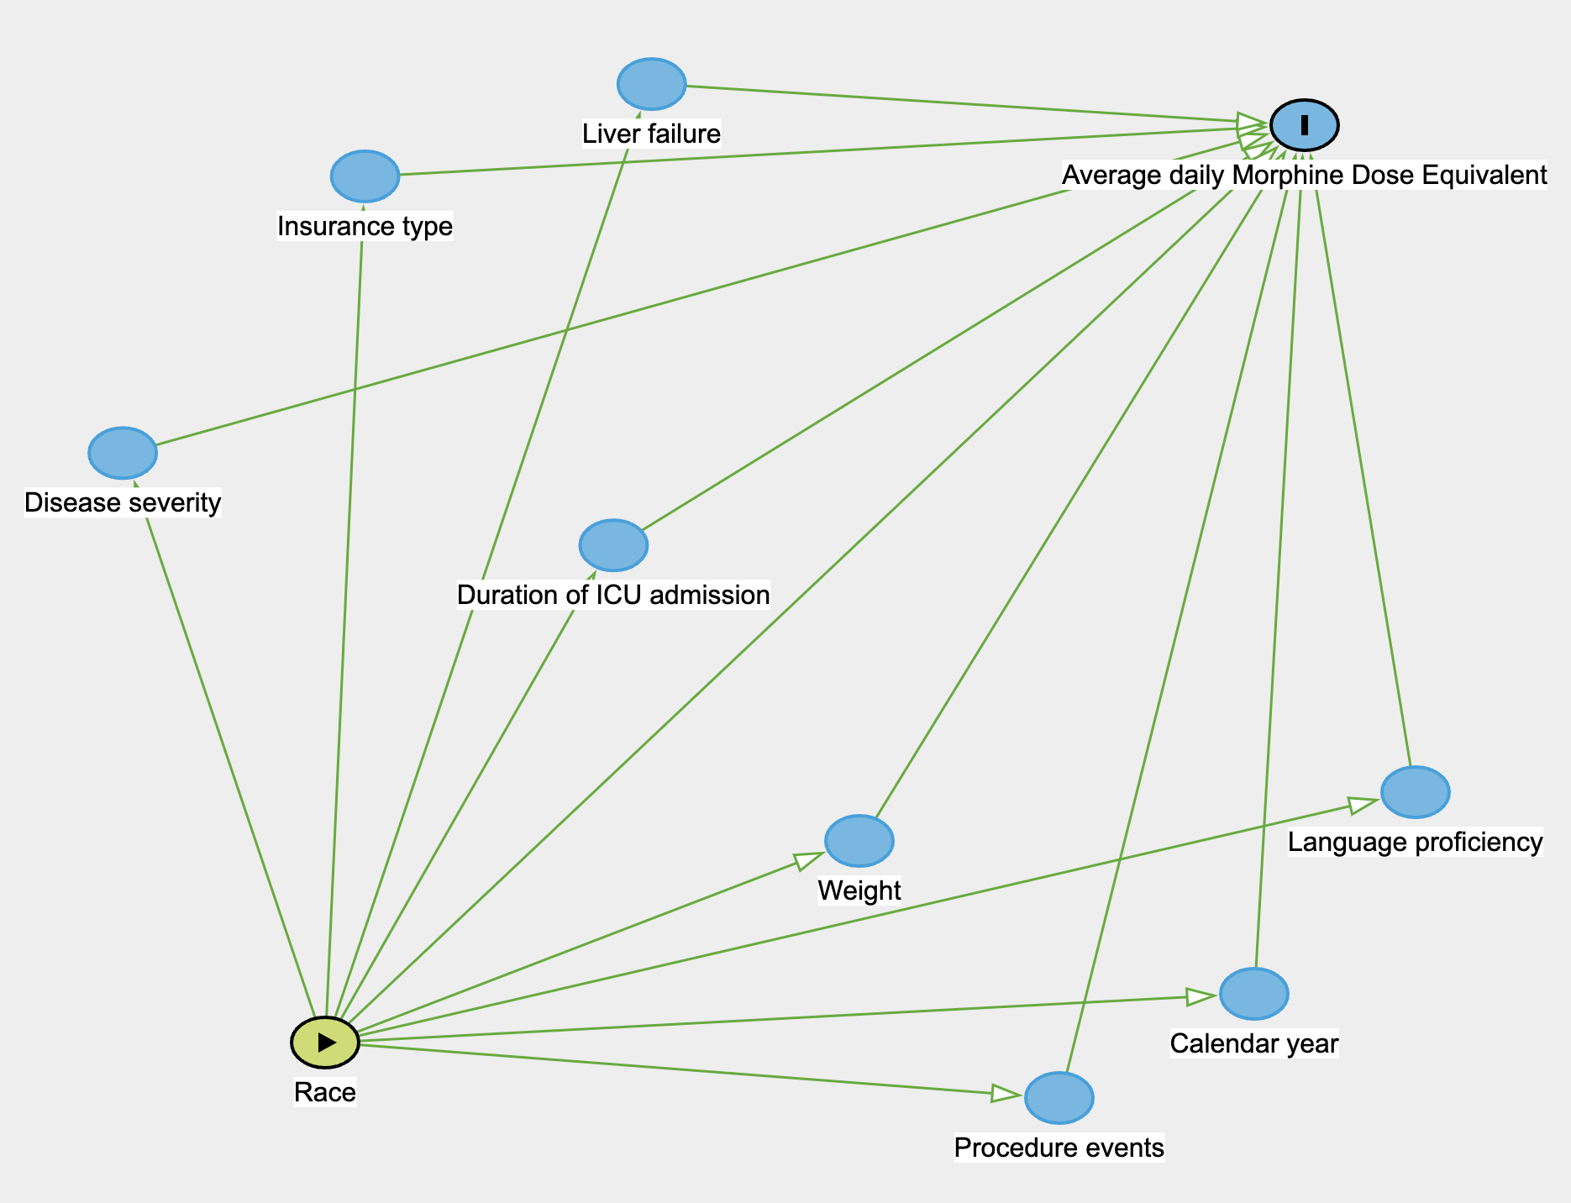
Notes:
Exposure (race) and outcome (ADM) and all the features included in our model.

Slide 9
Evaluation of in silico Model Performance
Metrics for model fit: mean squared error
Validation:
  internal - separate into training + testing cohorts
  external - eICU database

Slide 10
Implementation
Implementing the model into clinical workflow
  e.g., clinical support tool: give recommended dosing with racial disparity removed
Unintended consequence: over-prescription when unnecessary

Slide 11
Clinical Implications
Differential prescription of opioids by race-ethnicity could lead to widening of existing disparities in health and may have implications for disproportionate burden of opioid abuse among whites.
The model will potentially have important implications for medical provider education (e.g sensitization exercises)

Slide 12

Thank You =)

