Slide 1
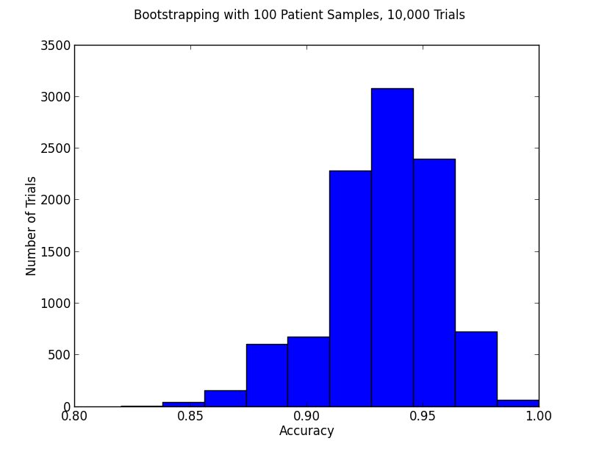
100pts, 10000 trials
Median 0.93
25% = 0.92, 75% = 0.95
Mean = 0.931626
Std = 0.025247101299

Slide 2
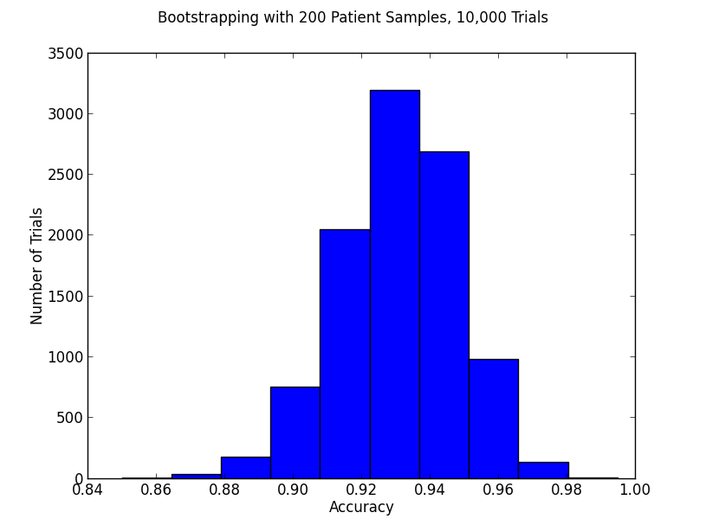
200pt samples
  Med = 0.93
  25% = 0.92, 75% = 0.945
  Std = 0.0179770881332

Slide 3
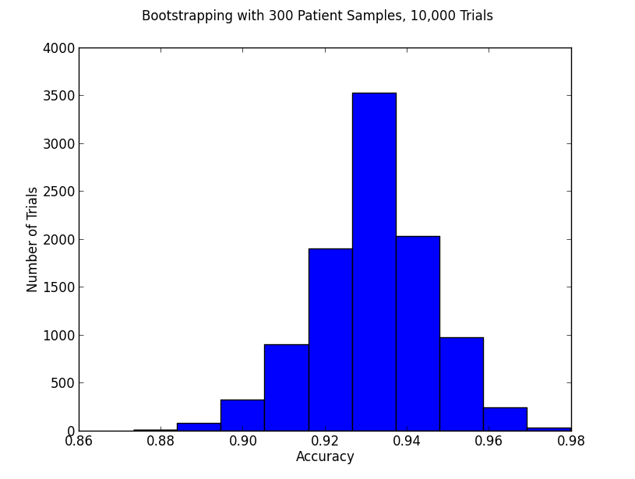
300 patients
  Med = 0.9333333333
  25% = 0.9233333, 75% = 0.94
  Mean 0.931447666667
  Std = 0.0145936376967

Slide 4
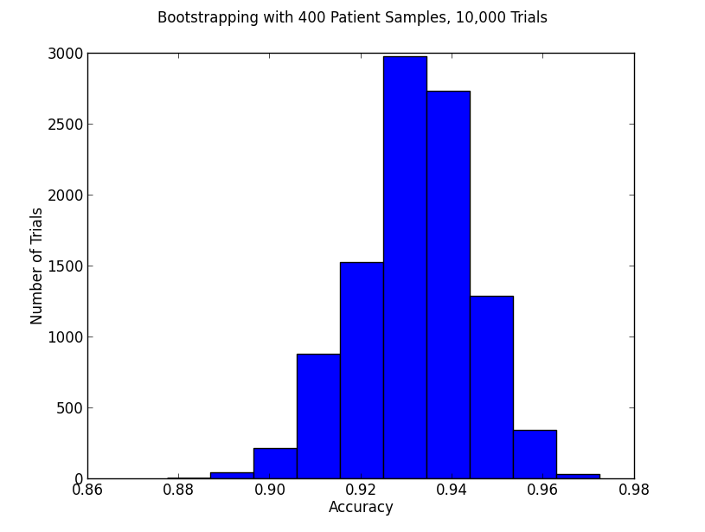
400 patient samples
  Median 0.9325
  25% = 0.9225, 75% = 0.94
  Mean 0.931559
  Std = 0.012589957069

