Slide 1
Some thoughts on single vs double precision

Slide 2
Single vs Double Precision
Component | Single (32-bit) | Double (64-bit)
Sign bit | 1 bit | 1 bit
Exponent | 8 bits | 11 bits
Fraction (mantissa) | 23 bits | 52 bits
Precision
Single precision: ~7 decimal digits of accuracy
Double precision: ~15–17 decimal digits of accuracy
Range
Single precision:
Approximate range: ±1.18 × 10⁻³⁸ to ±3.4 × 10³⁸
Double precision:
Approximate range: ±2.23 × 10⁻³⁰⁸ to ±1.80 × 10³⁰⁸
Memory
Single precision (4 bytes)
Double precision (8 bytes)

Slide 3
Risks
Risk | Description
Rounding error | Precision loss beyond ~7 digits
Catastrophic cancellation | Subtracting similar numbers amplifies errors
Equality errors | Values that differ in double may be identical in float
Divide by zero | Tiny numbers round to 0 → crash or inf
Overflow/underflow | Large/small values map to inf, 0, or NaN
Silent failures | Often no warning — just wrong results

Slide 4
Time errors
Float Value | Time Value | Single Float Precision | Time Precision (Single) | Double Float Precision | Time Precision (Double)
1 | 1 second | 1.19E-07 | 119 nanoseconds | 2.22E-16 | 0.222 femtoseconds
10 | 10 seconds | 9.54E-07 | 0.954 microseconds | 2.22E-15 | 2.22 femtoseconds
100 | ~1.5 minutes | 7.63E-06 | 7.63 microseconds | 2.22E-14 | 22.2 femtoseconds
1,000 | ~16 minutes | 6.10E-05 | 61 microseconds | 2.22E-13 | 222 femtoseconds
10,000 | ~3 hours | 9.77E-04 | 0.977 milliseconds | 2.22E-12 | 2.22 picoseconds
100,000 | ~1 day | 7.81E-03 | 7.81 milliseconds | 2.22E-11 | 22.2 picoseconds
1,000,000 | ~11 days | 6.25E-02 | 62.5 milliseconds | 2.22E-10 | 222 picoseconds
10,000,000 | ~4 months | 1.00E+00 | 1 second | 2.22E-09 | 2.22 nanoseconds
100,000,000 | ~3 years | 8.00E+00 | 8 seconds | 2.22E-08 | 22.2 nanoseconds
1,000,000,000 | ~32 years | 6.40E+01 | 64 seconds | 2.22E-07 | 222 nanoseconds
https://randomascii.wordpress.com/2012/02/13/dont-store-that-in-a-float/

Slide 5
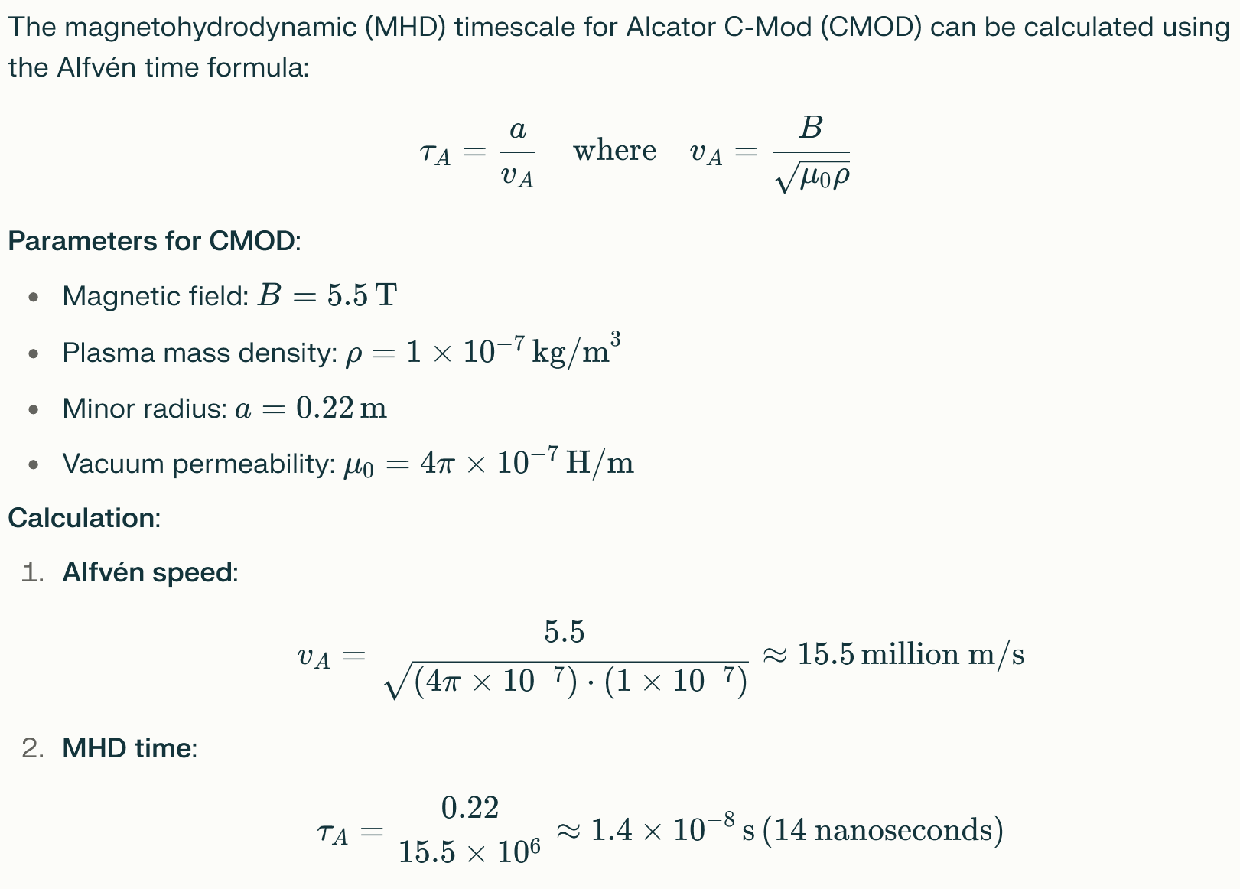
MHD timescale constrain
Float32's smallest representable positive value is ~1.4 × 10⁻⁴⁵ far smaller than 14 ns.

Slide 6
Fast magnetics sampling constrain
Time signals sampled at 2 MHz (0.5 µs per sample) can be represented in 32-bit floating-point (float32) for short durations, but 64-bit (float64) is required for long-term precision due to floating-point limitations ~8 seconds.
Float32 has ~7 significant decimal digits.
For timestamps, this means: After ~8.4 seconds, adding 0.5 µs increments no longer changes the float32 value due to mantissa truncation.
C-MOD shots are under 8 seconds. DIIID?

Slide 7
Temperature errors (eV)
Float Value (eV) | Temperature Equivalent (K) | Single Float Precision | ΔT (Single Precision) | Double Float Precision | ΔT (Double Precision)
1 | ~11,600 K | 1.19E-07 | 1.19E-07 eV | 2.22E-16 | 2.22E-16 eV
10 | ~116,000 K | 9.54E-07 | 9.54E-07 eV | 2.22E-15 | 2.22E-15 eV
100 | ~1.16 million K | 7.63E-06 | 7.63E-06 eV | 2.22E-14 | 2.22E-14 eV
1,000 | ~11.6 million K | 6.10E-05 | 6.10E-05 eV | 2.22E-13 | 2.22E-13 eV
10,000 | ~116 million K | 9.77E-04 | 9.77E-04 eV | 2.22E-12 | 2.22E-12 eV
100,000 | ~1.16 billion K | 7.81E-03 | 7.81E-03 eV | 2.22E-11 | 2.22E-11 eV
1,000,000 | ~11.6 billion K | 6.25E-02 | 6.25E-02 eV | 2.22E-10 | 2.22E-10 eV
10,000,000 | ~116 billion K | 1.00E+00 | 1 eV | 2.22E-09 | 2.22E-09 eV
100,000,000 | ~1.16 trillion K | 8.00E+00 | 8 eV | 2.22E-08 | 2.22E-08 eV
1,000,000,000 | ~11.6 trillion K | 6.40E+01 | 64 eV | 2.22E-07 | 2.22E-07 eV

Slide 8
Temperature errors (keV)
Float Value (keV) | Temperature (K) | Single Float Precision | ΔT (Single, keV) | Double Float Precision | ΔT (Double, keV)
1 | ~11.6 million K | 1.19E-07 | 1.19E-07 keV | 2.22E-16 | 2.22E-16 keV
10 | ~116 million K | 9.54E-07 | 9.54E-07 keV | 2.22E-15 | 2.22E-15 keV
100 | ~1.16 billion K | 7.63E-06 | 7.63E-06 keV | 2.22E-14 | 2.22E-14 keV
1,000 | ~11.6 billion K | 6.10E-05 | 6.10E-05 keV | 2.22E-13 | 2.22E-13 keV
10,000 | ~116 billion K | 9.77E-04 | 9.77E-04 keV | 2.22E-12 | 2.22E-12 keV
100,000 | ~1.16 trillion K | 7.81E-03 | 7.81E-03 keV | 2.22E-11 | 2.22E-11 keV
1,000,000 | ~11.6 trillion K | 6.25E-02 | 6.25E-02 keV | 2.22E-10 | 2.22E-10 keV
10,000,000 | ~116 trillion K | 1.00E+00 | 1.00 keV | 2.22E-09 | 2.22E-09 keV
100,000,000 | ~1.16 quadrillion K | 8.00E+00 | 8.00 keV | 2.22E-08 | 2.22E-08 keV
1,000,000,000 | ~11.6 quadrillion K | 6.40E+01 | 64.0 keV | 2.22E-07 | 2.22E-07 keV

Slide 9
Experiment
Experiments (for 212 shots)
Cast to 32
Cast to 64
No cast
Compare absolute and relative errors 32 vs 64 and No cast vs 64.

Slide 10
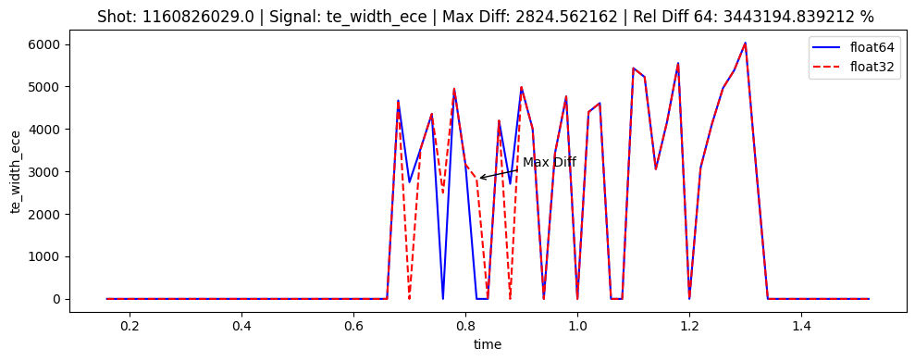
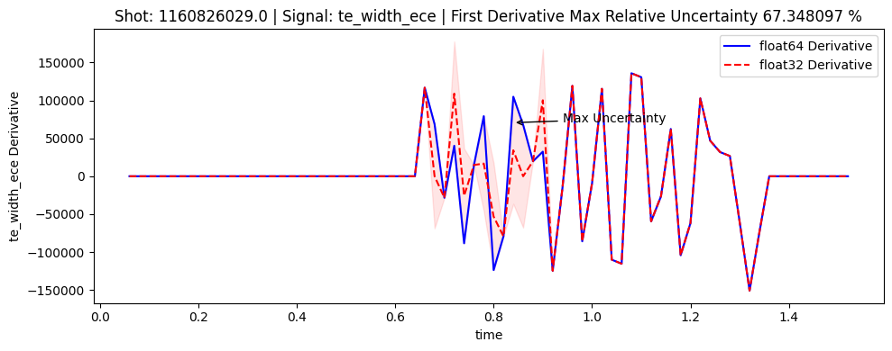
The worst offender

Slide 11
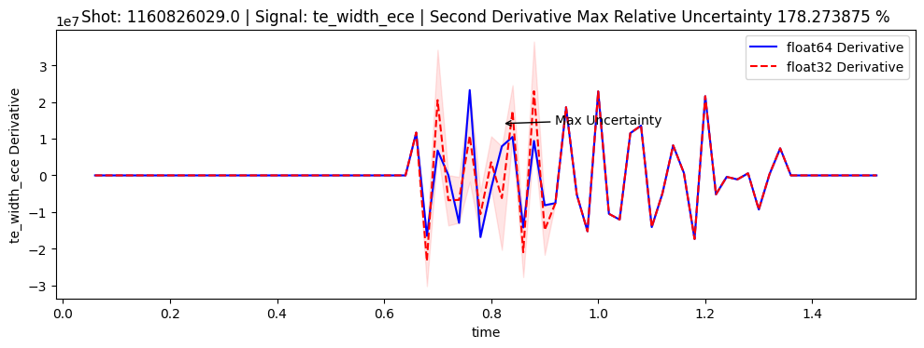
The worst offender

Slide 12
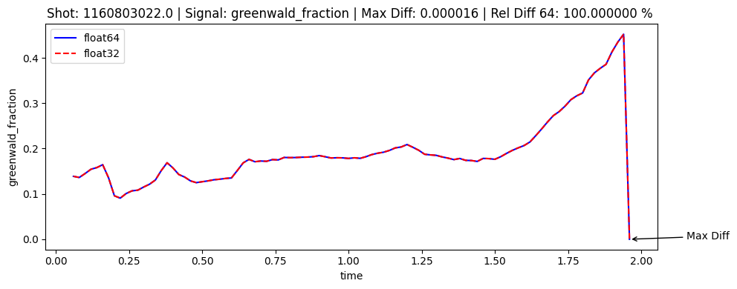
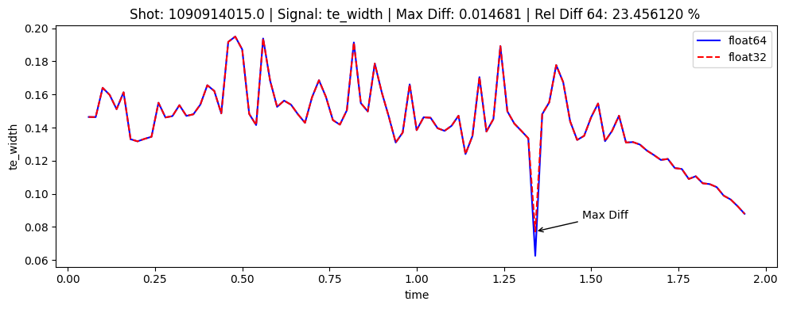
The worst offenders
Rest of signals look acceptable

