Slide 1

Group Tiger and Long
Logo here
IDEA PRESENTATION
03/08/2018

Slide 2

Backgrounds

Slide 3

Introduction
We are studying programming as a major.
We have learnt different languages in these years
Python Java JavaScript PHP node.JS
Tiger

Slide 4

What will happen
IF WE NEED TO USE THESE LANGUAGE AFTER WE ONLY LEARN IT FOR FEW MINUTES

Slide 5

AT THE FIRST FEW MINUTE
print(“I guess I am doing just fine”) def SlowAndSteady(Number): print(“Easy…”) print(“Easy…”)
for i in range(x): print(“Slowly…”)
Tiger

Slide 6


Slide 7
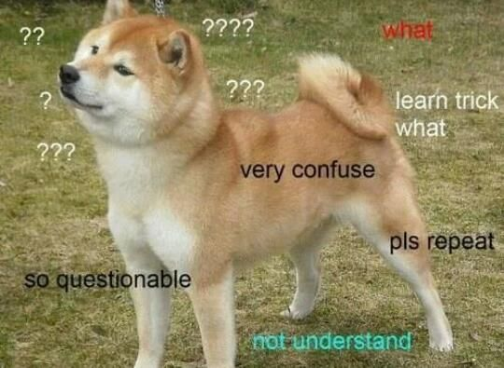
WE HAVE NO IDEA WHAT WE ARE TYPING
prin(“Why isn’t it working’]
Whilf HelpMe): print(“HELLLLP”)
$List = [“WHY”, “ISNT”, “THIS”, “WORKING”, “WHYY”]
Tiger

Slide 8

Problem will be solved if we have something to let beginners look at when they are coding for first time. Tiger and Long (2018)

Slide 9

By using this programme…
Beginners can understand what is each code for
They can reference to the program dictionary what code is for what purpose
They can have some example of which code they should use
Looking into each tab and they can have the information they want
Tiger

Slide 10

By using this programme…
People which is not technician can understand those code
Could be used as teaching material
Beginner can have more knowledge on different code and objects..
Tiger

Slide 11

INTRODUCTION
Demonstration of the Programme

Slide 12

THANK YOU
FOR ALL OF YOU GUYS

