Slide 1
Genetic engineering
Known as genetic modification or genetic manipulation

Slide 2
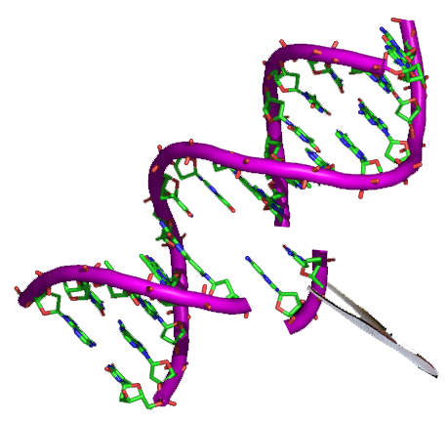
Effects on Business
Medicine & Research
Industrial & Agriculture
it is possible to create animal model organisms of human diseases
genetic engineering has the potential to cure genetic diseases through gene therapy
produce drugs can also have industrial applications such as producing enzymes for laundry detergent, cheeses and other products
The rise of commercialised genetically modified crops has provided economic benefit to farmers in many different countries.
Organisms can have their cells transformed with a gene coding for a useful protein

