Slide 1

Welcome to
were we take your security
to another level
By MITCHELL

Slide 2
Soft ware
Language
HTML
Vs Code
Netlify
CSS
Chrome
Git hub
Java-script

Slide 3
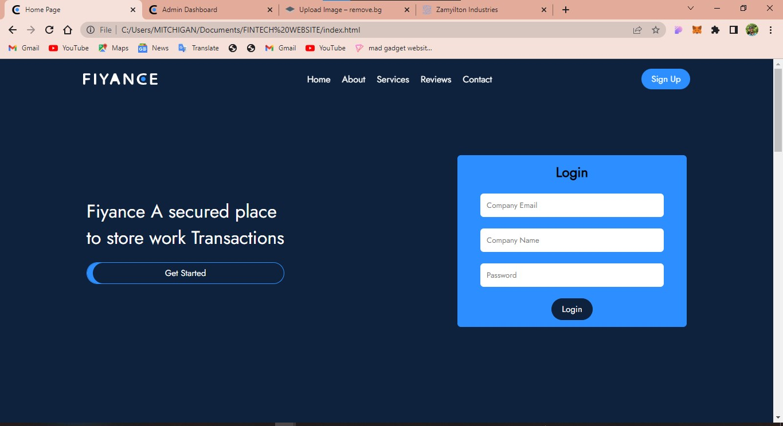
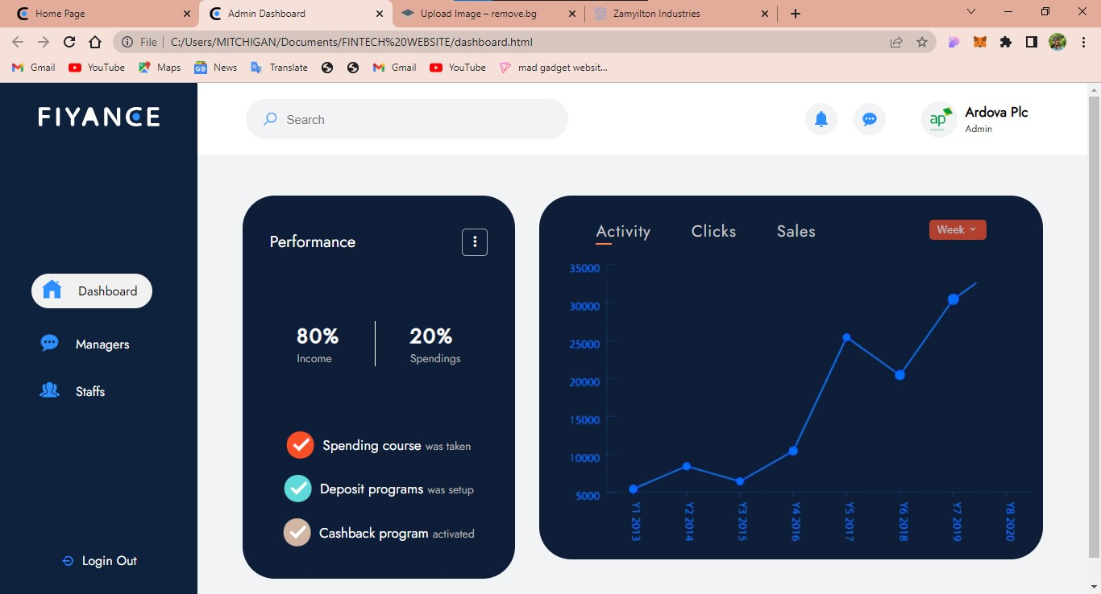
Home Page
Dashboard Page
Website Snip Shot

Slide 4
Thank You

