Slide 1
BLUESTOCK
Mutual Fund Analytics Capstone
ETL → SQLite → EDA → Performance Analytics → Advanced Analytics → Dashboard
40-Scheme Universe | July 2026

Slide 2
Executive Summary
End-to-end analytics pipeline across a 40-scheme mutual fund universe
₹62.74L Cr
₹31,002 Cr
26.12 Cr
40
Total AUM (from ₹30.18L Cr)
Latest Monthly SIP Inflow
Total Investor Folios
Schemes Analyzed
Mirae Asset Large Cap Fund tops the composite Fund Scorecard (84.4/100)
Small Cap schemes dominate the highest-VaR (riskiest) tail of the universe
3 equity funds flagged "Highly Concentrated" by sector HHI (> 2,500)
~35-40% of synthetic SIP investors (6+ SIPs) show early lapse-risk signals
Interactive 4-page HTML dashboard replaces the requested .pbix/.twbx file
2

Slide 3
Data & Methodology
Idempotent ETL, normalized SQLite schema, zero hard-coded paths
Raw
Ingestion
ETL
Cleaning
SQLite
Database
Analysis &
Dashboard
NAV reindexed to full business-day calendar per scheme, then forward-filled — closes weekend/holiday gaps without back-filling
CAGR annualized by trading days (252/yr) from actual NAV observation count, not calendar-day offsets
Sharpe/Sortino use a real 6.5% annual risk-free rate
SQLite: 11 tables, zero orphaned foreign keys, all 12 analytical queries pass verification
3

Slide 4
⚠ Data Disclosure
The source export did not include data/raw/08_investor_transactions.csv, which the project's own ETL scripts and SQLite schema depend on for investor-level analysis.
A seeded, reproducible synthetic dataset was generated instead (scripts/generate_synthetic_transactions.py)
~1,900 investors, ~33,000 transactions with realistic SIP/Lumpsum/Redemption behavior
Every chart, table, and notebook section built from it is explicitly labeled "(synthetic)"
Swapping in the real export requires zero code changes — same schema throughout
4

Slide 5
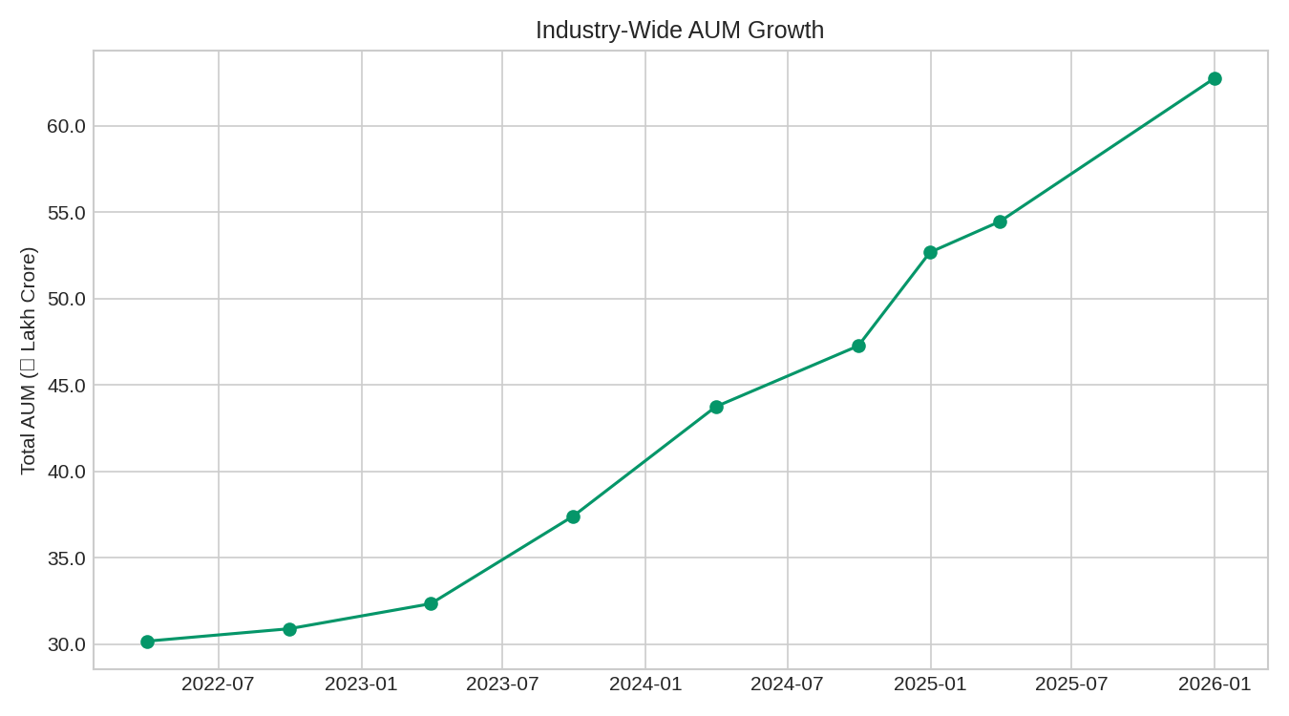
Industry AUM & SIP Growth
Exploratory Data Analysis
AUM grew ~108% cumulatively across the sample window
Growth is broadly steady rather than driven by a single spike
Top 10 fund houses account for the large majority of industry AUM
Consistent with well-documented concentration in Indian MF assets
5

Slide 6
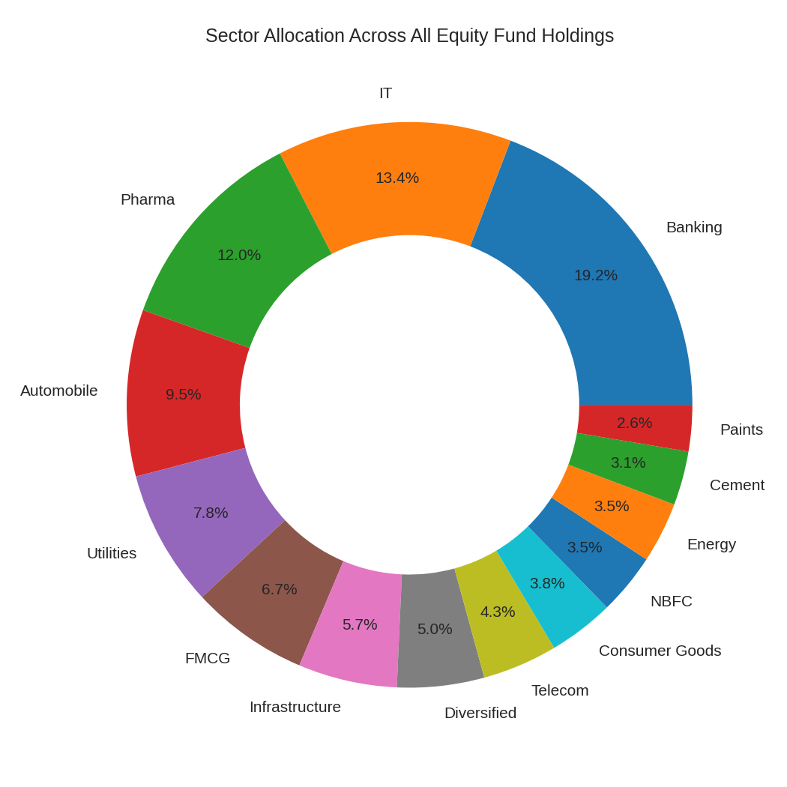
Sector Allocation
Equity fund holdings across the universe
Holdings concentrate in a handful of dominant sectors across the equity universe
This same concentration signal is quantified per-fund via the HHI metric in Advanced Analytics
Sector data available for 34 of 40 schemes (equity-only; debt/liquid/gilt don't disclose stock holdings)
6

Slide 7
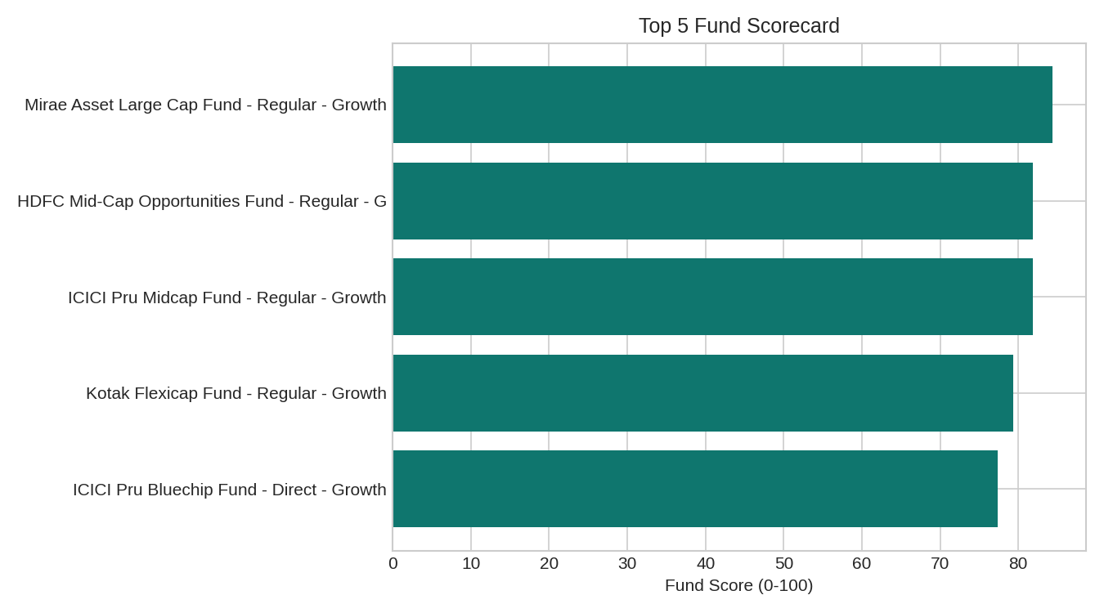
Composite Fund Scorecard
30% CAGR + 25% Sharpe + 20% Alpha + 15% Expense + 10% Drawdown
Scheme | Score | 3yr CAGR | Sharpe
Mirae Asset Large Cap Fund | 84.4 | 31.3% | 1.45
HDFC Mid-Cap Opportunities Fund | 81.9 | 33.6% | 1.09
ICICI Pru Midcap Fund | 81.9 | 30.2% | 1.18
Kotak Flexicap Fund | 79.4 | 25.7% | 1.31
ICICI Pru Bluechip Fund | 77.4 | 28.4% | 1.03
Rolling 90-day Sharpe crosses zero repeatedly for every top-5-AUM fund — trailing risk-adjusted performance is regime-dependent, not stable.
7

Slide 8
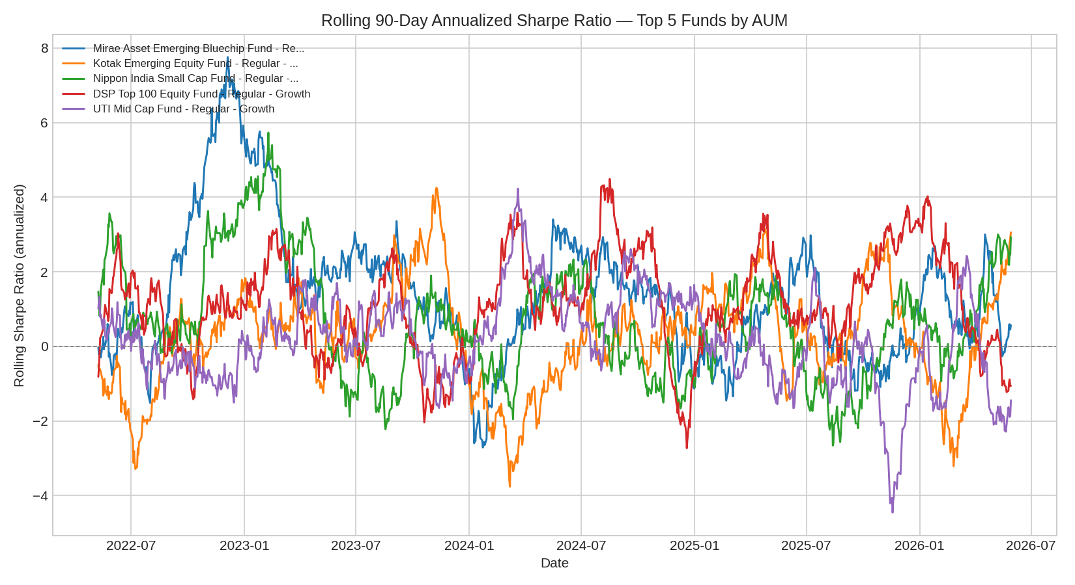
Rolling 90-Day Sharpe Ratio
Top 5 funds by AUM
8

Slide 9
Value-at-Risk & Conditional VaR
5th-percentile historical VaR(95%); CVaR = mean of the worst 5% of days
Scheme | Category | VaR 95% | CVaR 95%
SBI Small Cap Fund (Direct) | Equity | -2.69% | -3.24%
Axis Small Cap Fund | Equity | -2.62% | -3.17%
ABSL Small Cap Fund | Equity | -2.60% | -3.25%
Nippon India Small Cap Fund | Equity | -2.54% | -3.23%
SBI Small Cap Fund (Regular) | Equity | -2.45% | -3.06%
Small Cap dominates the riskiest tail
Consistent with higher idiosyncratic volatility & thinner liquidity in small-cap stocks
CVaR runs further below VaR for every fund shown — bad days tend to be worse than the VaR threshold alone suggests
9

Slide 10
Investor Behavior (synthetic)
Cohort analysis & SIP continuity
~1,900
35-40%
5 Years
Synthetic Investors Analyzed
At-Risk SIP Investors (avg gap > 35d)
Cohort Span (2022-2026)
Total invested skews toward earlier cohorts mainly due to longer accumulation time, not higher per-investor commitment
Average SIP ticket size is comparable across cohorts — a more reliable behavioral signal than total invested
Widening SIP cadence (avg gap > 35 days) is a plausible early-warning signal for lapse in a live deployment
10

Slide 11
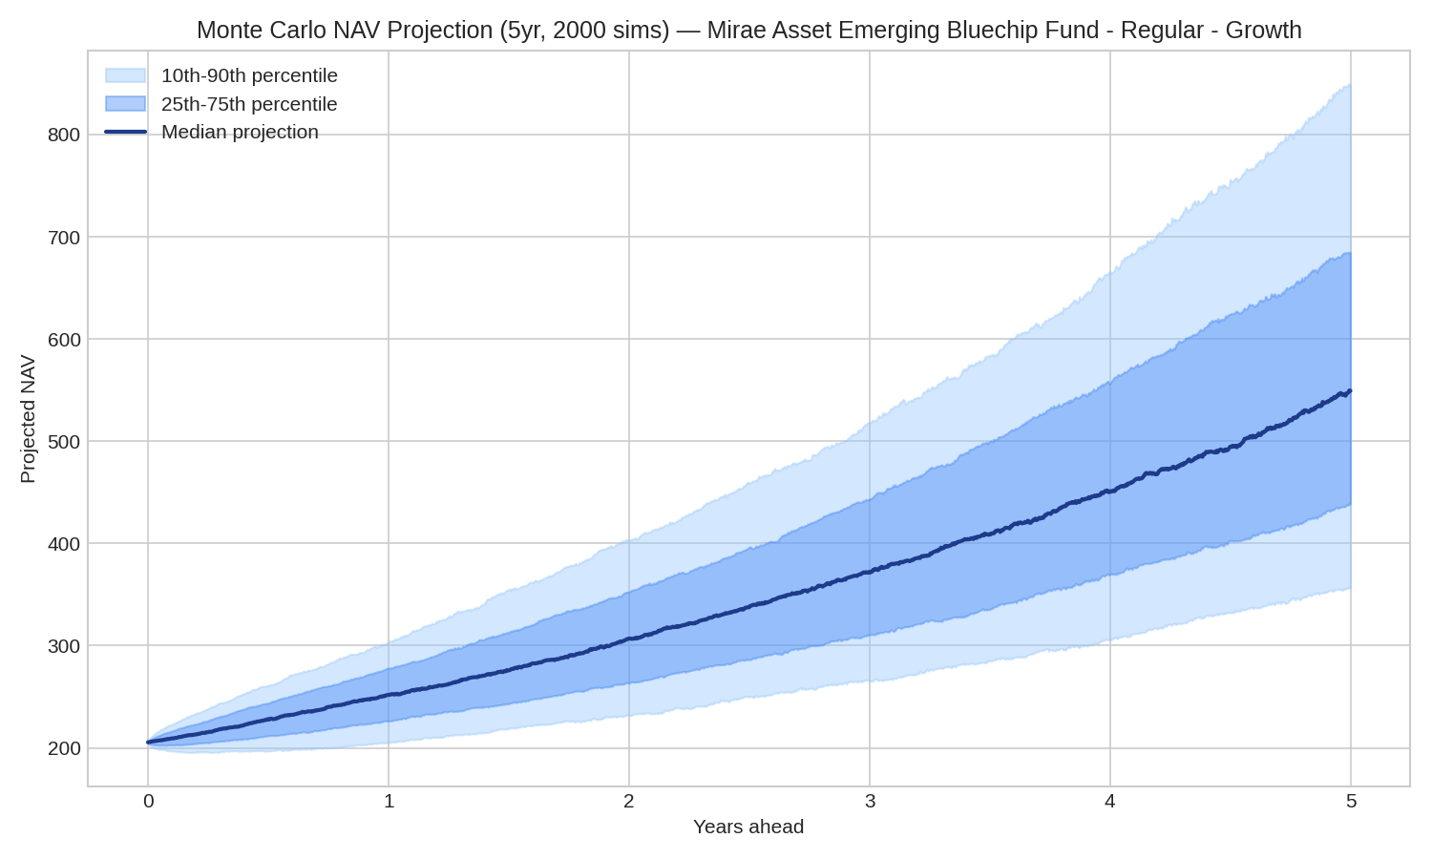
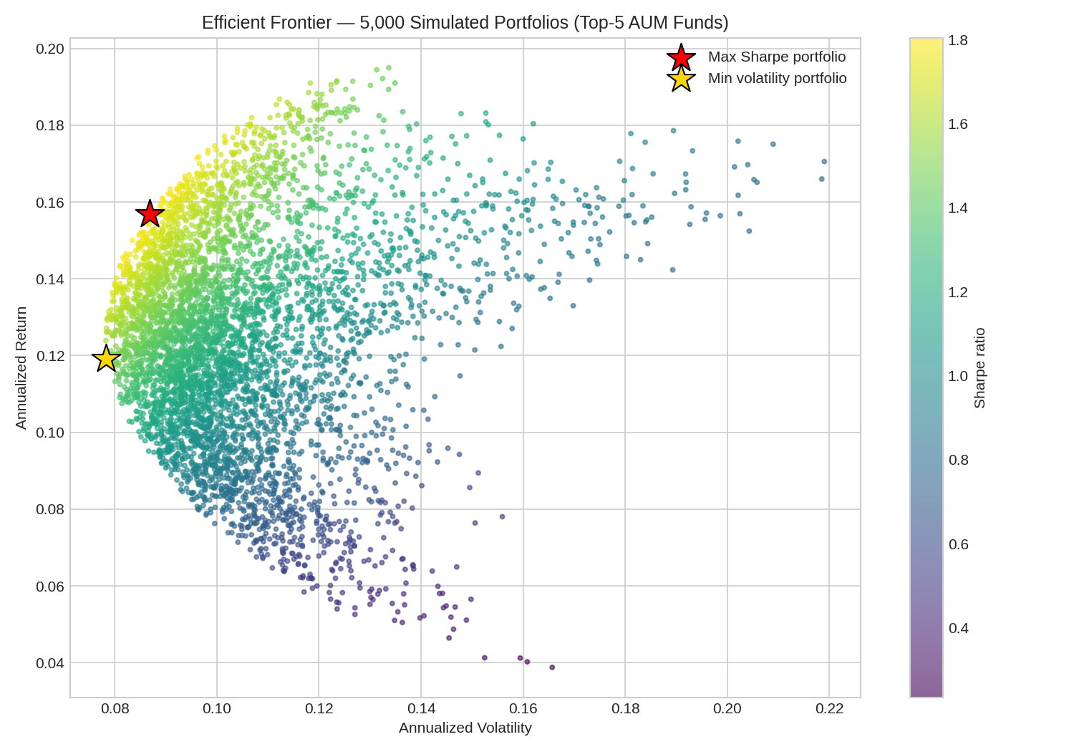
Bonus: Monte Carlo & Efficient Frontier
B3 — 5-year NAV projection | B4 — Markowitz optimization
Monte Carlo bands widen substantially by year 5 — compounding uncertainty, not just point-estimate CAGR, should inform return expectations.
The max-Sharpe portfolio concentrates in 2-3 names rather than spreading evenly — AUM size and optimal weight are unrelated.
11

Slide 12
Interactive Dashboard
4 pages, every page with 2+ genuinely functional slicers
Industry Overview
Fund Performance
AUM trend, SIP inflow trend, top-N AMC ranking
Risk/return scatter, sortable scorecard table
Slicers: Year, Top-N AMCs
Slicers: Fund house, Category, Plan
Investor Analytics
SIP & Market Trends
State-wise investment, transaction mix, SIP-by-age (synthetic)
SIP vs. Nifty50, category inflow heatmap
Slicers: State, Age Group, City Tier
Slicers: Category, Top-N Categories
Note: a native Power BI (.pbix) / Tableau (.twbx) file could not be authored — both require their proprietary desktop apps. This HTML/Chart.js dashboard is a functional substitute.
12

Slide 13
Recommendations
Prioritize the top-5 Fund Scorecard names as a "core recommended list" — balanced across return, risk, alpha, cost & drawdown
Flag Small Cap VaR/CVaR leaders with explicit downside disclosures; cap Small Cap exposure in Low/Moderate risk-appetite recommendations
Review the 3 "Highly Concentrated" HHI funds for diversification guidance, especially where they overlap with the high-VaR tail
Obtain the real investor-transaction export — cohort & SIP-continuity figures are illustrative only until validated on real data
Operationalize the SIP "at-risk" flag as a live retention-team alert once real data is available
13

Slide 14
Thank You
Full detail: notebooks/ 03-05 | reports/ | dashboard/bluestock_mf_dashboard.html

