Slide 1

CAPSTONE PROJECT
Secure Image Steganography
Student Name : Mithilesh Yogesh Kolhapurkar
College Name & Department : Nutan College of Engineering and Research - B.Tech CSE AI

Slide 2
OUTLINE
  Problem Statement
  Technology used
  Wow factor
  End users
  Result
  Conclusion
  Git-hub Link
  Future scope

Slide 3
Problem Statement
Secure communication is crucial in the digital era. Traditional encryption methods attract attention, making them vulnerable to attacks. Steganography offers a discreet way to hide messages within images. Our project implements a password-protected image steganography system, ensuring secure message concealment and extraction while maintaining data privacy. With a user-friendly interface, it provides a reliable solution for confidential communication in sensitive environments.

Slide 4
Technology Used
Our project is built using modern tools and technologies for seamless performance:
  Programming Language: Python
  Image Processing Library: OpenCV
  Data Handling: NumPy
  User Interface: Streamlit
  Security: SHA-256 hashing for password protection
These technologies ensure secure, efficient, and user-friendly encryption and decryption processes.

Slide 5
Wow factors
Our project stands out due to its:
  Password-Protected Encryption: Ensures only authorized users can retrieve the hidden message.
  Invisible Data Hiding: No noticeable distortion in images.
  Streamlit-Based UI: Simple and interactive design for easy encryption/decryption.
  Secure Verification: Messages can only be retrieved using the correct password.
  Low Image Distortion: Ensures the image remains visually unchanged while embedding data.

Slide 6
End users
This system is beneficial for:
  Cybersecurity Enthusiasts: Learning about secure communication methods.
  Government & Intelligence Agencies: Secret data transmission.
  Journalists & Whistleblowers: Safe communication without detection.
  Individuals Needing Privacy: Personal data protection.
It provides a secure way to share sensitive information without raising suspicion.

Slide 7
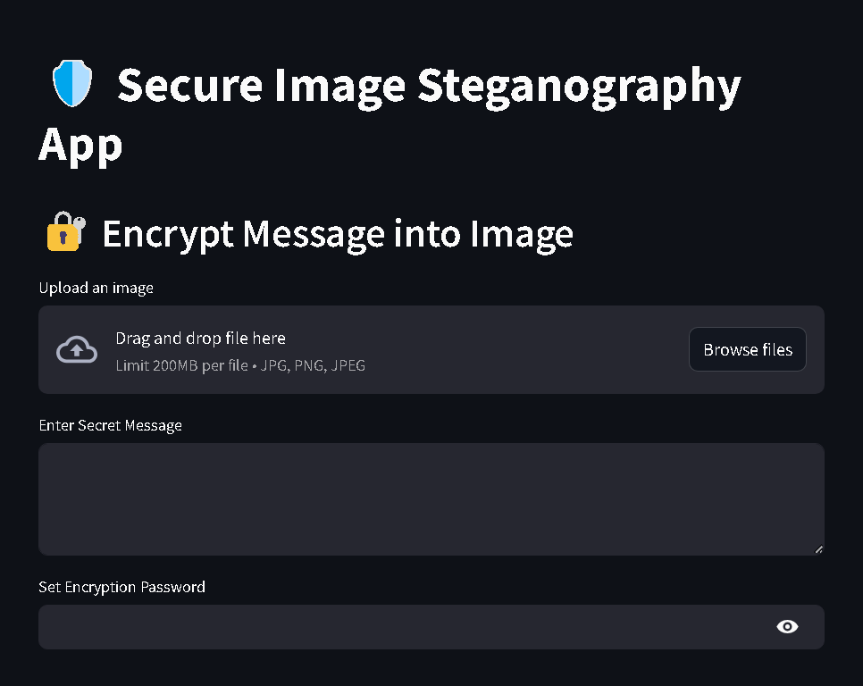
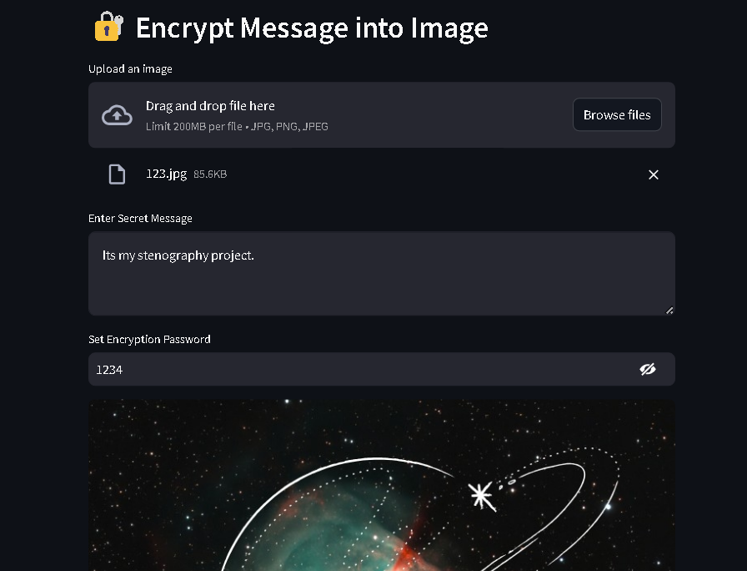
Results
Encryption

Slide 8
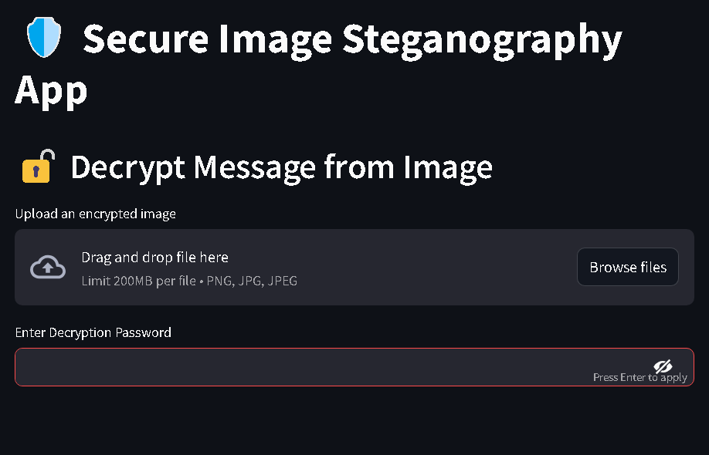
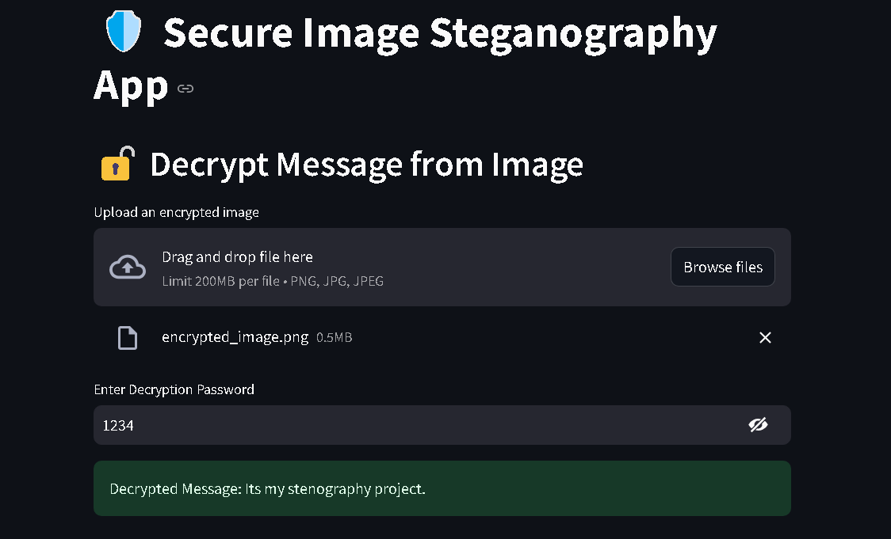
Results
Dcryption

Slide 9
Conclusion
  This project successfully implements secure image-based data hiding using steganography. With password-protected encryption, it adds an extra layer of security, ensuring only authorized users can access the hidden message. The system is designed to be user-friendly, lightweight, and efficient, making it useful for individuals and organizations needing secure, private communication. This approach enhances traditional encryption methods by making messages undetectable.

Slide 10
GitHub Link
The project is open-source and available on GitHub.
🔗 GitHub Repository:
https://github.com/MITHILESHK11/Steganography-App-Aicte-Internship-Cybersecurity-Edunet-Foundation
The repository contains:
  Source Code for encryption and decryption
  ReadMe File with setup instructions
  Sample Images for testing
Ensure that all documentation is properly maintained for easy setup and understanding.

Slide 11
Future Scope
To further improve the system, we plan to:
  Expand to Other File Types: Support for text, audio, and video steganography.
  Enhance Security: AI-powered steganalysis resistance.
  Cloud Integration: Secure encrypted storage and sharing.
  Mobile App Development: A lightweight mobile version for easy access.
These enhancements will improve usability and expand real-world applications.

Slide 12
THANK YOU

