Slide 1
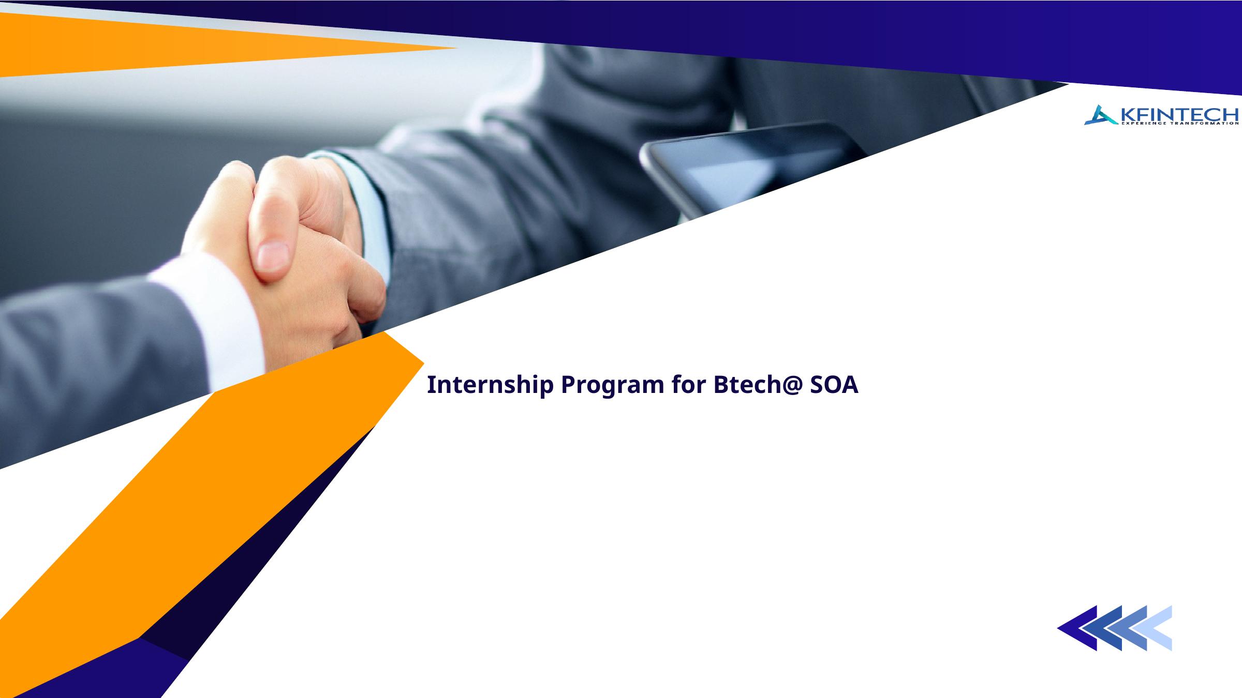
Backend API Development Course
DAY 2
Instructor: Mitrajanu Mishra
Senior Software Engineer @KFINTECH

Slide 2

2 DAYS · 9 MODULES
Course Roadmap
1
MongoDB and Hands On
2
3
Autentication and Authorization
AWS( S3,EC2,CLOUDFRONT,IAM)
4
Deploying a react app into AWS
We build ONE continuous project, evolving it module by module.
Backend API Development Masterclass · Day 2

Slide 3
MODULE 5
SQL vs NOSQL
60 min
We keep evolving one backend project, one capability at a time.
Backend API Development Masterclass · Day 2

Slide 4
MODULE 5
Learning Objectives
•
Compare SQL and NoSQL trade-offs without hype.
•
Identify entities, attributes, and relationships.
•
Model one-to-one, one-to-many, and many-to-many relationships.
•
Decide when to embed or reference in MongoDB.
Backend API Development Masterclass · Day 2

Slide 5
CONCEPT
SQL vs NoSQL: the real trade-off
•
SQL favors structured relations, joins, and strong consistency.
•
NoSQL favors flexible documents and access-pattern-driven design.
•
Neither is “better”; the product requirements decide.
•
Ask: how will the app read and update this data most often?
Backend API Development Masterclass · Day 2

Slide 6
MODULE 6
MongoDB + Connecting to Express
90 min
We keep evolving one backend project, one capability at a time.
Backend API Development Masterclass · Day 2

Slide 7
CONCEPT
What MongoDB gives us
•
Data is stored as flexible documents in collections.
•
Documents look like JSON but are stored as BSON.
•
It fits APIs where resources naturally map to nested objects.
•
Great flexibility still needs schema discipline in application code.
Backend API Development Masterclass · Day 2

Slide 8
CONCEPT
Indexes: the library catalog
•
Without an index, MongoDB may scan many documents.
•
An index speeds common lookups such as email or ownerId.
•
Indexes cost storage and write overhead.
•
Create indexes for real query patterns, not every field.
Backend API Development Masterclass · Day 2

Slide 9
CODE
MongoDB CRUD mental model
// Create db.tasks.insertOne({ title: 'Learn Mongo', done: false }) // Read db.tasks.find({ done: false }) // Update db.tasks.updateOne({ _id: id }, { $set: { done: true } }) // Delete db.tasks.deleteOne({ _id: id })
KEY LINE
Mongo operators like $set describe how to update a document.
Backend API Development Masterclass · Day 2

Slide 10
CONCEPT
Aggregation pipeline intro
•
Aggregation transforms data through stages.
•
Common stages: $match, $group, $sort, $project.
•
Think conveyor belt: each stage receives and reshapes documents.
•
Use it for reports, summaries, and advanced reads.
Backend API Development Masterclass · Day 2

Slide 11
CODE
Mongoose schema and model
const mongoose = require('mongoose'); const taskSchema = new mongoose.Schema({ title: { type: String, required: true, trim: true }, done: { type: Boolean, default: false }, owner: { type: mongoose.Schema.Types.ObjectId, ref: 'User' } }, { timestamps: true }); module.exports = mongoose.model('Task', taskSchema);
KEY LINE
Schema validation catches bad data before it reaches the database.
Backend API Development Masterclass · Day 2

Slide 12
CODE
Connect Mongo to Express
const mongoose = require('mongoose'); async function connectDb() { await mongoose.connect(process.env.MONGO_URI); console.log('MongoDB connected'); } connectDb() .then(() => app.listen(3000, () => console.log('API on port 3000'))) .catch(err => { console.error('Failed to start API', err); process.exit(1); });
KEY LINE
Start listening only after the database connection succeeds.
Backend API Development Masterclass · Day 2

Slide 13
CODE
Persisted create route
app.post('/tasks', validateTask, async (req, res, next) => { try { const task = await Task.create({ title: req.body.title, owner: req.user.id }); res.status(201).json({ success: true, data: task }); } catch (err) { next(err); } });
KEY LINE
async route errors should reach the central error handler.
Backend API Development Masterclass · Day 2

Slide 14
CODE
populate a referenced relationship
const task = await Task.findById(req.params.id) .populate('owner', 'name email'); res.json({ success: true, data: task });
KEY LINE
populate replaces an ObjectId reference with selected fields from the linked document.
Backend API Development Masterclass · Day 2

Slide 15
RECAP
Module 6 Recap
•
MongoDB stores flexible documents; Mongoose adds structure.
•
Indexes support performance for real query patterns.
•
Persisted CRUD is the same API contract with a real database behind it.
•
populate helps read referenced documents cleanly.
Backend API Development Masterclass · Day 2

Slide 16
MODULE 7
Authentication vs Authorization
75 min
We keep evolving one backend project, one capability at a time.
Backend API Development Masterclass · Day 2

Slide 17
MODULE 7
Learning Objectives
•
Separate authentication from authorization.
•
Hash passwords using bcrypt with salt.
•
Explain JWT header, payload, and signature.
•
Build register and login endpoints that issue tokens.
Backend API Development Masterclass · Day 2

Slide 18
CRITICAL DISTINCTION
Authentication vs authorization
•
Authentication asks: “Who are you?”
•
Authorization asks: “What are you allowed to do?”
•
Login proves identity; permissions control actions.
•
Common bug: checking identity but forgetting access rules.
Backend API Development Masterclass · Day 2

Slide 19
SECURITY CONCEPT
Password hashing with bcrypt
•
Never store plain-text passwords.
•
bcrypt adds salt so identical passwords do not create identical hashes.
•
On login, compare the supplied password against the stored hash.
•
You do not decrypt a password hash. You verify it.
GOTCHA
Hash passwords before saving. Never log passwords or tokens.
Backend API Development Masterclass · Day 2

Slide 20
CODE
User schema with password hash
const userSchema = new mongoose.Schema({ name: { type: String, required: true }, email: { type: String, required: true, unique: true }, passwordHash: { type: String, required: true }, role: { type: String, enum: ['user', 'admin'], default: 'user' } });
KEY LINE
Store passwordHash, not password.
Backend API Development Masterclass · Day 2

Slide 21
CODE
Register: hash then save
app.post('/register', async (req, res, next) => { try { const passwordHash = await bcrypt.hash(req.body.password, 12); const user = await User.create({ name: req.body.name, email: req.body.email, passwordHash }); res.status(201).json({ success: true, data: { id: user.id, email: user.email } }); } catch (err) { next(err); } });
KEY LINE
The cost factor balances security and performance.
Backend API Development Masterclass · Day 2

Slide 22
CONCEPT
JWT structure
•
A JWT has header.payload.signature.
•
The payload contains claims such as user id and role.
•
The signature proves the token was created by your server secret.
•
JWT content is encoded, not encrypted; avoid sensitive payload data.
Backend API Development Masterclass · Day 2

Slide 23
FLOW
Full auth flow
Register → hash password → store user Login → compare password → issue JWT Protected request → Bearer token → verify → req.user
Authentication creates trusted identity context for later route protection.
Backend API Development Masterclass · Day 2

Slide 24
CODE
Login: verify and issue JWT
app.post('/login', async (req, res, next) => { try { const user = await User.findOne({ email: req.body.email }); if (!user) return res.status(401).json({ success: false, error: { message: 'Invalid credentials' } }); const ok = await bcrypt.compare(req.body.password, user.passwordHash); if (!ok) return res.status(401).json({ success: false, error: { message: 'Invalid credentials' } }); const token = jwt.sign({ id: user.id, role: user.role }, process.env.JWT_SECRET, { expiresIn: '1h' }); res.json({ success: true, data: { token } }); } catch (err) { next(err); } });
KEY LINE
Use the same error message so attackers cannot enumerate emails.
Backend API Development Masterclass · Day 2

Slide 25
CONCEPT
Sending tokens
•
Client sends Authorization: Bearer <token>.
•
Server verifies signature and expiry on protected routes.
•
Do not put tokens in URLs; they leak through logs and history.
•
Token expiry limits damage if a token is exposed.
Backend API Development Masterclass · Day 2

Slide 26
🛠️ YOUR TURN
Build register and login
Implement /register with bcrypt hashing and /login with bcrypt compare + JWT issue.
Time-box: 30 minutes
Solution branch: checkpoint-05-auth
COACHING
Try first, then compare. The point is to practice reading errors, not avoid them.
Backend API Development Masterclass · Day 2

Slide 27
RECAP
Module 7 Recap
•
Authentication proves identity; authorization grants permissions.
•
Passwords must be salted and hashed.
•
JWTs are signed, encoded claims.
•
Login returns a token used on protected requests.
Backend API Development Masterclass · Day 2

Slide 28
MODULE 8
Securing the Endpoints
60 min
We keep evolving one backend project, one capability at a time.
Backend API Development Masterclass · Day 2

Slide 29
MODULE 8
Learning Objectives
•
Write auth middleware that protects routes.
•
Apply role-based access control.
•
Protect resource ownership.
•
Create reusable authorize(role) middleware.
Backend API Development Masterclass · Day 2

Slide 30
CODE
Auth middleware
function requireAuth(req, res, next) { const header = req.headers.authorization || ''; const [scheme, token] = header.split(' '); if (scheme !== 'Bearer' || !token) { return res.status(401).json({ success: false, error: { message: 'Missing token' } }); } try { req.user = jwt.verify(token, process.env.JWT_SECRET); next(); } catch { res.status(401).json({ success: false, error: { message: 'Invalid token' } }); } }
KEY LINE
Middleware attaches trusted user info to req.user.
Backend API Development Masterclass · Day 2

Slide 31
CONCEPT
RBAC: role-based access control
•
Roles are broad permissions such as admin or user.
•
RBAC is useful for admin dashboards and restricted actions.
•
Keep role checks centralized, not scattered across handlers.
•
Roles do not replace ownership checks.
Backend API Development Masterclass · Day 2

Slide 32
CODE
Reusable authorize middleware
function authorize(...allowedRoles) { return (req, res, next) => { if (!allowedRoles.includes(req.user.role)) { return res.status(403).json({ success: false, error: { message: 'Forbidden' } }); } next(); }; } app.get('/admin/stats', requireAuth, authorize('admin'), getStats);
KEY LINE
401 means not authenticated; 403 means authenticated but not allowed.
Backend API Development Masterclass · Day 2

Slide 33
CONCEPT
Resource ownership
•
A user role may allow creating tasks, but not deleting someone else’s task.
•
Ownership checks compare resource.owner with req.user.id.
•
Do the check after loading the resource.
•
Return 404 or 403 based on your API’s disclosure policy.
Backend API Development Masterclass · Day 2

Slide 34
CONCEPT
Git hygiene
•
Commit source code, not dependencies or secrets.
•
Use .gitignore for node_modules and .env.
•
Commit .env.example with variable names only.
•
Small, meaningful commits help teammates review changes.
GOTCHA
A secret committed once should be treated as leaked.
Backend API Development Masterclass · Day 2

Slide 35
CAPSTONE IDEAS
Project ideas
•
Task/project manager with teams and roles.
•
Mini e-commerce backend with cart and orders.
•
Blogging platform with authors, editors, and admins.
•
Online course platform with enrollments and lessons.
•
Event booking system with capacity rules.
Backend API Development Masterclass · Day 2

Slide 36
SELF-STUDY
Where to go next
•
Advanced validation patterns and schema libraries.
•
API pagination, filtering, and sorting.
•
Testing controllers and middleware locally.
•
Caching fundamentals and rate limiting concepts.
•
API documentation with OpenAPI/Swagger.
Backend API Development Masterclass · Day 2

Slide 37


Day 2 - Data, Persistence, and Security
Connect with the instructor
Scan the QR code or use the LinkedIn link below.
Mitrajanu Mishra
Senior Software Engineer @ KFINTECH
LinkedIn:
https://in.linkedin.com/in/mitrajanu-mishra-343539190
Scan to connect
Day 2 - Data, Persistence, and Security | Mitrajanu Mishra, Senior Software Engineer @ KFINTECH
51

Slide 38
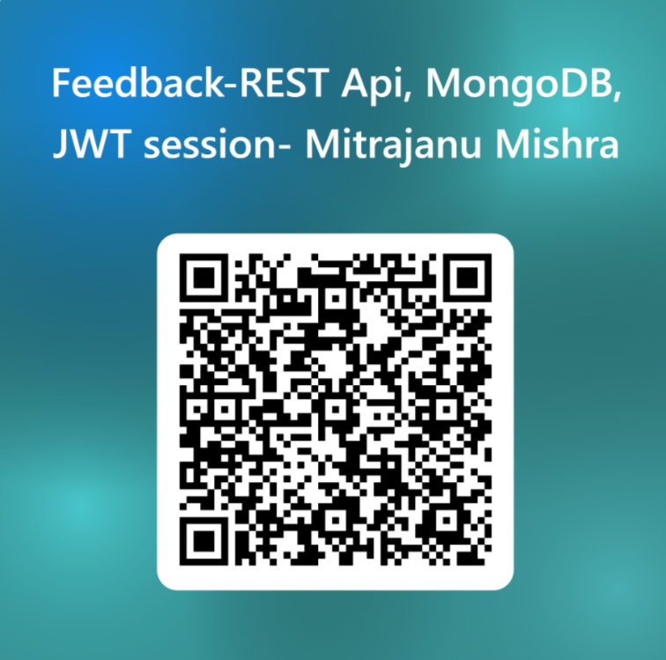
DAY 2 WRAP-UP
Backend API Development Masterclass · Day 2

Slide 39
THANK YOU
Questions & discussion
Backend API Development Masterclass · Day 2

