Slide 1
Alzheimer Pre-Diagnosis iOS App
Proposal
Sushil Cherian & Jithin Varghese

Slide 2
Solution & Research Question
Can building pre- diagnosis iOS app for Alzheimer will improve accessibility and efficiency?
Alzheimer's pre-diagnosed app improves accessibility and efficiency
Handy and take up the test anywhere anytime
This will be useful for the family member as well as the care takers to know the severity
App can be used for healthier persons who are doubting on the Alzheimer can also take up the test

Slide 3
MEASURABLE ORGANIZATIONAL VALUE(MOV)
Social impact
Economic impact
Initial screening can be done privately

Slide 4
SCOPE
Scope is limited to develop an Alzheimer Pre-Diagnosis Mobile App which can be used by a healthier person or a care taker to a patient based on the score the app will suggest he has Alzheimer traits or not.

Slide 5
AIM & OBJECTIVES
AIM:
Alzheimer Screening based on the questions and its score for Pre-diagnosis
OBJECTIVES:
Design, Develop, Test and Publish an interactive iOS application with database on SQL Server
Knowing the severity of the Alzheimer
Stake holders:
Healthier persons and Care takers to patients
Data Analysts, Developers, Family members

Slide 6
Add Values
Based on DSM-5 standard
Free iOS Mobile application for Alzheimer Pre-Diagnisis

Slide 7
Existing Applications
Android Apps
DeDementia Alzheimer’s Memory Diagnosis Test: MMSE
Mini Mental State App
SOCA Dementia Testing App
My Brain
iOS Apps
Alzheimer’s Disease Pocket card
Alzheimer's and Dementia Tips for Families
DementiAssist
Dementia Test - risk calculator of dementia

Slide 8
Existing Applications Benefits and Faults
Pros
Most of the apps are based on MMSE
Static Questions
Audio and Visual
Cons
Some iOS apps required professional assistance
Some features are device depended
Some app entire contents are downloaded into the phone which cause device performance issues

Slide 9
Features of our proposed app
User friendly Interface
Dynamic Questions
DSM-5 standard questions
Audio and visual interface

Slide 10
SOFTWARE TECHNOLOGIES AND METHODOLOGY
A software methodology is kind of framework that’s is used for software development which helps to do the developing in structure, plan and control the process of developing (Professionals, n.d.).
We have decided to choose Rapid Application Development (RAD), is a form an agile software development, which works on user feedback and strict planning and freezing the requirements.

Slide 11
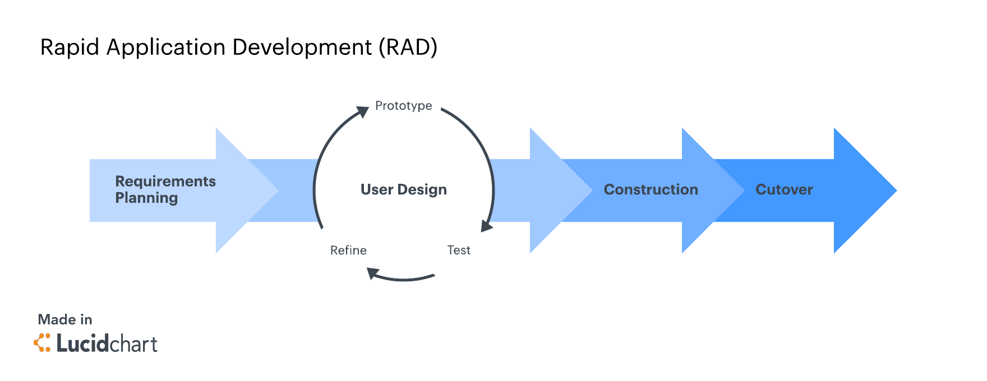
Rapid Application Methodology Phases (Team, 2018).

Slide 12
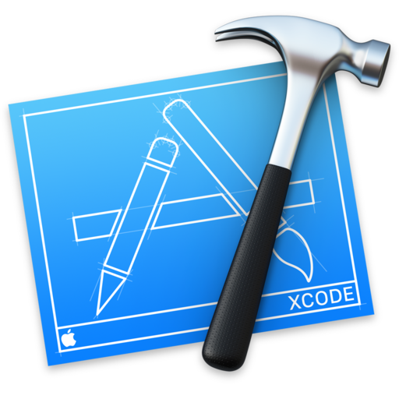




Resources

Slide 13
Project Risks
Time Constraints
Lack of Communication
Hardware Failure
Lack of Experience

Slide 14
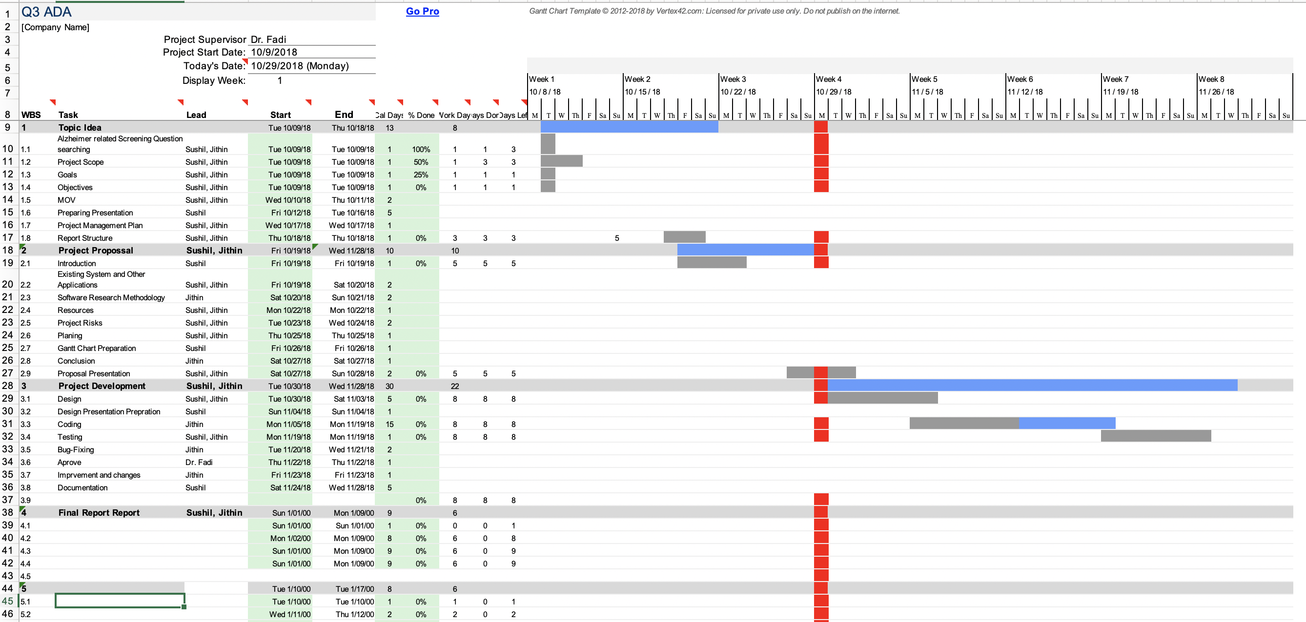
Gantt Chart

Slide 15
THANK YOU

