Slide 1

SEHAT

Slide 2
The Problem we are solving
Predicting heart disease and diabetes in patients based on input values.
Developing a heart disease and diabetes prediction model for India is crucial given the growing prevalence of these conditions. With lifestyle changes and urbanization, there's a rising health burden. The model aids in early identification of at-risk individuals, enabling proactive interventions and personalized healthcare strategies. This approach not only improves health outcomes but also addresses economic and healthcare system challenges posed by the increasing epidemic of non-communicable diseases in India.

Slide 3
Why this?
1 out of every 4 people in India is at risk, highlighting the importance of creating a predictive model for heart disease and diabetes.
By developing models that predict heart and diabetes issues, we aim to reduce the burden of these diseases by 30%, making healthcare more effective in India.
With a staggering 70 million people affected, it's urgent to implement predictive models that can address the widespread impact of heart disease and diabetes in India.

Slide 4
Overview of SEHAT
User Input Collection
Feature Selection
User Input Integration
Easy interface for users to input health details
Identify key health factors for focus.
Seamlessly integrate user data for real-time analysis
02
04
06
01
03
05
Data Preprocessing
Model Development
Output Presentation
Develop and fine-tune the predictive model.
Display clear predictions and actionable recommendations.
Clean and refine data for accuracy

Slide 5
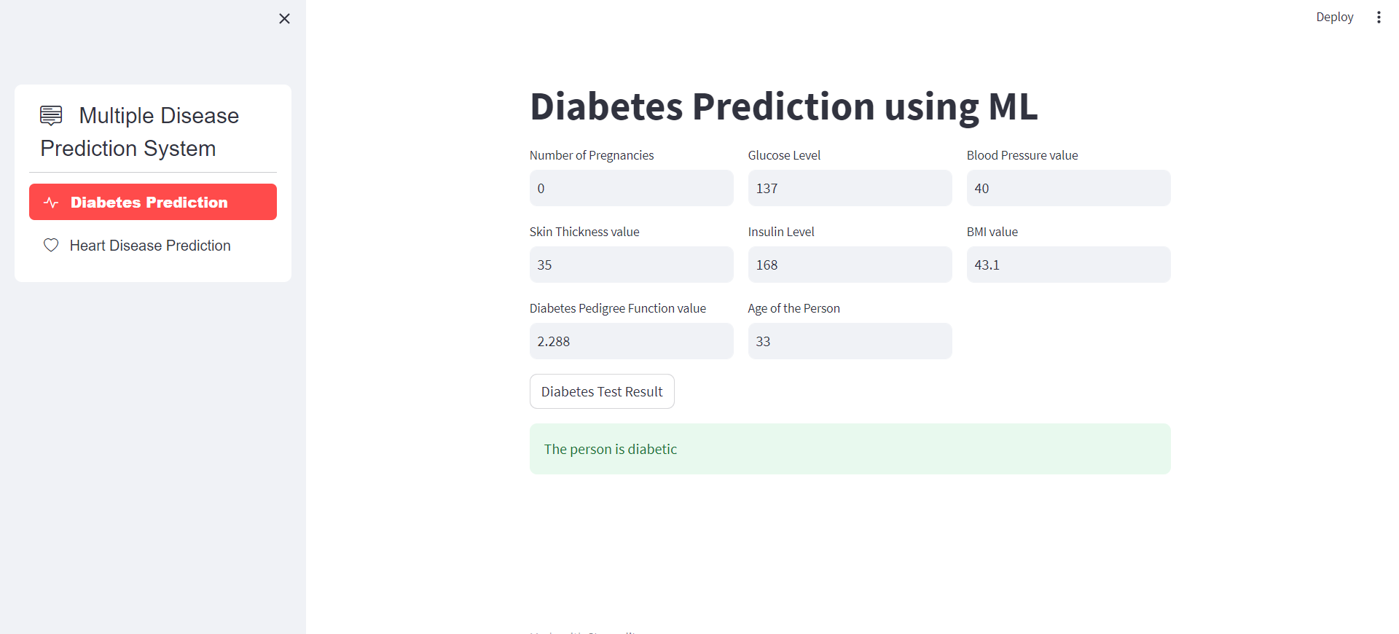
Project Overview

Slide 6
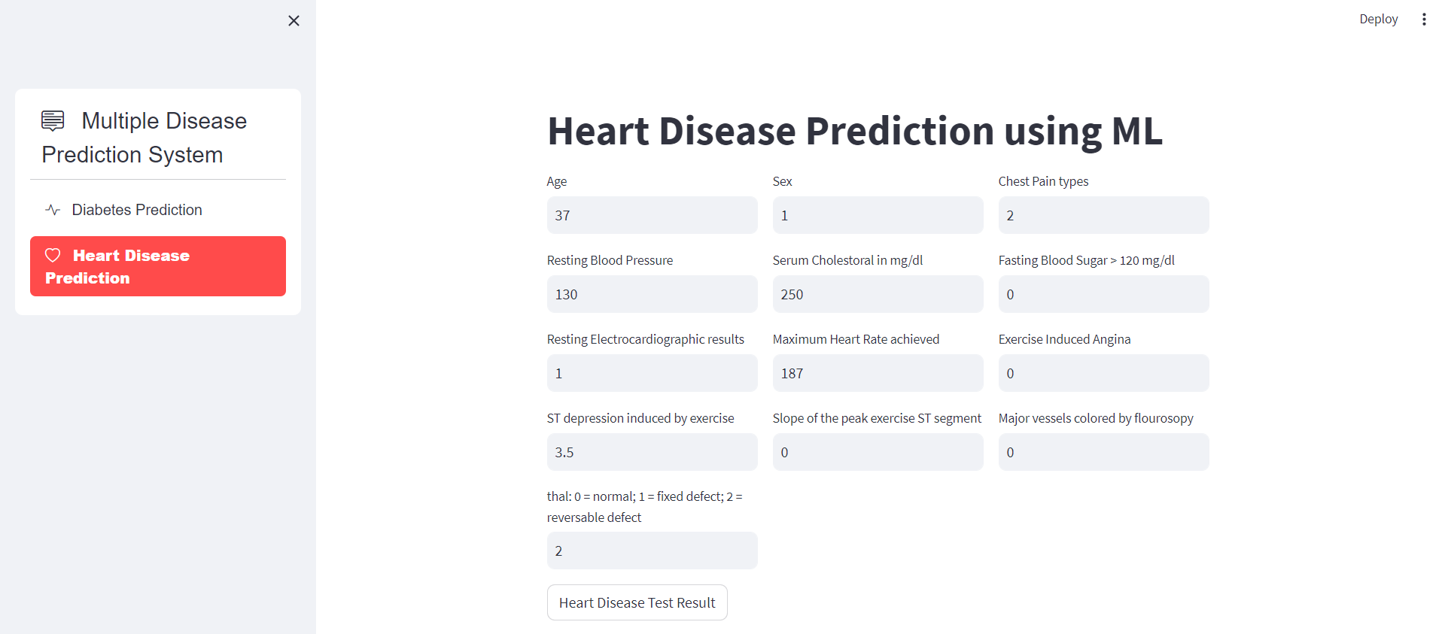
Project Overview

Slide 7
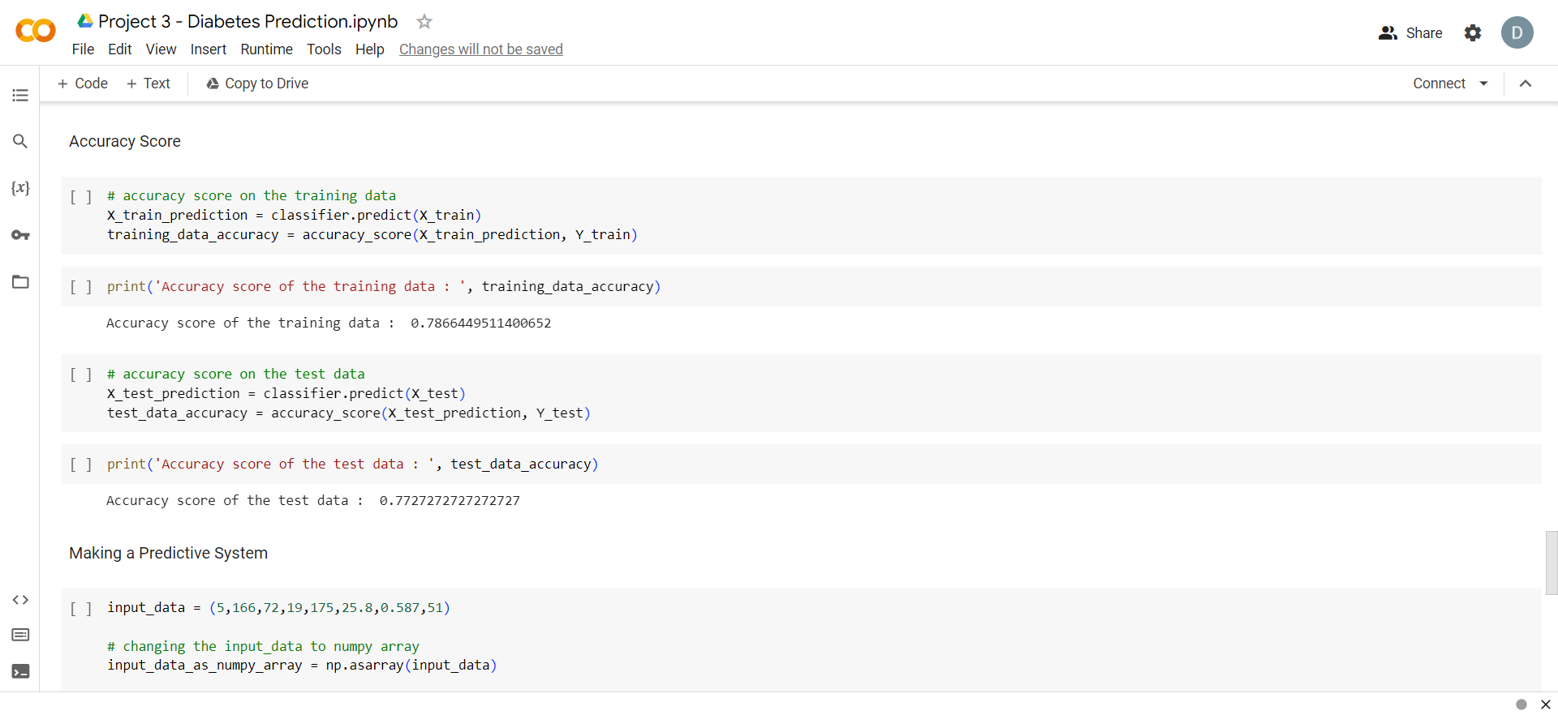
Codebase Preview

Slide 8
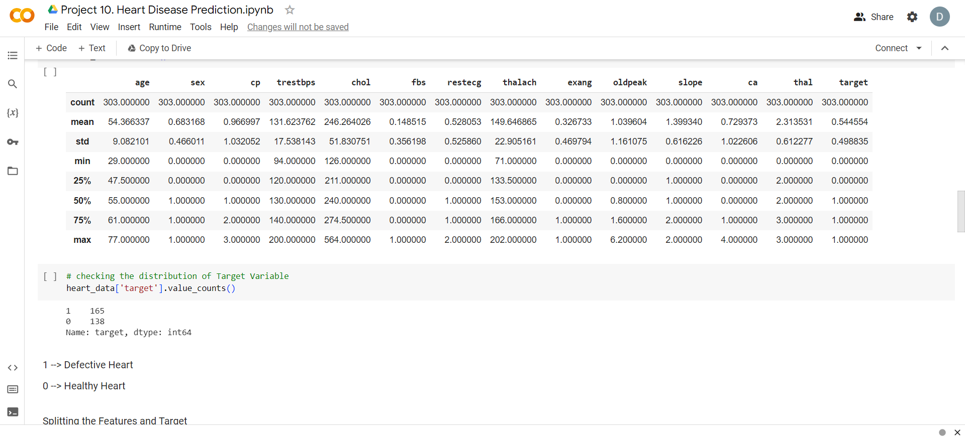
Codebase Preview

Slide 9
What technology is incorporated
into this project?
NumPy, pandas, sklearn for creating models
Google Colab for creating notebooks
Streamlit for creating frontend and connecting with model
Figma for design and layout
VS Code IDE

Slide 10
THANKYOU
Devanshi Bahuguna 2100910100065

