Slide 1

eHouseRent
By Bruke Andemariam :110447
Eyob Habtom :110931
Jirom Mebrahtu :110598
Selam Ghide:110468
https://github.com/MIU-SE/eHouseRent

Slide 2
MAIN CONTENTS OF THE PROJECT
Vision Documents
Use Case Description
Architectural Analysis
Use Case Analysis
Class Diagram

Slide 3
Problem Statement
Traveling whether it is for a very short or long time can be difficult or inconvenient unless you got a place/house to stay on. If the person changing location and doesn’t have information of the place he/she is visiting it will even make his experience more difficult.
In traditional way in order to rent a house the customer have to visit physically to a company that provides a list of houses to rent and visit the place where the house is located and see the houses condition, then the customer can rent the house if it is suitable and the price is affordable.

Slide 4
Introduction
Our eHouseRent is an online house rental enterprise architecture. It is a Web Based Application designed to serve to major use cases that has the need to provide the searching and booking services online. The system’s aim is to provide better business management and customer satisfaction by providing the following main services
Create an online access for customers so that they can create an account and make reservations online.
The user gets access to the requested resources by visiting the eHouseRent Management website. Once the data entered by the user is validated, user can book a house.
Provide the owner of the houses to create an account and post their houses

Slide 5
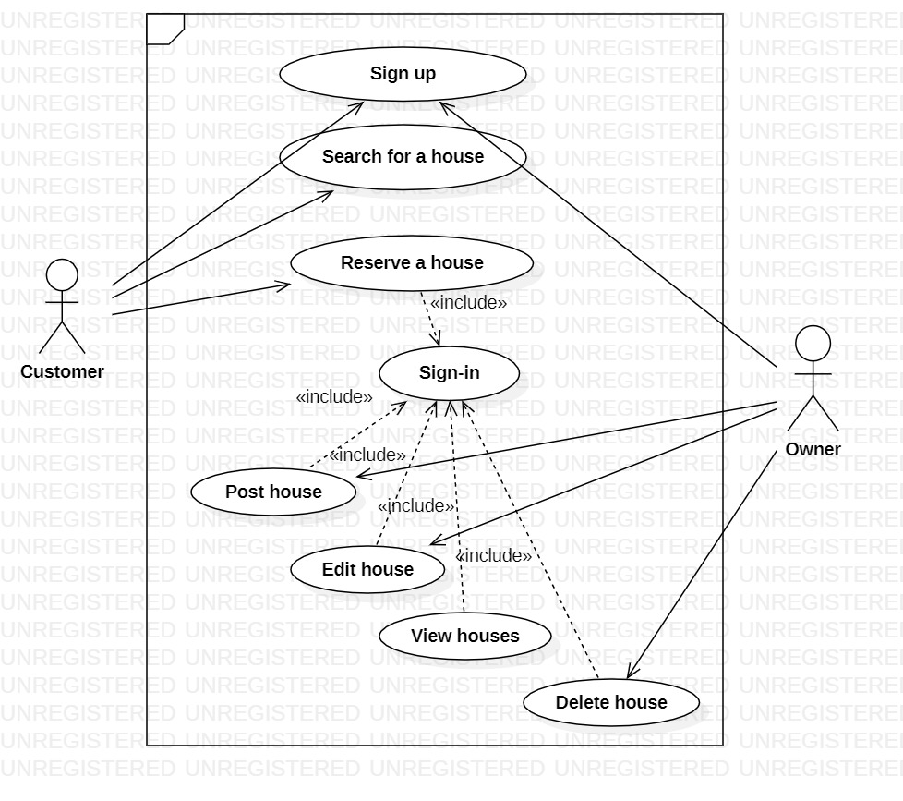
Use Case Diagram

Slide 6
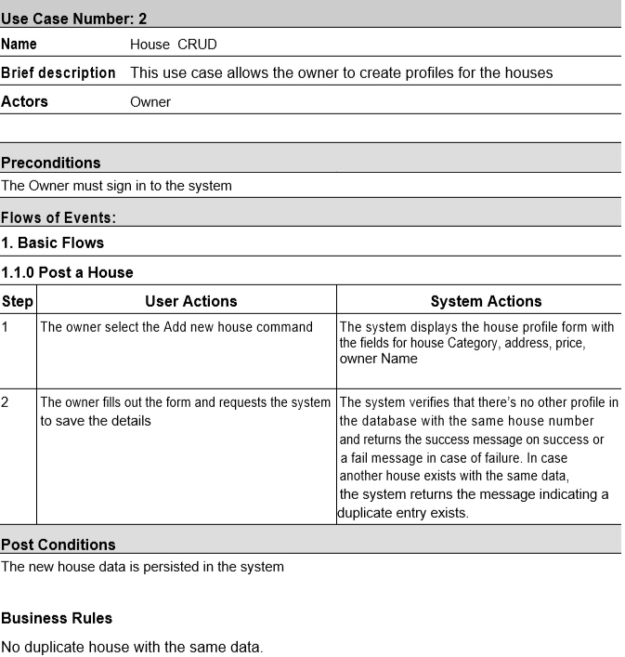

Slide 7
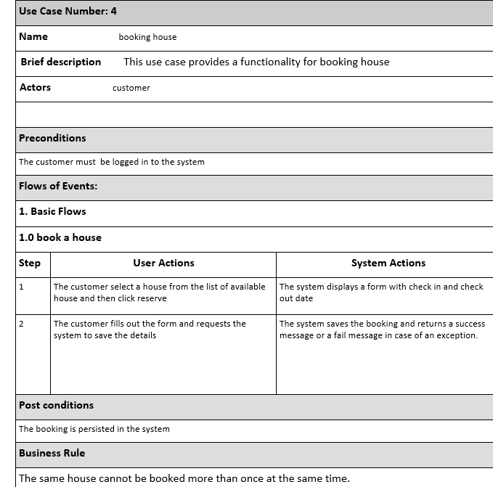

Slide 8
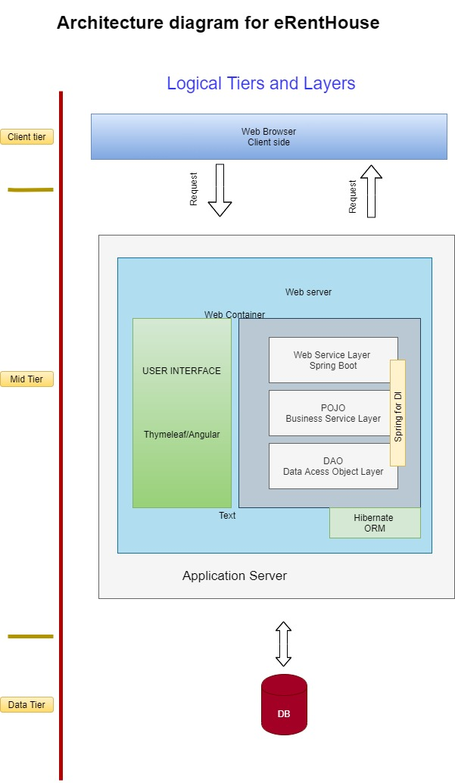

Slide 9
Key Abstractions identified
Owner
Customer
House
Category
Address
BookingRecord
Role

Slide 10
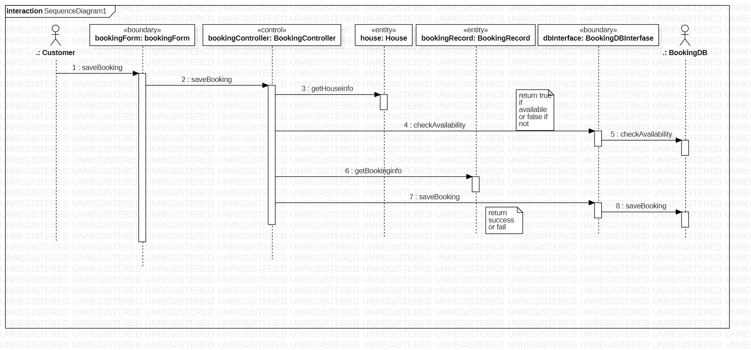
Booking sequence diagram

Slide 11
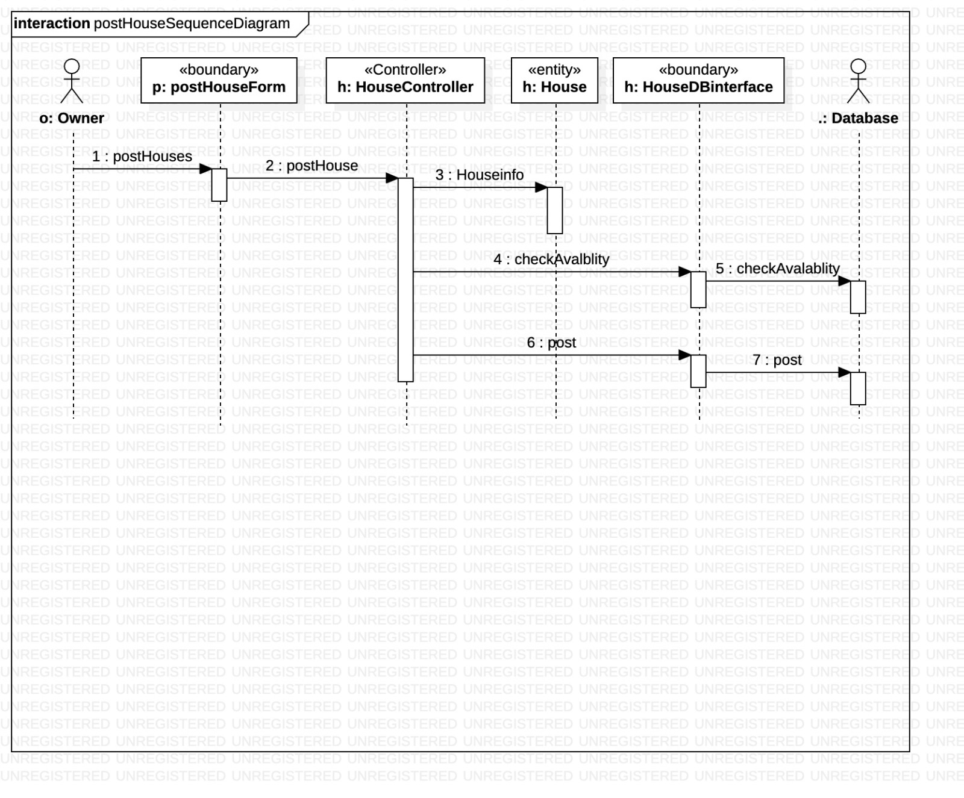
Posting house sequence diagram

Slide 12
