Slide 1
Team Legacy
Presentation

Slide 2
TABLE OF CONTENTS
01
02
03
Team
Projects idea
Steps of production

Slide 3
01
Team

Slide 4
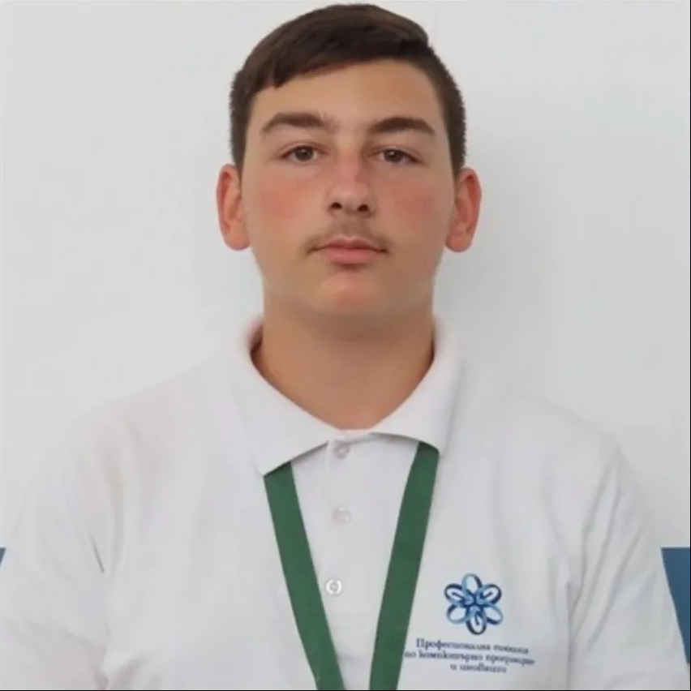
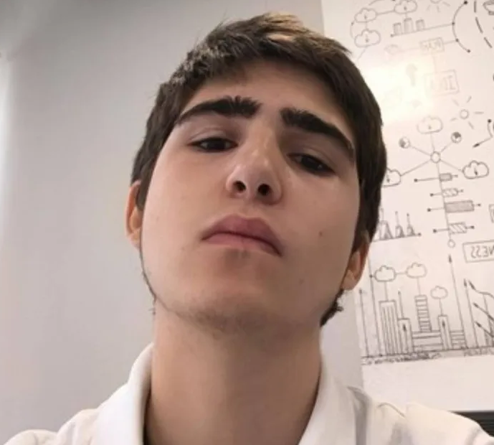
Team
Todor Stamboliev – 10 V
Milen Vasilev – 10 V
Frontend developer
Backend developer

Slide 5
02
Project idea

Slide 6
2. Project idea
Our idea is to create a collaborative historical platform designed for everyone. In the app you can add different historic events from which people can learn. It will be usefull for people becuase they can learn about new events.

Slide 7
03
Steps of production

Slide 8
3. Steps of production
Making a team
Coming up with an idea
Project preparation
Presentation

Slide 9
Lets get to the project!

